Slide 1
Supplementary Figures and Table
Longitudinal profiles of plasma gelsolin, cytokines and antibody
expression predict COVID-19 severity and hospitalization outcomes
Meshach Asare-Werehene^{1,2,4,5}, Michaeline McGuinty^{3,4,7}, Agatha Vranjkovic^{3,4,7}, Yannick Galipeau³, Juthaporn Cowan^{3,4,5,7}, Bill Cameron^{3,4,5,7}, Curtis L. Cooper^{3,4,7}, Marc-André Langlois^{3,5}, Angela M. Crawley^{3,4,5,6,8,9}, Benjamin K. Tsang^{1,2,5,6}
Departments of ¹Obstetrics & Gynecology, ²Cellular & Molecular Medicine, ³Biochemistry, Microbiology & Immunology, ⁴Medicine and ⁵Centre for Infection, Immunity & Inflammation, University of Ottawa, Ottawa, Ontario, Canada, K1H 8L1
⁶Chronic Disease Program and ⁷Clinical Epidemiology Program, Ottawa Hospital Research Institute, Ottawa, Canada, Ottawa, Ontario, Canada K1H 8L6
⁸Department of Biology, Carleton University, Ottawa, Ontario, Canada.
⁹Coronavirus Variants Rapid Response Network–Biobank, Canada.
Correspondence: Dr. Benjamin K Tsang, Chronic Disease Program, Ottawa Hospital Research Institute, The Ottawa Hospital (General Campus), 501 Smyth Road, Ottawa, Canada K1H 8L6; Tel: 1-613-798-5555 ext 72926; Email: btsang@ohri.ca

Slide 2
Supp. Fig. S1
A
B
P = 0.24
C
D
P = 0.372
P = 0.691
P = 0.22
P = 0.66
P = 0.07
pGSN (µg/ml)
pGSN (µg/ml)
pGSN (μg/ml)
pGSN (μg/ml)
Female
Male
<53
53-74
>75
0
4
0
8
Years
Days
Days
E
P = 0.99
F
G
P = 0.95
P = 0.84
pGSN (μg/ml)
pGSN (μg/ml)
pGSN (μg/ml)
0
12
0
4
8
0
4
8
12
Days
Days
Days
Supp. Fig. S1. pGSN levels are not affected by gender and age. The mean±SEM levels of pGSN were compared between (A) male and female COVID-19 patients as well as (B) age ranges. (C-G) The mean±SEM levels of pGSN were also compared between days of sample collection. P-values were calculated using one-way ANOVA and independent sample t-test.

Slide 3
Supp. Fig. S2
A
B
pGSN (μg/ml)
pGSN (μg/ml)
C
pGSN (μg/ml)
Supp. Fig. S2. pGSN multi-analyte panels for monitoring disease severity and outcomes days from symptoms onset. pGSN, pGSN/HGF, pGSN/IP-10, pGSN/IgM and pGSN/IgG were utilized to monitor (A) disease severity, (B) discharge and (C) ICU admittance following day 1 from symptoms onset. P-values were calculated by one-way ANOVA and independent sample t-test.

Slide 4
Supp. Fig. S3
Day 0
Day 4
Day 12
P = 0.7113
P = 0.1715
P = 0.37
IgG
IgG
IgG
P = 0.9129
P = 0.3723
P = 0.2054
IgA
IgA
IgA
P = 0.2004
P = 0.4825
P = 0.1255
IgM
IgM
IgM
Supp. Fig. S3. Correlation between pGSN and SARS-COV-2 antibodies. pGSN and SARS-COV-2 antibodies (IgG, IgM and IgA) were assessed on day 0, 4 and 12 and correlated using Pearson’s test.

Slide 5
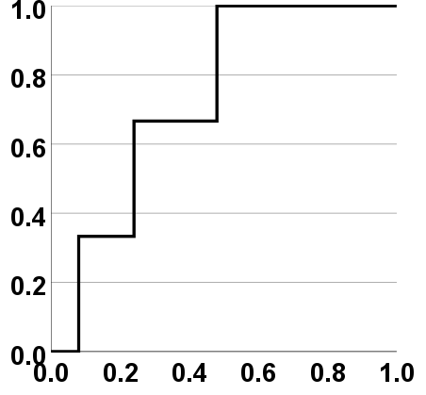
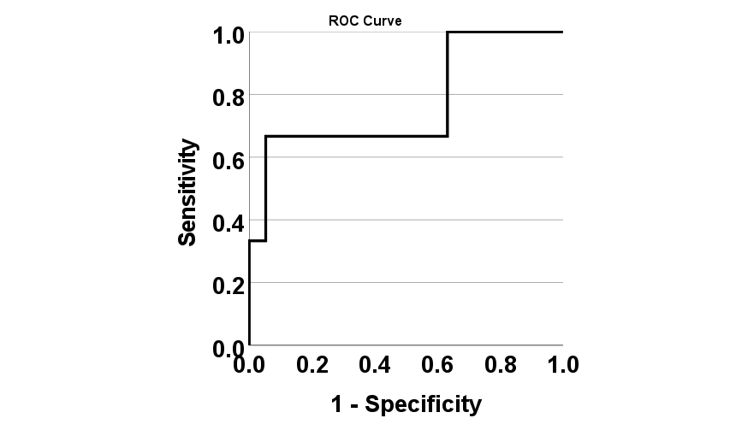
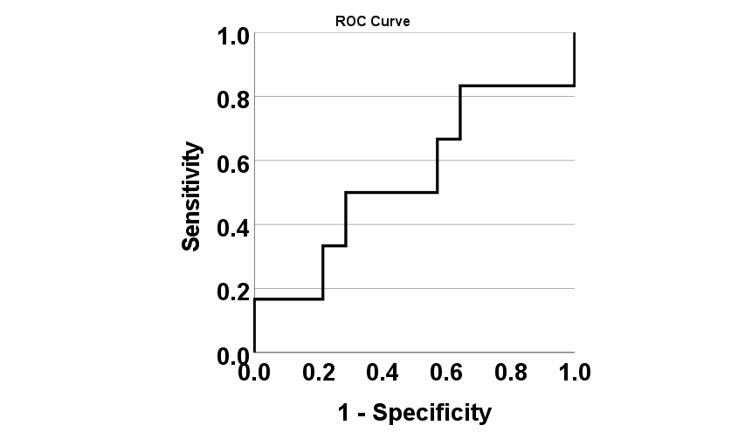
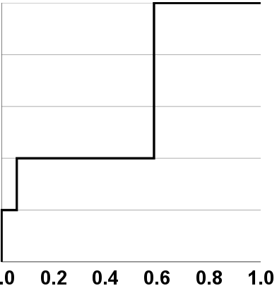
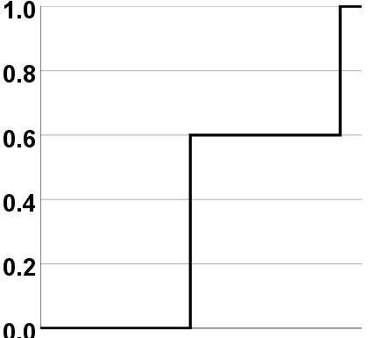
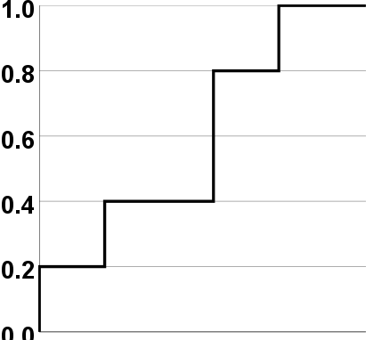
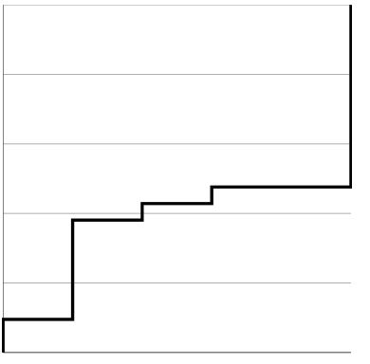
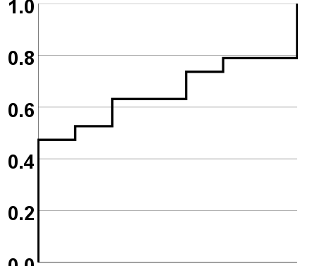
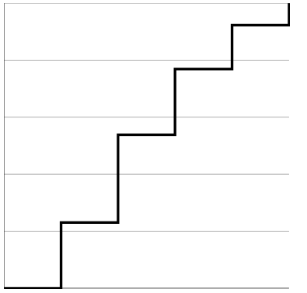

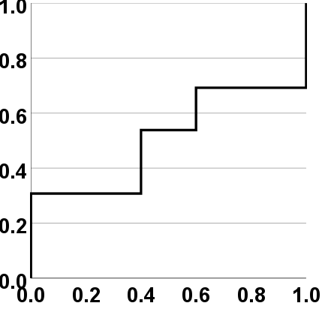
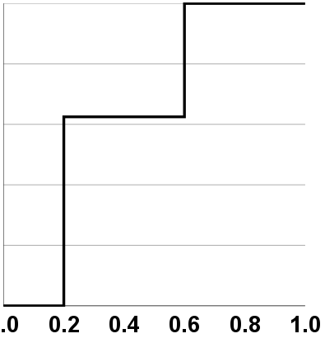
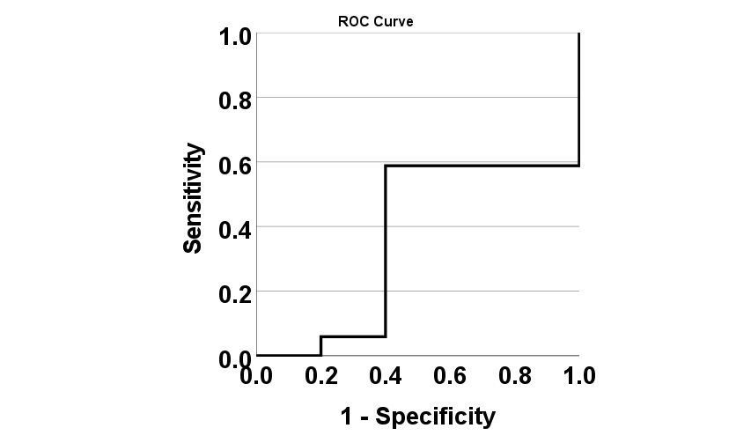
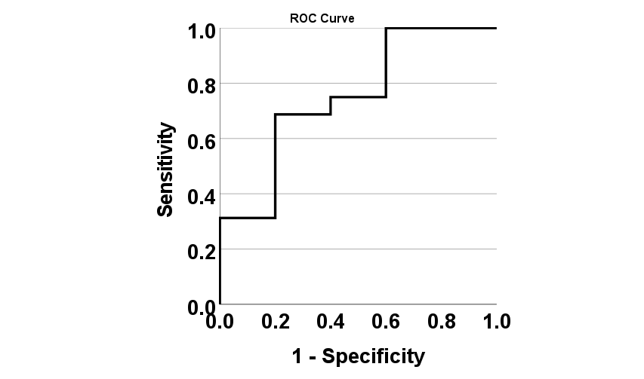
Supp. Fig. S4
A
Severe COVID-19
B
Deceased
pGSN
CRP
pGSN
CRP
Sensitivity
Sensitivity
AUC=0.733
P=0.194
AUC=0.772
P=0.138
AUC=0.548
P=0.741
AUC=0.365
P=0.368
1-Specificity
1-Specificity
C
D
E
Mild COVID-19
No-ICU
Discharged
pGSN
pGSN
Platelets
Platelets
D-dimer
Sensitivity
AUC=0.347
P=0.315
AUC=0.6
P=0.513
AUC = 0.371
P = 0.380
AUC=0.654
P=0.236
AUC=0.492
P=0.961
Sensitivity
Sensitivity
CRP
D-dimer
Ferritin
CRP
Ferritin
AUC=0.235
P=0.078
AUC = 0.508
P = 0.961
AUC = 0.650
P = 0.322
AUC=0.365
P=0.368
AUC=0.750
P=0.099
1-Specificity
1-Specificity
1-Specificity
Supp. Fig. S4. pGSN multi-analyte panels as predictors of COVID-19 outcomes. ROC curves were used to assess the test performances of pGSN, CRP, platelets, D-dimer and Ferritin in predicting (A) severe COVID-19, (B) deceased patients, (C) mild COVID-19 cases, (D) ICU admissions and (E) patients that are discharged.

Slide 6
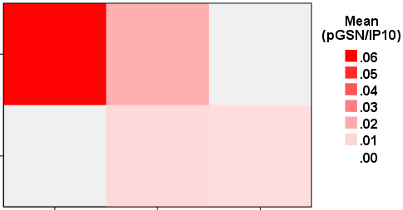
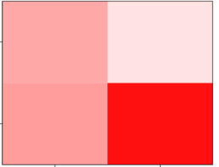

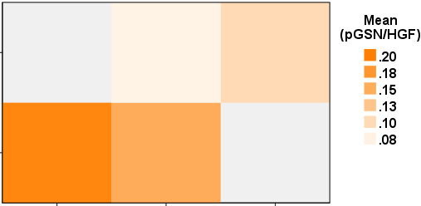
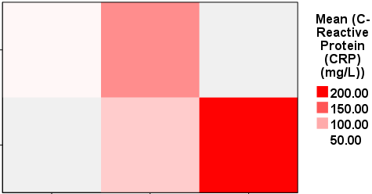
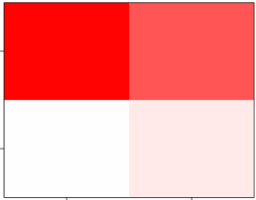

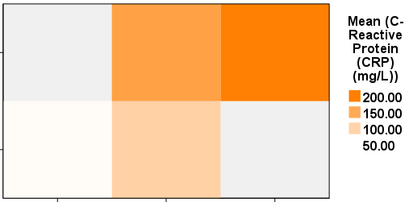
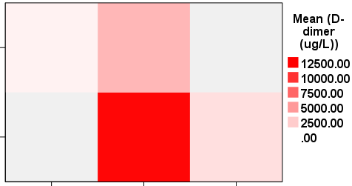
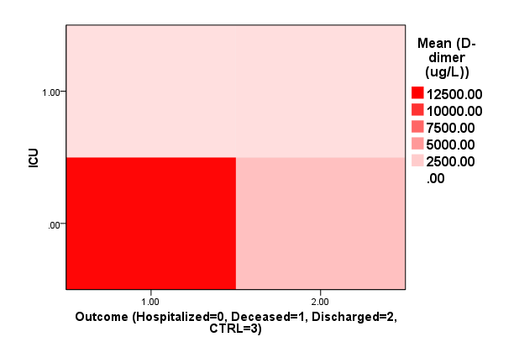
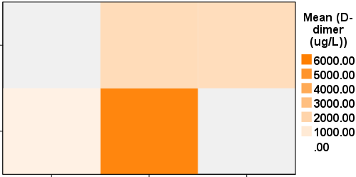
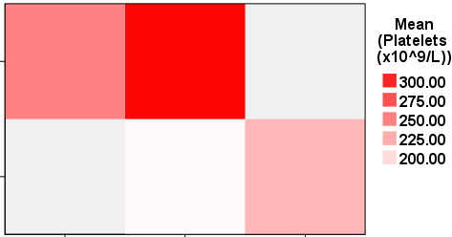
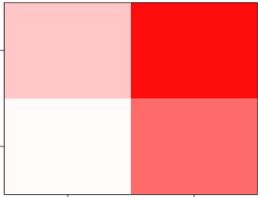

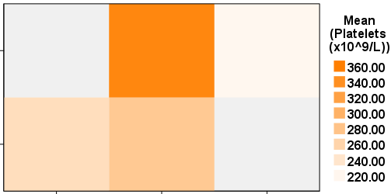
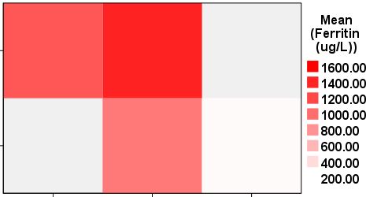
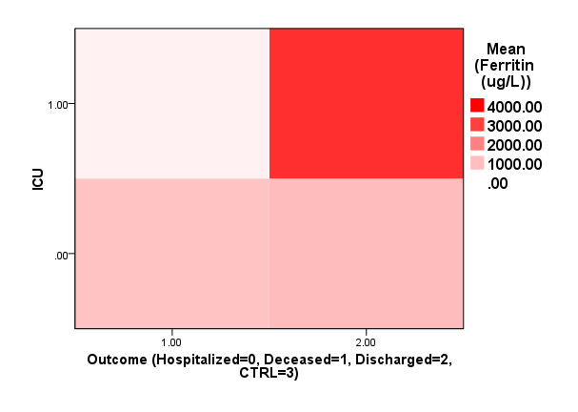
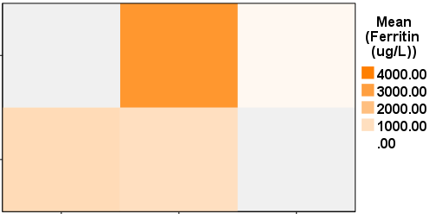
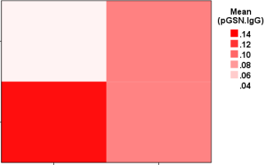
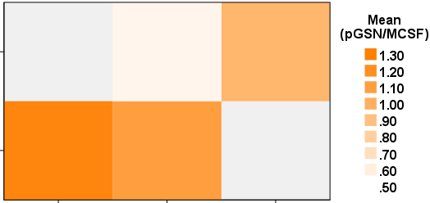
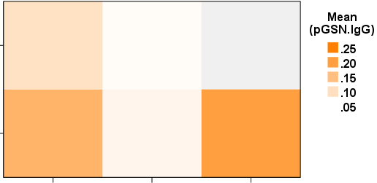
Supp. Fig. 5
A
B
C
Discharge
Yes
Yes
ICU
ICU
Death
NO
NO
Discharge
Yes
ICU
Yes
NO
ICU
Death
NO
Discharge
Yes
Yes
ICU
ICU
Death
NO
NO
Discharge
Yes
Yes
ICU
ICU
Death
NO
NO
Discharge
Yes
Yes
ICU
ICU
Death
NO
NO
Mild
Mod.
Severe
Yes
ICU
Yes
NO
ICU
NO
Death
Discharge
Yes
ICU
NO
Mild
Mod.
Severe
Supp. Fig. S4. Multi-analyte panels predict more than one clinical outcomes of COVID-19. pGSN/IP-10, pGSN/HGF, pGSN/M-CSF, CRP, platelets, Ferritin and pGSN/IgG were used in a heat map analyses to predict (A) disease severity and hospitalization outcomes, (B) ICU admissions and hospitalization outcomes and (C) disease severity and ICU admissions.

Slide 7
Supplementary Table 1: Demographics and Baseline Characteristics of COVID-19 Patients
 |  | COVID-19 |  | Non-COVID-19
 |  | Count | Mean | Count | Mean
Hospitalization outcomes at the end of follow-up | Deceased | 7 |  | 0
 | Discharged | 21 |  | 0
BMI (Kg/m2) |  |  | 30.51 |  | .
ICU Admittance | No | 23 |  | 0
 | Yes | 5 |  | 0
Age (yrs) |  |  | 63.93 |  | 41.67
Gender | Female | 6 |  | 7
 | Male | 22 |  | 5
COVID Disease Severity | No infection | 0 |  | 12
 | Mild | 7 |  | 0
 | Moderate | 18 |  | 0
 | Severe | 3 |  | 0
Days from first positive COVID-19 Test | 2 | 2 |  | 0
 | 3 | 7 |  | 0
 | 4 | 4 |  | 0
 | 5 | 1 |  | 0
 | 6 | 1 |  | 0
 | 7 | 4 |  | 0
 | 8 | 1 |  | 0
 | 9 | 2 |  | 0
 | 11 | 1 |  | 0
 | 13 | 1 |  | 0
 | 14 | 1 |  | 0
 | 15 | 1 |  | 0
 | 17 | 1 |  | 0
 | 20 | 1 |  | 0
 | 3 | 1 |  | 0
Days from symptom onset | 4 | 2 |  | 0
 | 5 | 1 |  | 0
 | 6 | 1 |  | 0
 | 7 | 3 |  | 0
 | 8 | 2 |  | 0
 | 9 | 4 |  | 0
 | 11 | 4 |  | 0
 | 12 | 2 |  | 0
 | 13 | 2 |  | 0
 | 15 | 1 |  | 0
 | 16 | 3 |  | 0
 | 20 | 1 |  | 0
 | 22 | 1 |  | 0
Disease severity was defined as follows:
Mild (no oxygen/room air received)
Moderate [supplemental oxygen, not high flow or no flow listed, no intubation/mechanical ventilation – ex. No Bi-level Positive Airway Pressure (BiPap) /intubation)].
Severe (high flow oxygen and non-invasive or invasive mechanical ventilation – ex. Yes BiPap/intubation)

