Slide 1
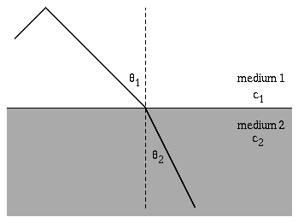
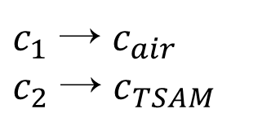
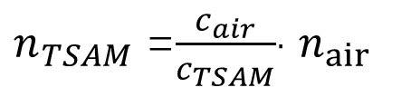
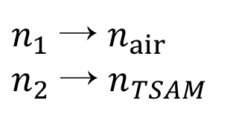
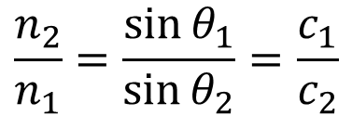
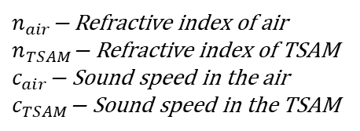
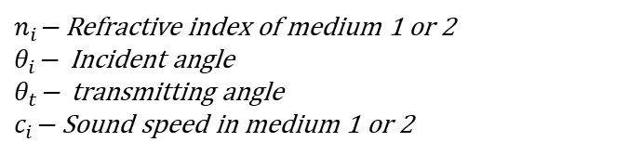
Research on Mechanism of TSAM
---by Shiqing Huang
What is refractive index?
By Snell’s law:
$$\frac{n_{2}}{n_{1}}=\frac{\sin{θ_{1}}}{\sin{θ_{2}}}=\frac{c_{1}}{c_{2}}$$
$n_{1}$ → $n_{air}$
$n_{2}$ → $n_{TSAM}$
$c_{1}$ → $c_{air}$
$c_{2}$ → $c_{TSAM}$
$n_{TSAM}$ =$\frac{c_{air}}{c_{TSAM}}$· $n_{air}$
$n_{i}\text{−}$ Refractive index of medium 1 or 2
$θ_{i}\text{−}$ Incident angle
$θ_{t}\text{−}$ transmitting angle
$c_{i}\text{−}$ Sound speed in medium 1 or 2
$n_{air}\text{−}$ Refractive index of air
$n_{TSAM}\text{−}$ Refractive index of TSAM
$c_{air}\text{−}$ Sound speed in the air
$c_{TSAM}\text{−}$ Sound speed in the TSAM

Slide 2
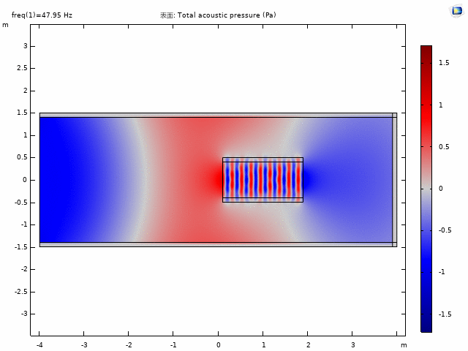
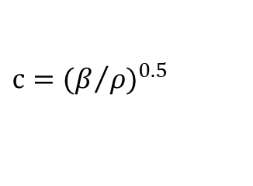
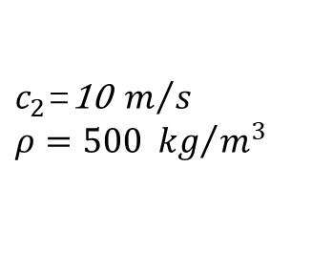
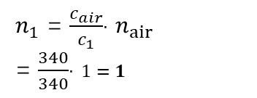
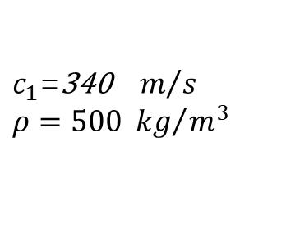
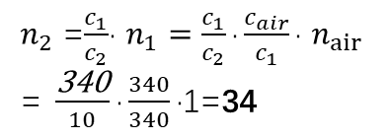
Research on Mechanism of TSAM
Trying with some simple FEA for high refractive index:
Assumption on materials above ↑:
Adiabatic
homogenous
High refractive
index materials
$$c{=(β/ρ)}^{0.5}$$
(Constitutive relation)
Low refractive
index materials
$c_{1}$=340${ m}/s$
$ρ=500$ ${ kg}/{m^{3}}$
$c_{2}$=1$\text{0}{ m}/s$
$ρ=500$ ${ kg}/{m^{3}}$
$n_{1}$ = $\frac{c_{air}}{c_{1}}$· $n_{air}$
= $\frac{340}{340}$· $1=1$
$n_{2}$ =$\frac{c_{1}}{c_{2}}$· $n_{1}=\frac{c_{1}}{c_{2}}\text{·}\frac{c_{air}}{c_{1}}\text{·} n_{air}$
= $\frac{\text{340}}{10}\text{·}\frac{340}{340}\text{·}\text{1=}\text{34}$

Slide 3
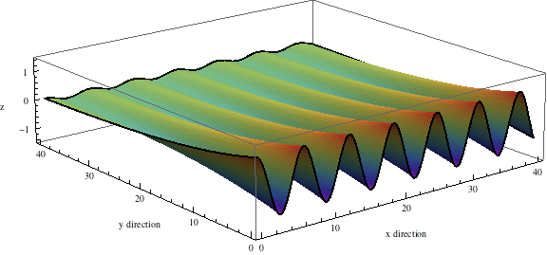
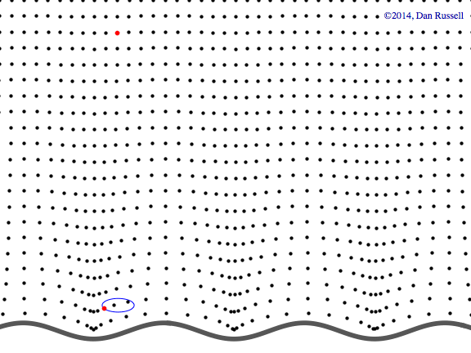
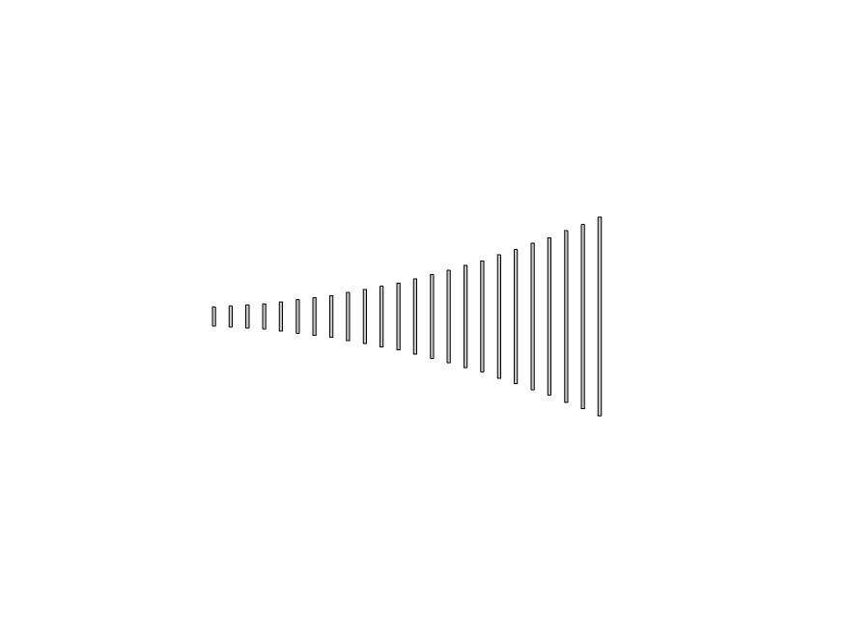
Air Particles Oscillation
Evanescent Coupling
Evanescent sound wave
Air Particles
Incident Sound Wave
z
Evanescent Coupling
x
Evanescent Coupling
Overall, in views of 2D , the sound wave is trapped inside the TSAM, and it propagates along the x-axis while oscillates along the y-axis.
At the boundary between the TSAM and the air, shown as , there is evanescent wave phenomenon^{[1,2]}, which also propagates along the x-axis but decays exponentially in z-axis.

Slide 4
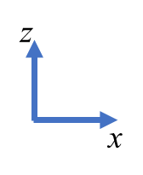
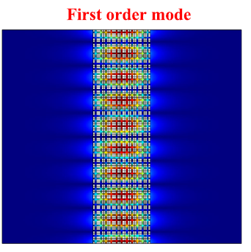
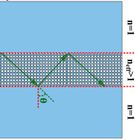
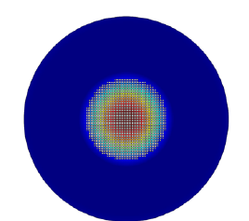
To get a better understanding on the mechanism of the TSAM, I divide the acoustic fields into 3 areas to analysis.
Why the sound can be trapped inside?
Because the effective refractive index(n) inside(Area 1, TSAM) is higher than the outside (Area 2, 3), just like optical signal travels inside the fibre, something like this:
Area 2 (air)
Area 1
Acoustic fibre
In fact, the figure ↑ shown above , is a acoustic fiber which comes from its counterpart, optical fiber.
So TSAM is somehow function as a acoustic fiber waveguide, but with a trumpet shape (Gradient increment).
As a result, the air particles jump around gaps, coupling the sound wave gap by gap.
Area 3 (air)

Slide 5
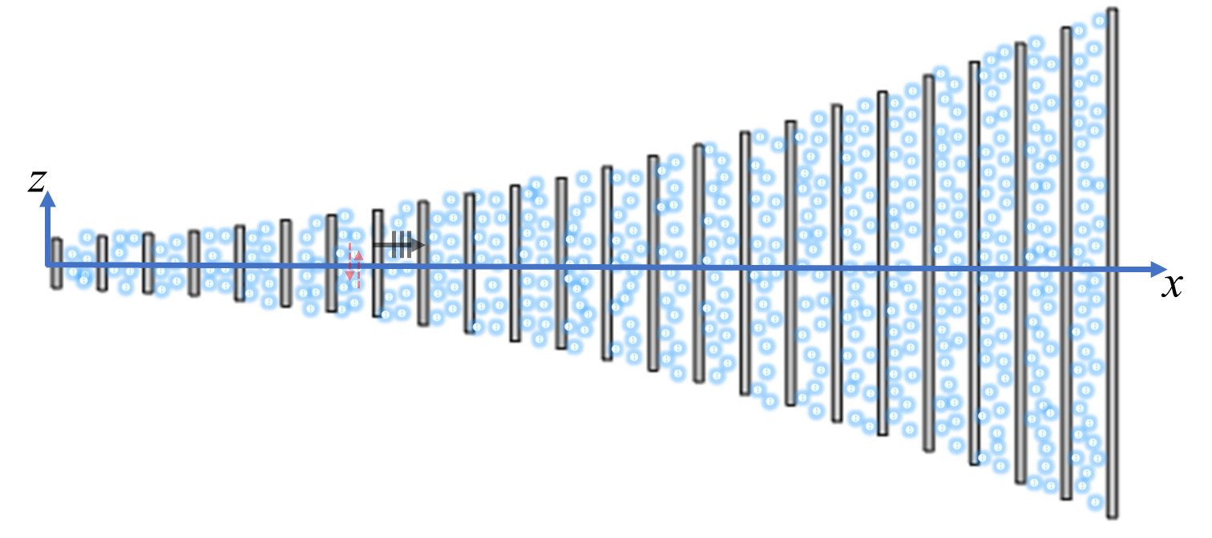
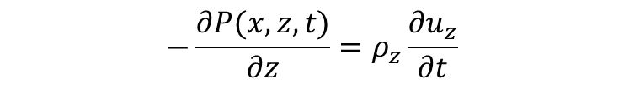








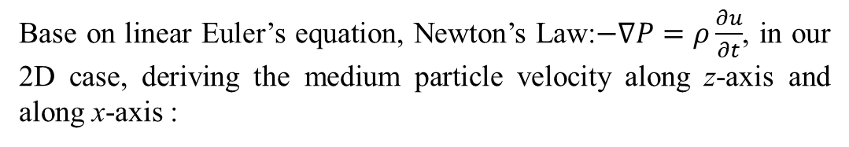

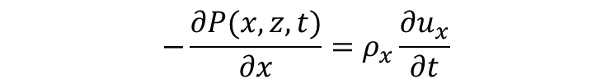




In area 1, the TSAM, the sound wave propagates along the x-axis while oscillates along the z-axis, which can be expressed as:
$$P(x,z,t)=P_{0}∙cos{{\left(k_{z}z\right)∙e}^{i(ωt−k_{x}x)}}$$
$$(1)$$
Area 1
Base on linear Euler’s equation, Newton’s Law:$−∇P=ρ\frac{∂u}{∂t}$, in our 2D case, deriving the medium particle velocity along z-axis and along x-axis :
$$−\frac{∂P(x,z,t)}{∂z}=ρ_{z}\frac{∂u_{z}}{∂t}$$
$$(2)$$
$$ρ_{x}=F_{r}∙ρ_{Al}+\left(1+F_{r}\right)ρ_{air}$$
Equivalent
constitutive
Parameters^{[3]}
$$(6)$$
$$ρ_{z}=\frac{ρ_{Al}∙ρ_{air}}{{\left(1−F_{r}\right)ρ}_{Al}+F_{r}∙ρ_{air}}$$
:
$$−\frac{∂P(x,z,t)}{∂x}=ρ_{x}\frac{∂u_{x}}{∂t}$$
$$(3)$$
$$β=\frac{β_{Al}∙β_{air}}{{\left(1−F_{r}\right)β}_{Al}+F_{r}∙β_{air}}$$
$$P \text{−} Sound pressure$$
$P_{0}∙cos\left(k_{z}z\right)\text{−}$Oscillation amplitude along z –axis
$k_{z}$ $\text{−}$Wave number along z-axis
$ω \text{−}$ Angular frequency
$k_{x}$ $\text{−}$Wave number along x-axis
$u_{z}$ $\text{−}$ Effective medium velocity along z-axis
$u_{x}$ $\text{−}$ Effective medium velocity along x-axis
$ρ_{z}$ $\text{−}$ Effective medium density of z-axis
$ρ_{x}$ $\text{−}$ Effective medium density of x-axis
$F_{r}$− Filling ratio of Aluminum and air
$β$ − Effective bulk modulus
By integrating both side of (2), (3), we got:
$u_{z}$($z,t$)= $\frac{P_{0}k_{z}}{iωρ_{z}}\sin{{\left(k_{z}z\right)∙e}^{i(ωt−k_{x}x)}}$
$$(4)$$
$u_{x}$($x,t$)= $\frac{P_{0}k_{x}}{ωρ_{x}}\cos{{\left(k_{x}x\right)∙e}^{i(ωt−k_{x}x)}}$
$$(5)$$

Slide 6





















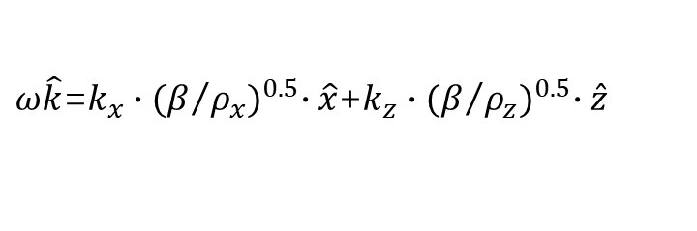


Besides, wave vector k of any arbitrary direction in acoustic field satisfied:
$k\hat{k}$=$k_{x}\hat{x}$+$k_{y}\hat{y}$+$k_{z}\hat{z}$
z
$$\vec{k}$$
$$(7)$$
$$k^{2}=k_{x}^{2}+k_{y}^{2}+k_{z}^{2}$$
$$(8)$$
$k$= $\frac{ω}{c}=\frac{2π}{λ}$
y
x
$$(9)$$
$$c{=(β/ρ)}^{0.5}$$
(Constitutive relation)
$$(10)$$
So , In our case, area 1, the TSAM, according to (6)~(9) above:
$k\hat{k}$=$k_{x}\hat{x}$+$k_{z}\hat{z}$
$$ρ_{x}=F_{r}∙ρ_{Al}+\left(1+F_{r}\right)ρ_{air}$$
Equivalent
constitutive
Parameters^{[3]}
$$(6)$$
$$ρ_{z}=\frac{ρ_{Al}∙ρ_{air}}{{\left(1−F_{r}\right)ρ}_{Al}+F_{r}∙ρ_{air}}$$
$\frac{ω}{c}\hat{k}$=$k_{x}\hat{x}$+$k_{z}\hat{z}$
:
$ω\hat{k}$=$k_{x}c\hat{x}$+$k_{z}c\hat{z}$
$$β=\frac{β_{Al}∙β_{air}}{{\left(1−F_{r}\right)β}_{Al}+F_{r}∙β_{air}}$$
$ω\hat{k}$=$k_{x}\vec{c_{x}}$+$k_{z}\vec{c_{z}}$
$\hat{k}$ $\text{−}$ Unit vector in any arbitrary direction
$\hat{x}$ $\text{−}$ Unit vector along x-axis
$$\hat{y} \text{− }\text{Unit} \text{vector} \text{along} \text{y}\text{−}\text{axis}$$
$$\hat{z} \text{− }\text{Unit} \text{vector} \text{along} \text{z}\text{−}\text{axis}$$
$k_{y}$ $\text{− }\text{Wave} \text{number} \text{along} \text{x}\text{−}\text{axis}$
$c$ $\text{−}$ Sound speed, 343m/s in room temperature
$β$ − Effective bulk modulus
$k_{z}$ $\text{−}$Wave number along z-axis
$ω \text{−}$ Angular frequency
$k_{x}$ $\text{−}$Wave number along x-axis
$ρ_{z}$ $\text{−}$ Effective medium density of z-axis
$ρ_{x}$ $\text{−}$ Effective medium density of x-axis
$ω\hat{k}$=$k_{x}{∙(β/{ρ_{x}})}^{0.5}∙\hat{x}$+$k_{z}{∙(β/{ρ_{z}})}^{0.5}∙\hat{z}$
$ω^{2}=\frac{k_{x}^{2}}{{ρ_{x}}/β}+$ $\frac{k_{z}^{2}}{{ρ_{z}}/β}$
$$(11)$$
(Dispersion relation in area 1)
For the Al-air compositions, it is approximate to assume that
$ρ_{Al}$ → ∞
$k_{z}$≈$\frac{ω}{c_{z}}=ω{({ρ_{z}}/β)}^{0.5}$
$β_{Al}$ → ∞
$Combined$ $\left(6\right)$ and (11)
$$(12)$$

Slide 7
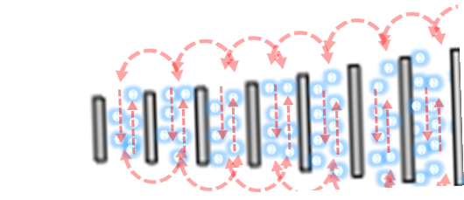


















In area 2, near the boundary between the air and the TSAM, it’s the evanescent wave propagates in x direction, while decaying exponentially in z direction.
$$k_{z−air}$$
$$P_{2}(x,z,t)=P_{air2}∙{e^{{−k}_{z_air}∙Z}{∙e}^{i(ωt−k_{x}x)}}$$
$$(12)$$
With the same procedure as (1)~(3), we derive the particle velocities in the area 2 by using linear Euler’s equation, Newton’s Law, −∇𝑃=𝜌 𝜕𝑢/𝜕𝑡 :
Area 2
$u_{2z}(x,z,t$)= $\frac{k_{z_air}P_{air2}}{{iω\text{ρ}}_{air}}∙e^{{−k}_{z_air}∙Z}{∙e}^{i(ωt−k_{x}x)}$
$$(13)$$
$$k_{x}$$
$u_{2x}$ $(x,z,t$)= $\frac{{k_{x}P}_{air2}}{{ω\text{ρ}}_{air}}∙e^{{−k}_{z_air}∙Z}{∙e}^{i(ωt−k_{x}x)}$
$$(14)$$
Due to the symmetricity along the x-axis of the system, in area 3, we can analogously derive the following equation:
$$P_{3}(x,z,t)=P_{air3}∙{e^{{−k}_{z_air}∙Z}{∙e}^{i(ωt−k_{x}x)}}$$
$$(15)$$
$ω \text{−}$ Angular frequency
$$k_{x}\text{− }\text{Wave} \text{number} \text{along} \text{x}\text{−}\text{axis}$$
$P_{2}\text{−}$ Sound pressure function in area2
$P_{air2}\text{−}$ Sound pressure amplitude in area2
$P_{air3}\text{−}$ Sound pressure amplitude in area3
$k_{z_air}\text{−}$ Transverse wave number along z-axis in area2
$u_{2x}$ $\text{−}$ Effective medium velocity along x-axis in area 2
$u_{2z}$ $\text{−}$ Effective medium velocity along z-axis in area 2
$u_{3z}$ $\text{−}$ Effective medium velocity along z-axis in area 3
$u_{3x}$ $\text{−}$ Effective medium velocity along x-axis in area 3
$u_{3z}(x,z,t$)= -$\frac{k_{z_air}P_{air3}}{{iω\text{ρ}}_{air}}∙e^{{−k}_{z_air}∙Z}{∙e}^{i(ωt−k_{x}x)}$
$$(16)$$
$u_{3x}$ $(x,z,t)$= $\frac{{k_{x}P}_{air3}}{{ω\text{ρ}}_{air}}∙e^{{−k}_{z_air}∙Z}{∙e}^{i(ωt−k_{x}x)}$
$$(17)$$
Due to the symmetricity of the system along the x-axis，we have:
$$P_{3}(x,z,t)=P_{2}(x,z,t)$$
$$(18)$$
$P_{air3}$= $P_{air2}$
$$(19)$$

Slide 8
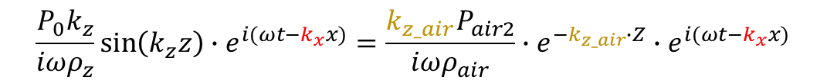
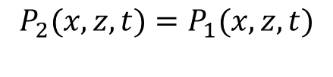






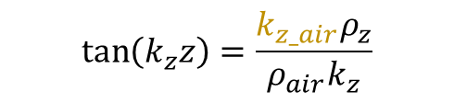





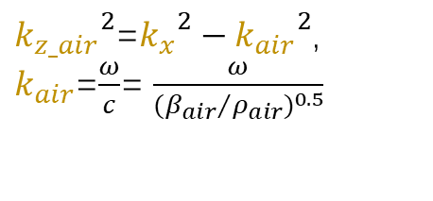
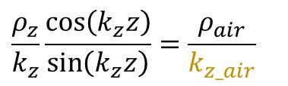

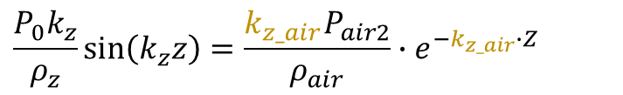

Here comes the important part, at the interface (boundary) between area1 and area2, the sound pressure equality can be obtained as follow:
$$k_{z−air}$$
$$P_{2}(x,z,t)=P_{1}(x,z,t)$$
$$(20)$$
Which is:
$P_{0}∙cos{{\left(k_{z}z\right)∙e}^{i(ωt−k_{x}x)}=}$ $P_{air2}∙{e^{{−k}_{z_air}∙Z}{∙e}^{i(ωt−k_{x}x)}}$
Cancelling out the exponential part:
$P_{0}∙cos\left(k_{z}z\right)=$ $P_{air2}∙{e^{{−k}_{z_air}∙Z}}$
$$(21)$$
Area 2
Likewise, at the interface (boundary) between area1 and area2, the medium velocities equality can be obtained as follow:
$$k_{x}$$
$u_{z}$($x,z,t$)= $u_{2z}$ $(x,z,t$)
$$(22)$$
Area 1
Which is:
$$\frac{P_{0}k_{z}}{iωρ_{z}}\sin{{\left(k_{z}z\right)∙e}^{i(ωt−k_{x}x)}}=\frac{k_{z_air}P_{air2}}{{iω\text{ρ}}_{air}}∙e^{{−k}_{z_air}∙Z}{∙e}^{i(ωt−k_{x}x)}$$
$$\frac{P_{0}k_{z}}{ρ_{z}}\sin\left(k_{z}z\right)=\frac{k_{z_air}P_{air2}}{{\text{ρ}}_{air}}∙e^{{−k}_{z_air}∙Z}$$
$ω \text{−}$ Angular frequency
$$k_{x}\text{− }\text{Wave} \text{number} \text{along} \text{x}\text{−}\text{axis}$$
$P_{2}\text{−}$ Sound pressure function in area2
$P_{air2}\text{−}$ Sound pressure amplitude in area2
$P_{air3}\text{−}$ Sound pressure amplitude in area3
$k_{z_air}\text{−}$ Transverse wave number along z-axis in area2
$u_{2x}$ $\text{−}$ Effective medium velocity along x-axis in area 2
$u_{2z}$ $\text{−}$ Effective medium velocity along z-axis in area 2
$u_{3z}$ $\text{−}$ Effective medium velocity along z-axis in area 3
$u_{3x}$ $\text{−}$ Effective medium velocity along x-axis in area 3
Cancelling out the exponential part:
$$(23)$$
Taking equations division operation$out of \frac{(21)}{(23)}$, we can obtain:
$$\frac{ρ_{z}}{k_{z}}\frac{cos\left(k_{z}z\right)}{\sin\left(k_{z}z\right)}=\frac{{\text{ρ}}_{air}}{k_{z_air}}$$
$$\tan\left(k_{z}z\right)=\frac{k_{z_air}ρ_{z}}{{\text{ρ}}_{air}k_{z}}$$
Which is:
$$(24)$$
In area2 and 3, the sound wave numbers satisfies relation
${k_{z_air}}^{2}$=${k_{x}}^{2}−{k_{air}}^{2}$, $k_{air}$=$\frac{ω}{c}$= $\frac{ω}{{({β_{air}}/{ρ_{air}})}^{0.5}}$
:
$$(25)$$
In general, the relation between the effective refractive index(n_{TSAM}) and the wave vector in air :
${k_{x}=k}_{air}∙$ ${\text{n}}_{TSAM}$
$$(26)$$

Slide 9
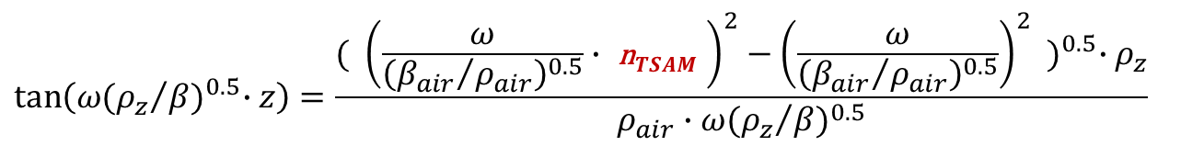

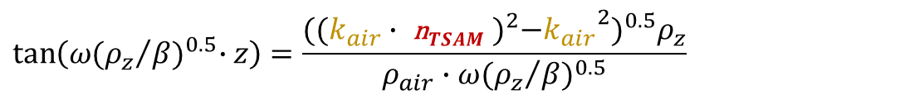

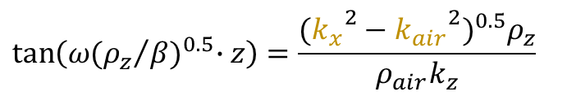
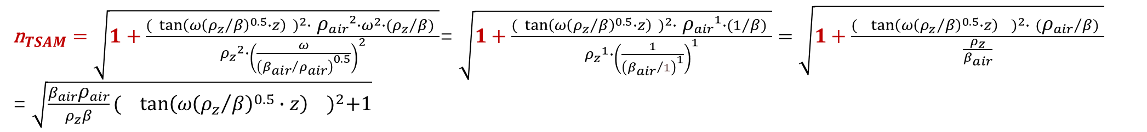
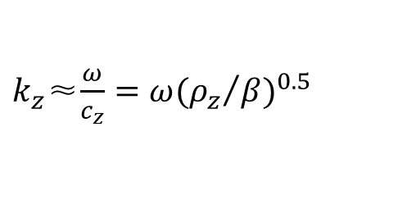
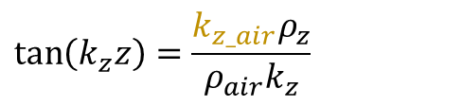
Plugging (25), (26), (12) into (24):
${k_{z_air}}^{2}$=${k_{x}}^{2}−{k_{air}}^{2}$, $k_{air}$=$\frac{ω}{c}$= $\frac{ω}{{({β_{air}}/{ρ_{air}})}^{0.5}}$
$$\tan\left(k_{z}z\right)=\frac{k_{z_air}ρ_{z}}{{\text{ρ}}_{air}k_{z}}$$
$$\tan\left(ω{({ρ_{z}}/β)}^{0.5}∙z\right)=\frac{{({k_{x}}^{2}−{k_{air}}^{2})}^{0.5}ρ_{z}}{{\text{ρ}}_{air}k_{z}}$$
${k_{x}=k}_{air}∙$ ${\text{n}}_{TSAM}$
$k_{z}$≈$\frac{ω}{c_{z}}=ω{({ρ_{z}}/β)}^{0.5}$
$$\tan\left(ω{({ρ_{z}}/β)}^{0.5}∙z\right)=\frac{{({(k_{air}∙ {\text{n}}_{TSAM} )}^{2}−{k_{air}}^{2})}^{0.5}ρ_{z}}{{\text{ρ}}_{air}∙ω{({ρ_{z}}/β)}^{0.5}}$$
$$\tan\left(ω{({ρ_{z}}/β)}^{0.5}∙z\right)=\frac{{( {\left(\frac{ω}{{\left({β_{air}}/{ρ_{air}}\right)}^{0.5}}∙ {\text{n}}_{TSAM} \right)}^{2}−{\left(\frac{ω}{{\left({β_{air}}/{ρ_{air}}\right)}^{0.5}}\right)}^{2} )}^{0.5}{∙ρ}_{z}}{{\text{ρ}}_{air}∙ω{({ρ_{z}}/β)}^{0.5}}$$
$\frac{tan\left(ω{({ρ_{z}}/β)}^{0.5}∙z\right) ∙{\text{ρ}}_{air}∙ω{({ρ_{z}}/β)}^{0.5}}{ρ_{z}}$= ${( {\left(\frac{ω}{{\left({β_{air}}/{ρ_{air}}\right)}^{0.5}}∙ {\text{n}}_{TSAM} \right)}^{2}−{\left(\frac{ω}{{\left({β_{air}}/{ρ_{air}}\right)}^{0.5}}\right)}^{2} )}^{0.5}$
$\frac{{( tan\left(ω{\left({ρ_{z}}/β\right)}^{0.5}∙z\right) )}^{2}∙ {{\text{ρ}}_{air}}^{2}{∙ω}^{2}∙({ρ_{z}}/β) }{{ρ_{z}}^{2}}= {\left(\frac{ω}{{\left({β_{air}}/{ρ_{air}}\right)}^{0.5}}∙ {\text{n}}_{TSAM} \right)}^{2}−{\left(\frac{ω}{{\left({β_{air}}/{ρ_{air}}\right)}^{0.5}}\right)}^{2}$ $={\left(\frac{ω}{{\left({β_{air}}/{ρ_{air}}\right)}^{0.5}}\right)}^{2}$ $∙$(${{\text{n}}_{TSAM}}^{2}$-1)
${\text{n}}_{TSAM}=\sqrt{1+\frac{{( tan\left(ω{\left({ρ_{z}}/β\right)}^{0.5}∙z\right) )}^{2}∙ {{\text{ρ}}_{air}}^{2}{∙ω}^{2}∙({ρ_{z}}/β) }{{ρ_{z}}^{2}{∙\left(\frac{ω}{{\left({β_{air}}/{ρ_{air}}\right)}^{0.5}}\right)}^{2}}}$= $\sqrt{1+\frac{{( tan\left(ω{\left({ρ_{z}}/β\right)}^{0.5}∙z\right) )}^{2}∙ {{\text{ρ}}_{air}}^{1}∙(1/β) }{{ρ_{z}}^{1}{∙\left(\frac{1}{{\left({β_{air}}/1\right)}^{1}}\right)}^{1}}}=$ $\sqrt{1+\frac{{( tan\left(ω{\left({ρ_{z}}/β\right)}^{0.5}∙z\right) )}^{2}∙ ({{\text{ρ}}_{air}}/β) }{\frac{ρ_{z}}{β_{air}}}}$
= $\sqrt{\frac{β_{air}{\text{ρ}}_{air}}{ρ_{z}β}{( tan\left(ω{\left({ρ_{z}}/β\right)}^{0.5}∙z\right) )}^{2}+1}$

Slide 10
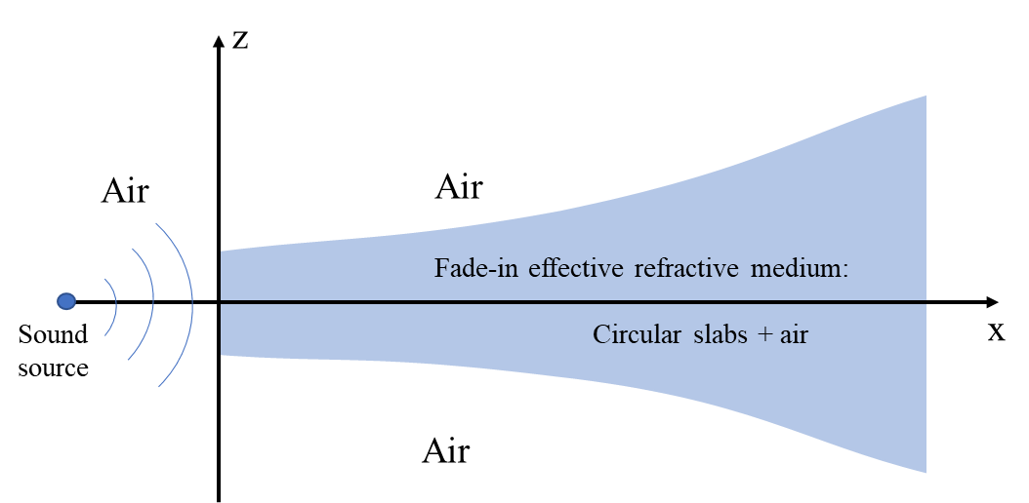
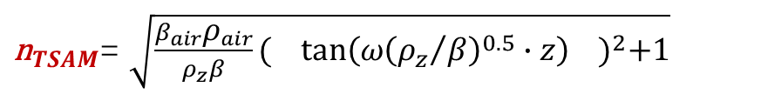

Now we have the refractive index of the TSAM:
${\text{n}}_{TSAM}$= $\sqrt{\frac{β_{air}{\text{ρ}}_{air}}{ρ_{z}β}{( tan\left(ω{\left({ρ_{z}}/β\right)}^{0.5}∙z\right) )}^{2}+1}$
Where 1 can be treat as the refractive index of the air, ${\text{n}}_{air}=1$, and z is the z-axis referring to the radius of the circular slabs(the shape of the TSAM), so, z is a function of x, z(x)=0.0006x^{𝟐}+9, curl fitting from the prototype:
Curl fitting : $Z=0.0006r^{2}+9$
${\text{n}}_{TSAM}(x,f)$= $\sqrt{\frac{β_{air}{\text{ρ}}_{air}}{ρ_{z}β}∙\tan^{2}\left( 2πf{\left({ρ_{z}}/β\right)}^{0.5}∙z\left(x\right) \right)+{\text{n}}_{air}}$
👆

Slide 11
Advantages of TSAM
1. Advantage of symmetry for sensing enhancement.
Due to the symmetry of the circular plates array, even in case of the incident sound angle is not normal to the proposed TSAM, the enhanced sound pressure collected in the gaps of the TSAM will stay the same as long as the distance between the sound source and the TSAM symmetric point is the same.
Figure 1(a) is the proposed TSAM, and Figure 1(b) is the rectangle shape acoustic metamaterials proposed in Ref 8, Ref 10, and Ref 13. Finite element analysis was carried out with the Figure 1(b) proportional scale up to the same size as Figure 1(a)(Each slab has the same area and thickness with TSAM). Unlike the metamaterials proposed in Ref.8 and Ref.10 whose metamaterial structures are formed by rectangle plates (Fig 1b), the resultant enhanced sound pressure induced by different incident angles could be various. The former case is more directional and suitable for acoustic sensing on fault detection.
Figure 1(c)~(e) are cases of incident sound waves with different incident angles interacting with the 2 kinds of acoustic metamaterials(Figure 1(a) and (b)). The results of directivities shown in Figures 1(a) and (b) indicate that the TSAM has more consistency in directivity compared to the rectangle acoustic metamaterials. Besides, the sound pressure amplification of the TSAM is significantly higher than the rectangle one from the sound signals collected in 3 gaps respectively(Figure 1(h) and (i)).

Slide 12
Advantages of TSAM
2. Advantages in acoustic field matching.
The trumpet-like outline of the proposed acoustic metamaterial consists of plates with radii formed by a nonlinear quadratic function, which have a higher acoustic mode-field match between the air and the metamaterial compared to the one proposed in Ref.8 and Ref.10, with which profiles are both linear.

Slide 13
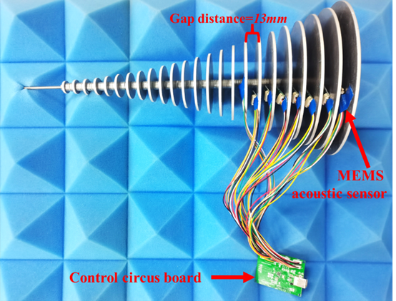
Advantages of TSAM
The gap distance between two circular plates of the proposed TSAM is 13mm which allows mounting the MEMS sensors arrays in gaps of TSAM for measuring the sound pressure as Fig 3 shows.
In contrast to the design in Ref 8 and Ref 10 whose gap distances are 1.4mm and 6.35mm respectively, resulting the installation of the conventional sensors array for fault detection is impossible.

