Slide 1
Supplement Figure 1: Doxorubicin treatment induces significant decrease in body weight change over time. DOX-RT mice had significantly decreased body weight change at 2, 8, 12 and 16 days post-treatment compared to control mice. DOX mice had significantly decreased body weight change 8 through 16 days post-treatment compared to control mice. Data represent the mean and SEM. DOX= doxorubicin group, RT= hindlimb radiation group, DOX-RT= doxorubicin and hindlimb radiation group.

Slide 2
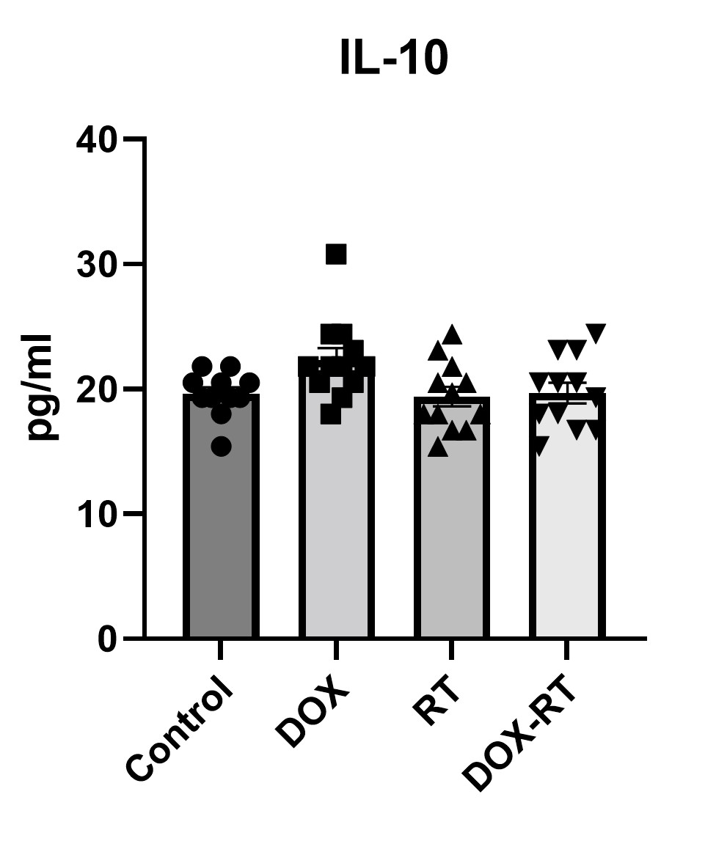
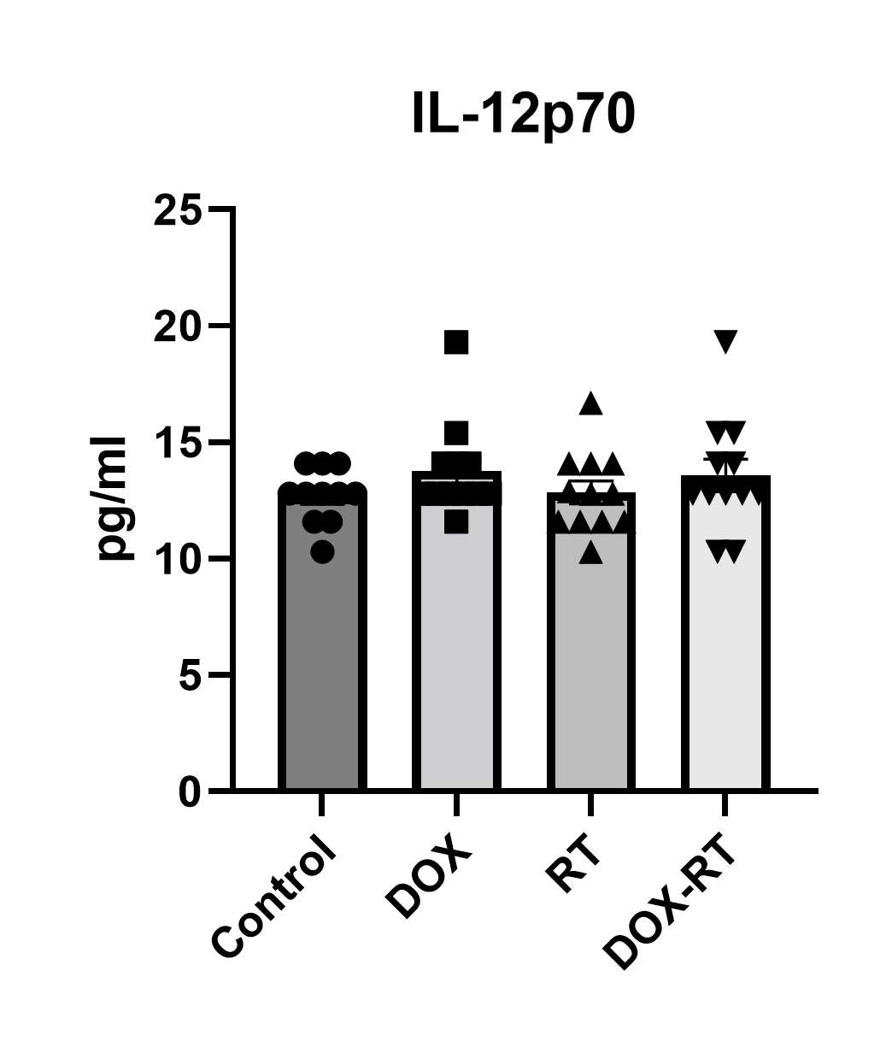
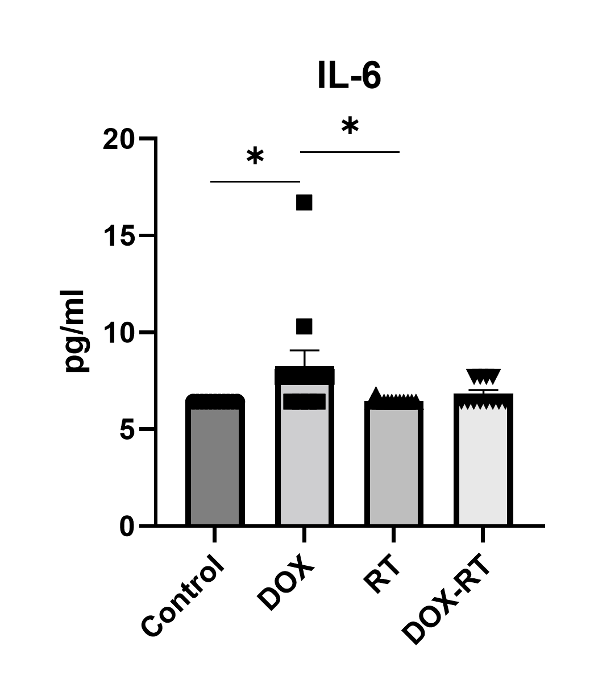
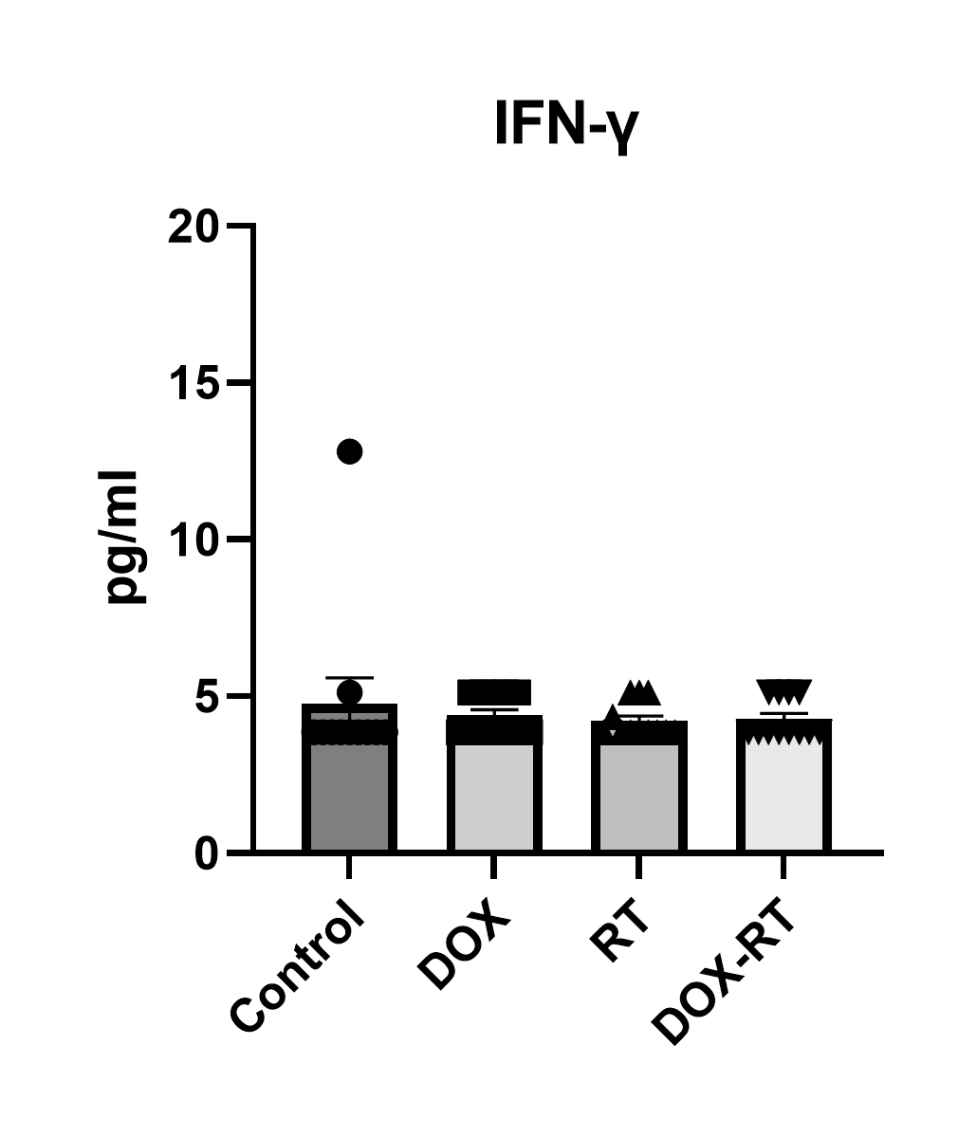
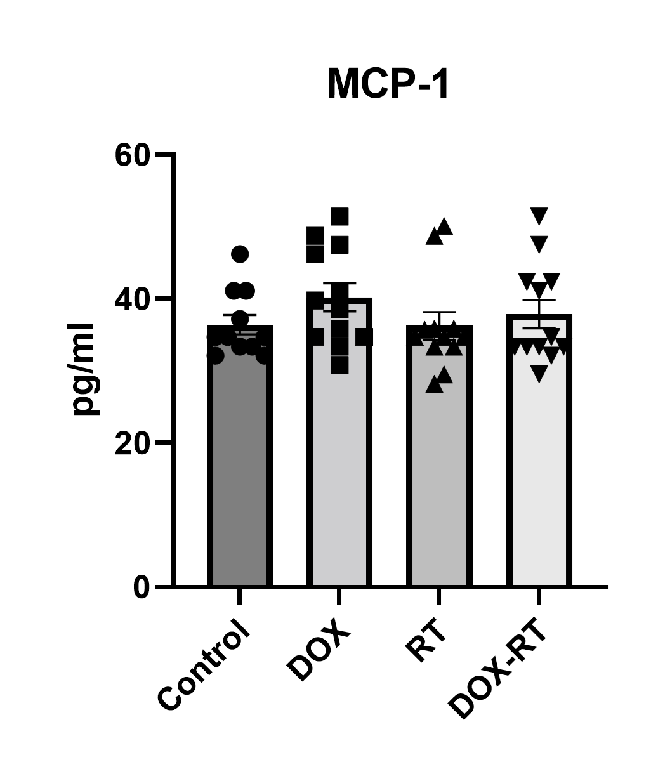
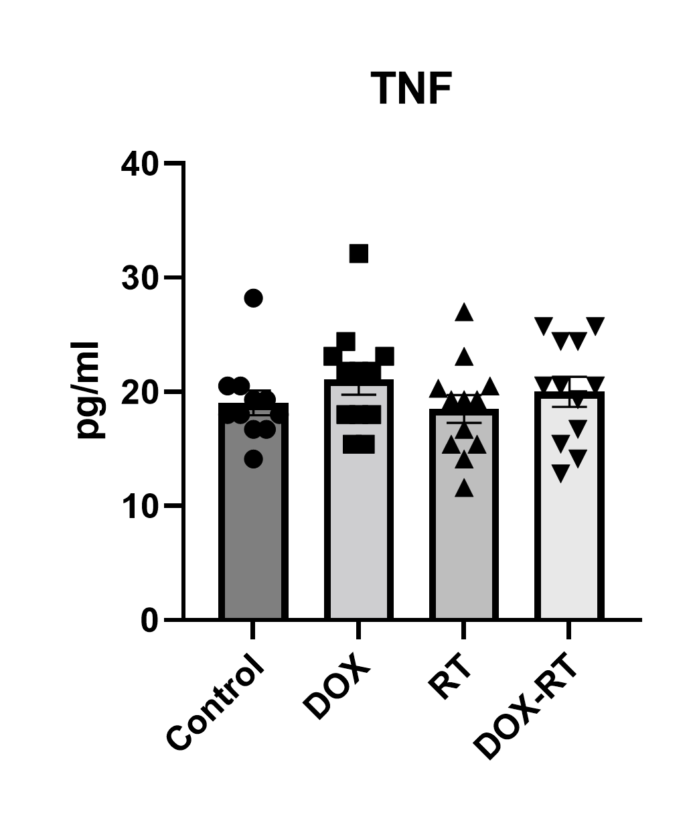
A
B
C
D
E
F
Supplement Figure 2: Doxorubicin induces systemic inflammation. (A-F) Plasma cytokines including IL-6 (A), IL-10 (B), IL-12p70 (C), IFN-𝛄 (D), MCP-1 (E) and TNF (F) measured on day 16 following treatment. Mice treated with DOX had significantly increased IL-6 concentrations compared to control and RT-treated mice (A); no other differences were detected (B-F). Data represent the mean and SEM evaluated from 11-12 mice per treatment group. DOX= doxorubicin group, RT= hindlimb radiation group, DOX-RT= doxorubicin and hindlimb radiation group.

