Slide 1
Supplementary Material
Sucrose preferentially promotes expression of OsWRKY7 and OsPR10a to enhance blast fungus defense response in rice
Win Tun¹, Jinmi Yoon², Kieu Thi Xuan Vo¹, Lae-Hyeon Cho², Hoang Viet Trung¹, Xin Peng³, Eui-Jung Kim¹, Kay Tha Ye Soe Win¹, Sang-Won Lee¹, Ki-Hong Jung¹, Jong-Seong Jeon^{1*}, and Gynheung An^{1*}
*Correspondence
Gynheung An and Jong-Seong Jeon
Email: genean@khu.ac.kr; jjeon@khu.ac.kr
1 Supplementary Figures and Tables

Slide 2
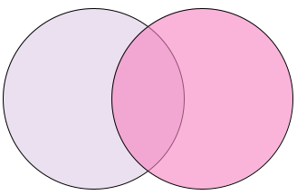
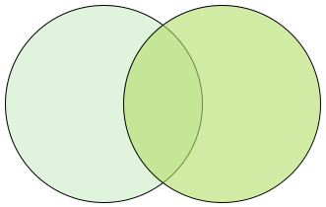
1.1 Supplementary Figures
A
B
up-regulated genes
down-regulated genes
1574
871
465
2358
1469
1148
glu
suc
glu
suc
C
gene number
18
12
42
Supplementary Figure 1 Transcriptome analysis of differentially expressed genes in Oc cells grown in sucrose or glucose. (A) Number of up-regulated genes. (B) Number of down-regulated genes. (C) Gene ontology enrichment analysis of sucrose-induced genes from the transcriptome analysis.

Slide 3
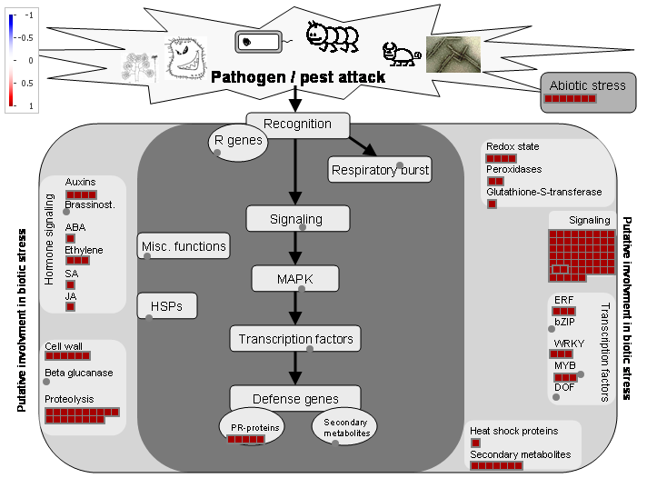
selected group
Supplementary Figure 2 MapMan analysis of the sucrose-preferentially induced genes that are related to pathogen/pest attack. Red squares are the transcripts induced preferentially by sucrose. Arrow indicates the selected group for further study.

Slide 4
*
*
*
Con
Suc
Suc +
MG132
Suc +
ethanol
Supplementary Figure 3 Effect of MG132 on sucrose-induced OsWRKY108 expression. Samples were collected at 1 h after addition of 3% sucrose, 3% sucrose plus 100 µM MG132, or 3% sucrose plus 0.5% ethanol. We tested the effect of ethanol because MG132 was dissolved in the alcohol. The relative transcript level was compared with OsActin1. Errors bars indicate standard deviations; n = 3 or more. The significant levels are indicated by * (P < 0.05).

Slide 5
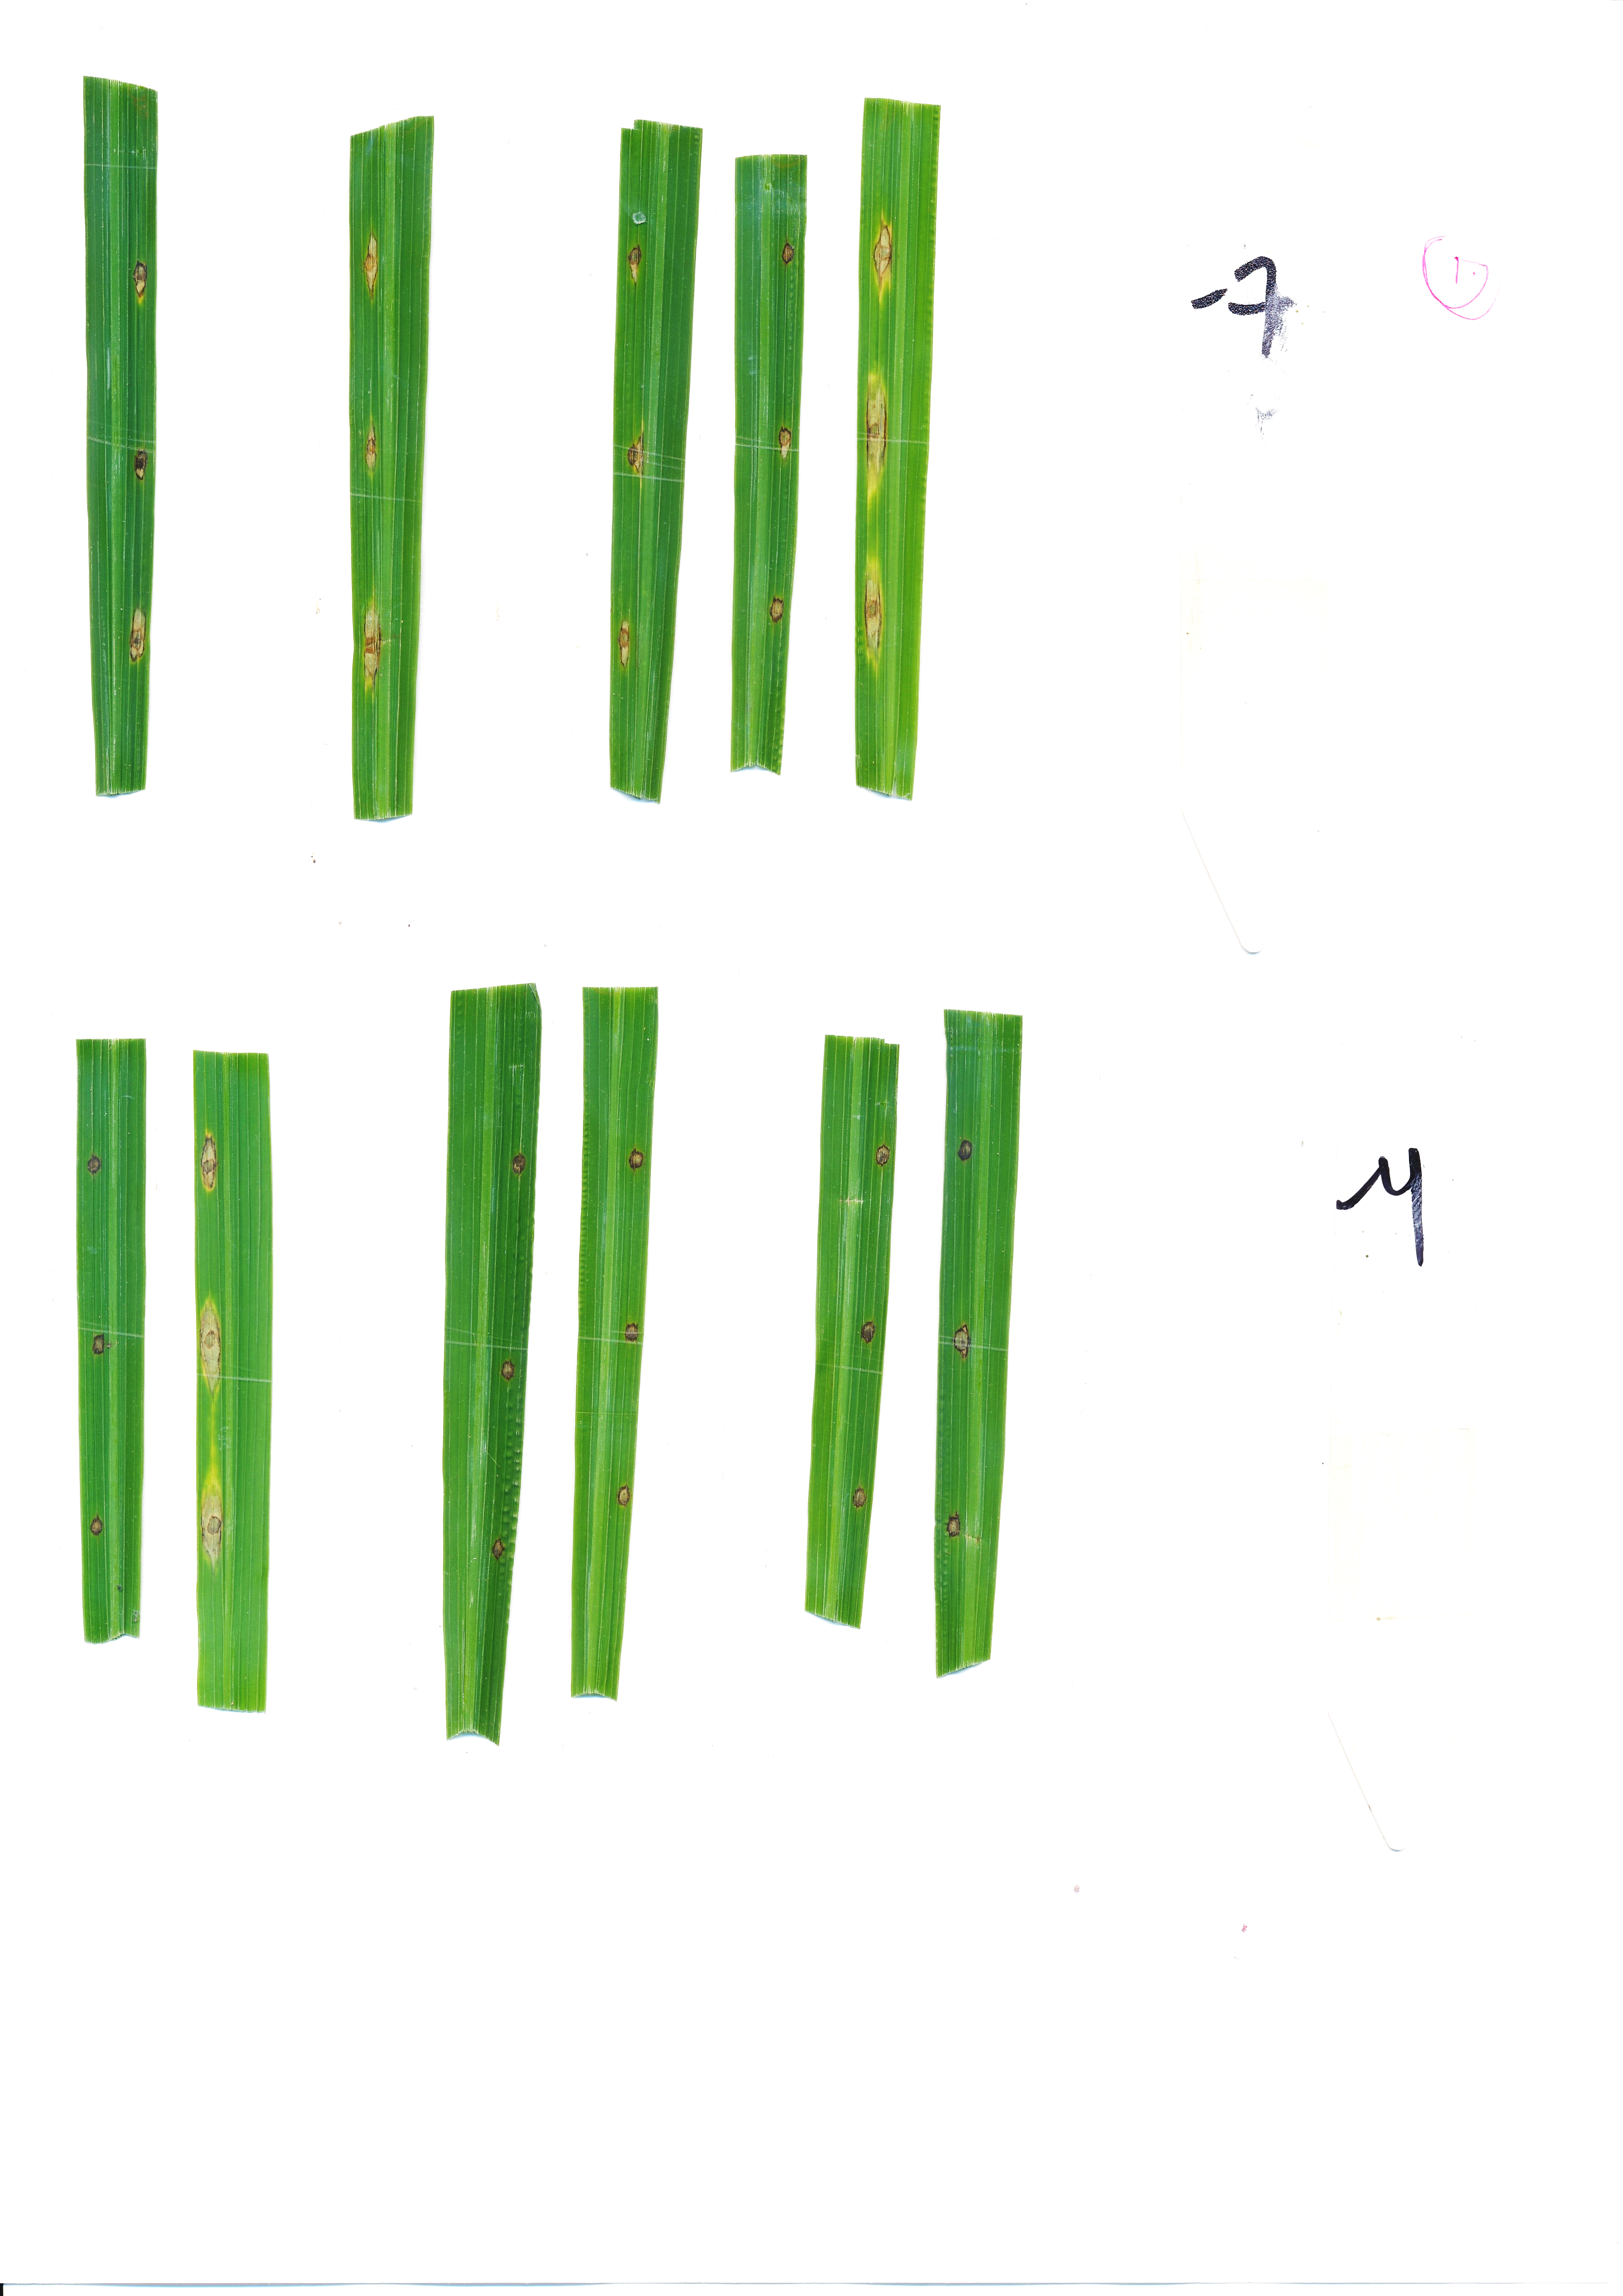
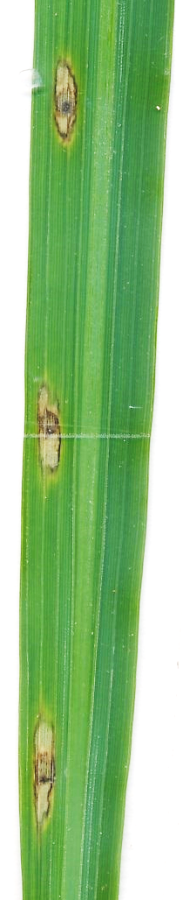

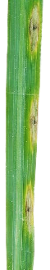
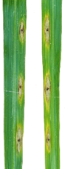
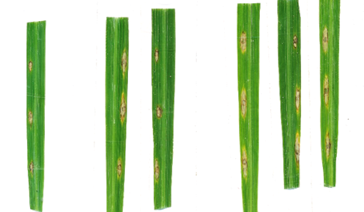
A
*
Mock
M. oryzae
B
C
NGUS2
5A-00022
200 bp
*
F
R
D
E
WT
oswrky7-1
***
1 cm
WT
oswrky7-1
WT
oswrky7-1
Supplementary Figure 4 Characterization of oswrky7-1 mutant generated by T-DNA insertion. (A) Relative transcript level of OsWRKY7 between mock and M. oryzae infected plants two days after infection. Gene expression levels are relative to those of OsActin1. (B) Gene structure of OsWRKY7 and the location of inserted T-DNA. Exons are indicated with black boxes; the lines between the boxes are introns; gray boxes indicates 5’- UTR and 3’-UTR regions. Triangle indicates T-DNA located at the promoter region of OsWRKY7. F, R, and NGUS2 (marked with arrows) are the primers used for genotyping the insertion mutant. Scale bar = 200 bp. (C) The OsWRKY7 transcript levels in WT and oswrky7-1 plants. Gene expression levels are relative to those of OsActin1. (D) Phenotypes of WT and oswrky7-1 after M. oryzae infection. Leaves of 42 DAG plants were inoculated with M. oryzae and the lesion development was observed 9 d after inoculation. Scale bar = 1 cm. (E) Lesion length of WT and oswrky7-1. The error bars show standard deviations; n = 20. Statistical significance is indicated by * (P < 0.05) and *** (P < 0.001).

Slide 6
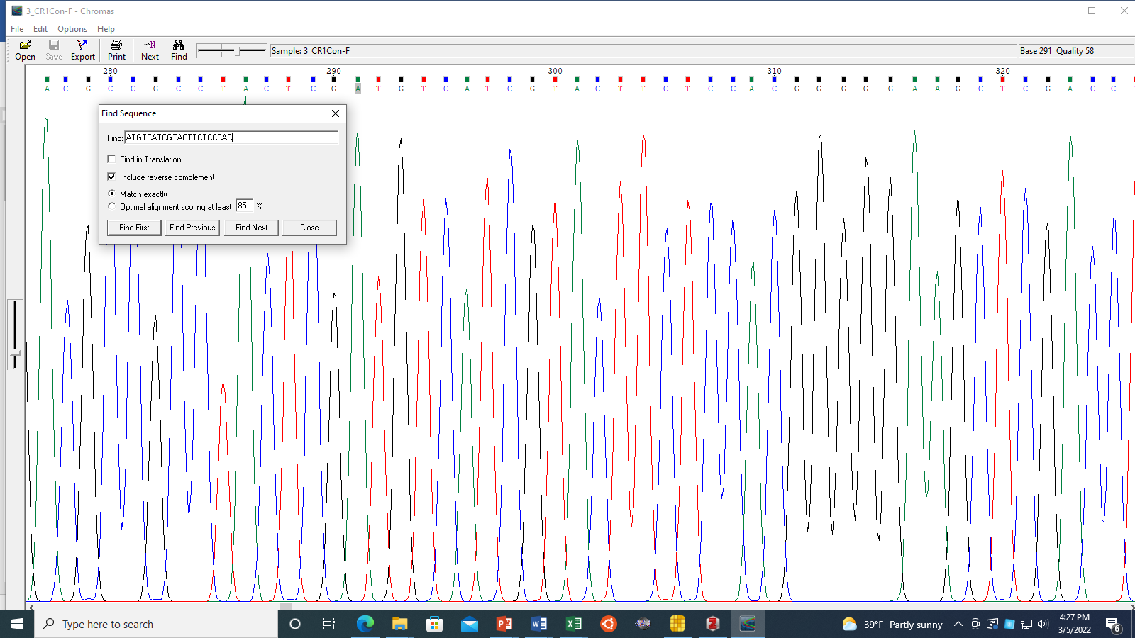
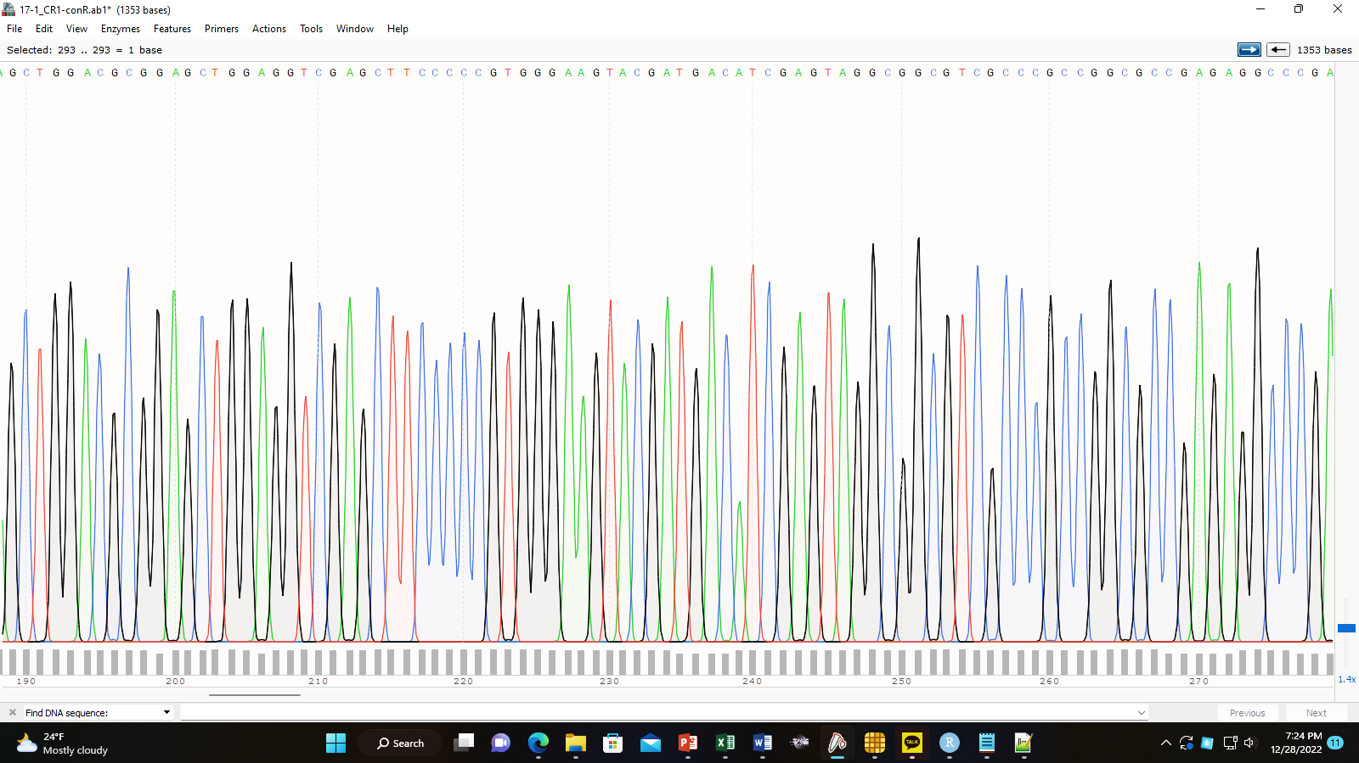
A
A T G T C A T C G T A C T T C T C C A C G G
oswrky7-2
ATGTCATCGTACTTCT-CCACGG
WT
ATGTCATCGTACTTCTCCCACGG
B
C C G T G G G A A G T A C G A T G A C A T
oswrky7-3
ATGTCATCGTACTT--CCCACGG
WT
ATGTCATCGTACTTCTCCCACGG
Supplementary Figure 5 Sequences of the deletion mutants generated by CRISPR/Cas9. The target sites were amplified by PCR using genomic DNA isolated from the oswrky7-2 (A) and oswrky7-3 (B) plants. The amplified DNA was cloned in Escherichia coli and at least 5 independent clones was sequenced. The deleted nucleotides are highlighted in red dashes. In the chromatograms, deletion sites are indicated with arrows. The blue letters indicate the PAM motif.

Slide 7
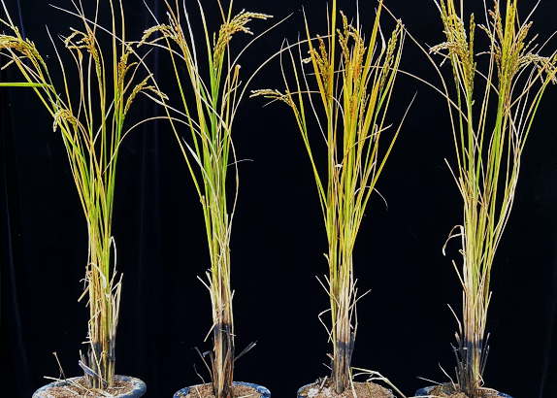
A
B
10 cm
WT
7-2
7-3
WT
7-2
7-3
oswrky
oswrky
C
D
WT
7-2
7-3
WT
7-2
7-3
oswrky
oswrky
E
Supplementary Figure 6 The agronomic parameters of the deletion mutants and WT plants. Plants were grown under the paddy conditions. (A) Phenotypes of the mutants and WT at the ripening stage. Scale bar = 10 cm. Plant height (B), grain number per panicle (C), panicle length (D), and 100-grain weight (E) of the mutants and WT. The error bars show standard deviations; n = 5.
WT
7-2
7-3
oswrky

Slide 8
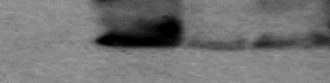

OsWRKY7
(KD)
WT
OX5
OX6
OX7
42
anti-HA
35
24
Ponceau S
Supplementary Figure 7 Western blot analysis of OsWRKY7-HA protein in the overexpression plants. Total proteins were extracted from the leaves of the OsWRKY7-HA overexpression plants after 24 hours of M. oryzae infection. The proteins were used for the western blot analysis using anti-HA antibody. Ponceau S staining was used to determine the amount of protein loading.

Slide 9
A
B
C
WT
7-2
7-3
WT
7-2
7-3
WT
7-2
7-3
oswrky
oswrky
oswrky
D
E
F
WT
7-2
7-3
WT
7-2
7-3
WT
7-2
7-3
oswrky
oswrky
oswrky
Supplementary Figure 8 Expression levels of JA and SA biosynthesis related genes. Leaf blades of WT and knockout mutants (oswrky7-2 and oswrky7-3) were sampled at 42 DAG and the transcript levels of OsPAL (A), OsICS1 (B), OsNH1 (C), OsAOS2 (D), OsAOC1 (E), and OsOPR3 (F) were determined by qRT-PCR analysis. The gene expression levels are relative to those of OsActin1. Error bars indicate standard deviations; n = 3 or more.

Slide 10
**
Supplementary Figure 9 Induction of OsPR10a expression by sucrose. Root samples of WT and oswrky7-2 were collected after 9 hours of 3% sugar treatment. Gray bars indicate WT and blue bars indicate oswrky7-2. Man, mannitol; Suc, sucrose. The gene expression levels are relative to those of OsActin1. The error bars show standard deviations; n = 5. Statistical significance is indicated by ** (P < 0.01).

Slide 11
Supplementary Table 2 Validation of RNA-seq data by qRT-PCR
Locus ID | log₂(Suc4/Suc0) |  | log₂(Suc4/Glu4) |  | Gene name
 | RNA-seq | qRT-PCR | RNA-seq | qRT-PCR
LOC_Os02g45420 | 1.9 | -0.8 | 3.1 | 2.2 | ERF20
LOC_Os05g46020 | 1.9 | 1.7 | 1.3 | 2.7 | WRKY7
LOC_Os01g51690 | 2.5 | 0.9 | 1.9 | 3.0 | WRKY26
LOC_Os02g18470 | 1.4 | -0.6 | 1.0 | 0.7 | NAC46
LOC_Os05g30790 | 0.9 | 1.7 | 1.1 | 0.6 | CWZF5
LOC_Os03g25480 | 1.1 | -4.3 | 0.9 | -0.3 | CP450
LOC_Os04g42520 | 2.0 | 1.1 | 1.5 | 1.4 | APT2
LOC_Os12g36880 | 5.1 | 2.1 | 0.5 | 1.3 | OsPR10a
LOC_Os03g20500 | 1.0 | 1.9 | 1.4 | 2.8 | OsFbox137
LOC_Os12g36110 | 1.3 | 3.5 | 2.0 | 0.9 | CaMBP
LOC_Os07g02910 | 0.8 | -1.6 | 1.0 | -0.6 | OsFbox333
LOC_Os10g21910 | 0.9 | 1.6 | 1.1 | 0.2 | ACC1
LOC_Os02g09510 | -1.7 | -0.7 | -2.2 | 1.1 | OsUGT84C1
LOC_Os08g43190 | -1.4 | -2.7 | -1.6 | -0.3 | OsDH1
LOC_Os01g71460 | -1.5 | -5.0 | -1.6 | 0.0 | OsFBDUF11
LOC_Os01g23760 | -2.1 | -3.3 | -1.0 | -0.1 | OsMADS93
LOC_Os02g15950 | -0.9 | -1.7 | -1.1 | -0.2 | OsFBK5
LOC_Os12g34310 | -1.2 | 1.0 | -1.1 | -0.5 | OsFBX455
LOC_Os11g41860 | -0.8 | -2.8 | -2.2 | 1.1 | OsFBX429
LOC_Os02g02320 | -0.8 | 1.3 | -1.7 | -3.6 | OsSCP6
LOC_Os09g06770 | -3.7 | -9.3 | -3.8 | -2.4 | Zinc finger
LOC_Os09g25070 | -2.9 | -3.6 | -1.8 | -3.6 | WRKY62
LOC_Os06g39370 | -0.8 | -4.5 | -1.7 | -1.3 | OsFbox314
LOC_Os02g56750 | -1.7 | -4.0 | -1.0 | -2.3 | OsFbox115
Suc0, before sucrose addition; Suc4, 4 h after sucrose addition; Glu4, 4 h after glucose addition.

