Slide 1
Low Sodium Diet
For congestive heart failure
Created by: Nutrition Department at South Texas Veterans Health Care System

Slide 2
Congestive heart failure
The heart can’t pump blood normally and fluid may collect in the legs, ankles, and lungs

Slide 3
How does CHF and diet relate?
Too much sodium can cause fluid retention
Drinking too many fluids can impact the heart’s ability to pump blood properly
The body’s goal is to balance electrolytes including water and sodium
When diet is high in sodium, the body holds on to the extra water to balance it, causing bloating and mild discomfort
Extra fluids in the body of a person with CHF can make fluid retention a serious health concern

Slide 4
Salt vs sodium: what is the difference?
Sodium
Salt
Mineral
Electrolyte that carries a positive charge
Balances water levels in cells
Stimulates nerve impulses
Initiates muscle contractions
Regulates heart muscle contractions
Controls blood volume
Chemical compound
Sodium Chloride
40% sodium and 60% chloride
Naturally occurs:
Sea Water
Underground deposits
Crystalline mineral known as rock salt or halite
Heavily ground with most impurities and trace minerals removed

Slide 5
SalT
1 tsp salt = 2300 mg
1 tsp lite salt = 1100 mg
1 tsp salt sub = <1 mg

Slide 6
What is considered low salt?
Low salt is <140 mg per serving
Look for items that:
do not have salt listed in the first 5 ingredients
Contain less than 300mg of sodium per serving
Goal is 1500-2000 mg sodium per day
Recommend to allow for 500 mg per meal (x3 meals per day)

Slide 7
How to read a food label: focus on sodium
Using % Daily Value (DV)
To consume less of a nutrient
choose foods with a lower % DV
5% or less (restricting salt or fat)
To choose foods with more of a nutrient
choose foods with a higher % DV
20 percent or more (fiber)

Slide 8
Terms of food packages
Sodium-free – Less than 5 milligrams of sodium per serving and contains no sodium chloride
Very low sodium – 35 milligrams or less per serving
Low sodium – 140 milligrams or less per serving
Reduced (or less) sodium – At least 25 percent less sodium per serving than the usual sodium level
Light (for sodium-reduced products) – If the food is “low calorie” and “low fat” and sodium is reduced by at least 50 percent per serving
Light in sodium – If sodium is reduced by at least 50 percent per serving

Slide 9
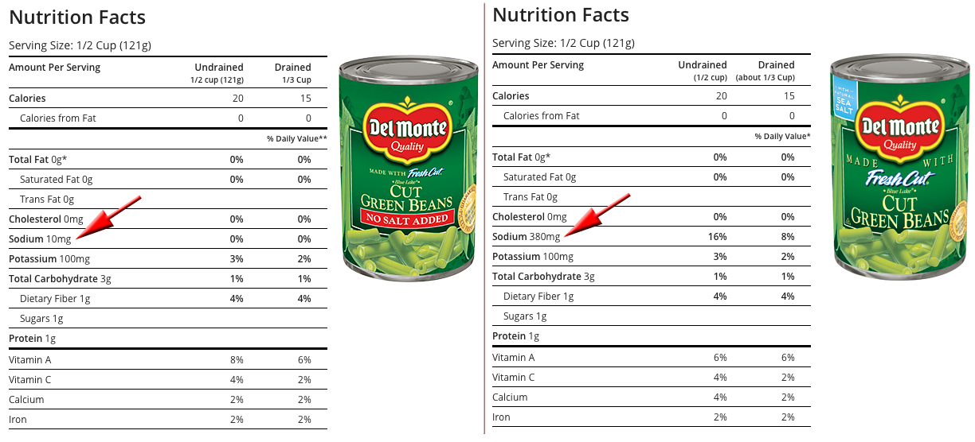

Slide 10
Comparison of vegetables
Canned vegetables
Frozen vegetables
Del Monte canned green beans
Serving ½ cup
380mg/serving
Draining liquid reduces salt content by 36%
Leaving 243mg/serving
Draining and rinsing reduces salt content by 40%
Leaving 228mg/serving
Frozen Green Beans
Serving ¾ cup
0 mg salt
Frozen Vegetables with Sauce
Bird’s Eye SteakHouse Frozen Green Beans
Serving ¾ cup
310 mg/serving

Slide 11
Convenience items high in salt
Canned
Vegetables
Meats
Soups
Cured
Bacon
Ham
Lunchmeat
Pickled
Sauerkraut
Pickles
Cabbage
Smoked foods
Commercial or convenience products with high salt content

Slide 12
Be careful of high sodium items
Barbeque sauce
Catsup
Gravy mixes
Marinades
Chili seasoning packets
Bouillon
Salad dressings
Meat tenderizers
Onion salt
Garlic salt
Celery salt

Slide 13
Acceptable convenience items low in salt
Frozen Vegetables
No Salt Added canned vegetables
No Salt Added tomato sauce
Frozen Dinners
Smart Ones
Healthy Choice

Slide 14
Alternative seasoning for beef
Bay leaf
Dry mustard
Nutmeg
Onion
Pepper
Sage
Thyme
Fresh mushrooms
Garlic
Leeks

Slide 15
Alternative seasoning for chicken
Green pepper
Lemon juice
Paprika
Parsley
Poultry seasoning
Sage
Thyme
Marjoram
Cumin
Garlic

Slide 16
Alternative seasoning for fish
Bay leaf
Dry mustard powder
Green pepper
Lemon juice
Paprika
Pepper
Dill
Mrs. Dash lemon pepper

Slide 17
Alternative seasoning for pork
Applesauce
Garlic
Onion
Sage
Pepper
Orange

Slide 18
Alternative seasoning for Potatoes
Onion
Paprika
Pepper
Parsley
Rosemary
Garlic
Chives

Slide 19
Alternative seasoning for Green beans
Dill
Lemon juice
Nutmeg
Pepper

Slide 20
DASH Diet (Dietary Approach to Stop Hypertension)
7-8 servings whole grains
4-5 servings vegetables
4-5 servings fruits
2-3 servings low-fat dairy foods
1-2 servings of lean meat, poultry or fish
4-5 servings of nuts, seeds, dried peas and beans per week
2-3 servings of plant-based fats or oils
5 or fewer servings of sweets per week
Notes:
Participants with high blood pressure in the DASH study saw a drop in pressure similar to what’s seen with a prescription drug, suggesting follwing the DASH diet may delay or prevent the need for medication in some people. More recent studies have shown adding salt or sodium restriction to the DASH diet further improved the reduction in blood pressure. The unique nature of the DASH study was it was designed to look at the effects of real foods on blood pressure, rather than specific nutrients in isolation. The result, a practical guide to specific changes which when incorporated into ones lifestyle will result in improvements in blood pressure.

Slide 21
Be careful of Liquids containing salt
Gatorade
Powerade
V-8 Juice
Tomato Juice

Slide 22
Salt substitutes
Without potassium
With potassium
Mrs. Dash
McCormick’s Saltless
Lawry’s Salt Free 17
Spike Salt Free (low potassium)
Paleo Powder All Purpose Salt Free Herb Seasoning
Morton’s Salt Substitute
Nu-Salt
No Salt
Benson’s Table Tasty

Slide 23
How about Other types of salt?
Sea Salt
Made by evaporating seawater
Contain minerals like potassium, iron and zinc
May contain pollutants due to pollution of the oceans
Sodium content 38.3%
Celtic Sea Salt
Made from seawater
Greyish color
Contains water and trace amounts of minerals
A bit lower in sodium than table salt (33.8% sodium)

Slide 24
How about Other types of salt?
Pink Himalayan Salt
Mined from a salt mine
Contains trace amounts of iron oxide (gives it the pink color)
Contains small amounts of calcium, iron, potassium and magnesium
36% sodium
Kosher Salt
Similar to table salt
Flaky and coarse
Less additives

Slide 25
How to eat out on a low salt diet
Request not adding salt to food
Look online for the nutrition values prior to eating out
Know what restaurants serve food from bulk and which ones cook to order
Educate yourself on high sodium foods
Eating out on a low salt diet makes it hard to control salt intake overall

Slide 26
Example: Mcdonalds information collected from website
Egg McMuffin
Calories 290 kcal
Sodium 760 mg
Removing only the cheese
Calories 240 kcal
Sodium 570 mg
This saves 190mg of sodium!
Sausage and Egg McMuffin
Calories 430 kcal
Sodium 850 mg
Removing only the cheese
Calories 390 kcal
Sodium 660 mg
This saves 190 mg of sodium!

Slide 27
Example: Mcdonalds information collected from website
Big Breakfast
Calories 640 kcal
Sodium 1120mg
Keep in mind additional butter/margarine adds salt
Sausage Egg and Cheese McGriddles
Calories 520 kcal
Sodium 1350 mg

Slide 28
Fluid restriction
Often if CHF is advanced or severe your doctor may recommend a fluid restriction
1500 ml/d
6 ½ cups
2000 ml/d
8 1/3 cups

Slide 29
What is considered a fluid?
Broth and soup
Coffee, tea, lemonade, soda
Jello
Milk
Juice
Anything liquid at room temperature

Slide 30
Summary of What to do…
Get rid of the salt shaker
Eat out less-request no salt added
Do not add salt when cooking
Use low sodium foods to cook
Use lots of salt free seasonings and herbs
Read labels!

Slide 31
Questions?
Make eating low salt a fun challenge to find new flavors you enjoy!

