Slide 1
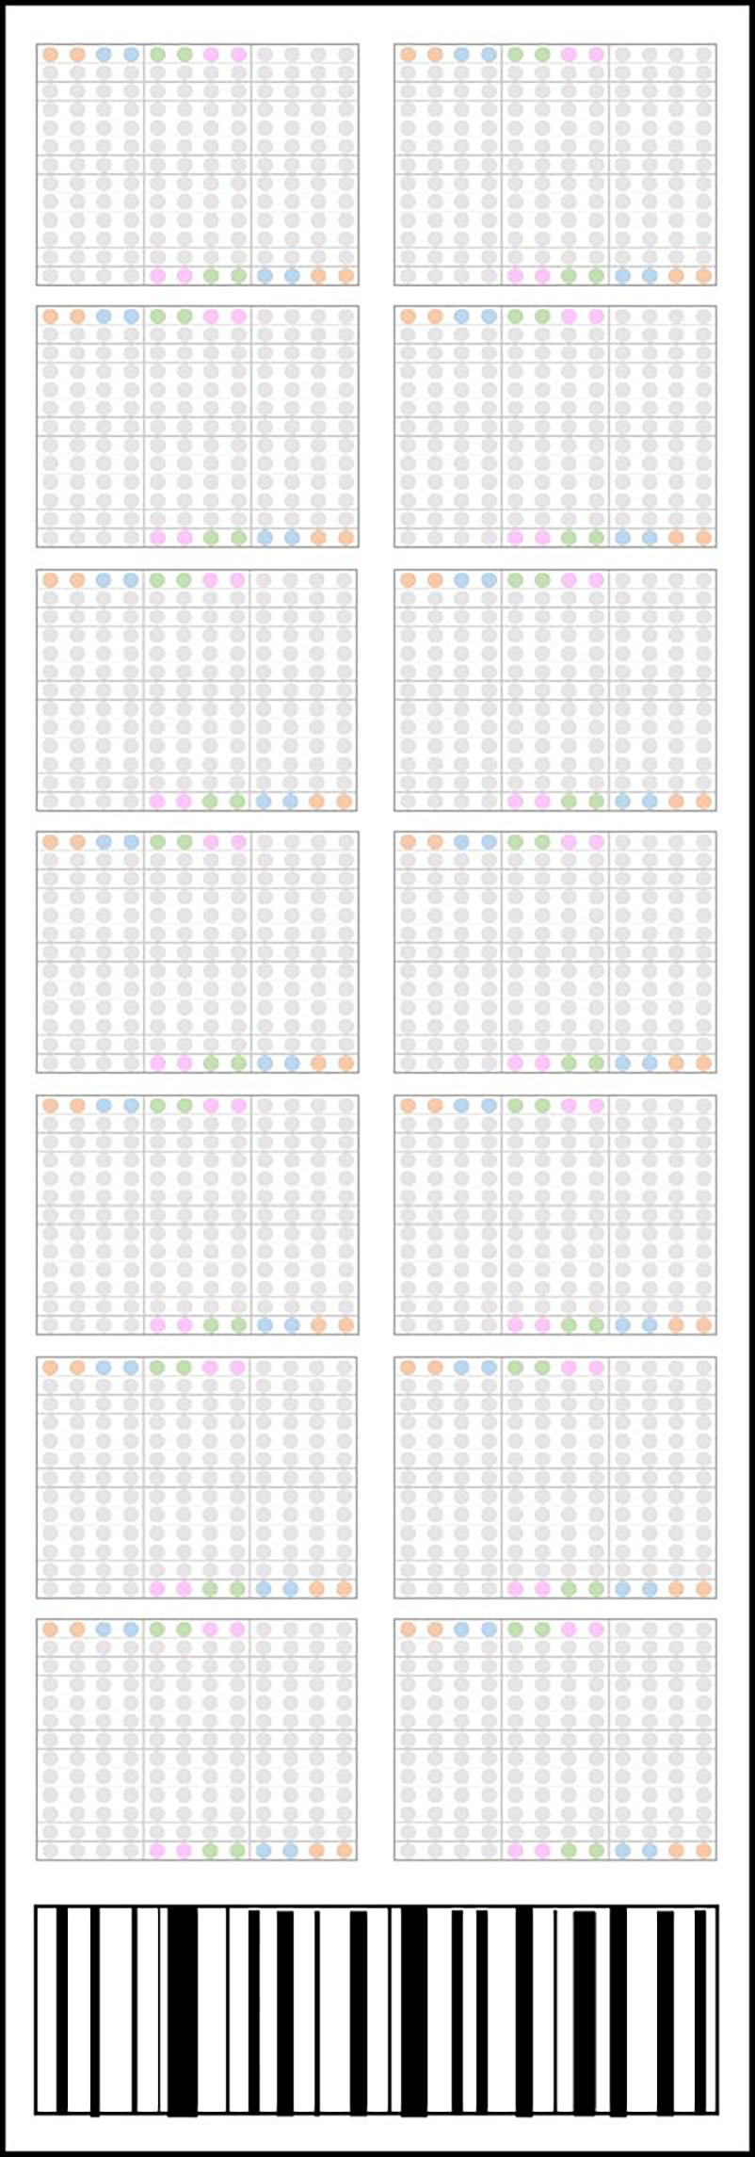
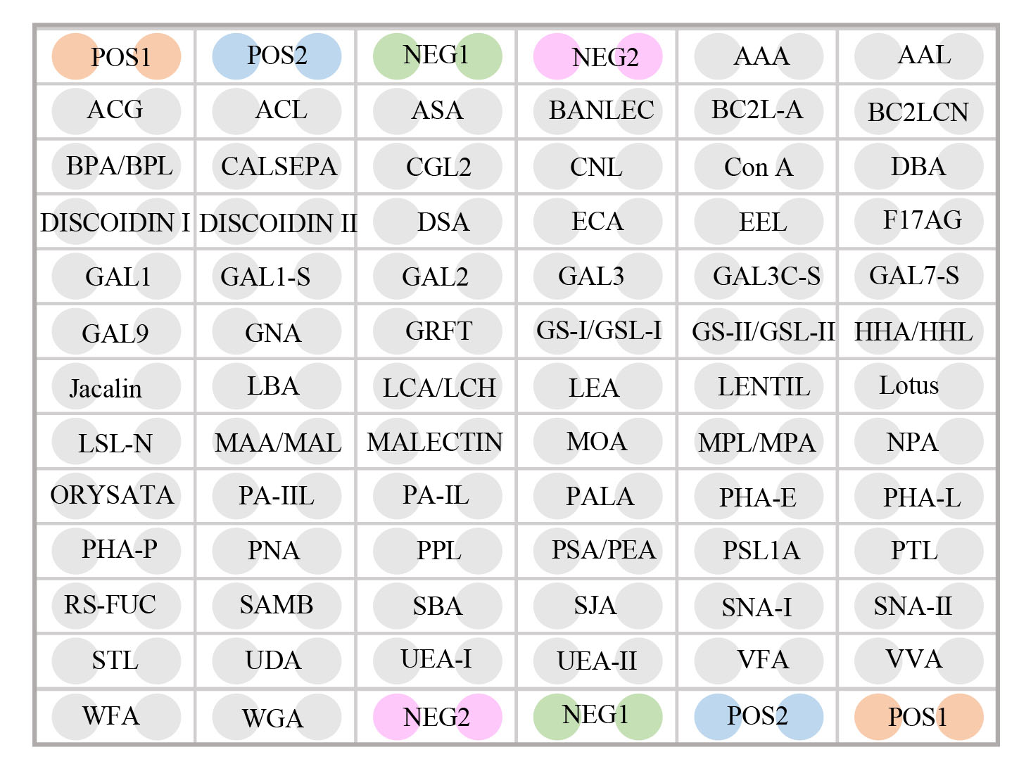
Supplementary figure 1
A
B
Supplementary figure 1. Example of lectin microarray. (A) Each lectin microarray has 14 loading wells for 14 serum samples. (B) Each loading well contains 70 lectins and positive or negative controls with 2 iterations.

Slide 2
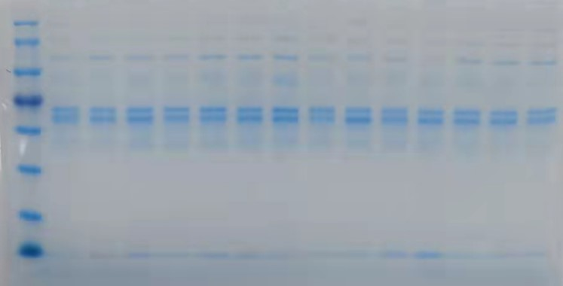
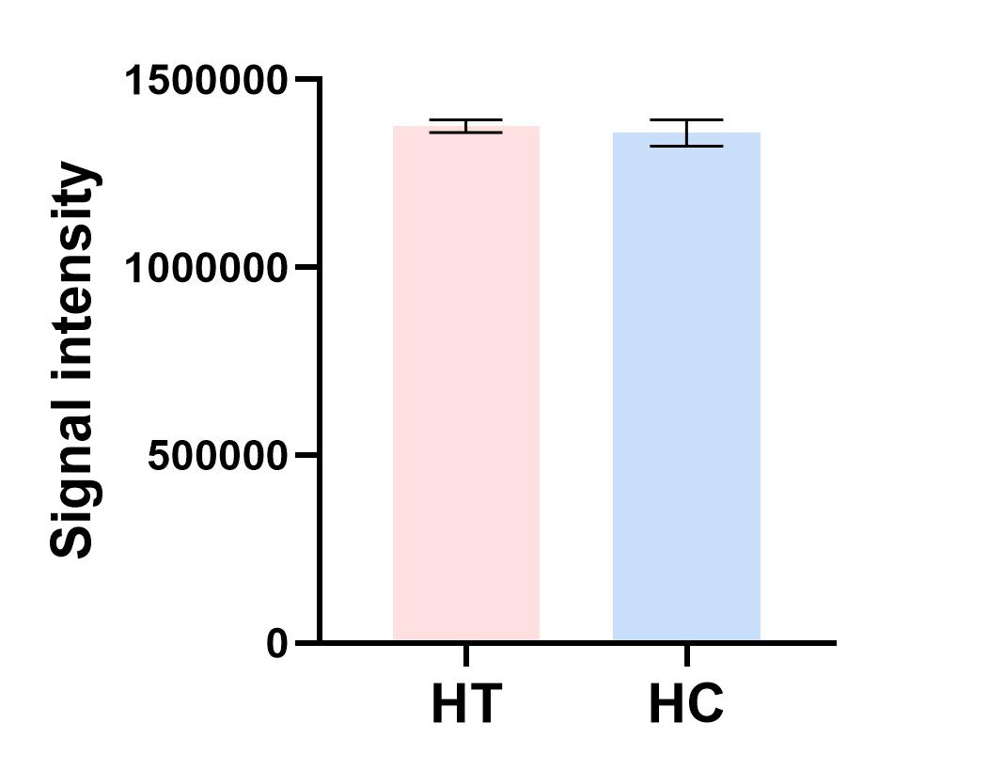
Supplementary figure 2
A
2628
2661
2609
3104
2652
3103
3106
3111
2616
3124
2259
2623
3127
3105
M
180KD
140KD
100KD
75KD
60KD
45KD
35KD
25KD
B
Supplementary figure 2. Vertification of the same quality of each protein in lectin blot. (A) Coomassie brilliant blue staining of polyacrylamide gel with serums from HT group (left 2-8 column) and HC group (left 9-15 column). The number above each column indicates the corresponding sample. (B) The signal intensity analysis on bands from Coomassie brilliant blue staining .

Slide 3
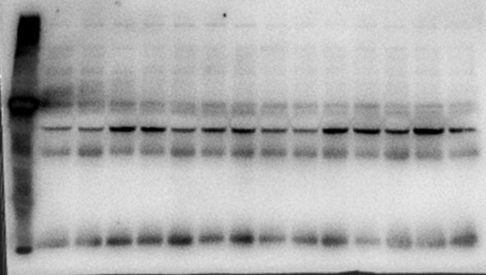
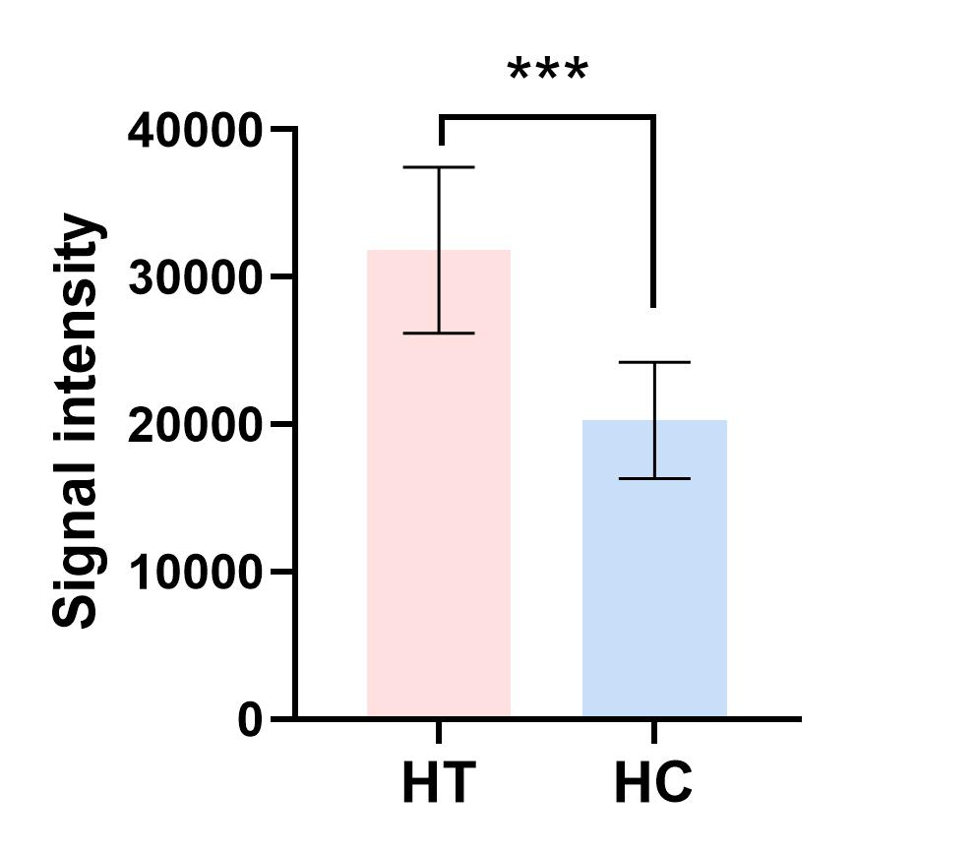
Supplementary figure 3
A
3106
3111
3103
3124
2652
3127
3105
2259
2616
2661
2609
2623
3104
2628
M
180KD
140KD
100KD
75KD
60KD
45KD
35KD
25KD
B
Supplementary figure 3. Lectin blot verification of a small cohort of serum samples profiled by lectin array. (A) The VVA blot of serums from HT group (left 2-8 column) and HC group (left 9-15 column). Red box shows the VVA blot bands at around 75 KDa. (B) The signal intensity analysis on bands from VVA blot. All error bars indicate SD. ***P <0.005.

Slide 4
Supplementary table 2
Pearson correlation analysis between lectin signals and TSH
 | Pearson′s r | Sig.
TSH
VVA | 0.05 | 0.77
MAA | -0.23 | 0.25
STL | -0.15 | 0.46
Calsepa | 0.17 | 0.40
SNA-I | -0.09 | 0.65
SAMB | -0.23 | 0.26
DSA | -0.25 | 0.20
BanLec | -0.80 | 0.69
ACG | 0.18 | 0.37
PHA-E | 0.10 | 0.63
PSA | -0.08 | 0.68
MPL | -0.28 | 0.15
GS-I | 0.08 | 0.71
Gal1 | 0.40 | 0.30

Slide 5
Supplementary table 3
Pearson correlation analysis in Hashimoto′s thyroiditis
 | Pearson′s r | Sig.
TSH
LTF | -0.143 | 0.104
MASP-1 | -0.146 | 0.097

Slide 6
Supplementary table 4
Pearson correlation analysis in papillary thyroid carcinoma
 | Pearson′s r | Sig.
TSH
LTF | 0.028 | 0.75
MASP-1 | 0.02 | 0.817

