Slide 1
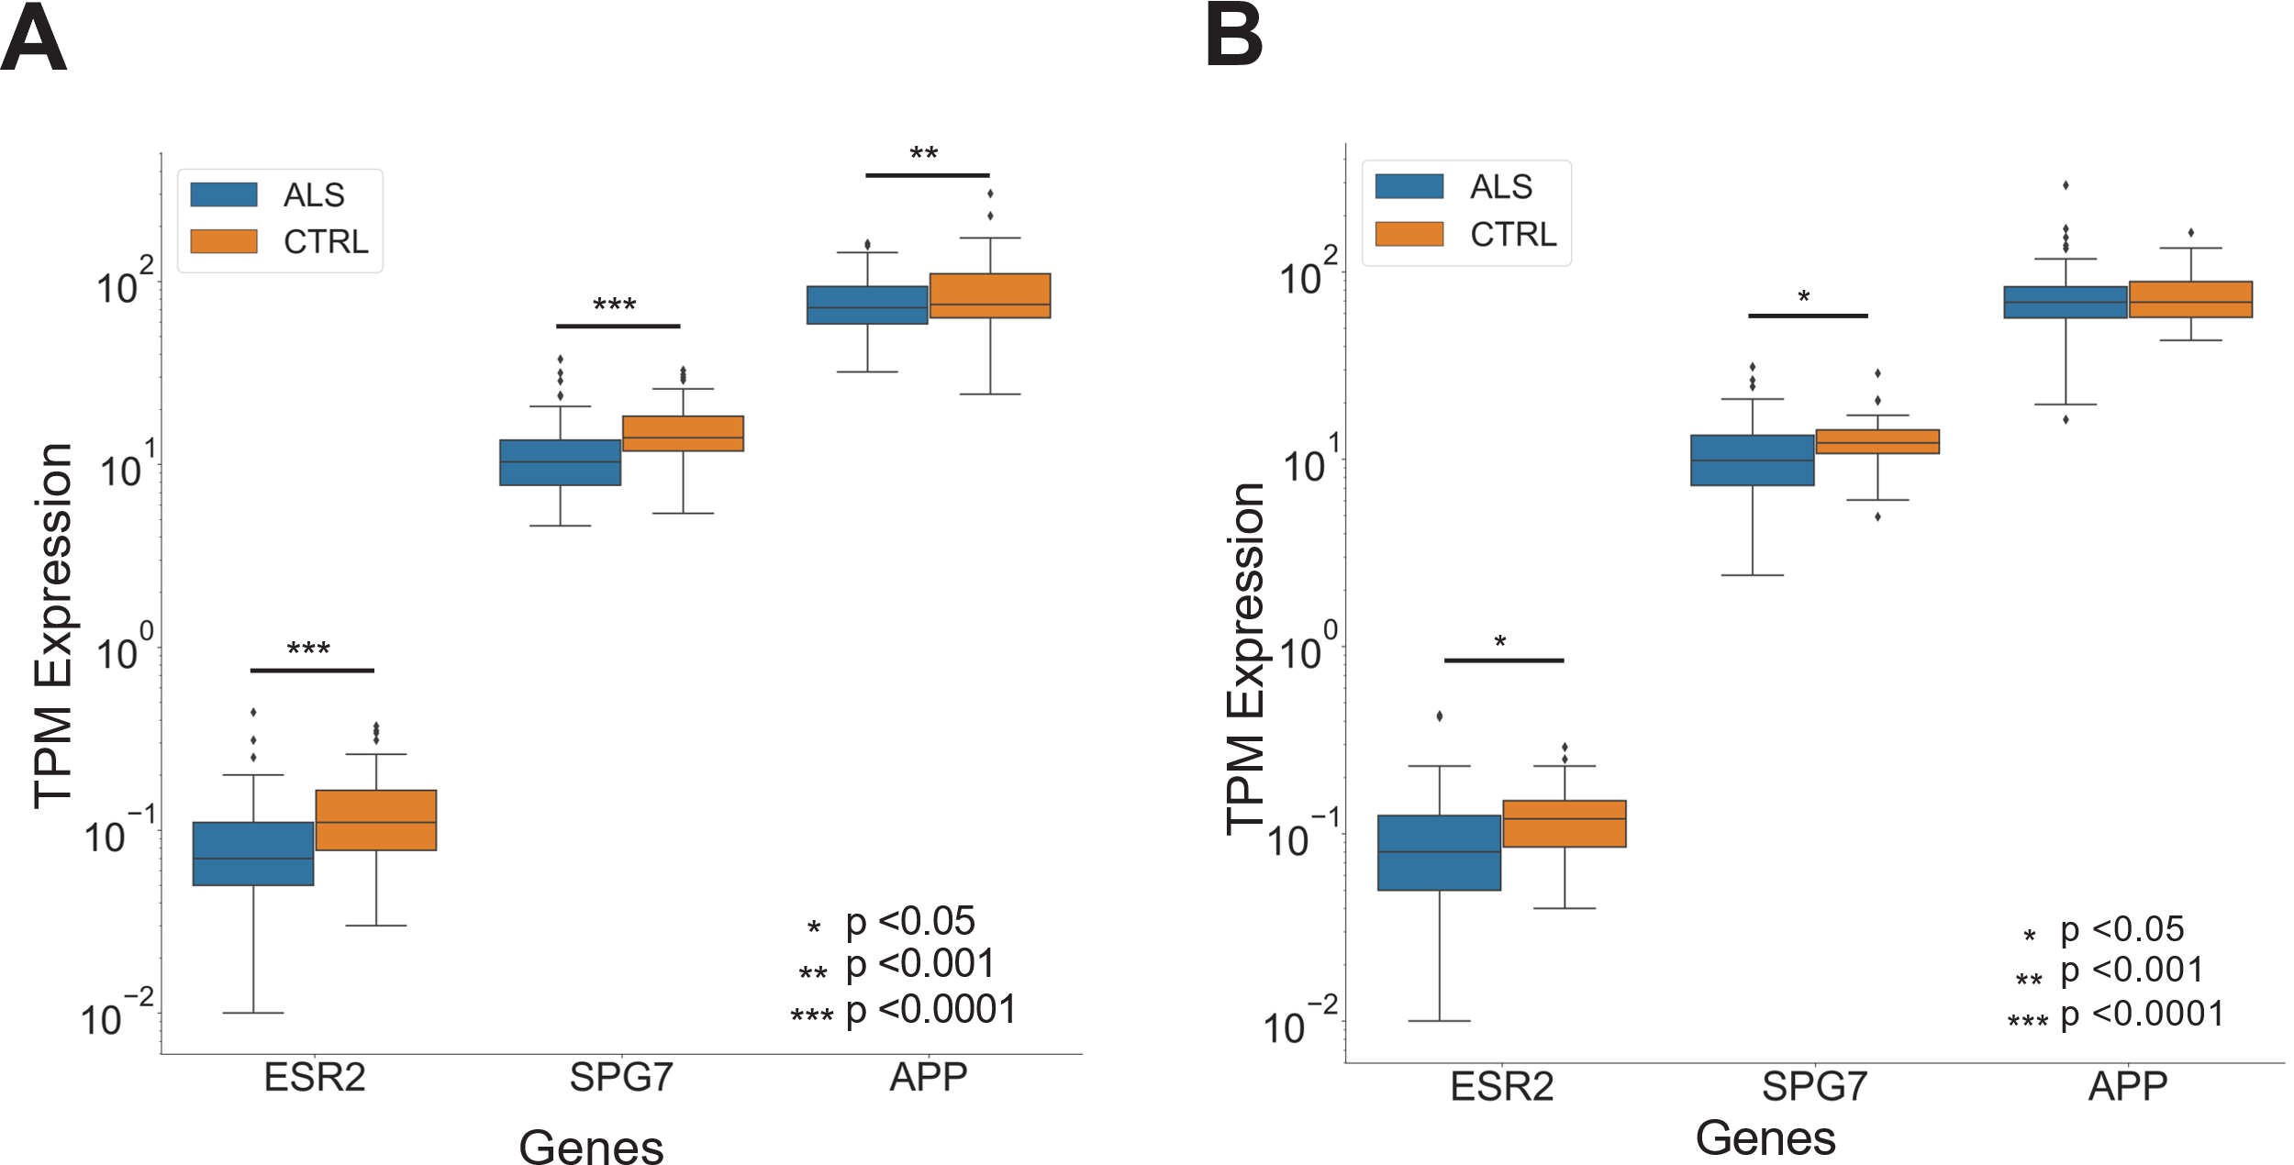
Suppl. Figure S6. Boxplot of the Transcripts Per Million (TPM) expression of connecting proteins from patients affected by ALS (n=138) vs control (n=36) in the (A) cervical region and the (B) lumbar regions. Statistical significance was tested by performing a Two independent samples T-test.

