Slide 1
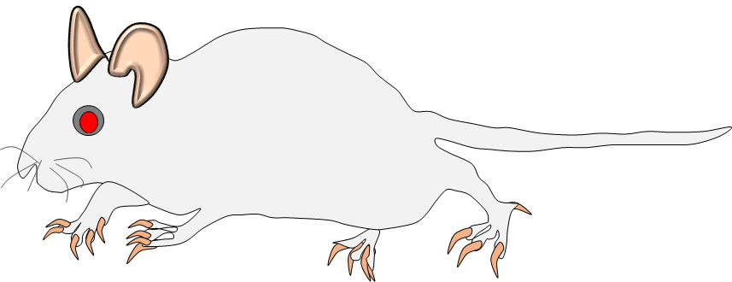
Control
HFpEF
Saline
Saline
Ang II
D
A
B
C
Day (-)7 Day 0 Day (+)12 Day (+)14
Pump-exchange
-Echocardiography
-Telemetry implant
-ICV Saline cannulation
-ICV Saline mini-pump implant
-Baseline Echocardiography on Day (-)2
-Mini-pump-exchange on Day 0
(Ang II 20 ng/min, or 0.9% sterile
saline infusion), 0.5 ul/h)
-Cardiac function (Miller)
-Heart isolation
Supplementary Figure 1. Schematic diagram demonstrated to develop HFpEF cardiac phenotype in SD rats. A) The chronic Ang II intracerebroventricular (ICV) infusion timeline and protocol are depicted from Day (-7) to Day (+)14. At Day (-7) Sprague-Dawley rats (250–300 g) were operated for brain ICV Ang II infusion via mini-pump (20 ng/min, 14 days, 0.5 ml/h) through osmotic mini-pumps. At day (-2), post-surgery recovery baseline Echocardiography was performed. B) Schematic timeline of treatment via Mini-pump-exchange on Day 0 (Ang II 20 ng/min, or 0.9% sterile saline infusion), 0.5 ul/h). C) on Day (+)12 pre-terminal Echocardiography was performed. D) on Day (+) 14 terminal cardiac function was recorded using Miller catheter, and rats were euthanized for organ isolation and histological evaluations.

