Slide 1
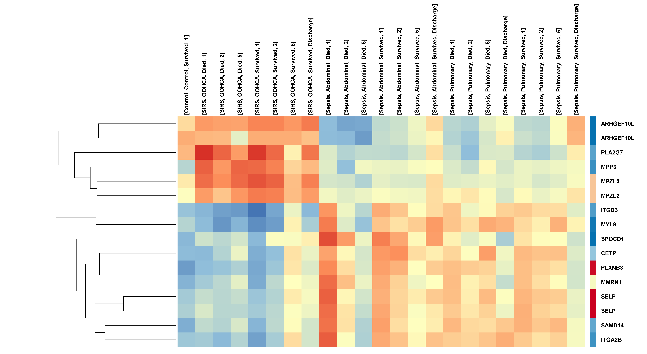

Figure S4.1
(a)
(b)

