Slide 1
Primer Name | Primer Sequences
ZM-Actin-F | TGCTCCTCCTGAGAGAAAGTA
ZM-Actin-R | TCATACTCGGCCTTGGAAATC
ZM-AOS-F | TCTGTTCCGATTGCTGGCTT
ZM-AOS-R | AAACTCAAACCCTCGCCGAT
ZM-WRKY-F | CACGAACATGGTCCTTCCGA
ZM-WRKY-R | CCGGTGGTATGTCTGCAGTT
ZM-ST-F | CGGTGTCGAGTTTGTGGAGA
ZM-ST-R | GAGCATGACACCGACGGTAA
ZM-ABCG-F | GACGAGGTTCACCGTGGAAT
ZM-ABCG-R | AACCCCGATGTGGGTTCATC
ZM-KAT-F | ACCTCCATCCAGATCCGTCA
ZM-KAT-R | CGACGTCATCGTCGAAGCTA
ZM-ZT-F | CAACTCTCCTTGCCTACCCG
ZM-ZT-R | CAACTCCACCGTCCGCTTTA
ZM-POD-F | CCCCCGCGAAATTTGACAAC
ZM-POD-R | CCCCTGTCAGCGGTTTAACA
ZM PR-F | AGGTTACTTGGTCTGCTGCC
ZM PR-R | AGTGGTATGTTGCCCGGATG
ZM CRK-F | CGCCGGTGATAGGCTCATAA
ZM CRK-R | CACCTCTGCACATCGCTAGT
ZM-MYB-F | TGGTTGGAATCCCATGGTCTG
ZM-MYB-R | TTGCAACCTGTGTCGGAGTT
ZM-Aux-F | TTGAGTCCAAGGTTTCCGGC
ZM-Aux-R | ATAAGGCGCTCCATCCACAG
ZM-AAP-F | GTCATCACTGCATTCGTCGC
ZM-AAP-R | CCTTGGCTTGTTCGATGTGC
ZM-CaldEF-F | ACTCGTCCTGGGTGAGAACT
ZM-CaldEF-R | CTGGGTGGAGATGGGCTTAT
Notes:
Supplementary Table 1 qRT-PCR primers

Slide 2
Notes:
Supplementary Figure 1 Number of up-regulated and down-regulated DEGs in roots (R), stems (S) and leaves (L) with fold change ≥ 2, q-value < 0.05.

Slide 3
Gene ID | Putative function | Log₂FC | P-value
Zosma01g16740 | Sulfate transporter | -1.263 | 2.54E-11
Zosma01g41810 | putative Cleft lip and palate transmembrane protein | -1.959 | 1.20E-10
Zosma02g24370 | Peroxiredoxin (Prx) | -1.598 | 4.19E-07
Zosma03g30090 | Flavonoid glucosyltransferase, family GT1 | -1.442 | 2.06E-06
Zosma04g01430 | putative Nitrate Transporter 1.5b | -3.163 | 1.47E-06
Zosma06g25690 | 4-coumarate--CoA ligase like (4CL) | -1.231 | 9.37E-05
Zosma01g22740 | putative sulfate transporter 3.5 | -1.256 | 2.35E-05
Zosma05g26860 | WRKY transcription factor 7 | -2.780 | 1.02E-05
Zosma06g19680 | 3-ketoacyl-CoA thiolase (KAT2) | -1.816 | 7.94E-04
Zosma01g01290 | Allene oxide synthase (AOS) | -1.287 | 6.19E-04
Zosma04g20730 | p-coumaroyl shikimate 3-hydroxylase (C3′H) | -1.924 | 3.39E-04
Zosma01g17090 | TBC1 domain family member 8B | -1.838 | 2.58E-04
Notes:
Supplementary Table 2 DEGs in the significant enrichment pathways in roots

Slide 4
Gene ID | Putative function | Log₂FC | P-value
Zosma01g35590 | Manganese transport protein mntH | -1.128 | 1.07E-09
Zosma06g17130 | ABC transporter B family member 21 | -3.637 | 3.04E-08
Zosma02g10160 | Glyceraldehyde-3-phosphate dehydrogenase (phosphorylating) | 7.713 | 4.72E-07
Zosma01g17090 | TBC1 domain family member 8B | -1.892 | 4.75E-05
Zosma02g20040 | 3-ketoacyl-CoA synthase (KCS) | -1.568 | 2.07E-05
Zosma02g20770 | Laccase | -1.528 | 1.52E-05
Zosma01g21240 | Zinc transporter | -1.311 | 2.95E-04
Zosma02g09920 | ketoacyl-CoA reductase (KCR) | -1.664 | 2.34E-03
Zosma02g16680 | 3-ketoacyl-CoA synthase (KCS) | -1.482 | 1.63E-03
Zosma01g32560 | Adiponectin receptor protein | -1.347 | 1.57E-03
Zosma05g21520 | Zinc transporter ZTP29 | -1.475 | 1.46E-03
Zosma05g27810 | 3-ketoacyl-CoA synthase (KCS) | -1.367 | 1.45E-03
Zosma01g21230 | Zinc transporter | -2.114 | 1.35E-03
Zosma02g21870 | laccase | -1.704 | 1.20E-03
Notes:
Supplementary Table 3 DEGs in the significant enrichment pathways in stems

Slide 5
Gene ID | Putative function | Log₂FC | P-value
Zosma05g26860 | WRKY transcription factor 7 (WRKY7) | -2.444 | 6.34E-32
Zosma03g00810 | Protein kinase-like | -3.456 | 3.08E-17
Zosma03g31770 | Calcium-binding EF-hand family protein | -3.014 | 2.82E-10
Zosma06g26970 | WRKY transcription factor 4 | -1.136 | 1.53E-08
Zosma01g01070 | Protein ApaG | -1.284 | 5.98E-07
Zosma06g17940 | putative cyclic nucleotide-gated ion channel 9 (CNGC9) | -1.281 | 3.67E-07
Zosma01g17090 | TBC1 domain family member 8B | -2.951 | 1.07E-07
Zosma02g06220 | Primary-amine oxidase | -2.596 | 2.76E-06
Zosma06g11260 | IQ-domain 6 (IQ6) | -1.757 | 1.22E-06
Zosma03g19950 | Calmodulin-binding protein, putative, expressed | -1.816 | 4.90E-05
Zosma01g08410 | Auxin responsive protein | -1.600 | 3.68E-05
Zosma01g07420 | myb-like transcription factor family protein | -1.114 | 4.02E-04
Zosma06g04050 | ABC transporter B family member 19 | -5.716 | 2.29E-04
Zosma05g13460 | Auxin responsive protein | -1.384 | 1.55E-04
Zosma03g31500 | Centrin-2 | -1.739 | 1.32E-04
Zosma01g13700 | F-box2 Auxin signaling F-box 2 (AFB2) | -1.036 | 4.03E-03
Zosma05g14180 | putative Myosin XI (MyXI) | -5.293 | 1.42E-03
Notes:
Supplementary Table 4 DEGs in the significant enrichment pathways in leaves

Slide 6
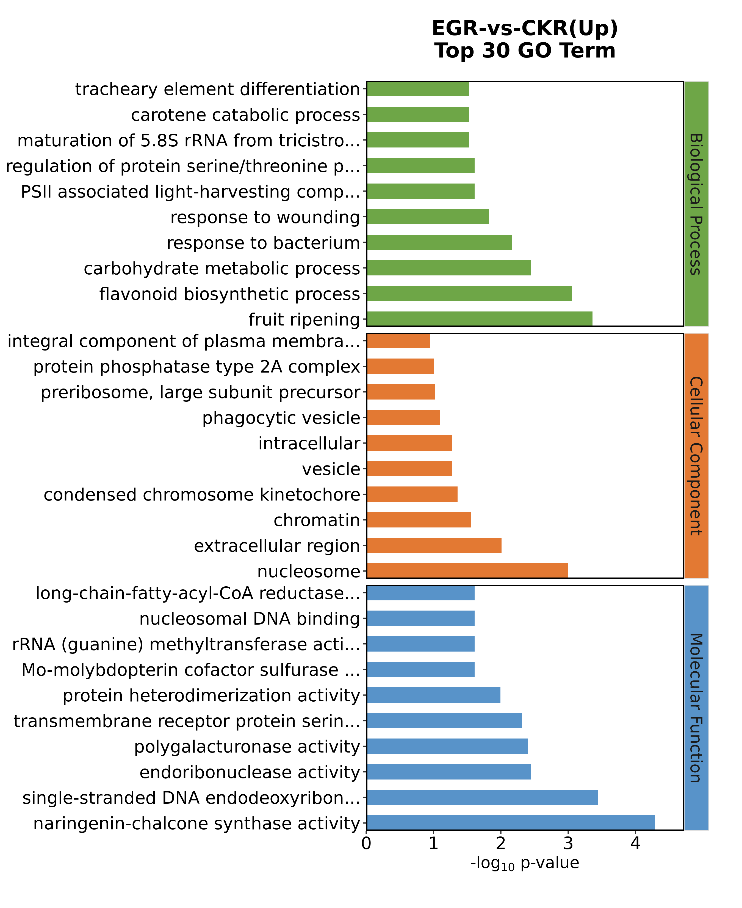
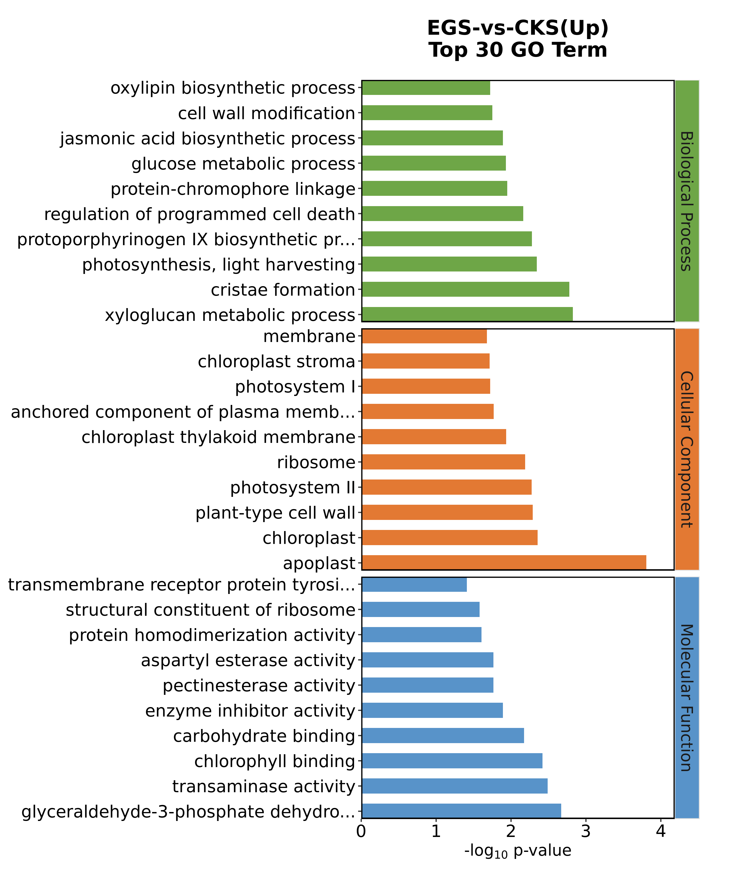
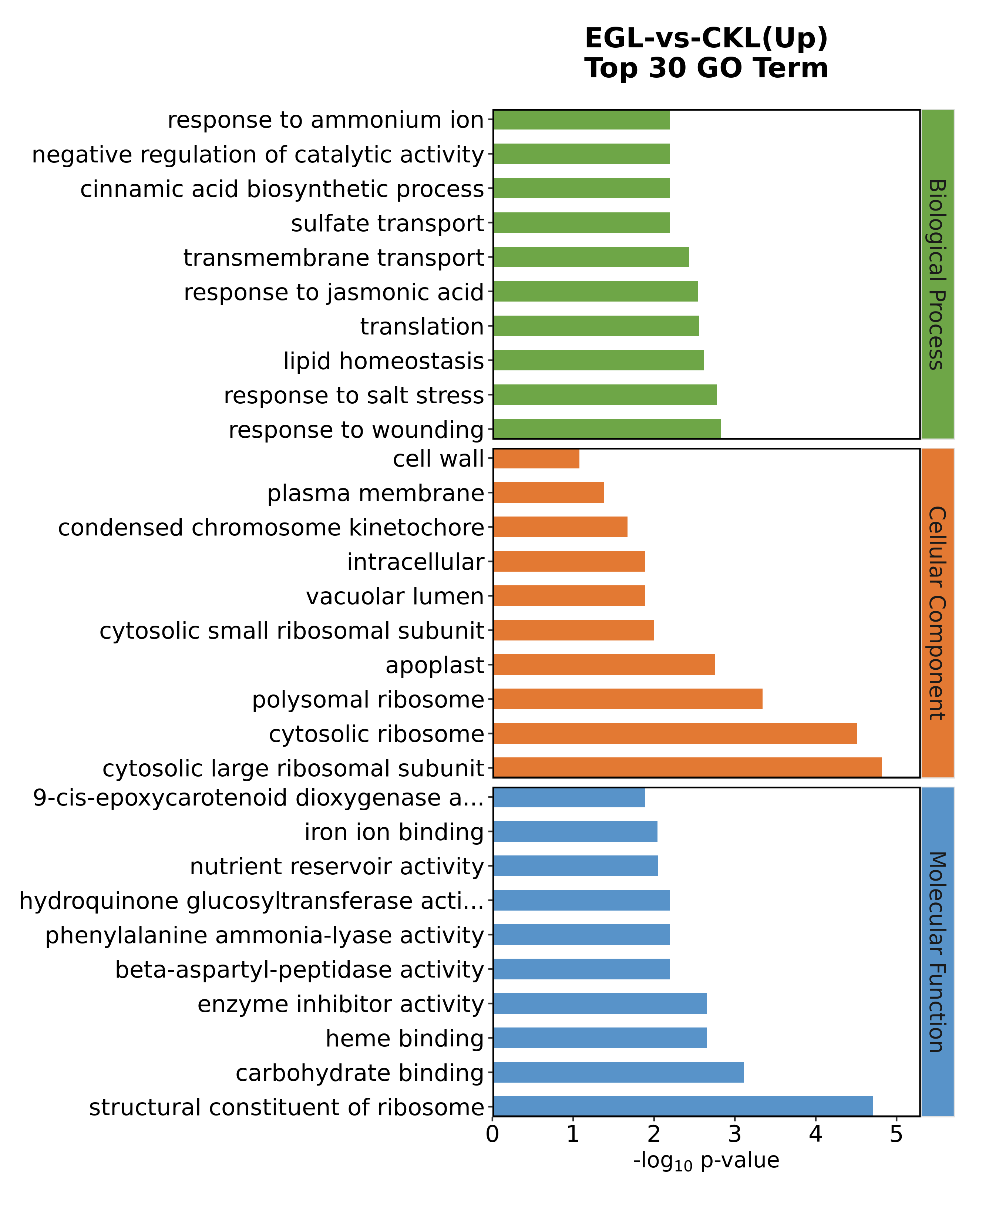
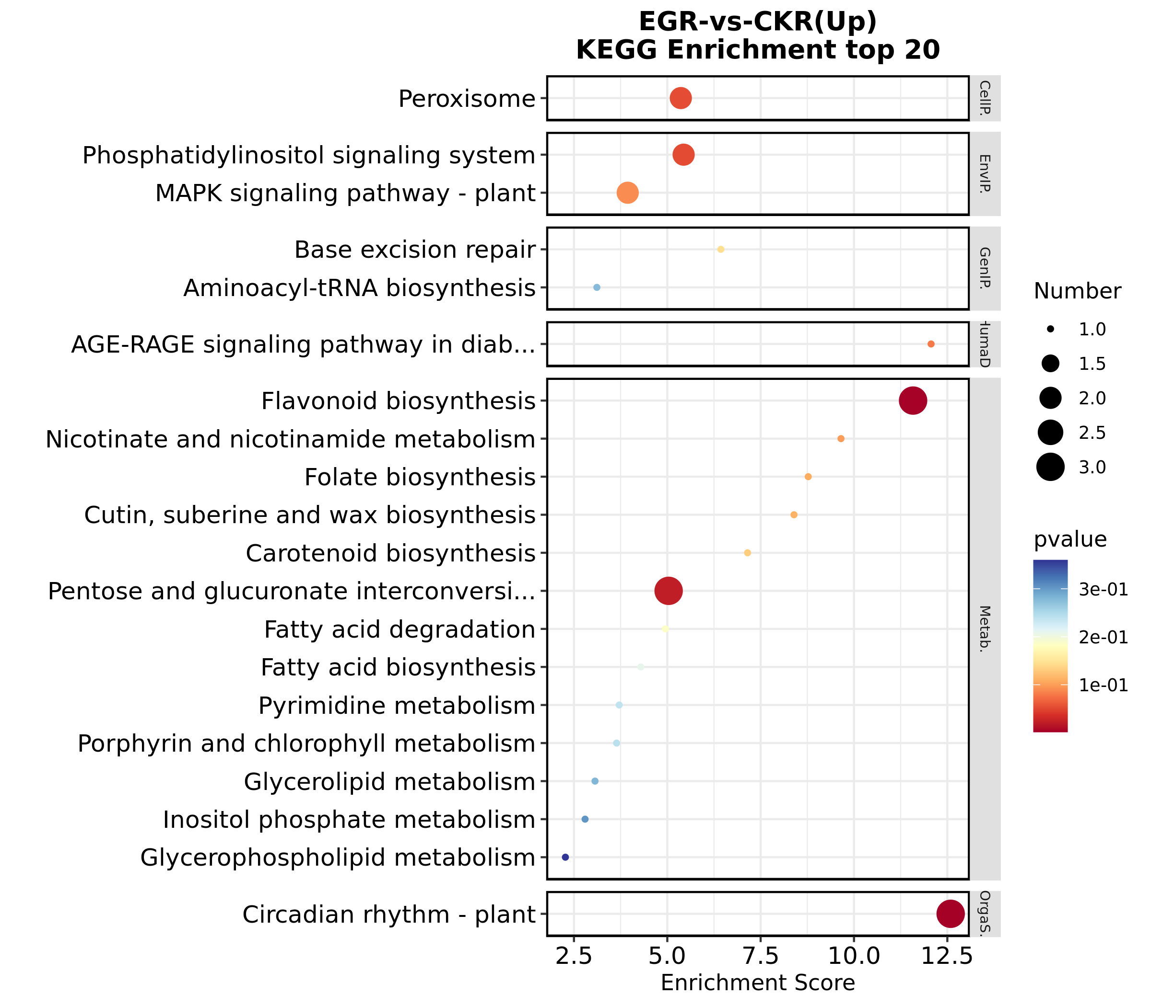
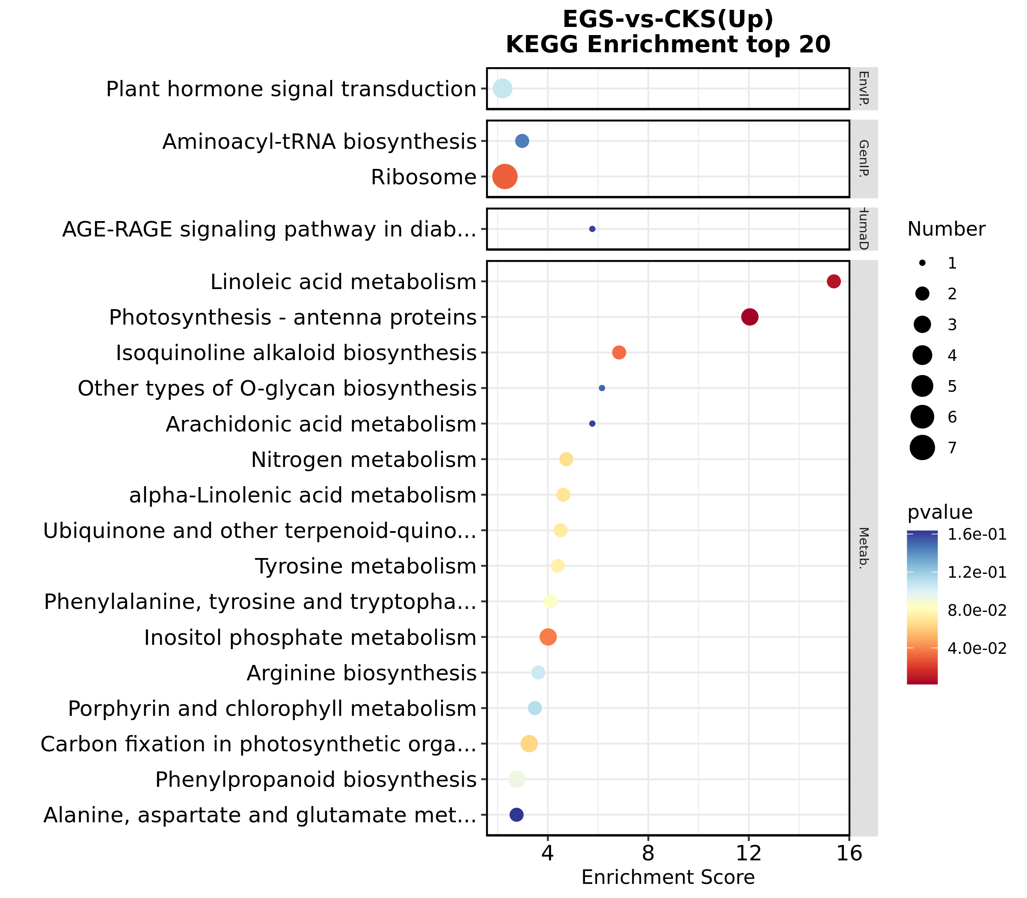
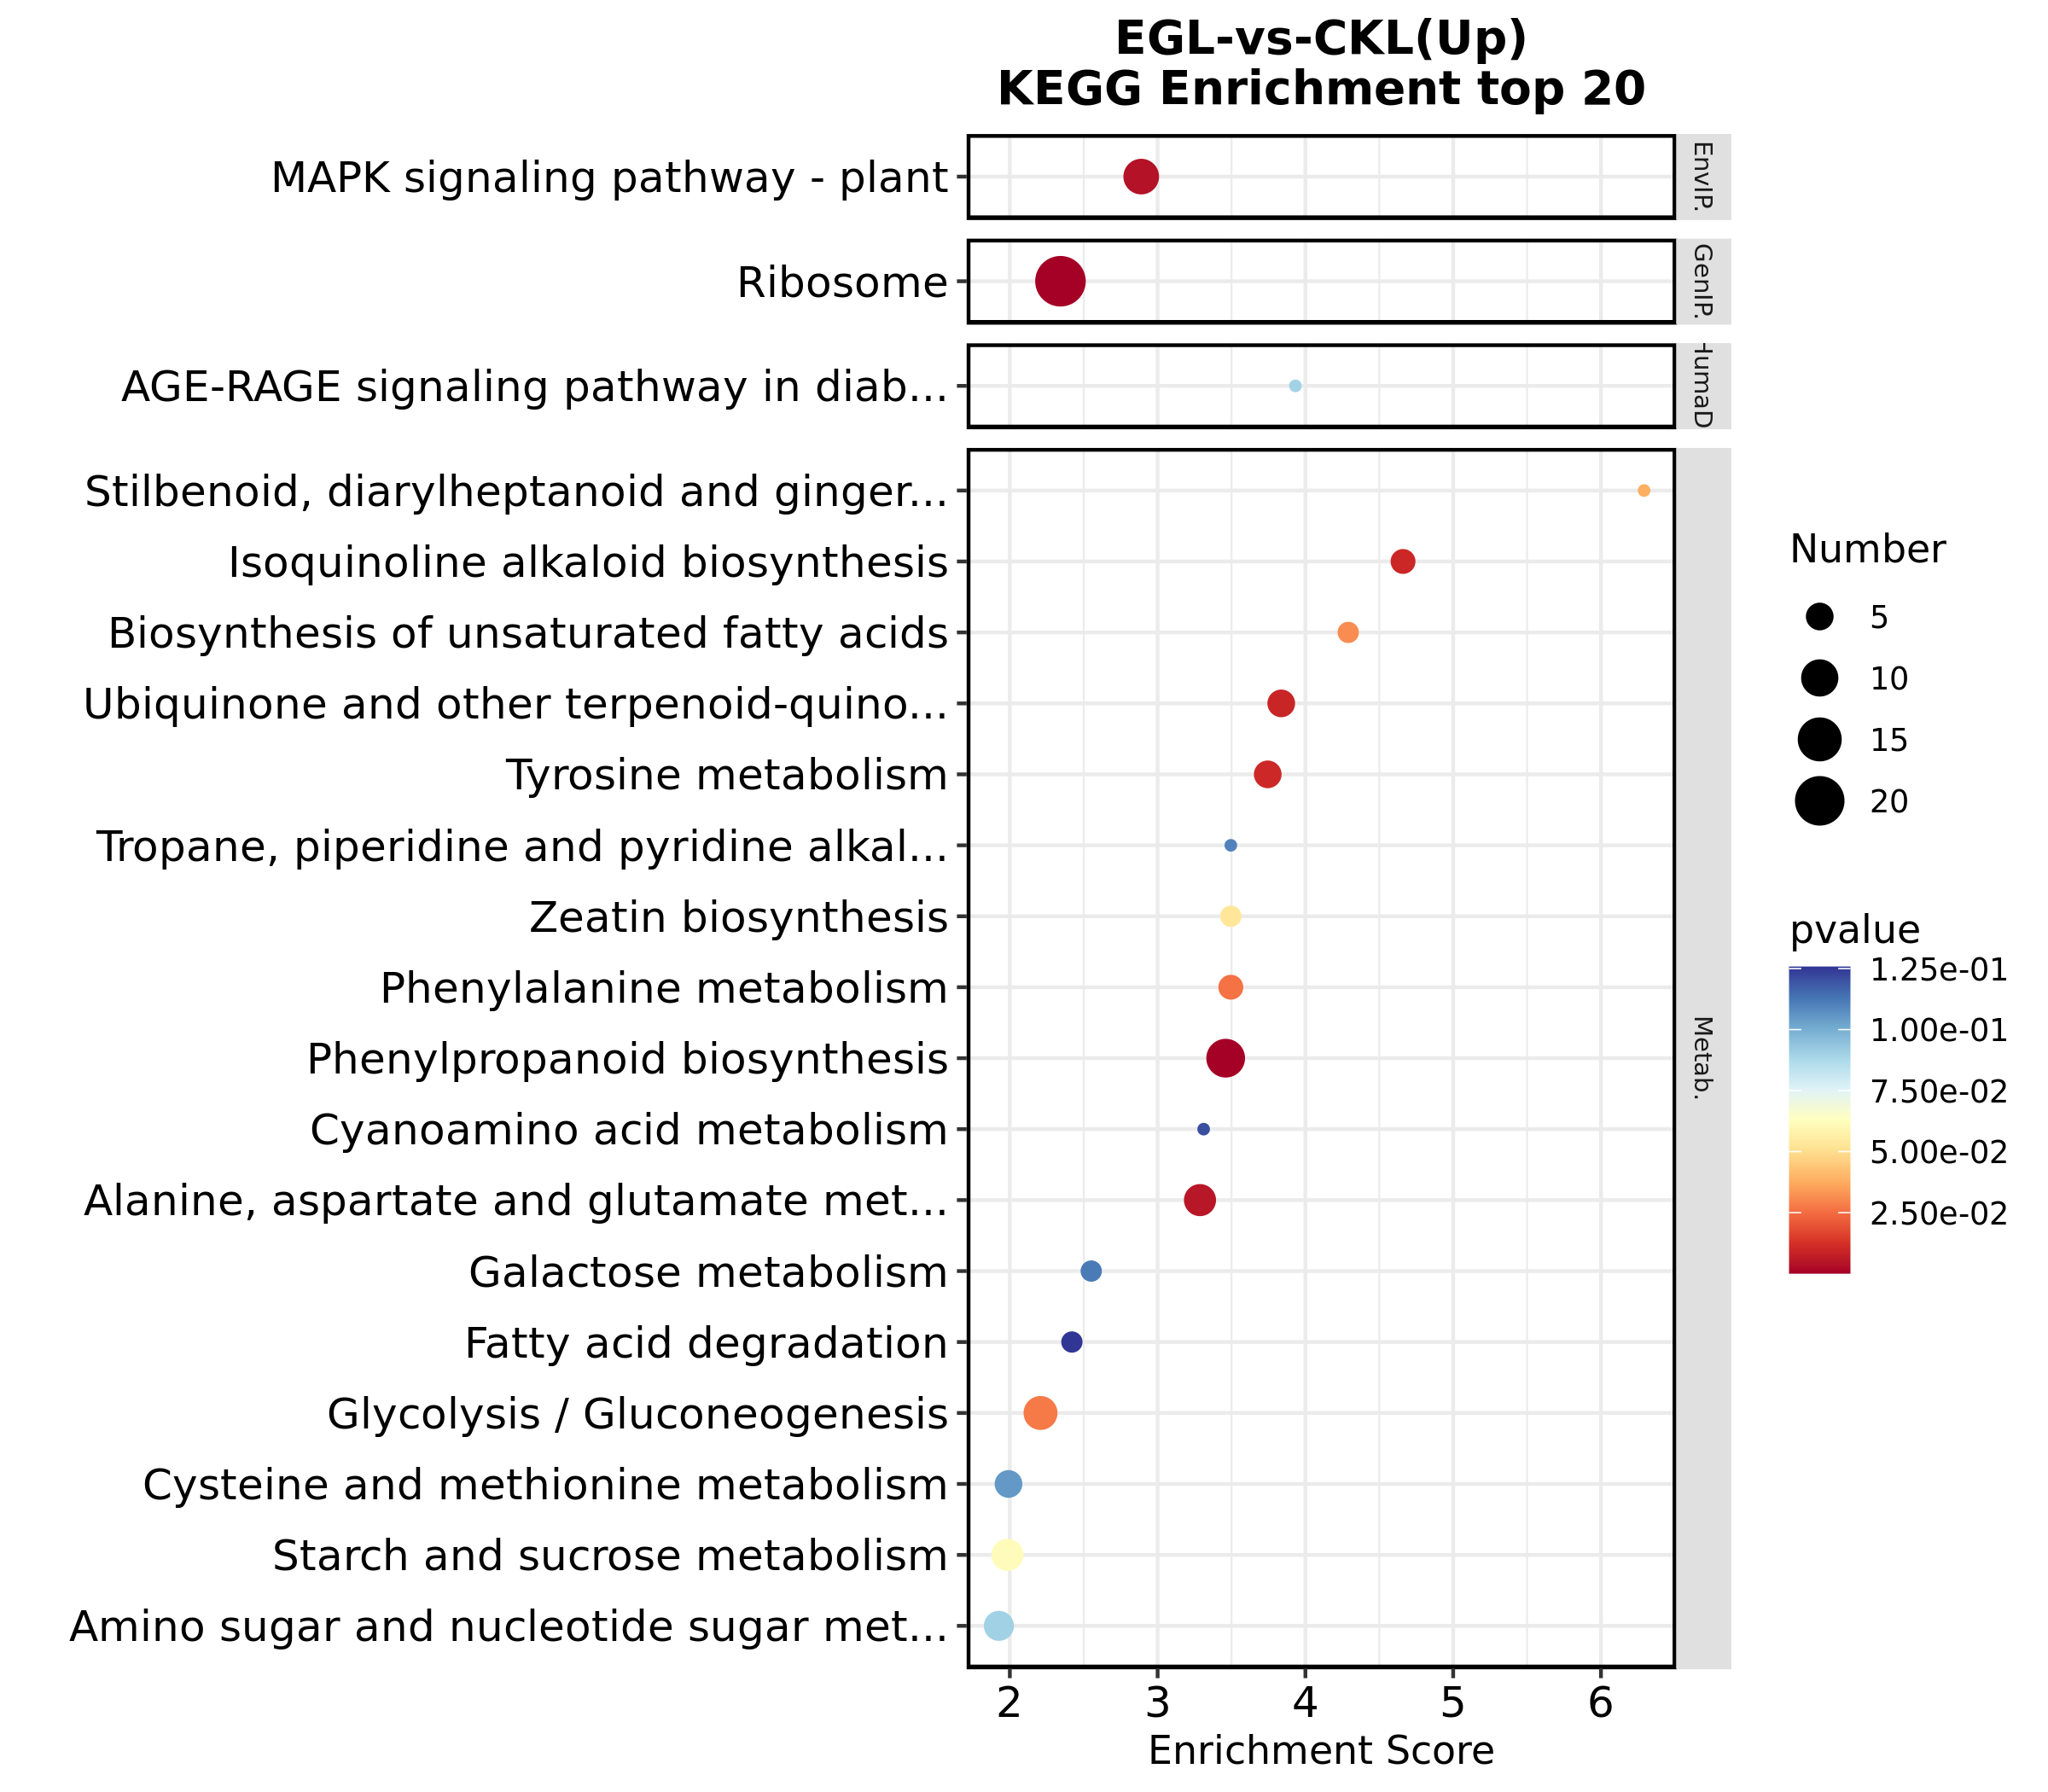
A
C
E
B
D
F
Notes:
Supplementary Figure 2 Up-regulated DEGs enriched on GO terms and KEGG pathways after inhibition of NO synthesis. Top 30 GO terms of DEGs in roots (A), stems (C), and leaves (E). Significantly enriched KEGG pathways of DEGs in roots (B), stems (D), and leaves (F).

Slide 7
A
B
C
D
E
F
Notes:
Supplementary Figure 3 qRT-PCR validation of selected up-regulated genes in different tissues. Expression patterns of selected genes based on the FPKM data in roots (A), stems (B) and leaves (C). qRT-PCR was performed to obtain the relative expression levels in roots (D), stems (E) and leaves (F). The error bars represent the standard deviations from three replicates. The asterisk indicates a significant difference (p < 0.05). The selected genes are as follows:PI (putative Proteinase inhibitor, Zosma03g06840), PG GH28 (Exo-polygalacturonase, family GH28 , Zosma02g09830), CHS (Chalcone synthase , Zosma04g18610), MDG (DNA-3-methyladenine glycosylase, Zosma04g18230), GAPDH (Glyceraldehyde-3-phosphate dehydrogenase (phosphorylating) , Zosma02g10160), PME (pectin methylesterase, family CE8, Zosma04g22530), NAC (putative NAC domain-containing protein, Zosma06g22340), Pled (Pleiotropic drug resistance protein 12, Zosma06g11890)

Slide 8
Notes:
Supplementary Figure 4 Number of up-regulated and down-regulated metabolites in roots (R), stems (S) and leaves (L) with VIP >1，p-value < 0.05.

Slide 9
Content change | Metabolites | EG | CK | P-value
Down | Hypoxanthine | 101630.301 | 146056.890 | 0.001
 | Xanthine | 84665.788 | 131087.838 | 0.007
 | Deoxyuridine | 273073.708 | 370216.287 | 0.039
 | Thymidine | 86157.462 | 129658.876 | 0.050
 | Allantoic acid | 1857.340 | 16107.100 | 0.017
 | Chlorogenic acid | 67425.094 | 180396.060 | 0.007
 | L-Phenylalanine | 31187.906 | 40729.201 | 0.020
 | Cysteinylglycine | 9506.075 | 16593.345 | 0.020
 | Betaine | 744726.234 | 936123.730 | 0.027
 | 4-Hydroxycinnamic acid | 275993.448 | 441644.524 | 0.034
 | Melatonin | 4093.236 | 7294.236 | 0.025
 | D-Manno-2-heptulose | 34823.862 | 43287.934 | 0.028
 | Dopamine | 17614.422 | 27466.759 | 0.029
 | Ascorbic acid | 8992.064 | 16522.287 | 0.036
Up | 5-Thymidylic acid | 14878.176 | 6068.732 | 0.007
 | Diosmetin | 4451.972 | 1121.547 | 0.009
 | Maysin | 11162.874 | 3684.274 | 0.024
Notes:
Supplementary Table 5 DAMs in roots

Slide 10
Content change | Metabolites | EG | CK | P-value
Down | Hypoxanthine | 4114.263 | 13883.114 | 0
 | Adenine | 34101.320 | 45016.185 | 0.007
 | Guanosine | 435980.674 | 898147.945 | 0.041
 | Uridine 5'-monophosphate | 55122.271 | 96250.217 | 0.025
 | Cytidine monophosphate | 4598.845 | 13902.583 | 0.027
 | Cytarabine | 34018.092 | 61611.100 | 0.031
 | Citramalic acid | 58160.497 | 108426.326 | 0
 | Salicylic acid beta-D-glucoside | 145920.211 | 272121.747 | 0.029
 | 9,10-Epoxyoctadecenoic acid | 19850.658 | 31308.790 | 0.038
Up | Jasmonic acid | 310771.951 | 298896.269 | 0.001
 | trans-Aconitic acid | 27603.259 | 18530.822 | 0.012
 | Chlorogenic acid | 393453.107 | 296603.592 | 0.031
 | L-Lysine | 19641.062 | 9102.540 | 0.025
 | Benzophenone | 140724.886 | 128255.111 | 0.013
Notes:
Supplementary Table 6 DAMs in leaves

Slide 11
Content change | Metabolites | EG | KS | P-value
Up | Citric acid | 87935.934 | 57282.448 | 0.016
 | Isocitric acid | 556874.103 | 404147.425 | 0.007
 | (1R,2R)-Isocitric acid | 6753.629 | 3219.652 | 0.012
 | Hexyl glucoside | 10328.131 | 3263.857 | 0
 | Curcumol | 133216.347 | 119790.179 | 0.002
 | Mulberrin | 11040.702 | 6191.459 | 0.014
 | Xanthomicrol | 14079.796 | 1110.582 | 0.022
 | 6-Hydroxydaidzein | 65881.769 | 32477.354 | 0.023
 | Betalamic acid | 19359.104 | 7033.680 | 0.034
 | L-Proline | 5128629.272 | 3026876.312 | 0.037
 | Homogentisic acid | 21271.994 | 15121.595 | 0.023
Down | 1-O-p-Coumaroyl-beta-D-glucose | 5080.625 | 12087.668 | 0.005
 | Cichoriin | 18214.558 | 48484.922 | 0.034
 | Tamarixetin | 130486.707 | 181277.015 | 0.041
Notes:
Supplementary Table 7 DAMs in stems

Slide 12
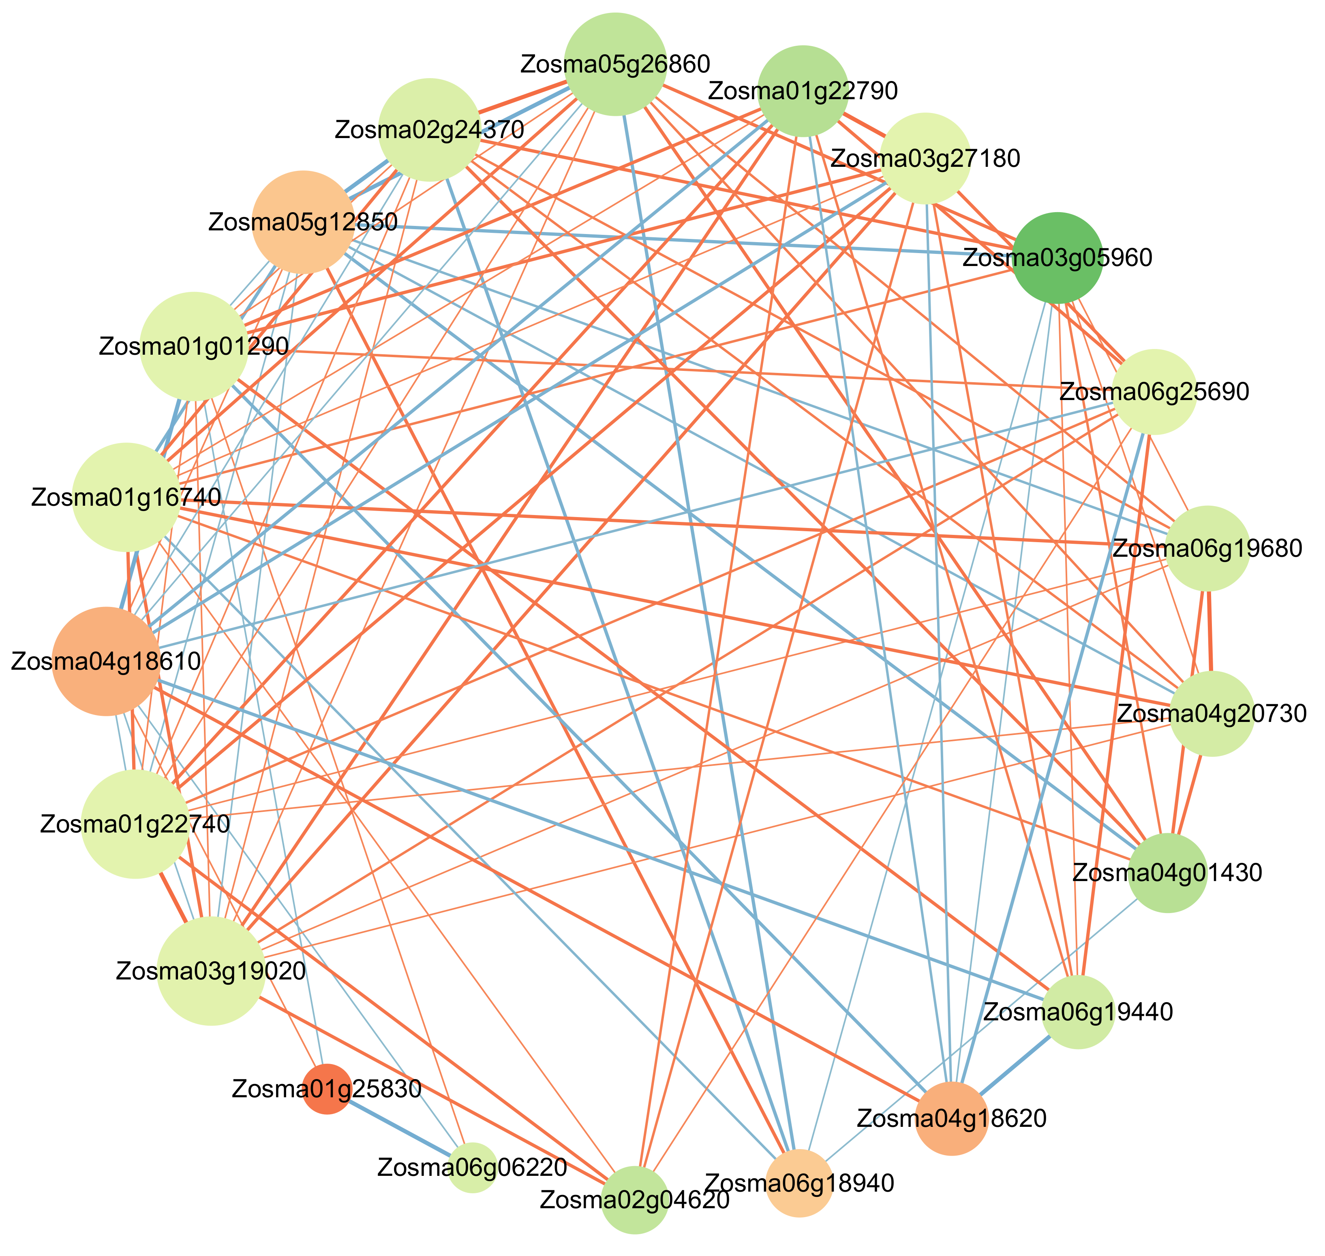
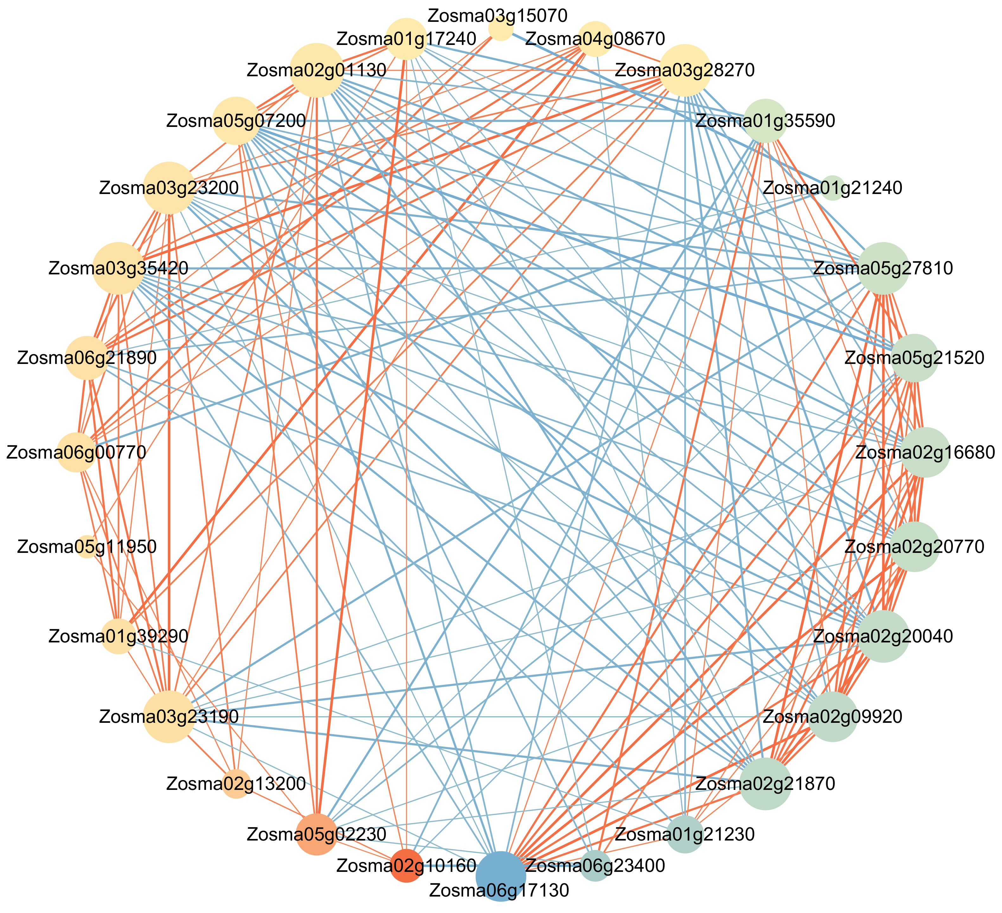
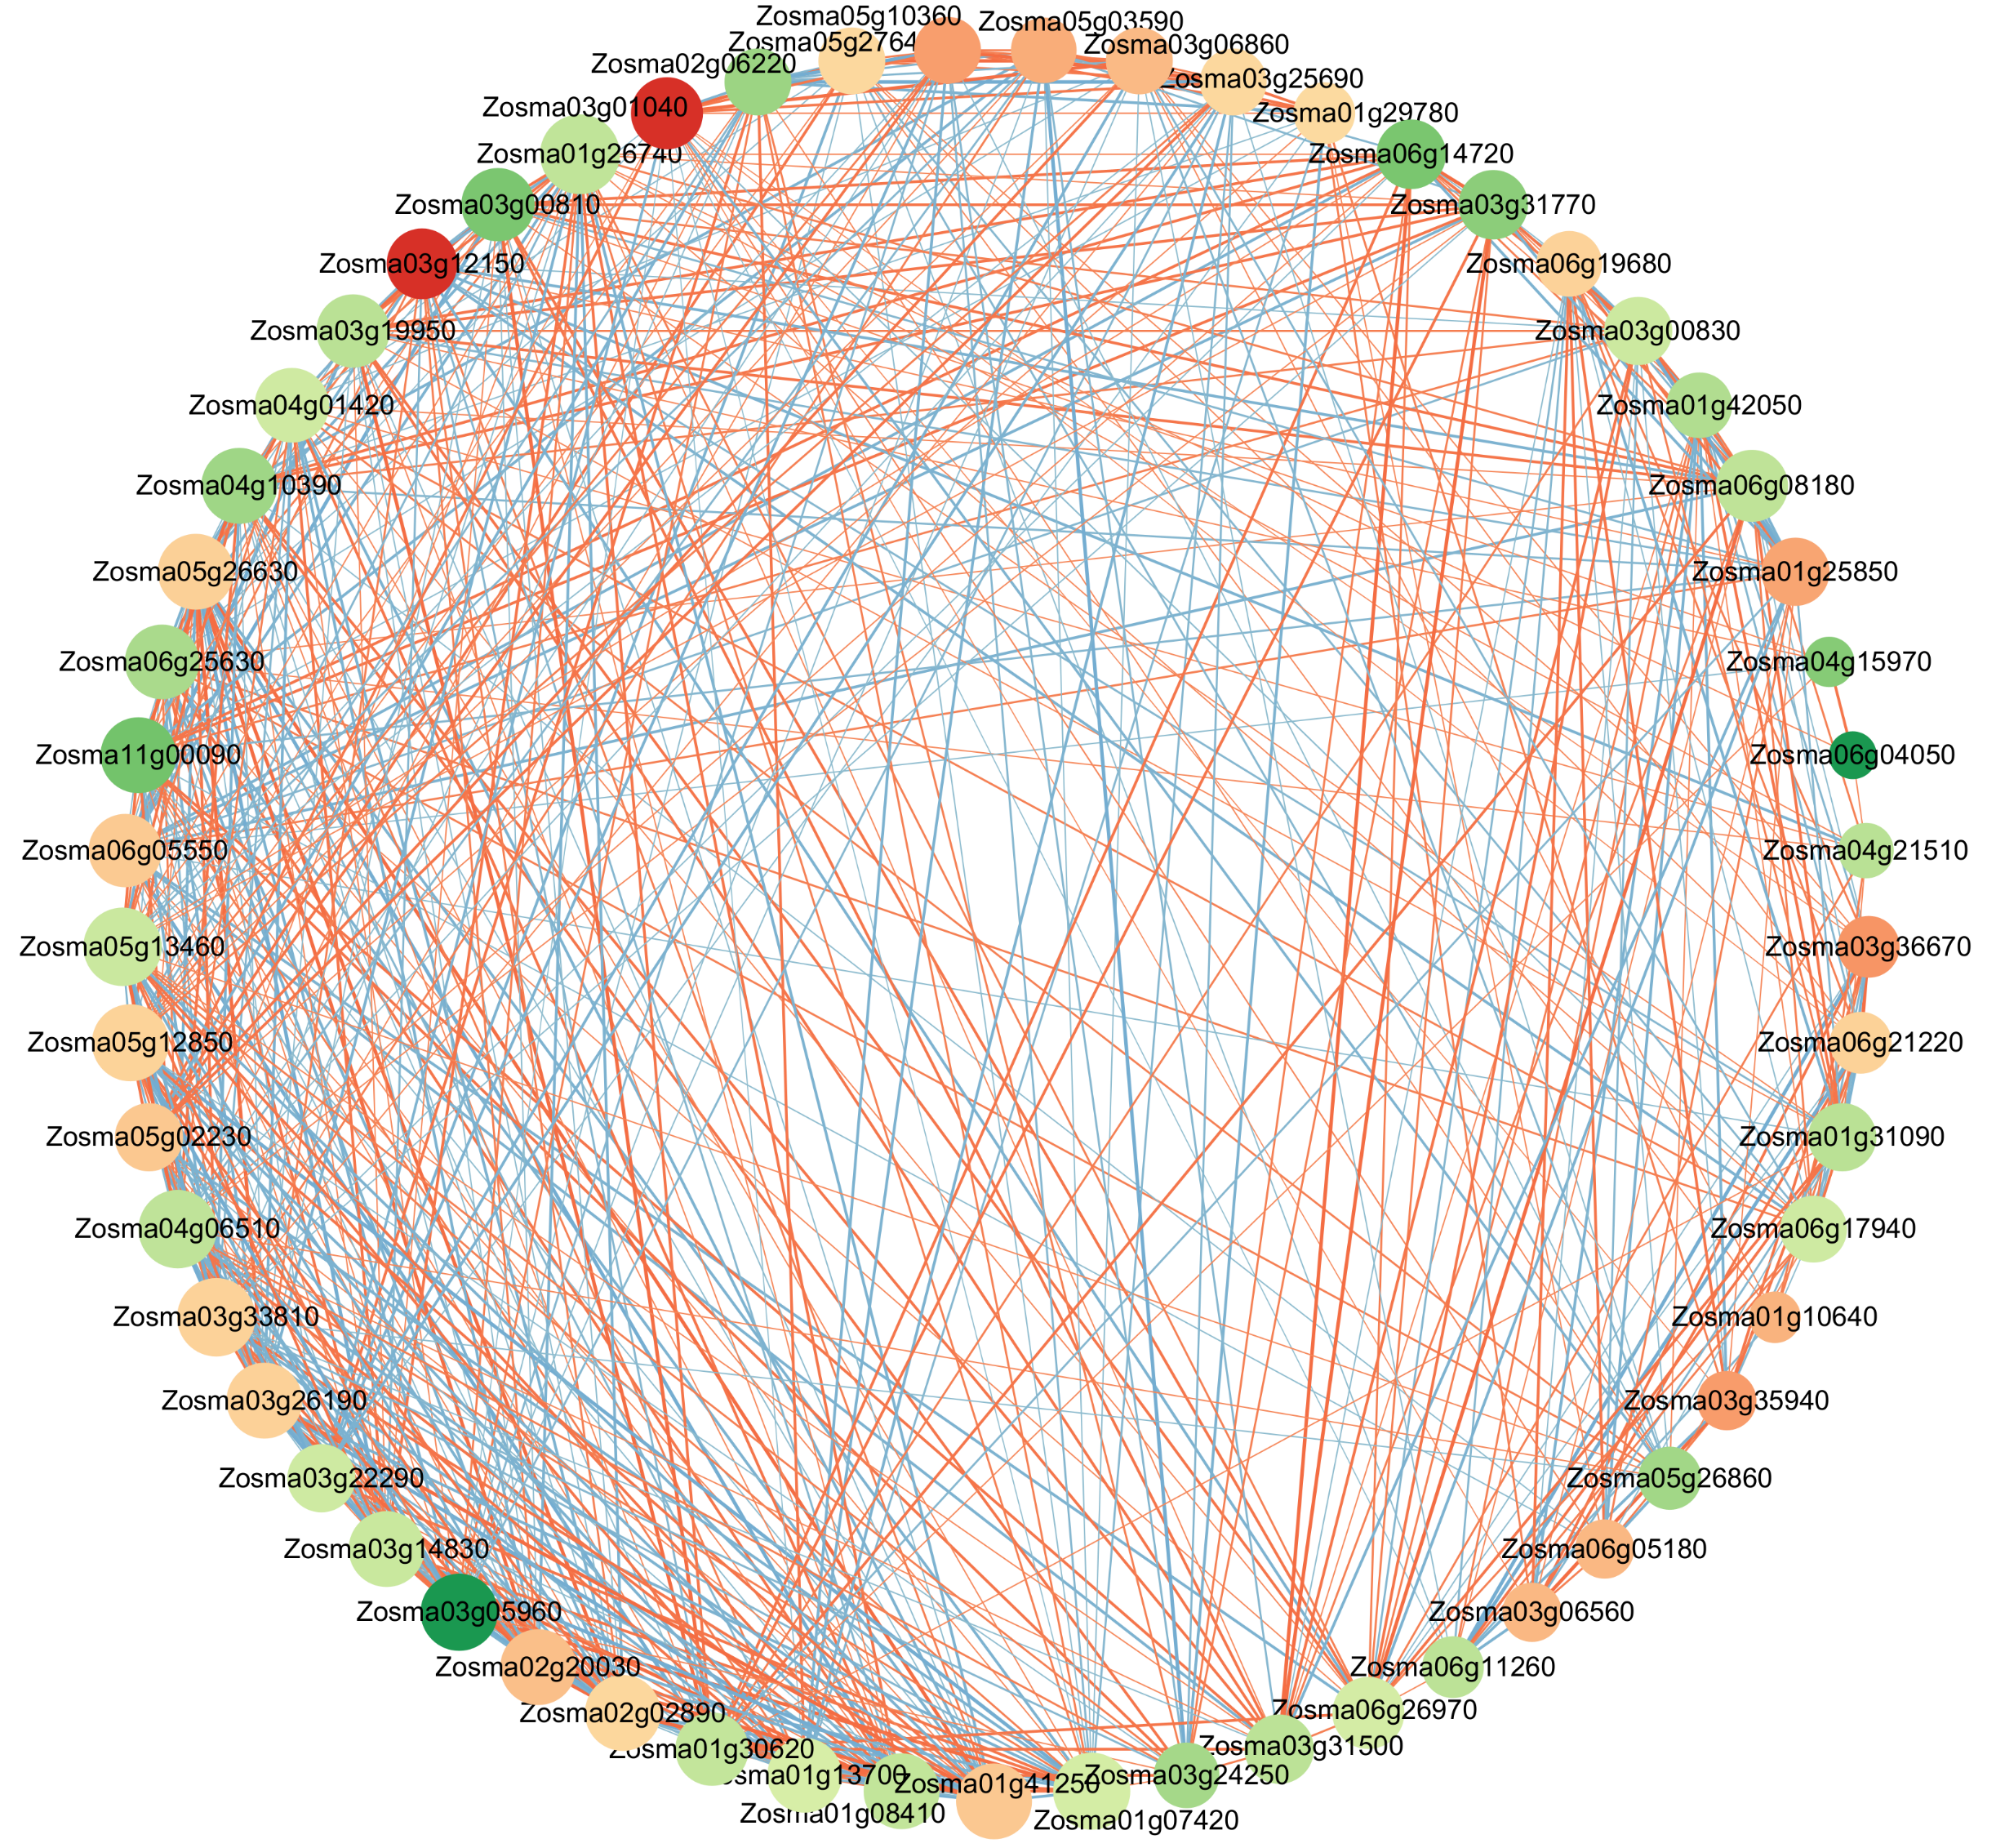
A
B
C
Notes:
Supplementary Figure 5 DEGs network diagram in transcriptome and metabolome metabolic pathways. Network diagram of DEGs (Cor >0.8 and p ≤ 0.05) in roots (A), stems (B), and leaves (C).

