Slide 1
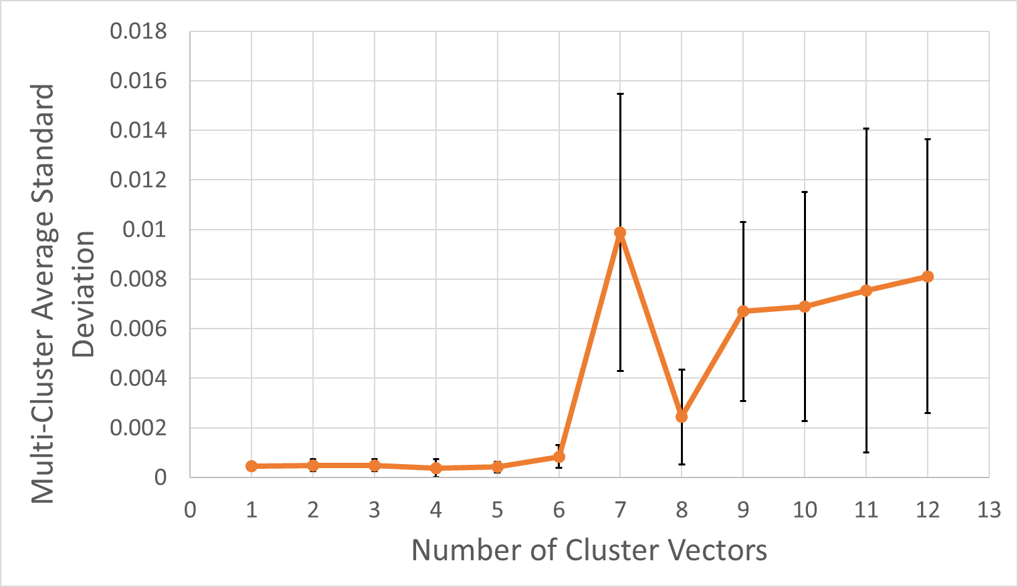
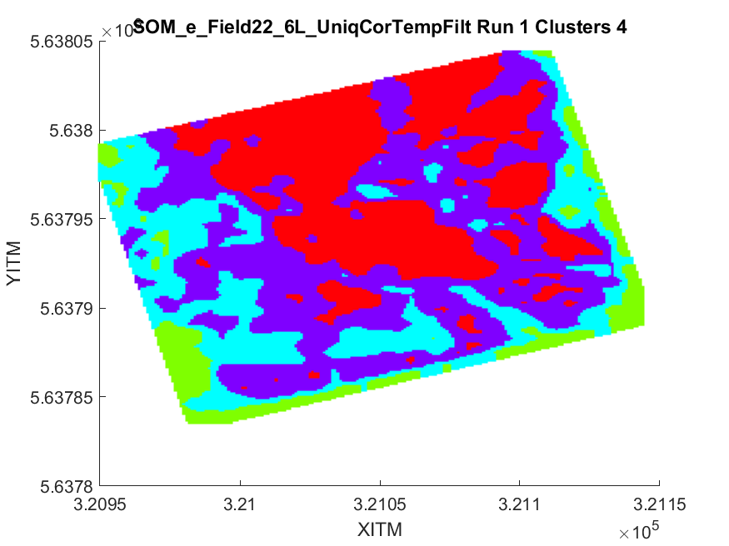
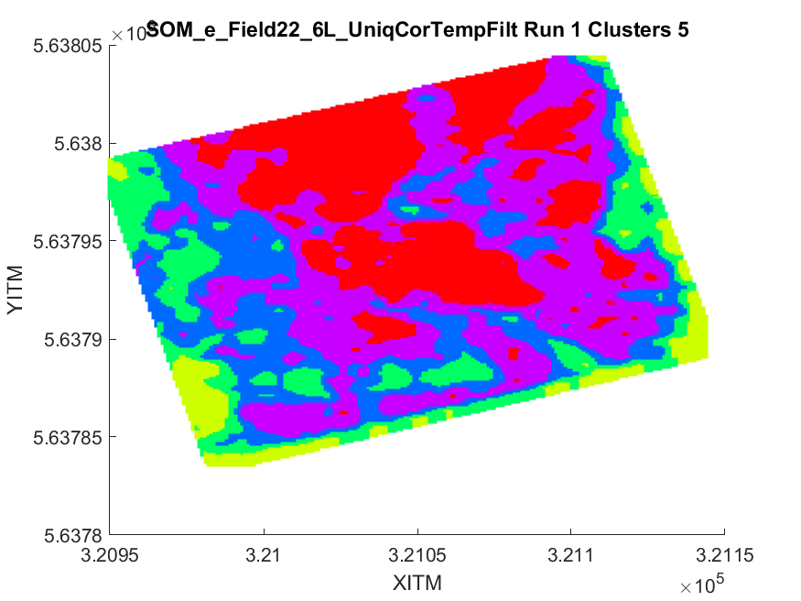
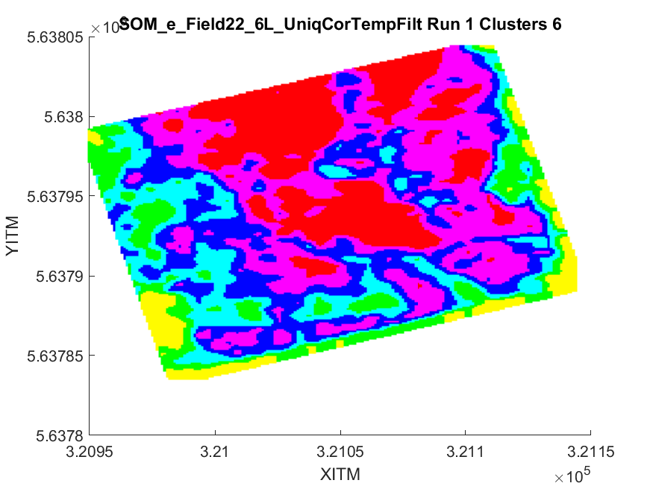
Supplementary Material
SM Figure 1: MCASD results for F22 in Germany. MCASD graph indicates all stable number of clusters that can be used to define this dataset, with a range of stability indicated by the error bars. Results from 4, 5 and 6 clusters show a low MCASD metric and range. The animation shows the geographic distribution of these clusters, again highlighting the stability when using 4, 5 or 6 clusters. The 6 cluster result us chosen at it represents the compromise between MCASD stability and highest spatial resolution of initial models.

Slide 2
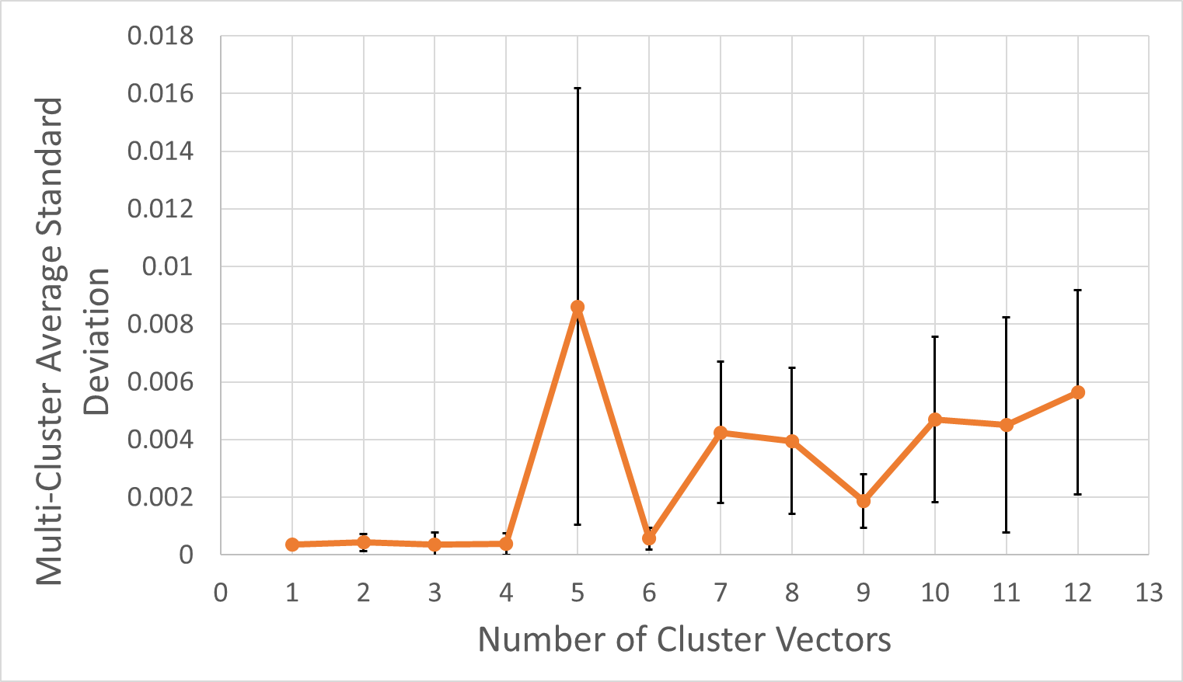
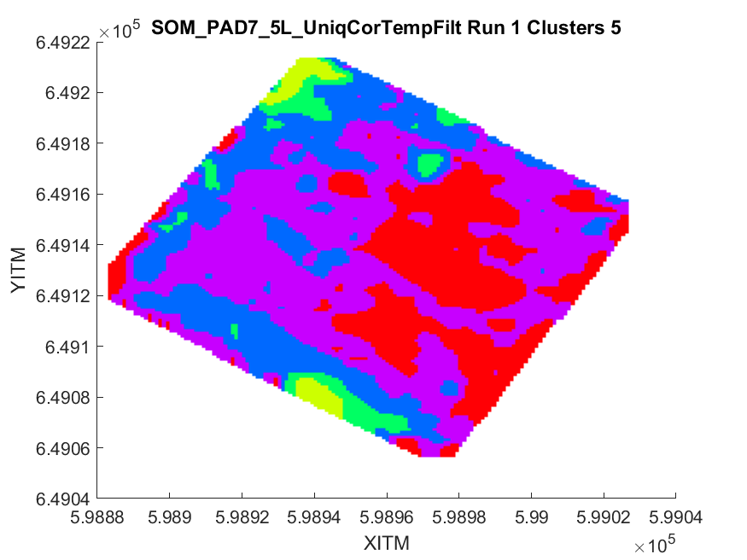
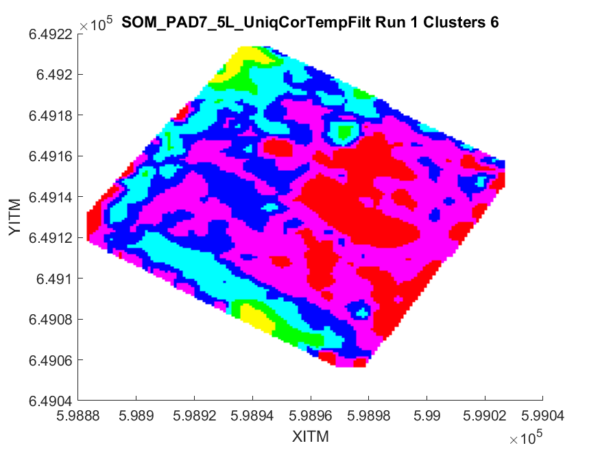
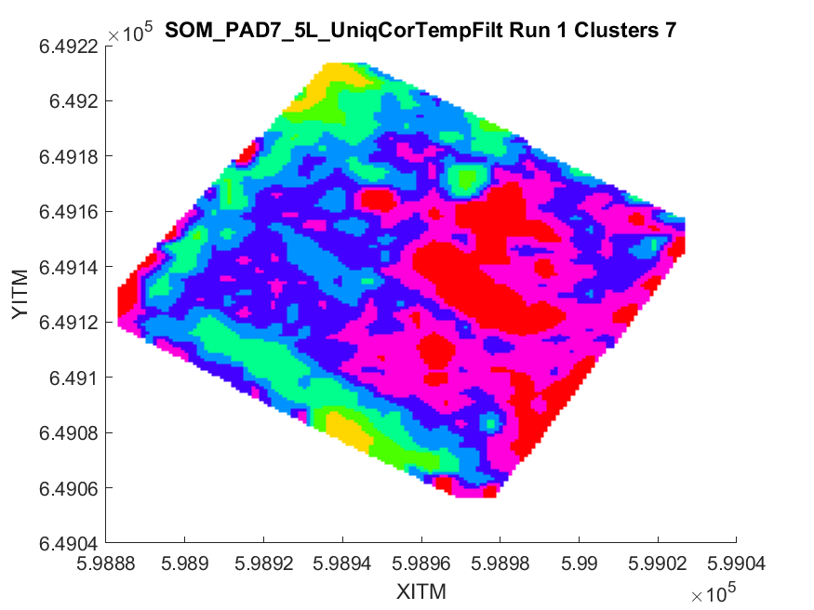
Supplementary Material
SM Figure 2: MCASD results for P7 in Ireland. MCASD graph indicates all stable number of clusters that can be used to define this dataset, with a range of stability indicated by the error bars. Results from 6 clusters show a low MCASD metric and range. The animation shows the geographic distribution of these clusters, again highlighting the stability when using 6 clusters. By contract, when using 5 or 7 clusters often the results are varying, indicating instability in the clustering result.

Slide 3
Supplementary Material
Supplementary Table 1: Linear regression between ECt and soil textures using 5-cluster solution for German data (SM Figure 2) and 4-cluster solution for Irish data (SM Figure 3)
* Indicates where the physical property sample location is within the bounds of one cluster but close to this cluster.
Site: | Initial Model | Clay % |  | Silt % |  | Sand %
Germany (5 cluster solution) |  | R² | RMSE | R² | RMSE | R² | RMSE
Sample 5 | Constant | 0.40 | 2.3% | 0.61 | 4.8% | 0.70 | 2.7%
 | Cluster 3 | 0.45 | 2.2% | 0.60 | 4.8% | 0.65 | 3.2%
Sample 12 | Constant | 0.28 | 1.3% | 0.42 | 12.5% | 0.43 | 11.5%
 | Cluster 4 | 0.63 | 1.0% | 0.67 | 11.7% | 0.67 | 10.8%
Sample 13 | Constant | 0.25 | 2.7% | 0.32 | 12.5% | 0.33 | 10.8%
 | Cluster 4 | 0.17 | 2.9% | 0.23 | 14.9% | 0.24 | 12.0%
 | Cluster 3* | 0.22 | 2.8% | 0.28 | 14.1% | 0.30 | 11.3%
Sample 22 | Constant | 0.08 | 2.2% | 0.11 | 1.2% | 0.05 | 0.8%
 | Cluster 4 | 0.18 | 1.8% | 0.21 | 1.1% | 0.13 | 0.7%
 | Cluster 5* | 0.00 | 2.6% | 0.01 | 1.3% | 0.02 | 0.9%
Sample 27 | Constant | 0.07 | 2.0% | 0.11 | 7.7% | 0.18 | 6.8%
 | Cluster 6 | 0.23 | 1.5% | 0.95 | 2.1% | 0.90 | 2.5%
Site: | Initial Model | Clay % |  | Silt % |  | Sand %
Ireland (4-cluster solution) |  | R² | RMSE | R² | RMSE | R² | RMSE
Trial Pit | Constant | 0.60 | 2.6% | 0.03 | 5.3% | 0.20 | 7.7%
 | Cluster 4 | 0.98 | 0.5% | 0.62 | 3.2% | 0.86 | 1.1%

