Slide 1
Gas distribution images
Blood distribution images
ROIs
ROIs applied to gas distribution images
ROIs applied to blood distribution images
Apex
Diaphragmatic dome
eFigure 1

Slide 2
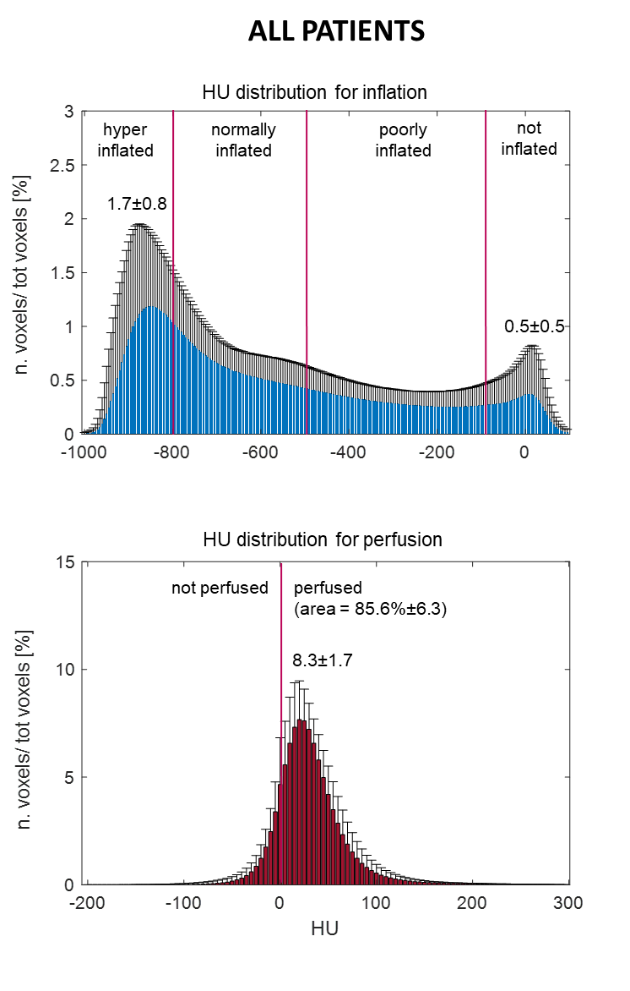
HU distribution for gas
HU distribution for blood
eFigure 2

Slide 3
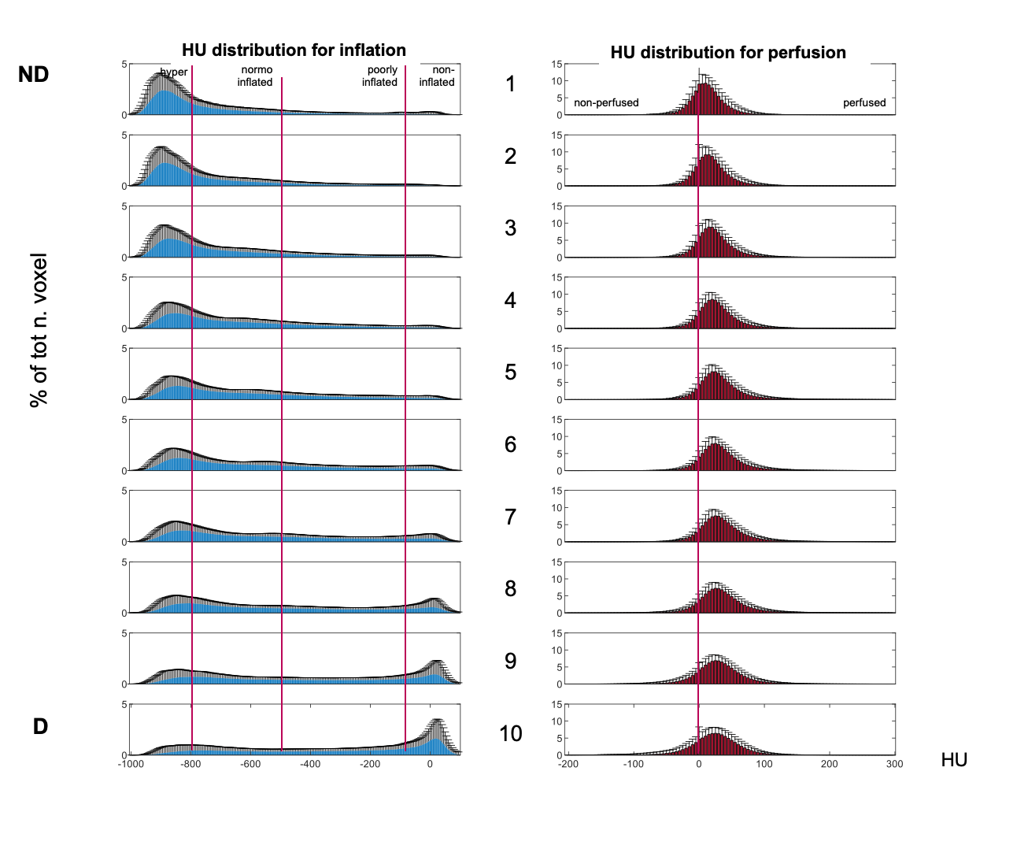
Gas Distribution
Blood Distribution
HU distribution for gas
HU distribution for blood
eFigure 3A
ALL PATIENTS
ND
D

Slide 4
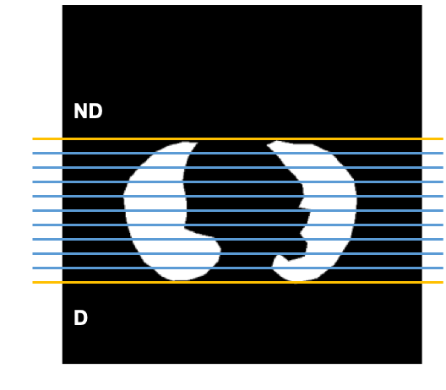
Gas Distribution
Gas Distribution
Blood Distribution
Gas Distribution
Blood Distribution
eFigure 3B
HU distribution for blood
hyper
normo
inflated
poorly
inflated
non-inflated
1
non-perfused
perfused
2
3
4
% of tot n. voxel
5
BMI 25 to 40 kg/m²
6
7
8
9
10
HU
Notes:
Only for ppt presentations

Slide 5
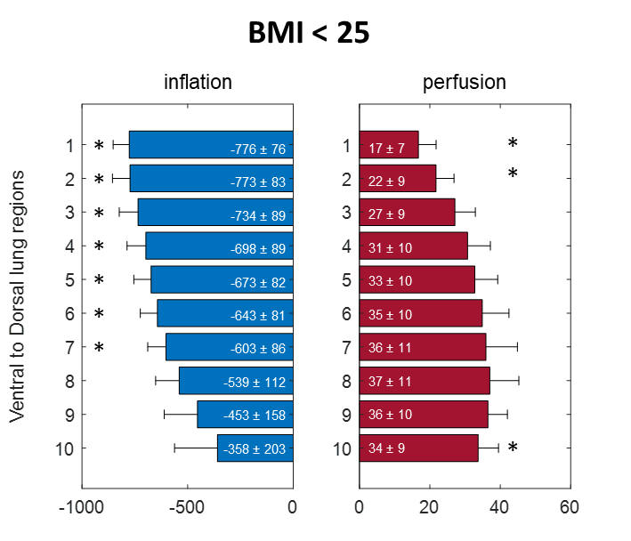
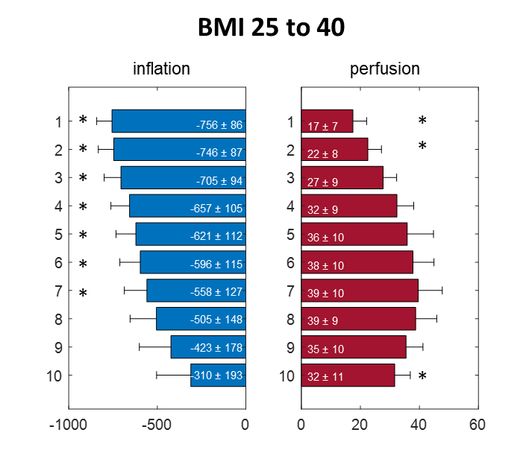
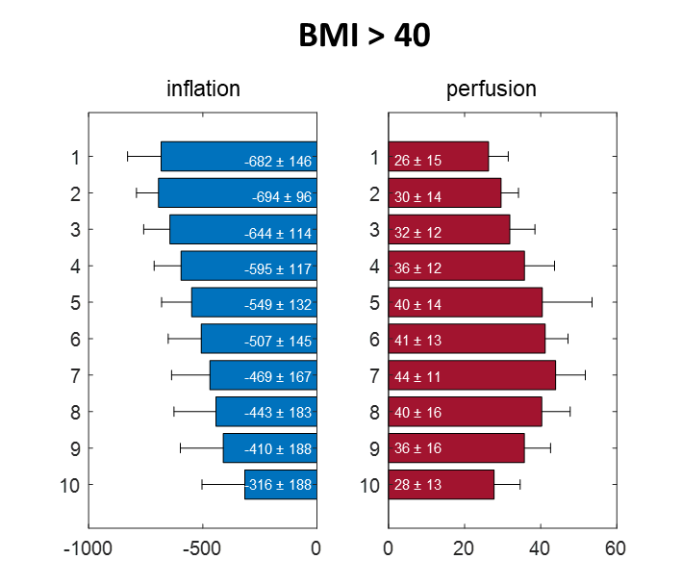
HU distribution for gas
HU distribution for blood
HU distribution for gas
HU distribution for blood
HU distribution for gas
HU distribution for blood
Gas distribution
Blood distribution
Gas distribution
Blood distribution
ND
D
: Gas distribution
: Blood distribution
eFigure 4

Slide 6
A
B
HU distribution for gas
HU distribution for blood
% and gas/blood mismatch
ND
7 | % | (± | 3 | )
6 | % | (± | 2 | )
3 | % | (± | 2 | )
1 | % | (± | 1 | )
-1 | % | (± | 2 | )
-2 | % | (± | 1 | )
-3 | % | (± | 2 | )
-4 | % | (± | 2 | )
-4 | % | (± | 2 | )
-5 | % | (± | 3 | )
*
*
*
Gas distribution
*
Blood distribution
*
Gas > Blood
*
Gas/blood match
Blood > Gas
D
Total gas/blood mismatch = 36%±1 *
eFigure 5

Slide 7
Statistical details

Slide 8
Statistics applied to variables describing the HU distribution for the gas and blood distribution maps. Tested variables are: 1) hyper inflated compartment peak; 2) Not inflated compartments peak; 3) Perfusion peak; 4) Perfused compartment area. Comparison among groups (BMI < 25; BMI 25 to 40, BMI > 40). One-way ANOVA followed by a multiple comparison test with Bonferroni method (α<0.05) comparing to the ten gravitational levels (Level1 to 10). Significant levels (p<0.05) are marked with *.

Slide 9
HU distribution for gas [HU]
HU distribution for blood [HU]
Gas/blood mismatch [%]
Statistics applied to HU distribution for the gas (above) and blood (middle) distribution and to gas/blood mismatch (below), divided in ten gravitational levels. Level 1 to 5. Comparison among groups (BMI < 25; BMI 25 to 40, BMI > 40). One-way ANOVA followed by a multiple comparison test with Bonferroni method (α<0.05) comparing to the ten gravitational levels (Level1 to 10). Significant levels (p<0.05) are marked with *.

Slide 10
HU distribution for gas [HU]
HU distribution for gas [HU]
HU distribution for blood [HU]
Gas/blood mismatch [%]
Statistics applied to HU distribution for the gas (above) and blood (middle) distribution and to gas/blood mismatch (below), divided in ten gravitational levels. Level 6 to 10. Comparison among groups (BMI < 25; BMI 25 to 40, BMI > 40). One-way ANOVA followed by a multiple comparison test with Bonferroni method (α<0.05) comparing to the ten gravitational levels (Level1 to 10). Significant levels (p<0.05) are marked with *.
Notes:
Table E2.

Slide 11
A
HU distribution for gas distribution maps (all patients)
B
HU distribution for blood distribution maps (all patients)
Statistics applied to HU distribution for the gas (A) and blood distribution maps (B). All patients are gathered in one group. One-way ANOVA followed by a multiple comparison test with Bonferroni method (α<0.05) comparing to the ten gravitational levels (Level1 to 10). Significant levels (p<0.05) are marked with *.

Slide 12
HU distribution for gas and blood distribution. All patients are gathered in one group. One-way ANOVA followed by a multiple comparison test with Bonferroni method (α<0.05) comparing to the ten gravitational levels (Level1 to 10). Significant levels (p<0.05) are marked with *.

Slide 13
HU distribution for gas distribution maps (BMI<25)
HU distribution for blood distribution maps (BMI<25)
A
B
Statistics applied to HU distribution for the gas (A) and perfusion distribution maps (B). BMI < 25. One-way ANOVA followed by a multiple comparison test with Bonferroni method (α<0.05) comparing to the ten gravitational levels (Level1 to 10). Significant levels (p<0.05) are marked with *.

Slide 14
Statistics applied to mismatched HU distribution for gas and blood. BMI < 25. One-way ANOVA followed by a multiple comparison test with Bonferroni method (α<0.05) comparing to the ten gravitational levels (Level1 to 10). Significant levels (p<0.05) are marked with *.

Slide 15
HU distribution for gas distribution maps (BMI 25 to 40)
HU distribution for blood distribution maps (BMI 25 to 40)
A
B
Statistics applied to HU distribution for the gas (A) and perfusion distribution maps (B). BMI 25 to 40. One-way ANOVA followed by a multiple comparison test with Bonferroni method (α<0.05) comparing to the ten gravitational levels (Level1 to 10). Significant levels (p<0.05) are marked with *.

Slide 16
Statistics applied to mismatched HU distribution for gas and blood. BMI 25 to 40. One-way ANOVA followed by a multiple comparison test with Bonferroni method (α<0.05) comparing to the ten gravitational levels (Level1 to 10). Significant levels (p<0.05) are marked with *.

Slide 17
HU distribution for gas distribution maps (BMI>40)
HU distribution for blood distribution maps (BMI>40)
A
B
Statistics applied to HU distribution for the gas (A) and blood distribution maps (B). BMI > 40. One-way ANOVA followed by a multiple comparison test with Bonferroni method (α<0.05) comparing to the ten gravitational levels (Level1 to 10). Significant levels (p<0.05) are marked with *.

Slide 18
Statistics applied to mismatched HU distribution for gas and blood. BMI > 40. One-way ANOVA followed by a multiple comparison test with Bonferroni method (α<0.05) comparing to the ten gravitational levels (Level1 to 10). Significant levels (p<0.05) are marked with *.

