Slide 1
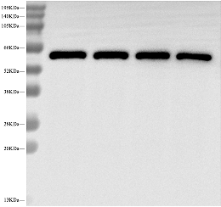
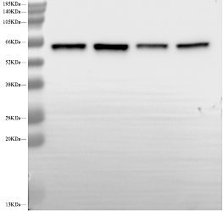
Western blotting Gels:
Figure S1
AMPK
(62/64 KDa)
AMPK
(62/64 KDa)
p- AMPK
(62/64 KDa)
p- AMPK
(62/64 KDa)
Figure S1：Capsaicin increased the protein expressions of p- AMPK in the PVN of salt-sensitive hypertensive rats.

Slide 2
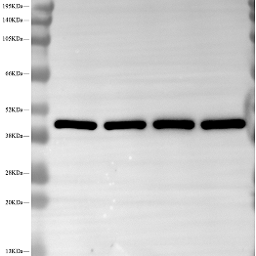
Western blotting Gels:
Figure S1
β-actin
(43KDa)
β-actin
(43KDa)
Figure S1：Internal reference of each group of proteins

Slide 3
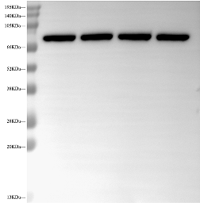
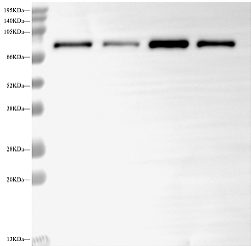
Western blotting Gels:
Figure S2
PI3K
(85KDa)
PI3K
(85KDa)
p- PI3K
(85KDa)
p- PI3K
(85KDa)
Figure S2：Capsaicin decreased the protein expressions of p- PI3K in the PVN of salt-sensitive hypertensive rats.

Slide 4
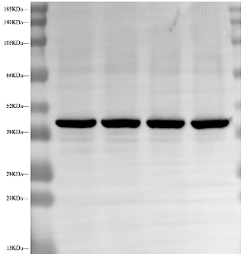
Western blotting Gels:
Figure S2
β-actin
(43KDa)
β-actin
(43KDa)
Figure S2：Internal reference of each group of proteins

Slide 5
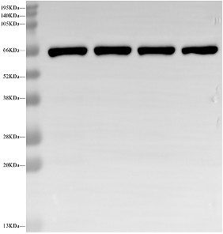
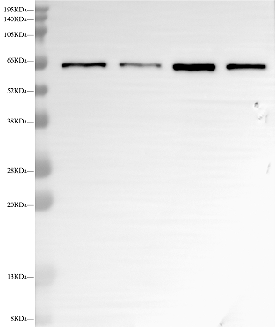
Western blotting Gels:
Figure S3
AKT
(60 KDa)
AKT
(60 KDa)
p- AKT
(60 KDa)
p- AKT
(60 KDa)
Figure S3：Capsaicin decreased the protein expressions of p- AKT in the PVN of salt-sensitive hypertensive rats.

Slide 6
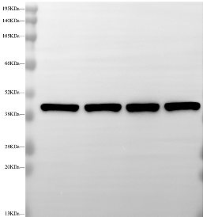
Western blotting Gels:
Figure S3
β-actin
(43KDa)
β-actin
(43KDa)
Figure S3：Internal reference of each group of proteins

