Slide 1
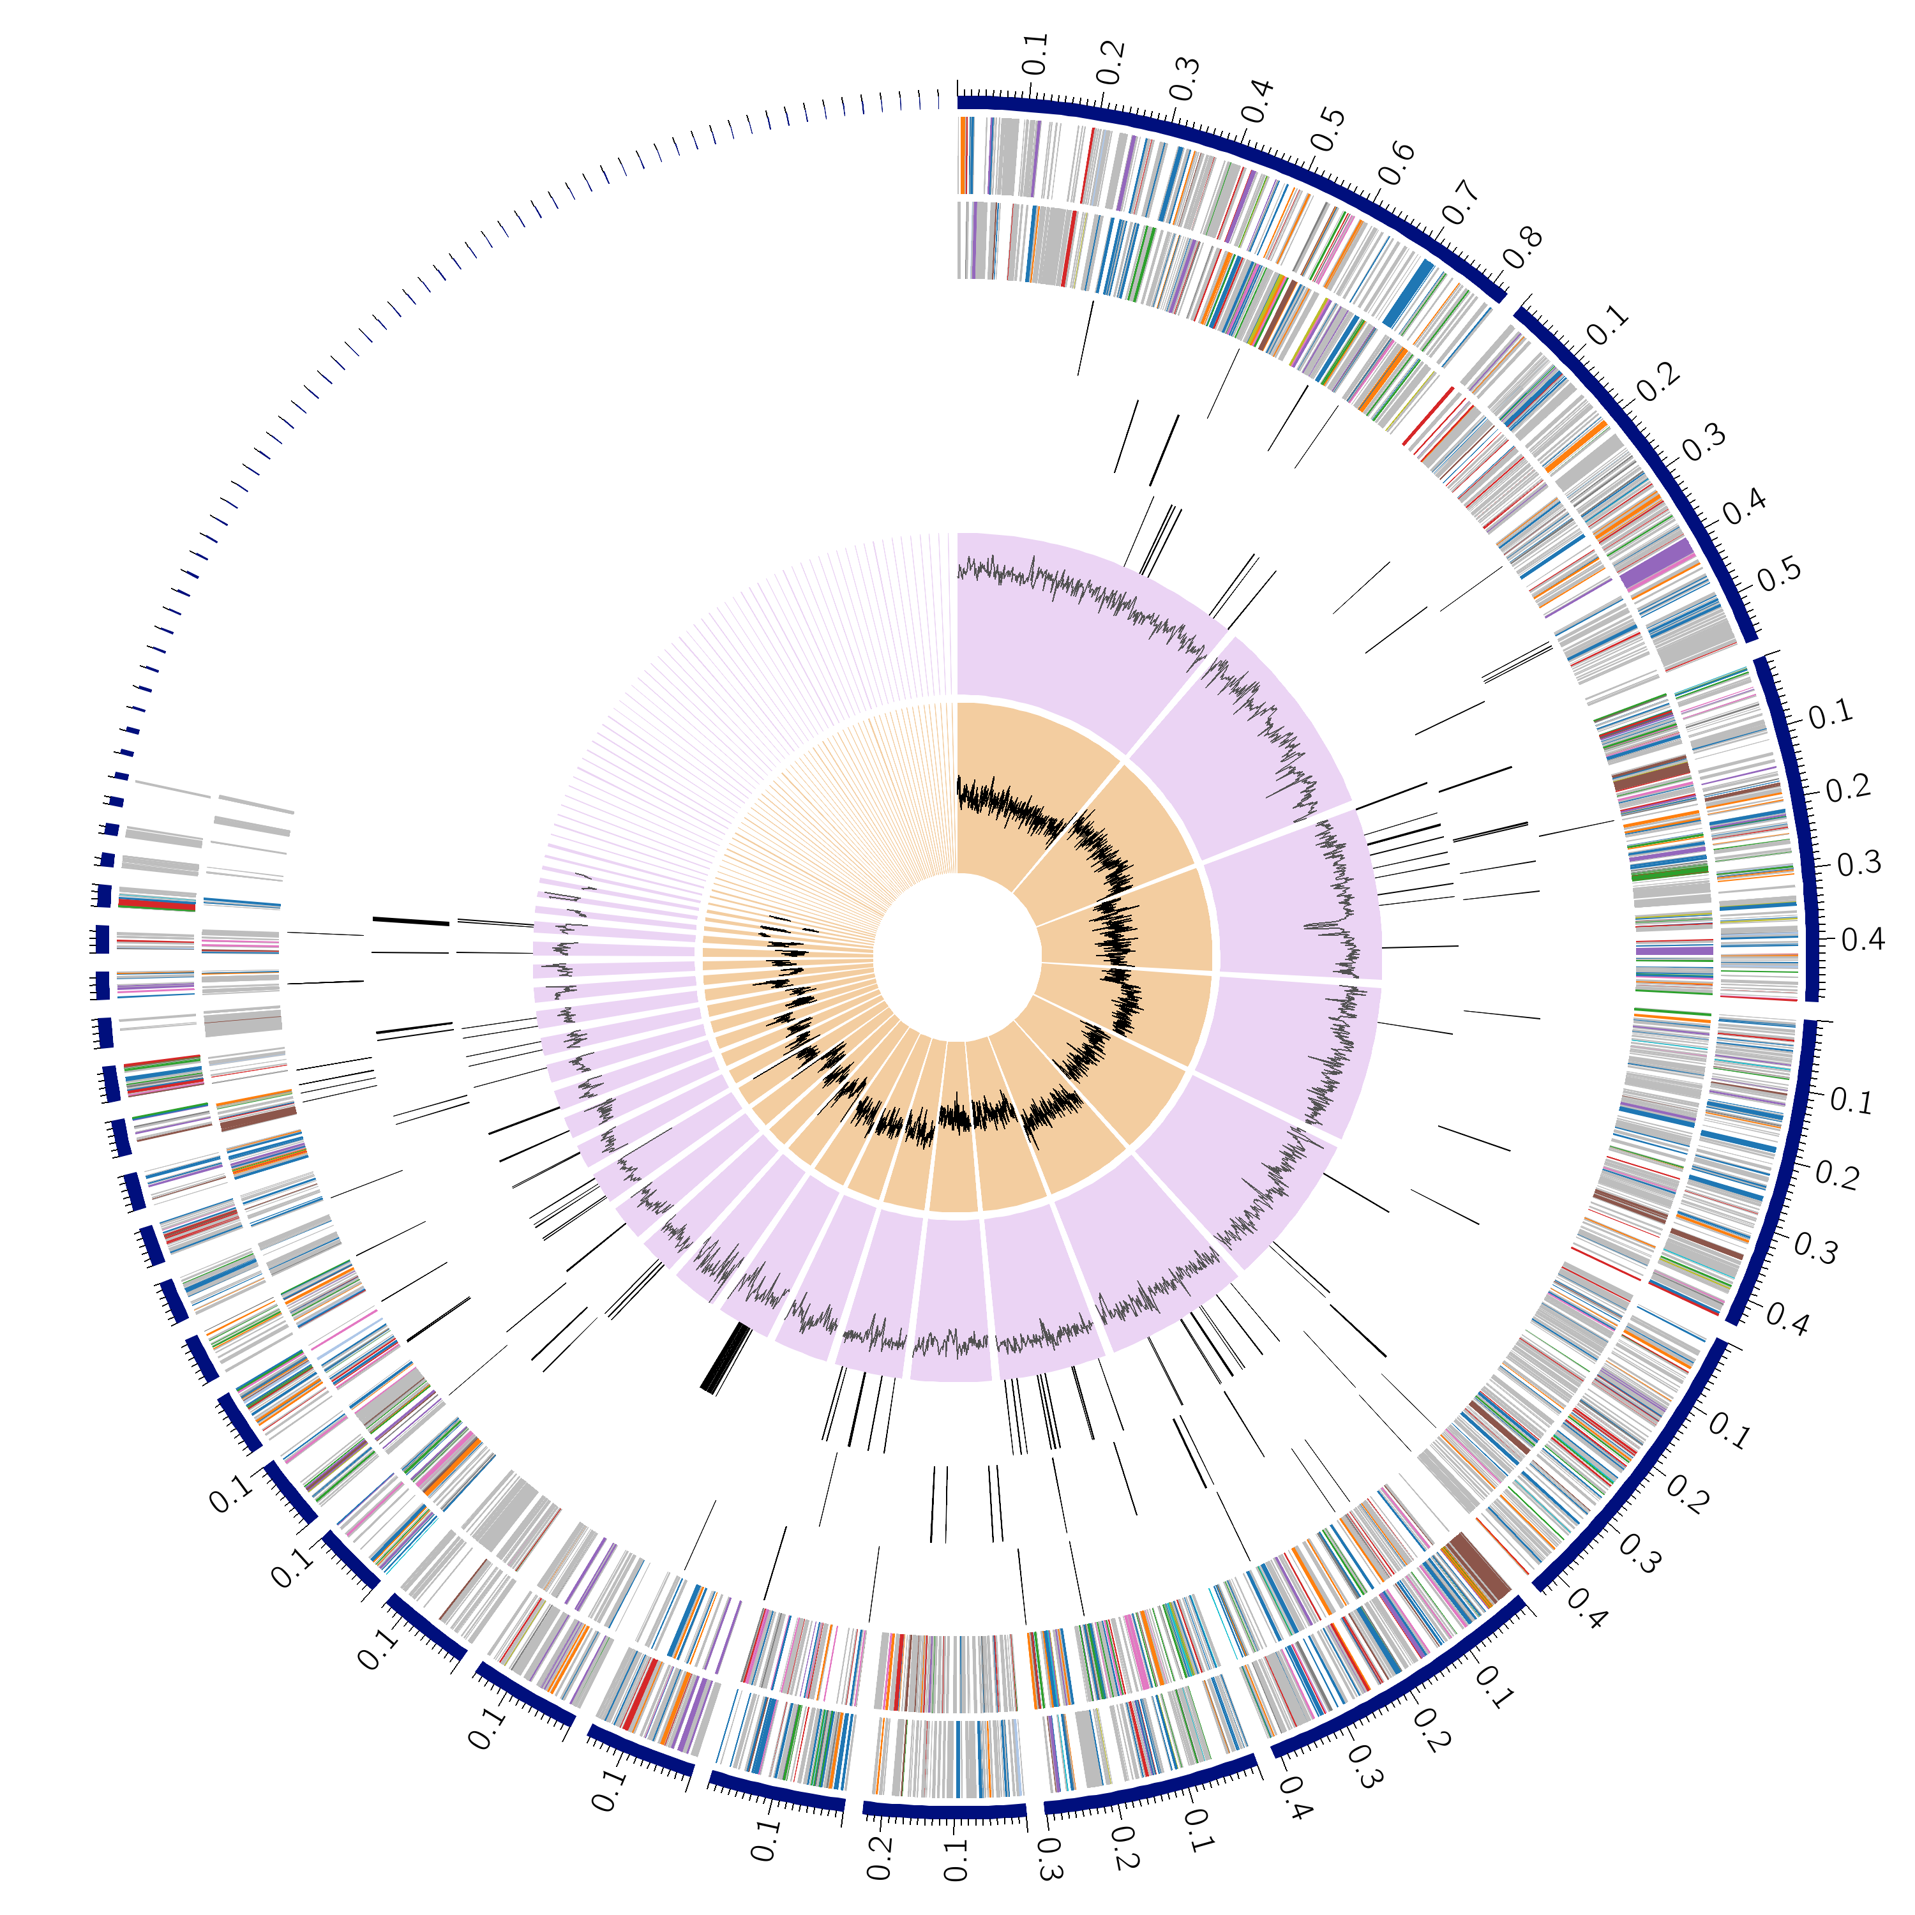
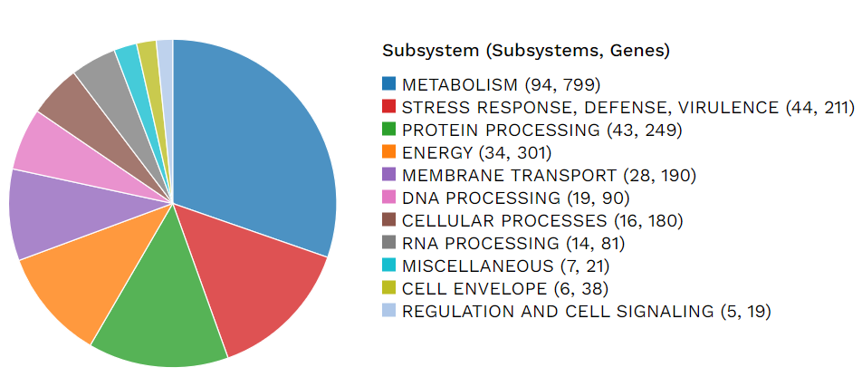
A
B
Supplementary Figure 1

Slide 2
Supplementary Figure 2

