Slide 1
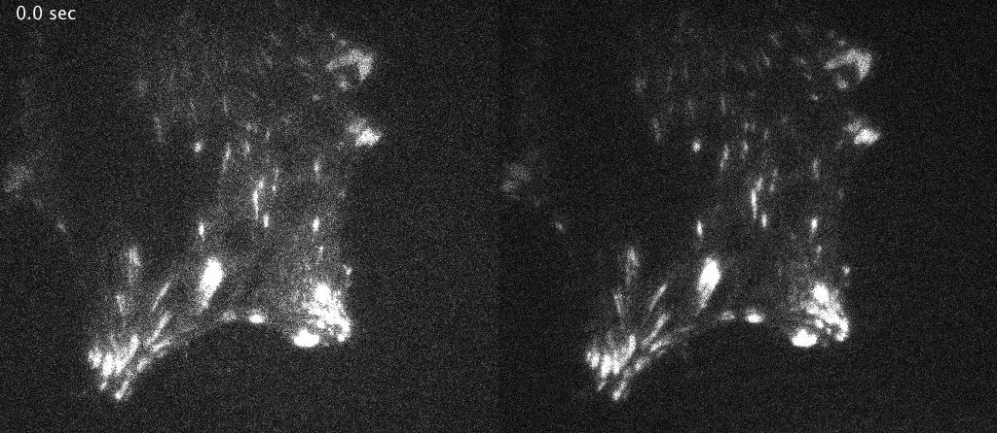
Dual_FRAP Experiments, MEF(Cell line)_GTC
FRAP of talin constructs in normal and transformed cells as a measure of talin cleavage
mCherry-C
Tail
GFP-Talin-mCherry
GFP-N
Head

