Slide 1
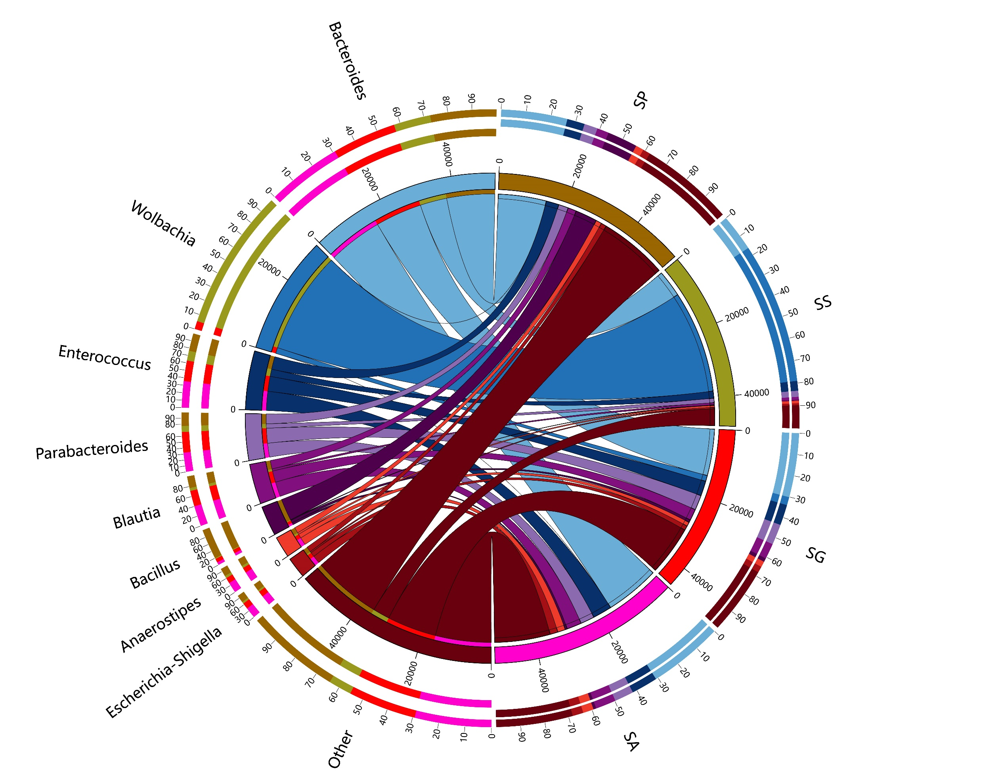
Figure S1: The content map of different symbiotic bacteria in four species. SG: Sclerodermus guani Xiao et Wu, SS: Sclerodermus sichuanensis Xiao, SP: Sclerodermus pupariae Yang et Yao, SA: Sclerodermus alternatusi Yang.

