Slide 1
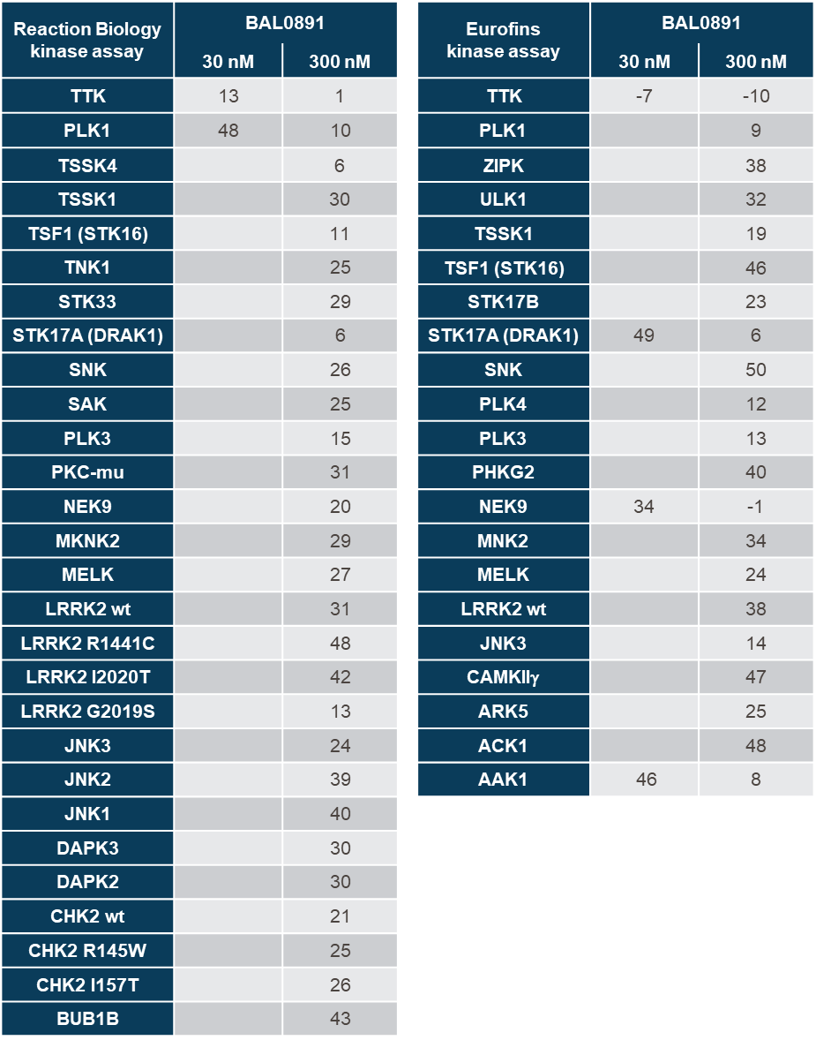
Supplementary Table 1

Slide 2
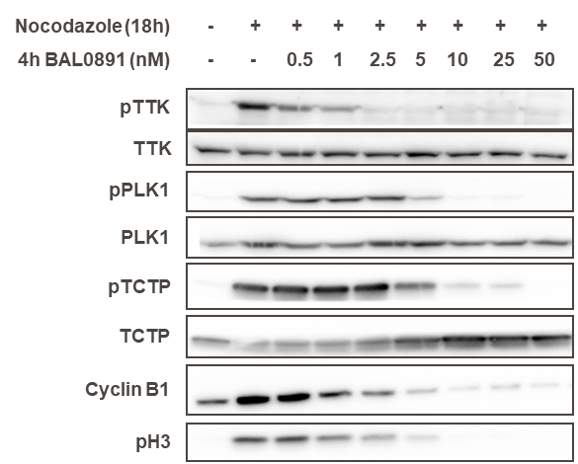
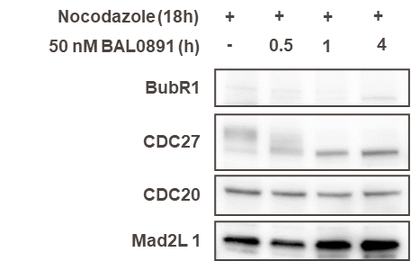
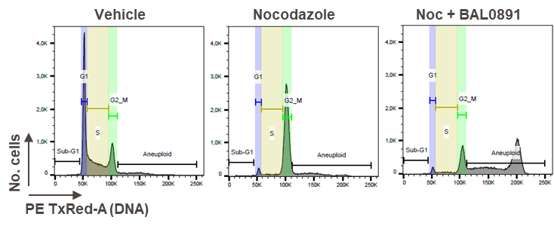
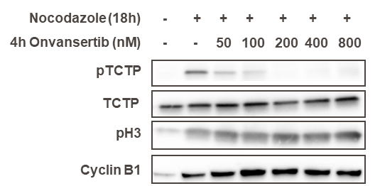
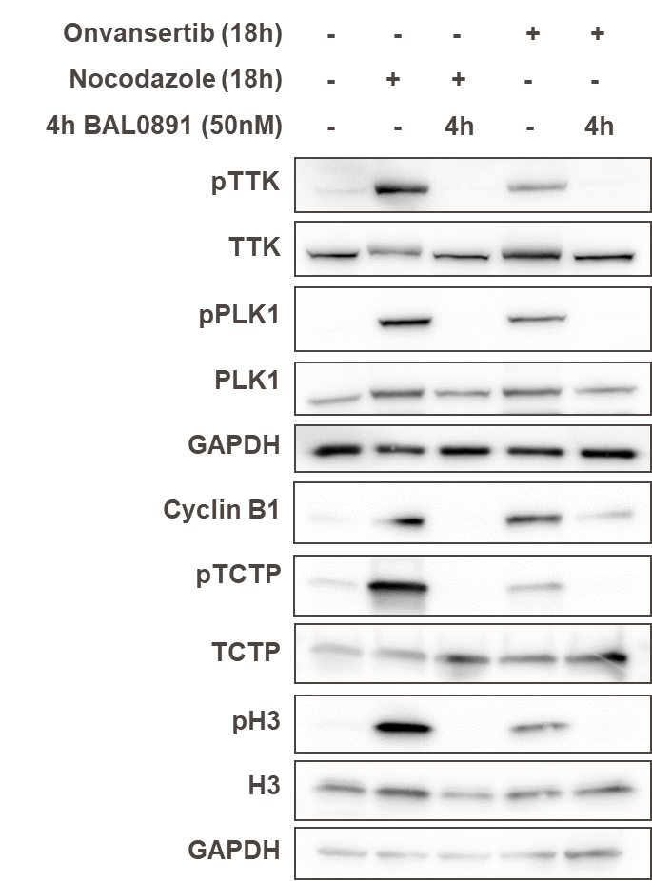
Supplementary Figure 1
(A)
(B)
(C)
(D)
(E)
(F)

Slide 3
Supplementary Figure 2

Slide 4
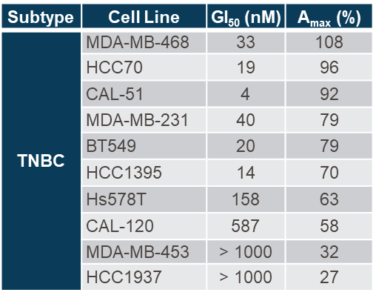
Supplementary Table 2

Slide 5
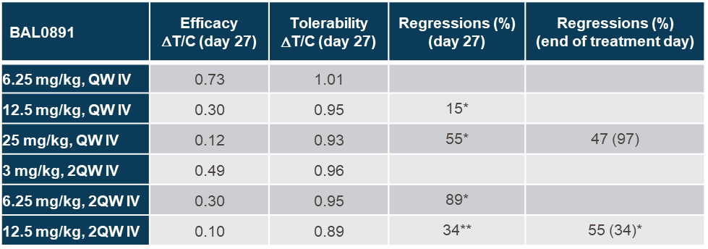
Supplementary Table 3

Slide 6
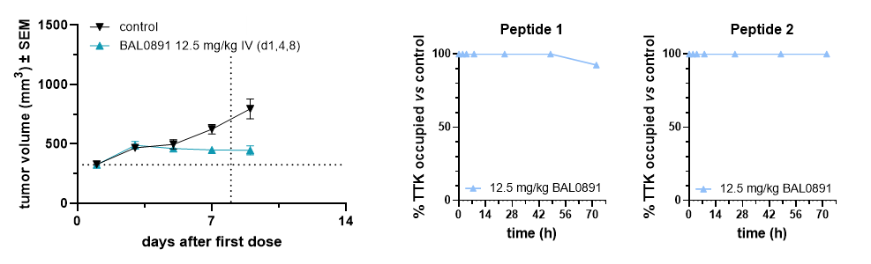
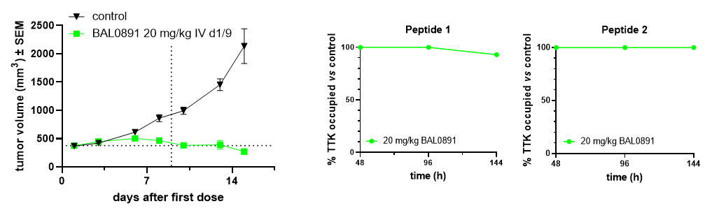
Supplementary Figure 3
A
B
C
D

Slide 7
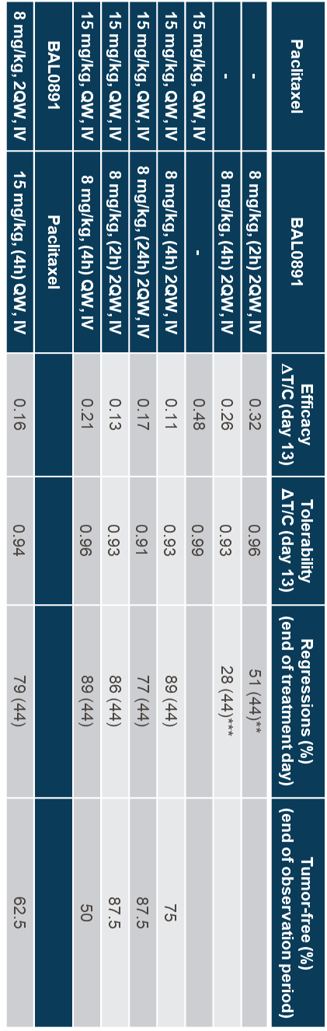
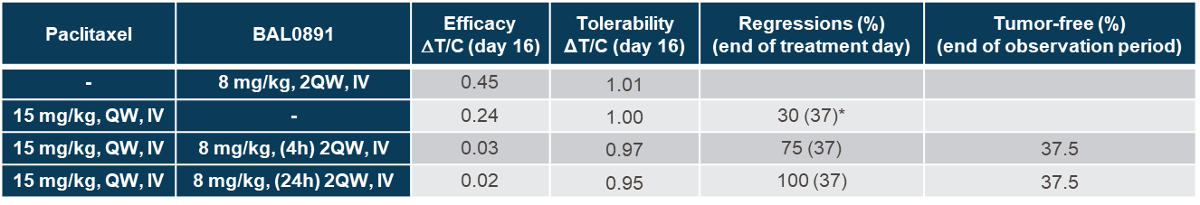
Supplementary Table 4
Study 1
Study 2

Slide 8
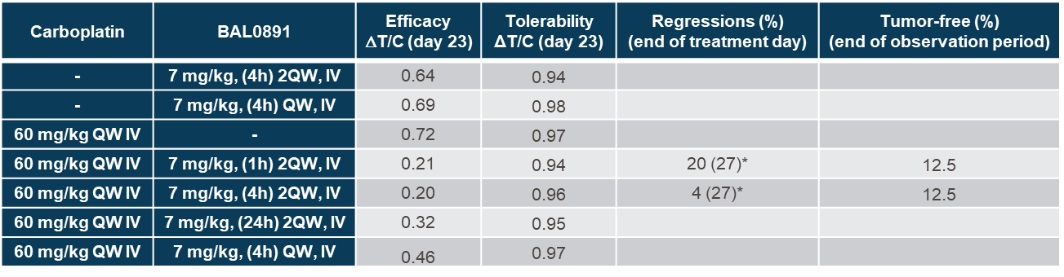
Supplementary Table 5

Slide 9
Supplementary Table 6
Cell line | Provider | Cat # | Lot | Medium
769-P | ATCC | CRL-1933 |  | RPMI-1640, 10% (v/v) FCS, 1% (v/v) Penicillin/Streptomycin
786-O | ATCC | CRL-1932 |  | RPMI-1640, 10% (v/v) FCS, 1% (v/v) Penicillin/Streptomycin
233132/87 | DSMZ | ACC 201 | Lot 9 | RPMI-1640, 10% (v/v) FCS, 1% (v/v) Penicillin/Streptomycin
ACHN | ATCC | CRL-1611 |  | DMEM, 10% (v/v) FCS, 1% (v/v) Penicillin/Streptomycin
AGS | Sigma/ECACC | 89090402 | Lot 12H012 | Ham’s F12, 10% (v/v) FCS, 1% (v/v) Penicillin/Streptomycin, 2 mM Glutamine
AN3 CA | ATCC | HTB-111 |  | DMEM, 10% (v/v) FCS, 1% (v/v) Penicillin/Streptomycin
BC-3C | DSMZ | ACC 450 | Lot 2 | McCoy's 5A, 10% (v/v) FCS, 1% (v/v) Penicillin/Streptomycin
BT474 | ATCC | HTB-20 |  | Ham’s F12, 10% (v/v) FCS, 1% (v/v) Penicillin/Streptomycin, 2 mM Glutamine
BT549 | ATCC | HTB-122 | Lot 57741121 | RPMI-1640, 10% (v/v) FCS, 1% (v/v) Penicillin/Streptomycin, 2 mM L-Glutamine, 0.023 U/mL Insulin
Caki-1 | ATCC | HTB-46 |  | McCoy's 5A, 10% (v/v) FCS, 1% (v/v) Penicillin/Streptomycin
Caki-2 | ATCC | HTB-47 |  | McCoy's 5A, 10% (v/v) FCS, 1% (v/v) Penicillin/Streptomycin
CAL-120 | DSMZ | ACC459 | Lot 9 | DMEM, 10% (v/v) FCS, 1% (v/v) Penicillin/Streptomycin
CAL-29 | DSMZ | ACC515 | Lot 4 | DMEM, 10% (v/v) FCS, 1% (v/v) Penicillin/Streptomycin
CAL-51 | DSMZ | ACC302 | Lot 13 | DMEM, 10% (v/v) FCS, 1% (v/v) Penicillin/Streptomycin
CAL-54 | DSMZ | ACC 365 | Lot 5 | DMEM, 15% (v/v) FCS, 1% (v/v) Penicillin/Streptomycin, 4 mM L-glutamine, 1 mM sodium pyruvate, 0.4 µg/mL hydrocortisone, 10 ng/mL EGF
CAMA-1 | ATCC | HTB-21 | Lot 62486985 | DMEM, 10% (v/v) FCS, 1% (v/v) Penicillin/Streptomycin
DLD1 | Sigma | CLL0001-1VL |  | RPMI-1640, 10% (v/v) FCS, 1% (v/v) Penicillin/Streptomycin, 2 mM L-Glutamine, 1 mM Sodium pyruvate
Fu97 | JCRB | JCRB1074 | Lot 03132015 | DMEM, 10% (v/v) FCS, 1% (v/v) Penicillin/Streptomycin, 0.023 U/mL Insulin
G401 | Sigma | CLL0004-1VL |  | McCoy's 5A, 10% (v/v) FCS, 1% (v/v) Penicillin/Streptomycin
HCC1395 | ATCC | CRL-2324 | Lot 64146724 | DMEM, 10% (v/v) FCS, 1% (v/v) Penicillin/Streptomycin
HCC1500 | ATCC | CRL-2329 |  | RPMI-1640, 10% (v/v) FCS, 1% (v/v) Penicillin/Streptomycin
HCC1937 | ATCC | CRL-2336 | Lot 4714380 | RPMI-1640, 10% (v/v) FCS, 1% (v/v) Penicillin/Streptomycin, 2 mM L-Glutamine, 1% (v/v) MEM non-essential amino acids, 1 mM Sodium pyruvate
HCC1954 | ATCC | CRL-2338 | Lot 63681081 | RPMI-1640, 10% (v/v) FCS, 1% (v/v) Penicillin/Streptomycin, 1 mM Sodium pyruvate, 1% (v/v) Hepes
HCC70 | ATCC | CRL-2315 | Lot 61978349 | RPMI-1640, 10% (v/v) FCS, 1% (v/v) Penicillin/Streptomycin, 1 mM Sodium pyruvate, 1% (v/v) Hepes
HCT116 | ATCC | CCl-247 | Lot 5056139 | McCoy's 5A, 10% (v/v) FCS, 1% (v/v) Penicillin/Streptomycin
HCT-15 | ATCC | CCL-225 | Lot 710626977 | RPMI-1640, 10% (v/v) FCS, 1% (v/v) Penicillin/Streptomycin
HEC-1-A | ATCC | HTB-112 |  | McCoy's 5A, 10% (v/v) FCS, 1% (v/v) Penicillin/Streptomycin
HEC-1-B | ATCC | HTB-113 |  | DMEM, 10% (v/v) FCS, 1% (v/v) Penicillin/Streptomycin
HEC-251 | JCRB | JCRB1141 |  | DMEM, 15% (v/v) FCS, 1% (v/v) Penicillin/Streptomycin
HEC-265 | JCRB | JCRB1142 |  | DMEM, 15% (v/v) FCS, 1% (v/v) Penicillin/Streptomycin
HEC-50B | JCRB | JCRB1145 | Lot 10182013 | DMEM, 15% (v/v) FCS, 1% (v/v) Penicillin/Streptomycin
HEC-59 | Accegen | ABC-TC0348 | Lot 09042012 | DMEM, 10% (v/v) FCS, 1% (v/v) Penicillin/Streptomycin
HEC-6 | JCRB | JCRB1118 |  | DMEM, 15% (v/v) FCS, 1% (v/v) Penicillin/Streptomycin
HGC-27 | ECACC | 94042256 | Lot 17H077 | MEM, 10% (v/v) FCS, 1% (v/v) Penicillin/Streptomycin
HMEC | Lonza | CC-2551 | Lot 7F3285 | MEBM, SingleQuots growth factors
HRT-18 | ECACC | 86040306 | Lot 12D002 | RPMI-1640, 10% (v/v) FCS, 1% (v/v) Penicillin/Streptomycin, 2 mM L-Glutamine
Hs578T | ATCC | HTB-126 | Lot 63087041 | DMEM, 10% (v/v) FCS, 1% (v/v) Penicillin/Streptomycin
HS68 | ATCC | CRL-1635 | Lot 4748910 | DMEM, 10% (v/v) FCS, 1% (v/v) Penicillin/Streptomycin, 1 mM Sodium pyruvate
Hs746T | ATCC | HTB-135 | Lot 70021638 | DMEM, 10% (v/v) FCS, 1% (v/v) Penicillin/Streptomycin
HT1197 | ECACC | 87032403 |  | DMEM, 10% (v/v) FCS, 1% (v/v) Penicillin/Streptomycin, 2 mM L-Glutamine, 1% (v/v) MEM NEAA
HT1376 | ECACC | 87032402 |  | DMEM, 10% (v/v) FCS, 1% (v/v) Penicillin/Streptomycin, 2 mM L-Glutamine, 1% (v/v) MEM NEAA
HT-29 | ATCC | HTB-38 |  | RPMI-1640 10% (v/v) FCS, 1% (v/v) Penicillin/Streptomycin, 2 mM L-Glutamine, 1% (v/v) MEM NEAA
HT55 | ECACC | 85061105 |  | RPMI-1640 10% (v/v) FCS, 1% (v/v) Penicillin/Streptomycin, 2 mM L-Glutamine, 1% (v/v) MEM NEAA
IM95 | JCRB | JCRB1075 | Lot 09302016 | DMEM, 10% (v/v) FCS, 1% (v/v) Penicillin/Streptomycin, 0.023 U/mL Insulin
J-82 | ATCC | HTB-1 |  | DMEM, 10% (v/v) FCS, 1% (v/v) Penicillin/Streptomycin, 1 mM Sodium pyruvate
JMSU1 | DSMZ | ACC 505 | Lot 3 | RPMI-1640, 10% (v/v) FCS, 1% (v/v) Penicillin/Streptomycin, 2 mM L-Glutamine
Kato-III | Sigma/ECACC | 86093004 | Lot 13G015 | RPMI-1640, 20% (v/v) FCS, 1% (v/v) Penicillin/Streptomycin, 2 mM L-Glutamine
KU-19-19 | DSMZ | ACC 395 | Lot 5 | RPMI-1640, 10% (v/v) FCS, 1% (v/v) Penicillin/Streptomycin
LoVo | ATCC | CCL-229 | Lot 4031215 | RPMI-1640, 10% (v/v) FCS, 1% (v/v) Penicillin/Streptomycin, 2 mM L-Glutamine, 1% (v/v) MEM non-essential amino acids, 1 mM Sodium pyruvate
LS174T | ATCC | CL-188 | Lot 57624482 | DMEM, 10% (v/v) FCS, 1% (v/v) Penicillin/Streptomycin, 1 mM Sodium pyruvate
MCF7 | ATCC | HTB-22 | Lot 7529960 | DMEM, 10% (v/v) FCS, 1% (v/v) Penicillin/Streptomycin, 1 mM Sodium pyruvate, 1% (v/v) MEM NEAA
MDA-MB-231 | ATCC | HTB-26 | Lot 5069789 | DMEM, 10% (v/v) FCS, 1% (v/v) Penicillin/Streptomycin, 1 mM Sodium pyruvate
MDA-MB-453 | ATCC | HTB-131 | Lot 4019064 | DMEM, 10% (v/v) FCS, 1% (v/v) Penicillin/Streptomycin, 1 mM Sodium pyruvate
MDA-MB-468 | ATCC | HTB-132 | Lot 57675411 | DMEM, 10% (v/v) FCS, 1% (v/v) Penicillin/Streptomycin, 1 mM Sodium pyruvate
MDST8 | ECACC | 99011801 | Lot 13K001 | DMEM, 10% (v/v) FCS, 1% (v/v) Penicillin/Streptomycin, 2 mM L-Glutamine
MFE-280 | ECACC | 98050131 | Lot 11J030 | DMEM, 10% (v/v) FCS, 1% (v/v) Penicillin/Streptomycin, 2 mM L-Glutamine
MFE-296 | ECACC | 98031101 | Lot 12F039 | DMEM, 10% (v/v) FCS, 1% (v/v) Penicillin/Streptomycin, 2 mM L-Glutamine
NCI-H716 | ATCC | CCL-251 | Lot 63990056 | RPMI-1640, 10% (v/v) FCS, 1% (v/v) Penicillin/Streptomycin
NCI-N87 | ATCC | CRL-5822 | Lot 70014503 | RPMI-1640, 10% (v/v) FCS, 1% (v/v) Penicillin/Streptomycin
NUGC-3 | JCRB | JCRB0822 | Lot 11162017 | RPMI-1640, 10% (v/v) FCS, 1% (v/v) Penicillin/Streptomycin
OCUM-1 | JCRB | JCRB0192 |  | DMEM, 10% (v/v) FCS, 1% (v/v) Penicillin/Streptomycin, 1 mM Sodium pyruvate
RCC4 vector | Sigma | 3112702 |  | DMEM, 10% (v/v) FCS, 1% (v/v) Penicillin/Streptomycin, 2 mM L-Glutamine
RERF-GC-1B | JCRB | JCRB1009 | Lot 07192016 | RPMI-1640, 10% (v/v) FCS, 1% (v/v) Penicillin/Streptomycin
RKO | ATCC | CRL-2577 | Lot 62300117 | DMEM, 10% (v/v) FCS, 1% (v/v) Penicillin/Streptomycin
RL95-2 | ATCC | CRL-1671 | Lot 62130010 | DMEM, 10% (v/v) FCS, 1% (v/v) Penicillin/Streptomycin
RT112/84 | ECACC | 85061106 |  | DMEM, 10% (v/v) FCS, 1% (v/v) Penicillin/Streptomycin, 2 mM L-Glutamine, 1% (v/v) MEM NEAA
RT4 | ECACC | 91091914 |  | McCoy's 5A, 10% (v/v) FCS, 1% (v/v) Penicillin/Streptomycin, 2 mM Glutamine
SKBR3 | ATCC | HTB-30 |  | McCoy's 5A, 10% (v/v) FCS, 1% (v/v) Penicillin/Streptomycin
SNG-M | JCRB | JCRB0179 | Lot 07212009 | Ham’s F12, 10% (v/v) FCS, 1% (v/v) Penicillin/Streptomycin, 2 mM Glutamine
SNU16 | ATCC | CRL-5974 |  | DMEM, 10% (v/v) FCS, 1% (v/v) Penicillin/Streptomycin
SNU-349 | KCLB | 349 |  | RPMI-1640, 10% (v/v) FCS, 1% (v/v) Penicillin/Streptomycin
SW-1710 | DSMZ | ACC 426 | Lot 3 | DMEM, 15% (v/v) FCS, 1% (v/v) Penicillin/Streptomycin
SW403 | DSMZ | ACC 294 | Lot 4 | DMEM, 10% (v/v) FCS, 1% (v/v) Penicillin/Streptomycin
SW48 | ATCC | CCL-231 | Lot 3247840 | DMEM, 10% (v/v) FCS, 1% (v/v) Penicillin/Streptomycin, 1 mM Sodium pyruvate
SW480 | ATCC | CCL-228 | Lot 4487738 | RPMI-1640, 10% (v/v) FCS, 1% (v/v) Penicillin/Streptomycin, 2 mM L-Glutamine, 1% (v/v) MEM non-essential amino acids, 1 mM Sodium pyruvate
SW620 | ATCC | CCL-227 | Lot 58483168 | RPMI-1640 10% (v/v) FCS, 1% (v/v) Penicillin/Streptomycin, 2 mM L-Glutamine, 1% (v/v) MEM NEAA
SW-780 | ATCC | CRL-2169 | Lot 61978343 | DMEM, 10% (v/v) FCS, 1% (v/v) Penicillin/Streptomycin
SW948 | ATCC | CCL-237 | Lot 62522213 | RPMI-1640, 10% (v/v) FCS, 1% (v/v) Penicillin/Streptomycin
T24 | DSMZ | ACC 376 | Lot 5 | DMEM, 10% (v/v) FCS, 1% (v/v) Penicillin/Streptomycin
T47D | ATCC | HTB-133 |  | DMEM, 10% (v/v) FCS, 1% (v/v) Penicillin/Streptomycin, 1 mM Sodium pyruvate
T84 | ECACC | 88021101 |  | Ham’s F12, 10% (v/v) FCS, 1% (v/v) Penicillin/Streptomycin, 2 mM Glutamine
TCC-SUP | DSMZ | ACC 377 | Lot 3 | DMEM, 15% (v/v) FCS, 1% (v/v) Penicillin/Streptomycin
ZR-75-1 | ATCC | CRL-1504 |  | RPMI-1640, 10% (v/v) FCS, 1% (v/v) Penicillin/Streptomycin

