Slide 1
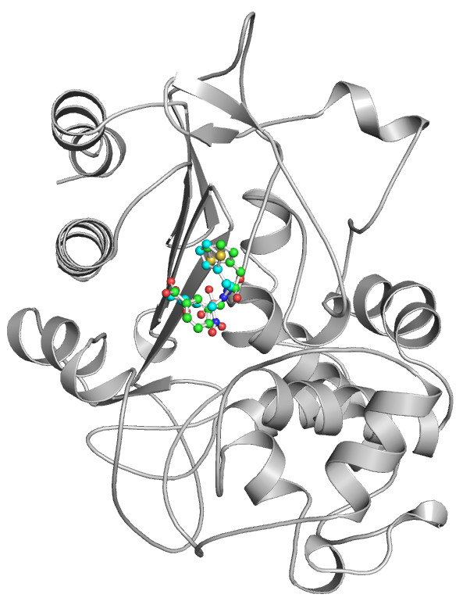
β-Lactamase
Co-crystalized SM23
Docked SM23
Figure S1: Binding pose of SM23 in complex with β-Lactamase. Green and cyan elements show co-crystallized and docked SM23 with β-Lactamase in the grey, respectively. The structural coordinates for the β-Lactamase-SM23 complex were obtained from the RCSB-Protein Data Bank, PDB ID: 5CHJ.

Slide 2
A
B
β-Lactamase
β-Lactamase-Aristospan
β-Lactamase-SM23
C
D
Figure S2: Replica simulation showed similar structural dynamics and compactness of β-Lactamase upon Aristospan and SM23 binding. (A) RMSD plot of β-Lactamase in complex with Aristospan and SM23. (B) Residual fluctuations of β-Lactamase with Aristospan and SM23. (C) Time evolution of radius of gyration (Rg) and (D) SASA of β-Lactamase and its docked complexes.

Slide 3
A
β-Lactamase
β-Lactamase-Aristospan
β-Lactamase-SM23
B
C
SM23-β-Lactamase
Aristospan-β-Lactamase
Figure S3: Replica simulation showed similar dynamics of hydrogen bonds in β-Lactamase and its docked complexes with Aristospan and SM23. (A) Time evolution of hydrogen bonds formed intra-β-Lactamase before and after Aristospan and SM23 binding. (B) The time evolution plot shows the formation of intermolecular hydrogen bonds between β-Lactamase and Aristospan. (C) The time evolution plot shows the formation of intermolecular hydrogen bonds between β-Lactamase and SM23.

