Slide 1
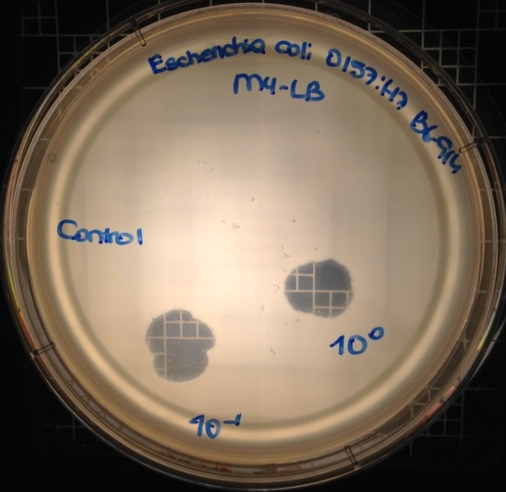
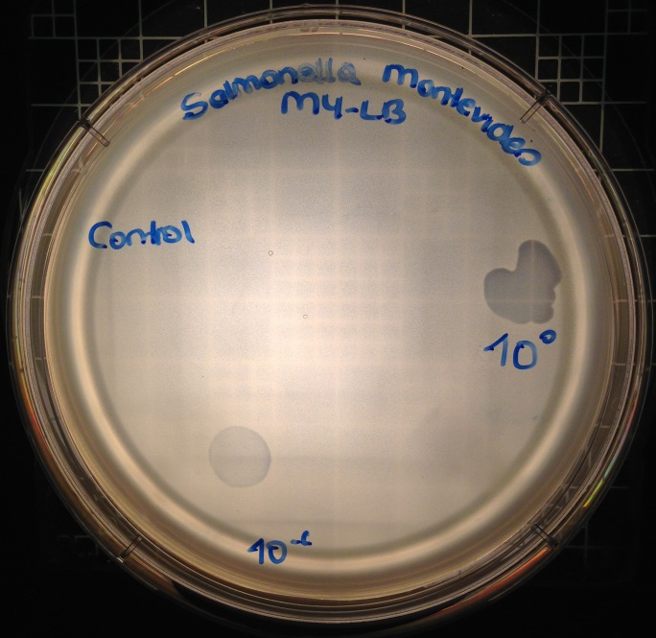
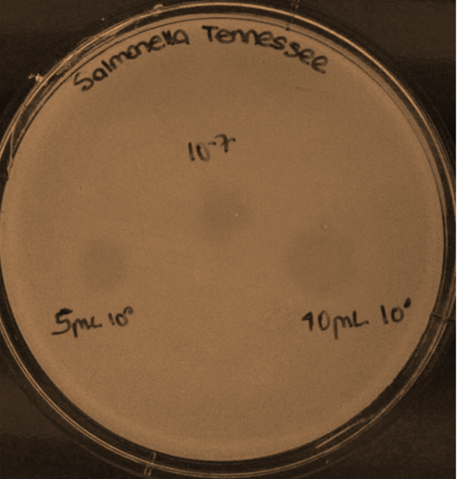
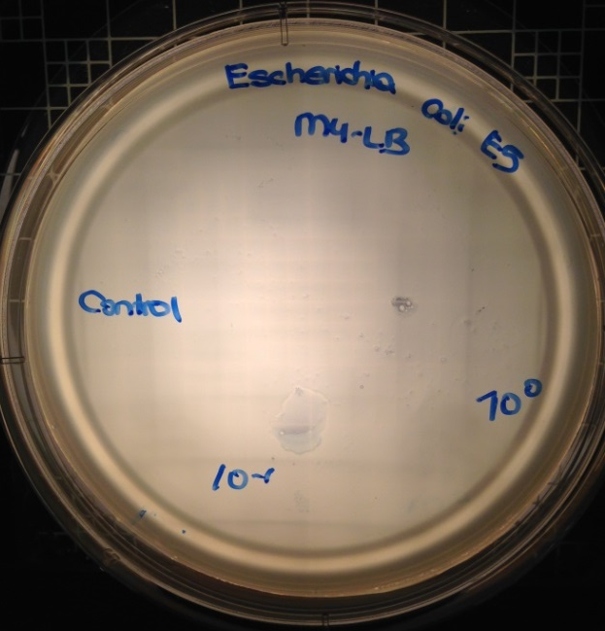
A
B
C
D
Supplementary Figure 1. Determination of Escherichia bacteriophage OSYSP host range using (A) E. coli O157:H7 B6-914 (+++; Clear plaques or complete inhibition zones), (B) Salmonella Montevideo (++ Clear plaques or complete inhibition zone with relatively low haziness), (C) Salmonella Tennessee (+; Hazy plaques or inhibition zones with relatively high turbidity), and (D) E. coli O157 E5 (Phage has no effect on host growth under the experimental conditions tested).

