Slide 1
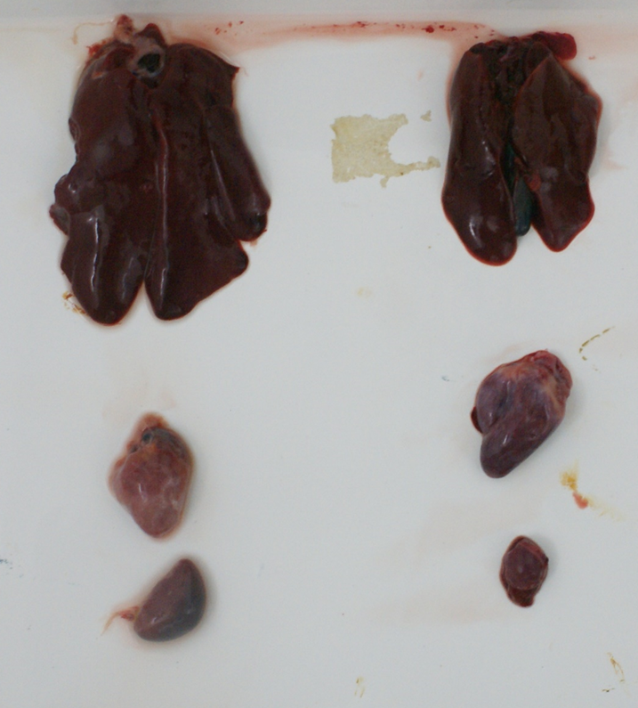
Group CC-60d
Group CC-120d
Group CC-180d
Figure S1. Pathological lesions observed in SPF chicken challenged with the MDV vvMD5 strain.

