Slide 1
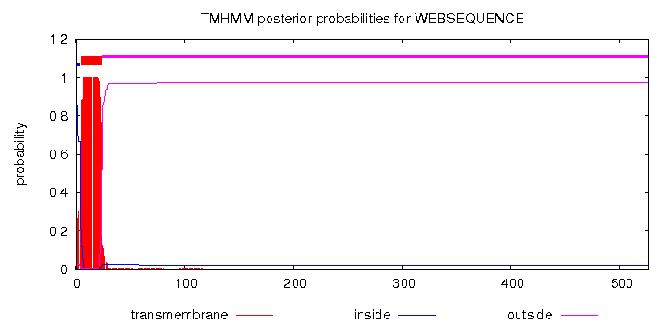
Supplementary Fig. S4: (A) TMHMM output window for FlotP. Red region indicates transmembrane region while pink indicates extracellular region of the protein. (B) Analysis report of FlotP localization by PSORTb
A.
B.
Subcellular locations | Localization Scores
CytoplasmicMembrane | 9.96
Cytoplasmic | 0.04
Cellwall | 0.00
Extracellular | 0.00

