Slide 1
Supplementary Fig. S7: Expression analysis of FlotP at protein level by immunoblotting. Cells from both B. anthracis virulent (pXO1⁺ , pXO2⁺) as well as Sterne (pXO1⁺ , pXO2⁻) were fixed overnight in 4 % paraformaldehyde followed by washing with PBS three times. Cellular lysate was prepared by sonication and the samples were allowed to run on 12 % SDS-PAG using 4X SDS-loading dye. The separated proteins from the gel were then transferred to nitrocellulose membrane for immunoblotting. Anti-rFlotP was used to identify FlotP specific band. Lanes: M, Marker ; 1, Virulent (pXO1⁺ , pXO2⁺); 2, Sterne (pXO1⁺ , pXO2⁻).
M 1 2
70
55
35
25
15

Slide 2
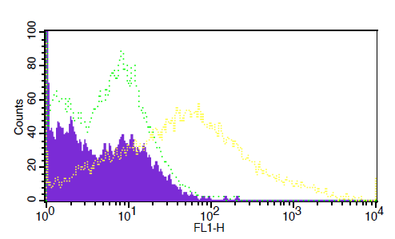
Blue – Only cells
Green -- Pre immune
Yellow -- Anti-Flot

