Slide 1
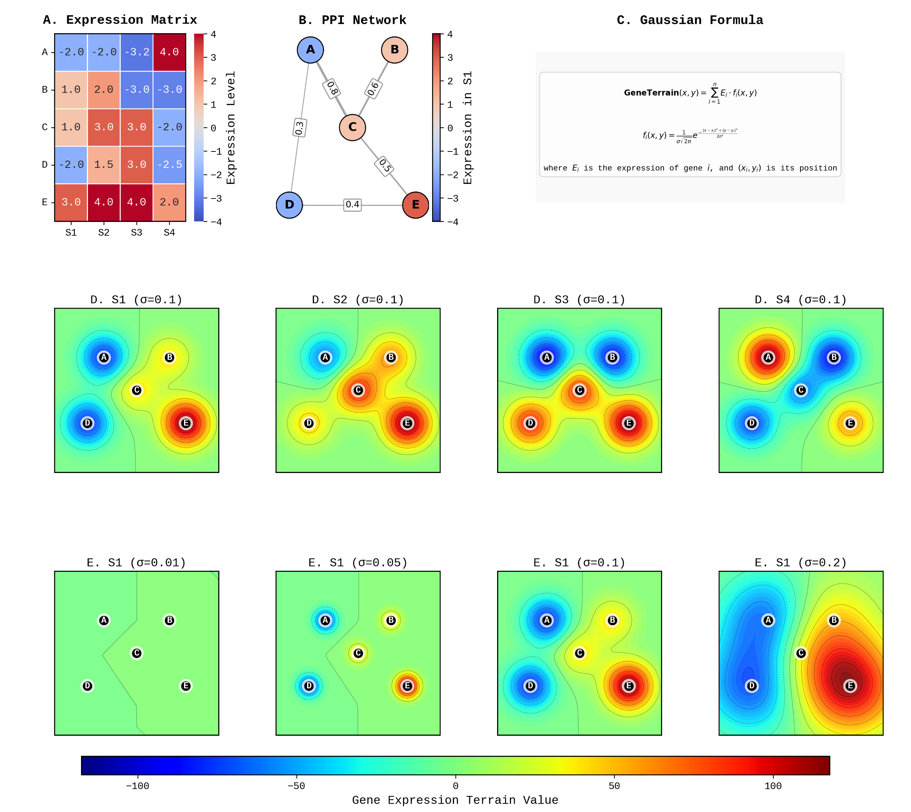
Figure 1: GeneTerrain overview. A) Expression matrix. B) PPI network. C) Gaussian formula. D) Terrain per sample. E) σ parameter effects on S1 terrain.

Slide 2
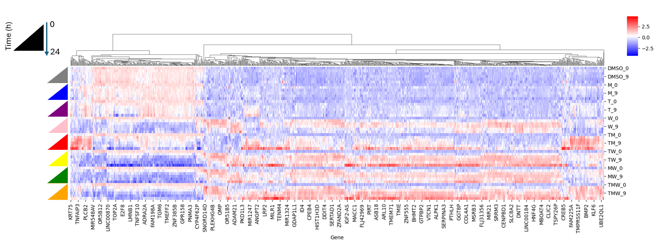
Figure 2. Static heatmap of LNCaP gene expression across 0–24 h time points with hierarchical clustering. Each column represents a time-point treatment condition, and each row a gene, colored by Z-score normalized expression (red = upregulated; blue = downregulated).

