Slide 1
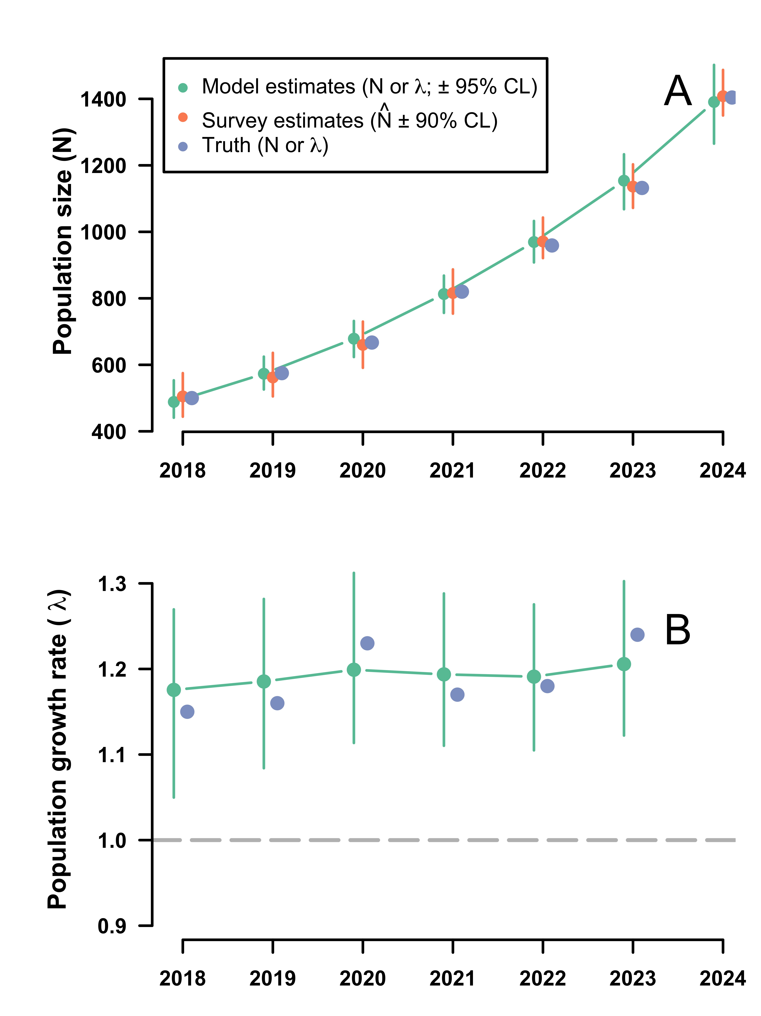
Supplementary Figure 1. State-space model estimates of (A) population size (N) and (B) population growth rate (λ) from an analysis of simulated data. The model is unbiased at estimating λ and N, but uncertainty in model estimates increase as the number of years decreases and error and uncertainty with N-hat increases.

