Slide 1
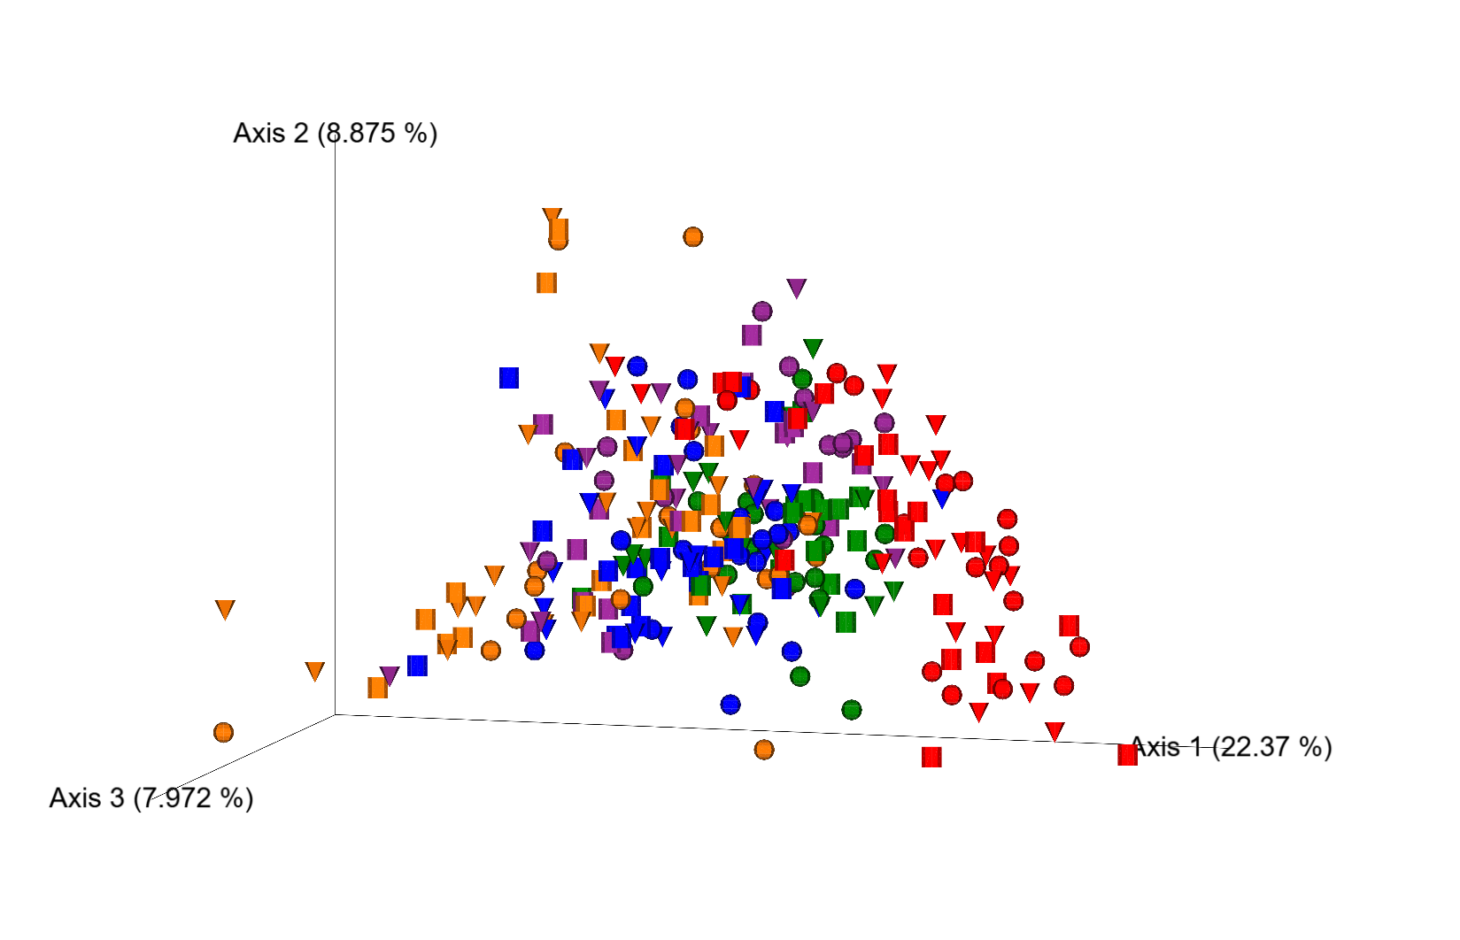
● 0wk
▼ 4wk
■ 8wk
BaBiBl
BaBiF
BaFBl
BaPF
BaRF
Supplemental Fig.1

Slide 2
A
##
B
#
C
##
#
Chao1
Shannon index
Simpson index
Supplemental Fig.2

Slide 3
A
**
**
**
**
p=0.058
*
*
**
**
**
Chao1
B
Shannon index
C
Simpson index
Supplemental Fig.3

Slide 4
A
Acetic acid
B
Propionic acid
C
Isobutyric acid
D
Butyric acid
r=-0.401
p=0.0001
r=-0.5396
p=0.0001
r=-0.5621
p=0.0001
r=-0.3876
p=0.0001
Δ8wk-0wk
[nmol/g fecal weight]
Δ8wk-0wk
[nmol/g fecal weight]
Δ8wk-0wk
[nmol/g fecal weight]
Δ8wk-0wk
[nmol/g fecal weight]
0wk
[nmol/g fecal weight]
0wk
[nmol/g fecal weight]
0wk
[nmol/g fecal weight]
0wk
[nmol/g fecal weight]
E
Isovaleric acid
F
Valeric acid
G
Caproic acid
r=-0.5031
p=0.0001
r=-0.3577
p=0.0004
r=-0.0713
p=0.4949
Δ8wk-0wk
[nmol/g fecal weight]
Δ8wk-0wk
[nmol/g fecal weight]
Δ8wk-0wk
[nmol/g fecal weight]
0wk
[nmol/g fecal weight]
0wk
[nmol/g fecal weight]
0wk
[nmol/g fecal weight]
H
Formic acid
I
Lactic acid
J
Malonic acid
K
Succinic acid
r=-0.5119
p=0.0001
r=-0.3187
p=0.0017
r=-0.2516
p=0.0144
r=-0.4499
p=0.0001
Δ8wk-0wk
[nmol/g fecal weight]
Δ8wk-0wk
[nmol/g fecal weight]
Δ8wk-0wk
[nmol/g fecal weight]
Δ8wk-0wk
[nmol/g fecal weight]
0wk
[nmol/g fecal weight]
0wk
[nmol/g fecal weight]
0wk
[nmol/g fecal weight]
0wk
[nmol/g fecal weight]
L
2-Methylvaleric acid
M
4-Methylvaleric acid
r=-0.3892
p=0.0001
r=-0.1836
p=0.0766
Δ8wk-0wk
[nmol/g fecal weight]
Δ8wk-0wk
[nmol/g fecal weight]
0wk
[nmol/g fecal weight]
0wk
[nmol/g fecal weight]
Supplemental Fig.4

Slide 5
A
##
B
##
##
##
Bifidobacterium in Probiotics intake group
[Relative abundance]
Bifidobacterium in
No Probiotics intake group
[Relative abundance]
Supplemental Fig.5

