Slide 1
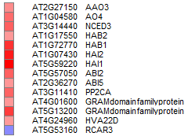
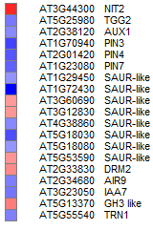
A)
Supplementary figure. 10
ABA
SA
JA
ET
BR
AUX
GA
B)
ABA
SA
JA
ET
BR
AUX
CK
GA

Slide 2
Supplementary figure S10. Transcriptome profile of genes related to hormone in DP/PD combined stressed plants. Total DEGs (fold change cut off >2, unpaired t-test p-value < 0.05) under combined DP (A) and PD (B) stress were mapped to phytohormone biosynthesis, signaling and catabolism related processes (KAAS and MAPMAN). Fold change values in gene expression (over mock control) were used to plot heat maps where color bar in red and blue represents up- and down-regulated genes respectively. ABA, abscisic acid; SA, salicylic acid; JA, jasmonic acid; ET, ethylene; BR, brassinosteroid; AUX, auxin; GA, gibberellic acid.

