Slide 1
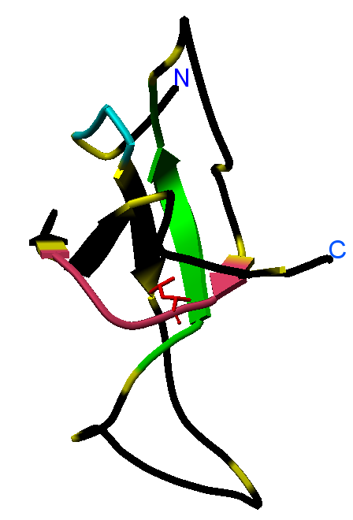
Supplemental Figure S1
A
Phe-73
B
Leu-73
100
NL: 2.56E7
Base Peak m/z=
80
454.2400-454.2720+
538.7900-538.8100+
555.7900-555.8000+
60
WT full-length
658.3700-658.3900 MS
40
q4613-morten-wt-2
20
0
NL: 5.29E6
100
Base Peak m/z=
80
454.2400-454.2720+
538.7900-538.8100+
WT core
555.7900-555.8000+
60
658.3700-658.3900 MS
Relative Abundance
q4615-morten-wt+2
Relative abundance
40
20
0
NL: 2.30E7
100
Base Peak m/z=
80
454.2400-454.2720+
555.7900-555.8000+
658.3700-658.3900 MS
60
Leu73Phe
full-length
Q4607-Morten-mu-2
40
20
0
NL: 1.81E6
100
Base Peak m/z=
80
454.2400-454.2720+
555.7900-555.8000+
Leu73Phe
core
658.3700-658.3900 MS
60
q4609-morten-mu+2
40
20
0
0
5
10
15
20
25
30
35
Time (min)
Time (min)]

Slide 2
Supplemental Figure S2

Slide 3
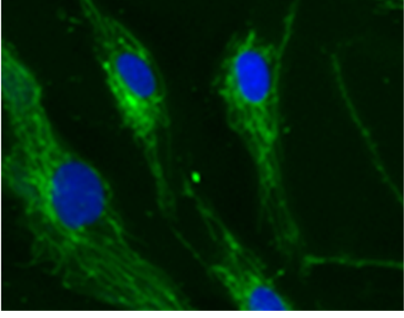
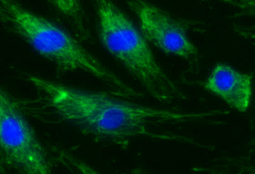
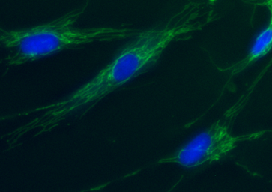
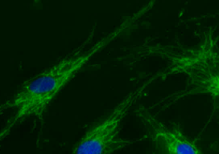
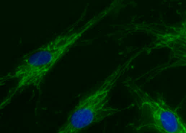
Supplemental Figure S3
Control
Patient

Slide 4
Supplemental Figure S4
A
B
C
D
1
2
3

