Slide 1
Triplet excited carbonyls and singlet oxygen formation during oxidative radical reaction in skin
Ankush Prasad#, Anastasiia Balukova, Pavel Pospíšil*
Department of Biophysics, Centre of the Region Haná for Biotechnological and Agricultural Research, Faculty of Science, Palacký University, Šlechtitelů 27, 783 71 Olomouc, Czech Republic.

Slide 2
50 μM H₂O₂
0.1 mM H₂O₂
0.2 mM H₂O₂
0.4 mM H₂O₂
0.6 mM H₂O₂
0.8 mM H₂O₂
1 mM H₂O₂
Figure S1: Ultra-weak photon emission measured using visible photomultiplier tube (PMT). Kinetics of ultra-weak photon emission was measured in the presence of variable concentration of Fenton’s reagent [50µM-1mM H₂O₂ (as indicated) containing 500µM FeSO₄] added after ~2 min of the start of measurement (indicated by arrow). The decay curve was measured for a duration of 30 min.

Slide 3
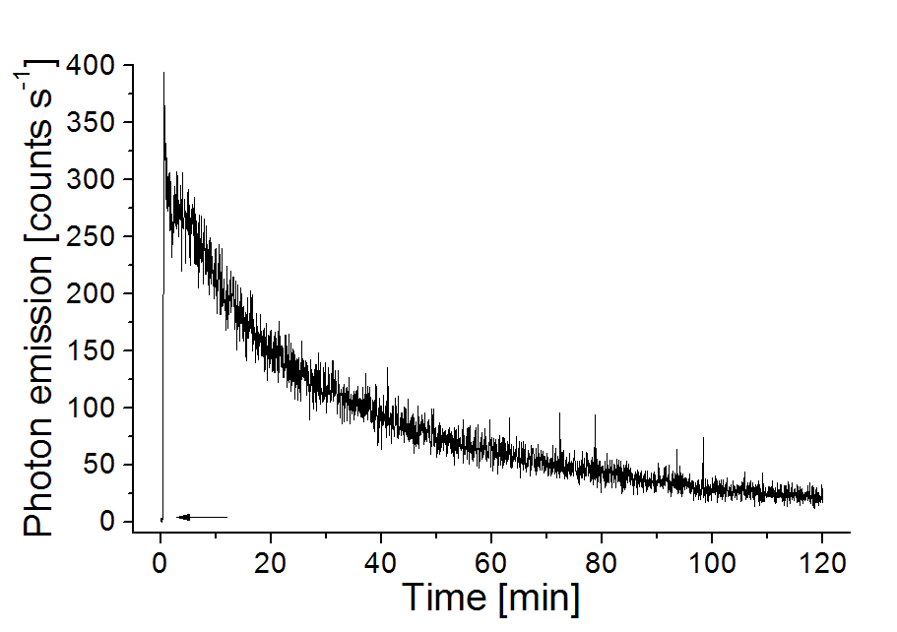
Figure S2: Ultra-weak photon emission measured using visible photomultiplier tube (PMT). Kinetics of ultra-weak photon emission was measured in the presence of Fenton’s reagent (2mM H₂O₂ containing 500µM FeSO₄). The decay curve was measured for a duration of 120 min.

Slide 4
A
B
C
D
E
Figure S3: Ultra-weak photon emission measured using visible photomultiplier tube (PMT). Kinetics of ultra-weak photon emission was measured in dark (A); in the presence of Fenton’s reagent (100µM H₂O₂ containing 500µM FeSO₄) (B); in the presence of Fenton’s reagent (1mM H₂O₂ containing 500 µM FeSO₄) (C) and in the presence Fenton’s reagent (1mM H₂O₂ containing 500µM FeSO₄) containing 5mM sodium ascorbate (D). The decay curve was measured for a duration of 10 min. The presented data are expressed as mean value of photon emission and the standard deviation of at least three measurements (mean ± SD, n=3) (E).

