Slide 1
a
a
c
b
c
b
1
2
a
a
a
b
a, b
a, b
3
4
5

Slide 2
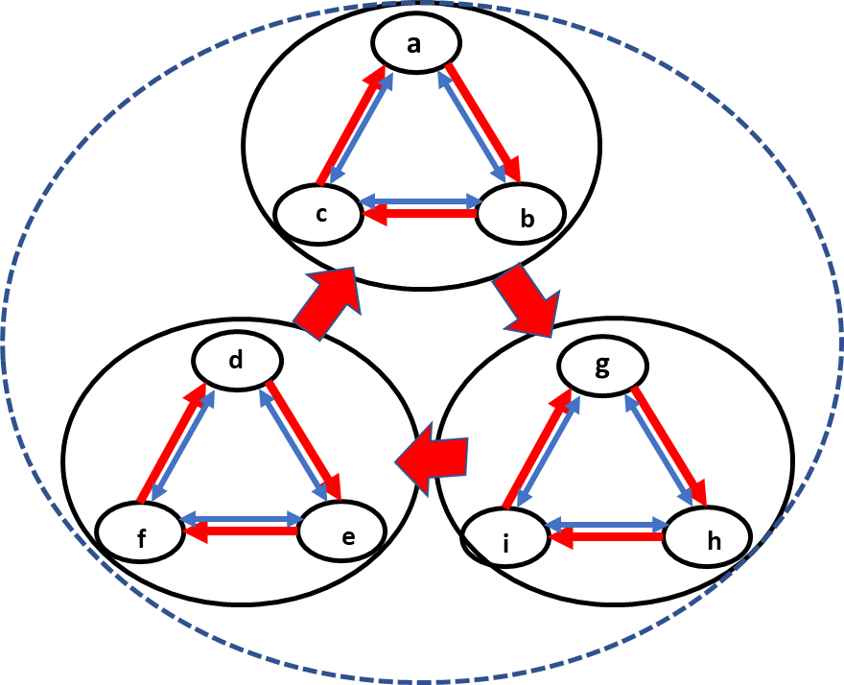
a
c
b
d
g
f
e
i
h

