Slide 1
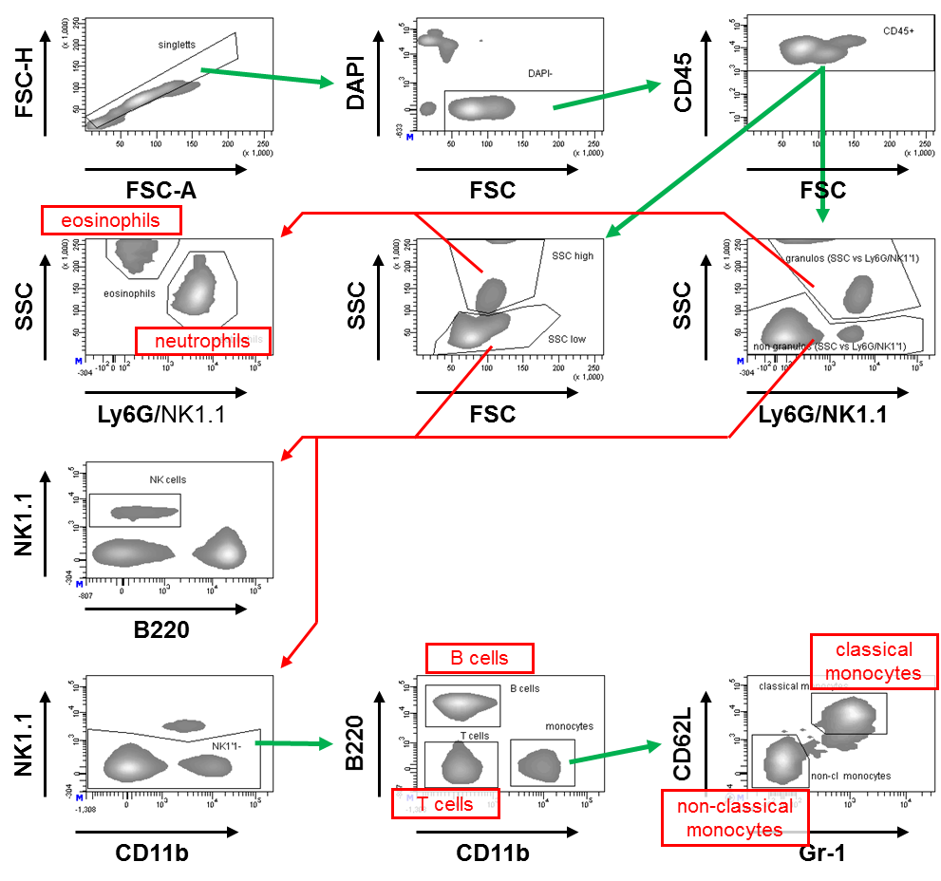
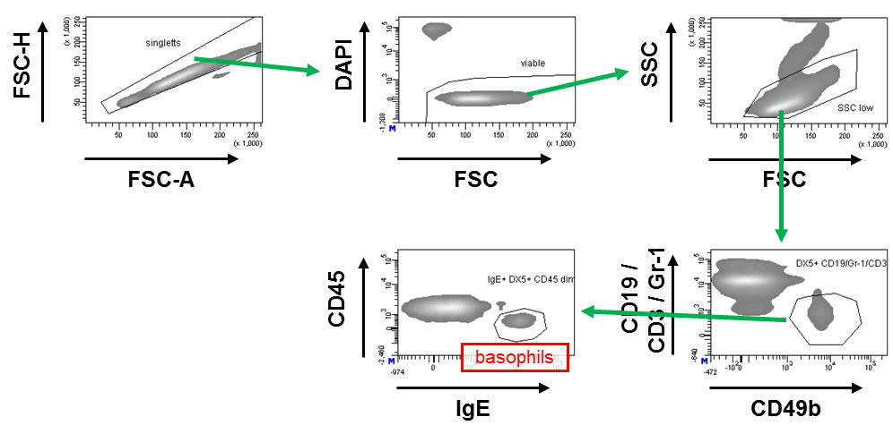
Supplementary Figure S1
A
B

Slide 2
Supplementary Figure S1
Gating strategies for murine leukocytes.
Depicted is a typical gating strategies for murine leukocyte subpopulations. Further analysis of a cell population defined by a distinct gate is indicated by green arrows originating from that gate. Red arrows indicate further analysis of cells which combine features defined by the two originating gates (“intersection”, ≙ Boolean operator “AND” ).
A) Among aggregate-excluded (‘singletts’) viable (= DAPI negative) CD45⁺ leukocytes, granulocytes were identified by their high granularity resulting in their distinct light scatter characteristics (SSC^{high}) For this identification the SSC was plotted against both FSC and a fluorescence channel that represents staining for Ly6G and NK1.1. The intersection of highly granular populations in both plots defined the granulocyte population. Among those, neutrophils and eosinophils were distinguished by Ly6G expression of neutrophils and the high SSC of eosinophils. The intersection of populations with low SSC in the two abovementioned plots contains lymphocytes and monocytes. NK cells were defined by their NK1.1 expression. NK1.1 negative cell were distinguished as B220⁺ CD11b negative B cells, B220 negative CD11b negative T cells (whose identity was verified by additional CD3 or TCRß staining in several experiments), and CD11b^{high} monocytes. The latter are further discriminated as Gr-1⁺ CD62L⁺ classical monocytes and non-classical monocytes which are negative/low for both Gr-1 and CD62L.
B) Among aggregate-excluded viable murine leukocytes basophils were characterized as cells with low side-scatter characteristics which were negative for lineage markers CD19, CD3 and Gr-1 but were CD49b⁺ and positively stained for IgE.

Slide 3
Supplementary Figure S2
A
B
C
D
Supplementary Figure S2
Influence of Truestain Fc block on specific detection of Fcγ receptors.
Depicted are median fluorescence intensities of indicated peripheral human blood leukocyte populations - either untreated or pre-incubated with 5% (v/v) Truestain Fc block - upon staining with antibodies specific A) for FcγRI, B) for FcγRII,
C) for FcγRIIb or D) for FcγRIII.

Slide 4
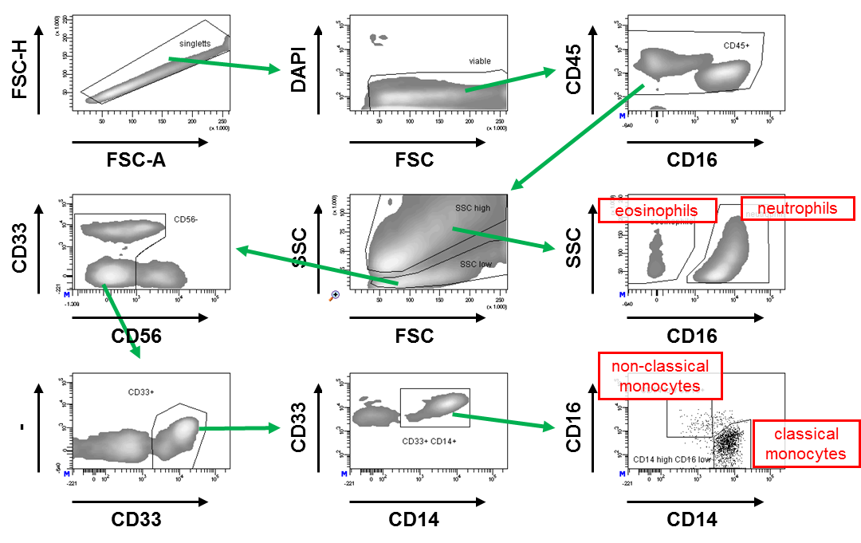
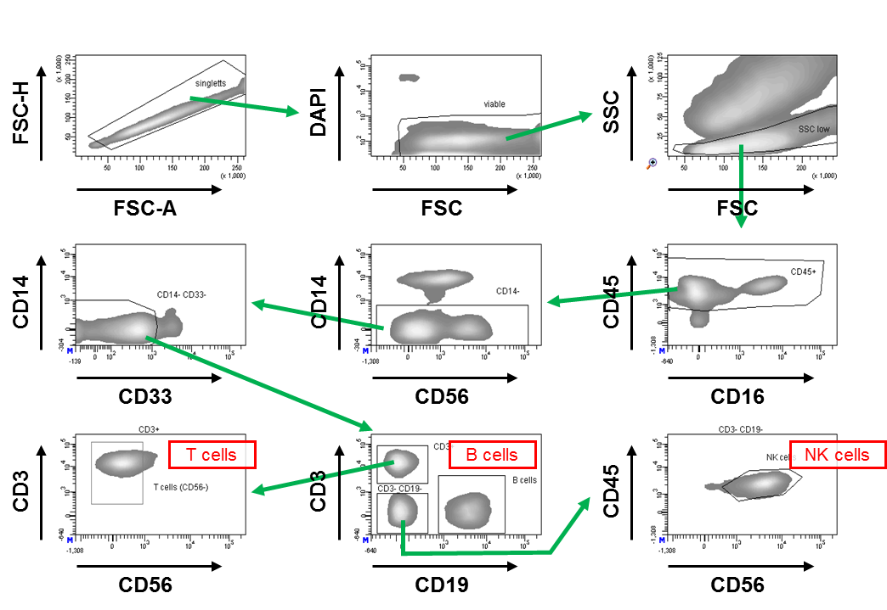
Supplementary Figure S3
A
B

Slide 5
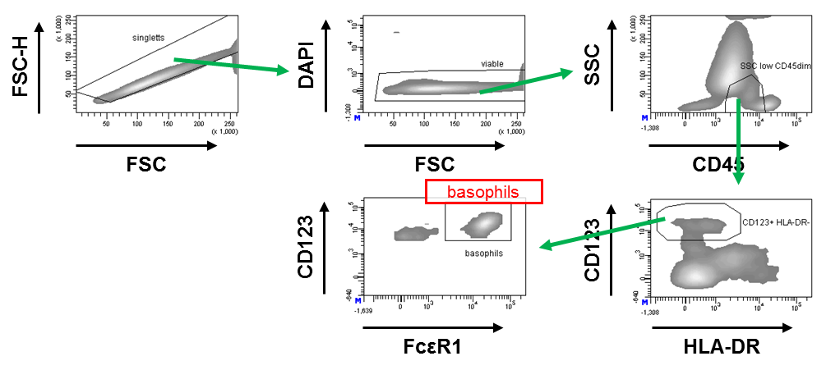
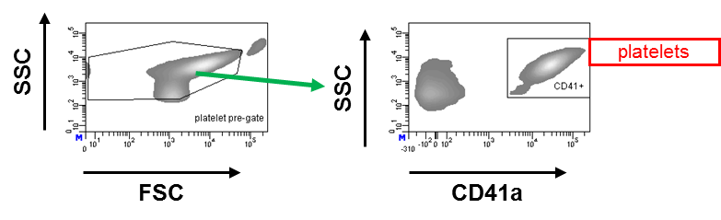
Supplementary Figure S3 (continued)
C
D
Supplementary Figure S3
Gating strategies for human peripheral blood leukocytes.
Depicted are typical gating strategy for human leukocyte subpopulations (i.e. neutrophils, eosinophils and monocytes (A), B cells, T cells and NK cells (B) and basophils (C) as well as platelets (D). Further analysis of a cell population defined by a distinct gate is indicated by green arrows originating from that gate.
A) Among aggregate-excluded (‘singlet’) viable (= DAPI negative) CD45⁺ leukocytes, neutrophils and eosinophils were identified by their high granularity resulting in their distinct light scatter characteristics (SSC^{high}) and distinguished from monocytes by the high CD33 expression of the latter. Within these SSC^{high} cells neutrophils and eosinophils were distinguished by CD16 expression of neutrophils (and/or the intrinsic auto-fluorescence of the eosinophils). Among the SSC^{low} cells monocytes can be characterized among CD56 negative cells as CD33⁺ CD14⁺ cells which are further distinguished as classical CD14^{high} CD16^{low} and much less frequent non-classical CD14^{low} CD16⁺ monocytes. B) Among the CD14⁻ CD33⁻ population of singular viable SSC^{low} CD45⁺ leukocytes, B cells were identified by their expression of CD19 and T cells as CD3⁺ CD56⁻ cells. The remaining CD19⁻ CD3⁻ leukocytes are mainly CD56⁺ NK cells. C) Among the singular viable SSC^{low} CD45^{dim} leukocytes, basophils were identified as CD123⁺ HLA-DR negative cells which were positively stained for IgE receptor FcεR1. D) Platelets were characterized by their small size as reflected by low light scatter and by their expression of CD41a.

Slide 6
Supplementary Figure S4
Supplementary Figure S4
Titration of anti-FcγRII clone IV.3 on human leukocyte populations.
Depicted are the fluorescence intensities of the indicated cell populations upon staining with serial dilutions of PE conjugated anti-FcγRII clone IV.3. Cells were stained either without blocking of FcγRIIb or after pre-incubation with anti-FcγRIIb antibody 2B6-N297Q.

Slide 7
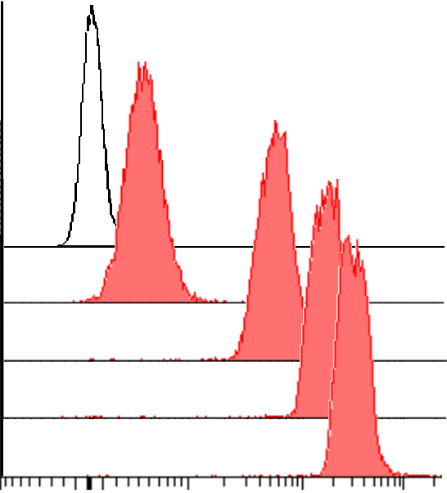
Supplementary Figure S5
A
non-classical
monocytes
classical
monocytes
eosinophils
neutrophils
FMO
anti-FcγRI
B cells
T cells
NK cells
numbers
FMO
anti-FcγRI
fluorescence
intensity
B
C
QSC anti-mouse IgG beads
with anti-huFcγRI-PE
MFI:
bead:
B 5
#1 418
#2 5501
numbers
#3 16149
#4 30231
fluorescence
intensity

Slide 8
Supplementary Figure S5 (continued)
D

Slide 9
Supplementary Figure S5 (continued)
E
 | Channel |  | ABC calc
B cells |  |  |  |  | B cells | ABC | = ABC calc_{anti-CD64} - ABC calc_{FMO}
donor 1 FMO | 11 |  | 68 |  | donor 1 | 53
donor 2 FMO | 19 |  | 121 |  | donor 2 | 68
donor 3 FMO | 19 |  | 121 |  | donor 3 | 34
donor 4 FMO | 14 |  | 88 |  | donor 4 | 88
donor 5 FMO | 13 |  | 81 |  | donor 5 | 20
donor 6 FMO | 17 |  | 108 |  | donor 6 | 61
donor 1 + anti-CD64 | 19 |  | 121
donor 2 + anti-CD64 | 29 |  | 189
donor 3 + anti-CD64 | 24 |  | 155
donor 4 + anti-CD64 | 27 |  | 176
donor 5 + anti-CD64 | 16 |  | 101
donor 6 + anti-CD64 | 26 |  | 169
non-classical monocytes |  |  |  |  | non-cl. monocytes | ABC
donor 1 FMO | 53 |  | 359 |  | donor 1 | 5866
donor 2 FMO | 48 |  | 323 |  | donor 2 | 6011
donor 3 FMO | 44 |  | 294 |  | donor 3 | 8444
donor 4 FMO | 34 |  | 224 |  | donor 4 | 3534
donor 5 FMO | 44 |  | 294 |  | donor 5 | 26658
donor 6 FMO | 85 |  | 591 |  | donor 6 | 2285
donor 1 + anti-CD64 | 786 |  | 6225
donor 2 + anti-CD64 | 799 |  | 6334
donor 3 + anti-CD64 | 1083 |  | 8739
donor 4 + anti-CD64 | 488 |  | 3759
donor 5 + anti-CD64 | 3139 |  | 26952
donor 6 + anti-CD64 | 379 |  | 2876
classical monocytes |  |  |  |  | class. monocytes | ABC
donor 1 FMO |  | 27 | 176 |  | donor 1 | 65900
donor 2 FMO |  | 23 | 148 |  | donor 2 | 77438
donor 3 FMO |  | 34 | 224 |  | donor 3 | 97347
donor 4 FMO |  | 23 | 148 |  | donor 4 | 77332
donor 5 FMO |  | 15 | 94 |  | donor 5 | 125415
donor 6 FMO |  | 24 | 155 |  | donor 6 | 75871
donor 1 + anti-CD64 |  | 7324 | 66075
donor 2 + anti-CD64 |  | 8524 | 77586
donor 3 + anti-CD64 |  | 10585 | 97571
donor 4 + anti-CD64 |  | 8513 | 77480
donor 5 + anti-CD64 |  | 13428 | 125509
donor 6 + anti-CD64 |  | 8362 | 76026
NK cells |  |  |  |  | NK cells | ABC
donor 1 FMO |  | 35 | 231 |  | donor 1 | 106
donor 2 FMO |  | 27 | 176 |  | donor 2 | 183
donor 3 FMO |  | 28 | 183 |  | donor 3 | 133
donor 4 FMO |  | 29 | 189 |  | donor 4 | -21
donor 5 FMO |  | 13 | 81 |  | donor 5 | 150
donor 6 FMO |  | 34 | 224 |  | donor 6 | 42
donor 1 + anti-CD64 |  | 50 | 337
donor 2 + anti-CD64 |  | 53 | 359
donor 3 + anti-CD64 |  | 47 | 316
donor 4 + anti-CD64 |  | 26 | 169
donor 5 + anti-CD64 |  | 35 | 231
donor 6 + anti-CD64 |  | 40 | 266
T cells |  |  |  | T cells | ABC
donor 1 FMO | 21 | 135 |  | donor 1 | 62
donor 2 FMO | 22 | 141 |  | donor 2 | 62
donor 3 FMO | 26 | 169 |  | donor 3 | 28
donor 4 FMO | 20 | 128 |  | donor 4 | 41
donor 5 FMO | 15 | 94 |  | donor 5 | 68
donor 6 FMO | 30 | 196 |  | donor 6 | 42
donor 1 + anti-CD64 | 30 | 196
donor 2 + anti-CD64 | 31 | 203
donor 3 + anti-CD64 | 30 | 196
donor 4 + anti-CD64 | 26 | 169
donor 5 + anti-CD64 | 25 | 162
donor 6 + anti-CD64 | 36 | 238
neutrophils |  |  |  | neutrophils | ABC
donor 1 FMO | 90 | 628 |  | donor 1 | 1059
donor 2 FMO | 79 | 547 |  | donor 2 | 1156
donor 3 FMO | 79 | 547 |  | donor 3 | 5728
donor 4 FMO | 70 | 481 |  | donor 4 | 612
donor 5 FMO | 56 | 380 |  | donor 5 | 6736
donor 6 FMO | 89 | 621 |  | donor 6 | 1372
donor 1 + anti-CD64 | 229 | 1688
donor 2 + anti-CD64 | 231 | 1703
donor 3 + anti-CD64 | 792 | 6275
donor 4 + anti-CD64 | 152 | 1094
donor 5 + anti-CD64 | 892 | 7116
donor 6 + anti-CD64 | 268 | 1993
eosinophils |  |  |  | eosinophils | ABC
donor 1 FMO | 339 | 2556 |  | donor 1 | 910
donor 2 FMO | 359 | 2716 |  | donor 2 | 1239
donor 3 FMO | 363 | 2748 |  | donor 3 | 1076
donor 4 FMO | 413 | 3150 |  | donor 4 | -177
donor 5 FMO | 419 | 3198 |  | donor 5 | 10736
donor 6 FMO | 404 | 3077 |  | donor 6 | 170
donor 1 + anti-CD64 | 452 | 3466
donor 2 + anti-CD64 | 512 | 3954
donor 3 + anti-CD64 | 496 | 3824
donor 4 + anti-CD64 | 391 | 2973
donor 5 + anti-CD64 | 1683 | 13934
donor 6 + anti-CD64 | 425 | 3247
Supplementary Figure S5
Exemplary calculation of ABCs for anti-FcγR antibodies using the example of human FcγRI.
Depicted are histograms of the indicated cell populations of one of the donors, showing FMO controls and probes upon staining with anti-FcγRI-PE antibody (A), as well as histograms of the QSC reference beads accordingly stained with anti-FcγRI-PE antibody (B). In C) the calibration blot of the Quickcal program is shown, which is gained by fitting the measured MFI values (“Channels”) of the QSC bead to their known numbers of antibody binding sites. This calibration curve is used by Quickcal software to calculate the individual ABC values of cell populations based on their MFI as shown in D). In E) the calculation of the respective MFI values is depicted, which is achieved by subtracting from the ABC values of anti-FcγRI-incubated cell populations their virtual ‘background’ ABC values that correspond to their intrinsic fluorescence in the absence of anti-FcγRI antibody.

Slide 10
Supplementary Figure S6
Supplementary Figure S6
Activating Fc gamma receptors on PBLs of FcγR knockout mice.
Depicted are numbers of individual anti-FcγR binding sites for Fcγ receptors I and IV on activating-receptor expressing PBLs of C57BL/6 wt mice and mice lacking one of the activating receptors, respectively (n=5-6).

Slide 11
Supplementary Figure S7
Supplementary Figure S7
Activating Fc gamma receptors on PBLs of FcγRIIb knockout mice.
Depicted are numbers of individual anti-FcR binding sites for Fcγ receptors I, and IV on activating-receptor expressing PBLs of C57BL/6 wt mice and mice lacking FcγRIIb from one of two experiments. (n=4-5)

Slide 12
Supplementary Figure S8
classical
monocytes
non-classical
monocytes
B cells
Supplementary Figure S8
Correlation of FcγRIIb expression with FcγIIIa haplotypes in human donors.
Individual values are depicted for classical monocytes, non-classical monocytes and B cells. Data from individuals bearing the low affinity haplotype of FcγRIIIa, - i.e. being homozygous with phenylalanine at position 158 - are depicted in red, those with the high affinity haplotype bearing at least one valine allele are shown in blue. Depicted are values from two measurements with ten donors (bright red and blue symbols) and six donors (dark red and blue symbols), respectively.

Slide 13
Supplementary Figure S9
A
age
non-classical monocytes
B
sample#
1
3
4,13,16
2,11,12,
9
5,6,15
7,8,10,14
haplotype
non-classical monocytes
Supplementary Figure S9
Overview on age and FcγRIIa / FcγRIIIa haplotypes with respect to ABC values
for FcγRIIb.
Depicted is the age and haplotype together with the respective FcγRIIb expression values shown exemplary for the non-classical monocytes.
In A) the age of the donors upon blood donation is shown. In B) the respective FcγRIIa and FcγRIIIa haplotypes pertaining to the individual samples are depicted. The color of the left side of the individual symbols reflects the R/R low affinity (red) or H/R heterozygous (light blue) and H/H homozygous (blue) high affinity FcγRIIa haplotype; the color of the right side reveals the FcγRIIIa haplotype (F/F, red; V/F, light blue; V/V blue). Samples 1-10 are derived from a random cohort, 11-16 from a cohort selected to contain two representatives of each of the FcγRIIIa haplotypes 158 V/V, 158 V/F and 158 F/F.

Slide 14
Supplementary Figure 10
A
donor:
a
b
c
d
e
f
classical
monocytes
non-classical
monocytes
eosinophils
FcγRIIb
basophils
FcγRI
FcγRIIa
FcγRIII
B
classical monocytes
non-classical monocytes
a
b
c
d
e
f
a
b
c
d
e
f
eosinophils
basophils
a
b
c
d
e
f
a
b
c
d
e
f
C
donor:
FcγRIIIa:
FcγRIIa:
a
V/V
H/R
b
V/V
H/R
c
F/V
H/R
d
F/V
H/R
e
F/F
H/R
f
F/F
R/R

Slide 15
Supplementary Figure 10:
Individual FcγR expression patterns.
Depicted are anti-FcγR binding sites for Fcγ receptors I (black), IIa (purple),
III (orange) and inhibitory IIb (red) on classical and non-classical monocytes, eosinophils and basophils - of individual donors. Respective fractions among all activating FcγR are depicted in A). In B) absolute numbers of respective anti-FcγR antibody binding sites are shown. In C) FcγRIIa and FcγRIIIa haplotypes of the individual donors are presented.

