Slide 1
Supplementary Figures

Slide 2
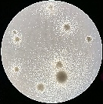
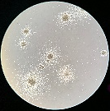
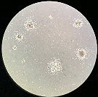
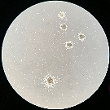
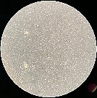
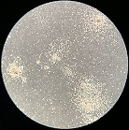
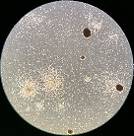
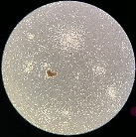
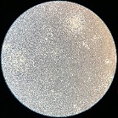
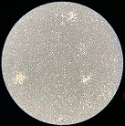
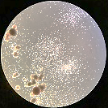
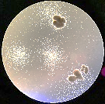
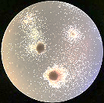
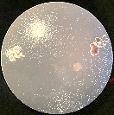
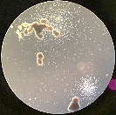
Figure S1
A
B
0
1
3
6
10
C
ISC-4 (µM)
AML
Pt. 1290
AML
Pt. 1241
CB MNCs
Figure S1. A) IC₅₀ values of single-agent treatments or a combination of constant ISC-4 (5 µM) with increasing AraC (0.75-24 µM) concentrations at 24, 48 and 72 h. B) Representative images of colonies of primary AML and cord blood (CB MNCs) cells exposed to ISC-4 (1-10 µM) for 7-14 days in a methylcellulose media. 4X magnification. C) Clonogenicity of cells pretreated with ISC-4 for 24 hours.

Slide 3
Figure S2
A
B
Frequency (%)
94.6
60.5
8.6
8.8
Frequency (%)
3.3
2.4
87.4
4.8
Figure S2. A) Effect of ISC-4 on normal premature cells (CD34+ or CD123+) in cord blood (CB MNCs). B) Viability of normal T (CD3+), B (CD19+) or myeloid (CD11b+) cells in response to ISC-4 treatment in normal peripheral blood mononuclear cells (PBMC). The frequency of cell populations in the samples shown on the right panel. Viability was assessed by 7AAD staining.

Slide 4
Figure S3
A
B
Figure S3. Efficacy of ISC-4 on apoptosis at various time points in (A) MV4-11 and OCI-AML3; and (B) primary human AML cells. Data are the mean ± standard deviation (SD)

Slide 5
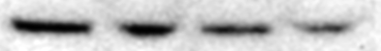
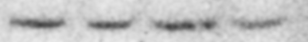
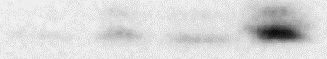
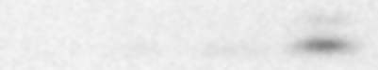
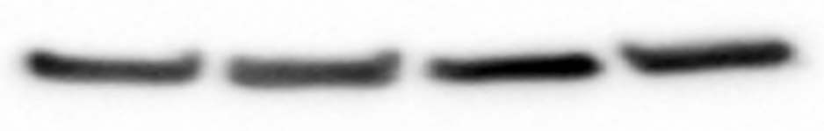
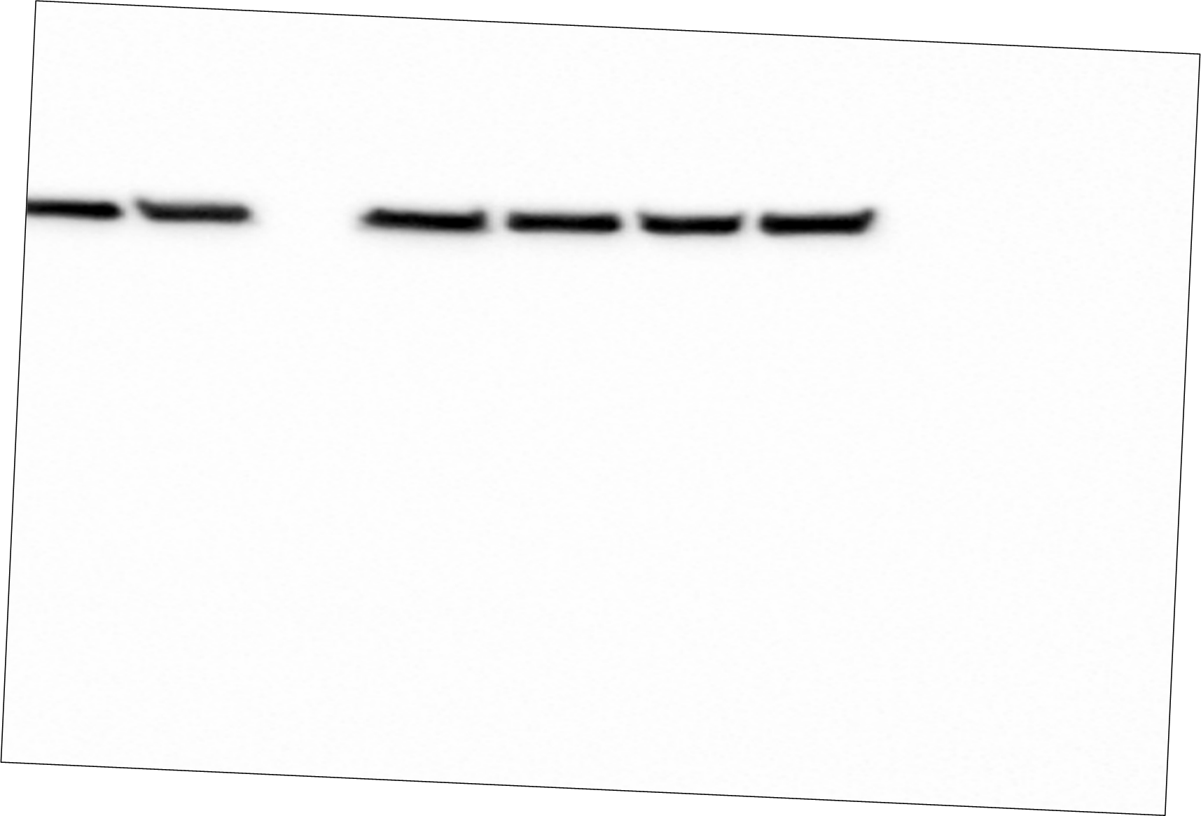
Figure S4
A
OCI-AML3
B
6 h
12 h
ISC-4 (µM)
0
1
1.5
3
0
1
1.5
3
Phospho-Akt (Ser473)
60 kDa
Akt
60 kDa
PARP
116 kDa
Cleaved PARP
89 kDa
Caspase-3
30 kDa
C
Cleaved Caspase-3
19 kDa
Caspase-9
47 kDa
Cleaved Caspase-9
37 kDa
GAPDH
37 kDa
Figure S4. A) Western blot analysis of OCI-AML3 cells exposed to increasing concentrations of ISC-4 for 6 or 12 hours. B) Flow cytometric analysis of multicaspases (caspases 1, 3, 4, 5, 6, 7, 8, and 9), and (C) mitochondrial membrane potential in OCI-AML3 cells after treatment with ISC-4 (1-10 µM) for 6 or 24 hours.

Slide 6
Figure S5
Figure S5. Bar graph showing changes in the cell cycle phases. ISC-4 (0.5-3 µM) treatment after 24 hours induces cell death as evidenced by increase in sub G0/G1 population (black bars).

Slide 7
Figure S6
Figure S6. Combinatory effect of ISC-4 with daunorubicin (DNR), azacitidine (Aza) or venetoclax (VEN) in AML cell lines (OCI-AML3, MV4-11 and U937).

Slide 8
Figure S7
Figure S7. Comparison of sensitivity of primary human AML cells with or without (wt.) indicated mutations (mut.) to ISC-4 treatment. Sensitivity was identified by IC₅₀ values. NS; not significant.

Slide 9
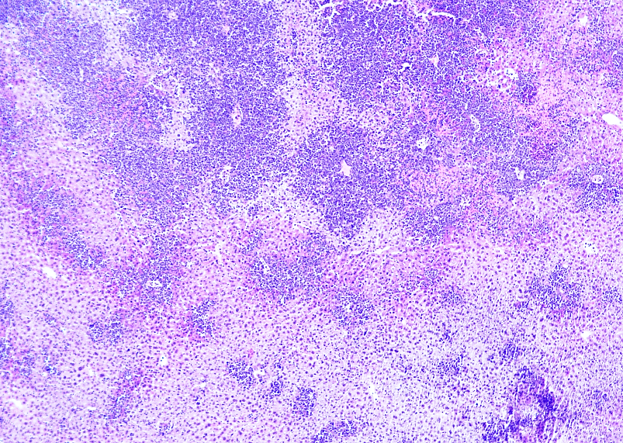
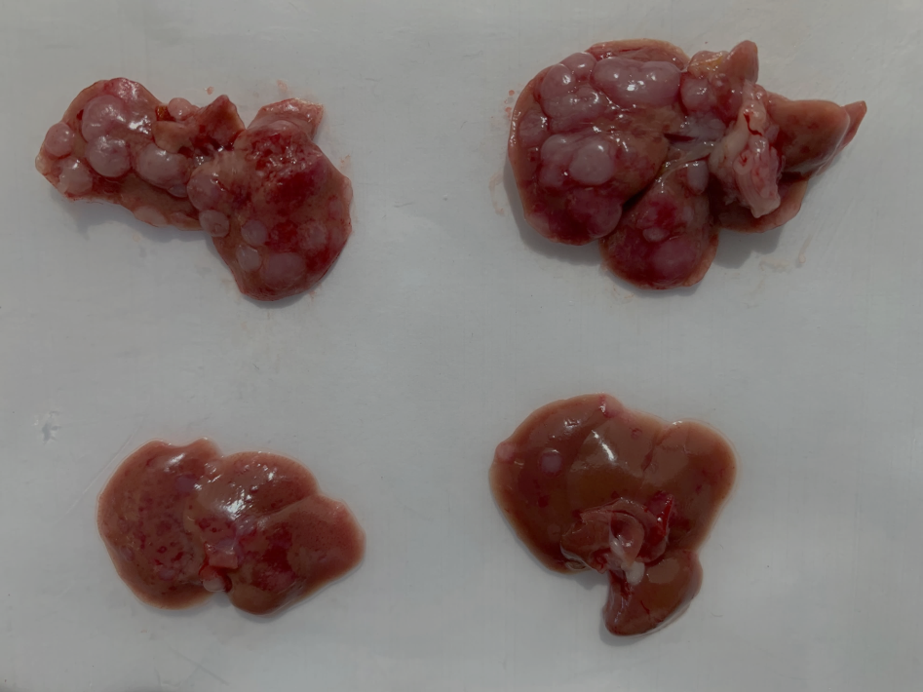
Figure S8
B
A
Control
ISC-4
(7 mg/kg)
Figure S8. ISC-4 reduces leukemic infiltration in the liver of mice. A) Luciferase and dsRed-expressing C1498 (C1498-dsRed-Luc)-bearing albino B6 mice (n=3) were treated either with vehicle control (DMSO) or ISC-4 (7 mg/kg). Gross anatomy of livers at termination of with chloromas (arrows). B) H&E-stained histology of liver sections from Albino B6 mice treated with control (upper) or ISC-4 (lower). Magnification 4X.

Slide 10
Figure S9
A
B
Figure S9. ISC-4 is not toxic to mice. C1498-Luc-dsRed-bearing Albino B6 mice were treated with either vehicle control or ISC-4 (7 mg/kg) A) No changes was observed in body weight or B) complete blood count (CBC) of animals throughout the study. NS; not significant.

