Slide 1
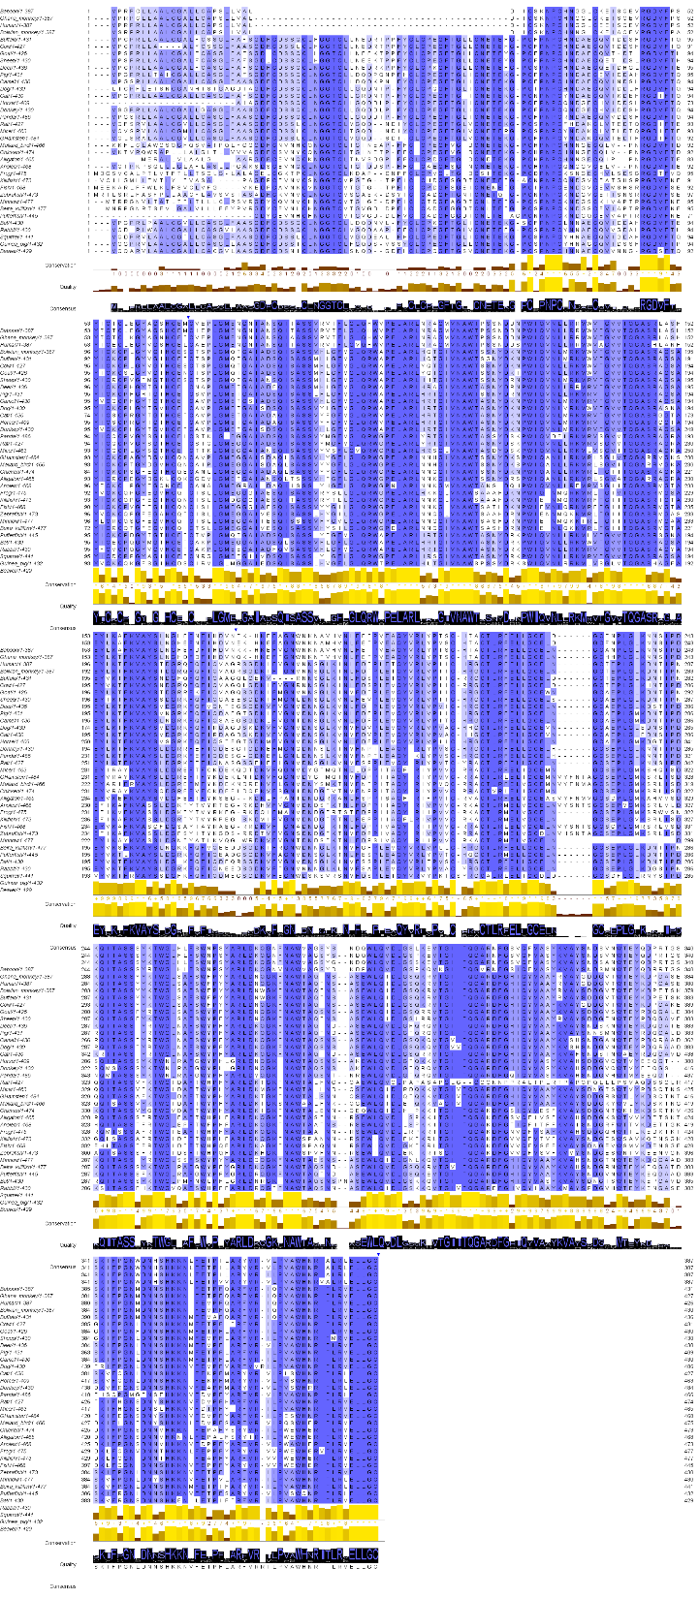
Supplementary Figure 1

Slide 2
Supplementary Figure 2

Slide 3
Supplementary Figure 3

Slide 4
Supplementary Figure 4

Slide 5
Supplementary Figure 5

Slide 6
Supplementary Figure 6

Slide 7
Supplementary Figure 7

