Slide 1
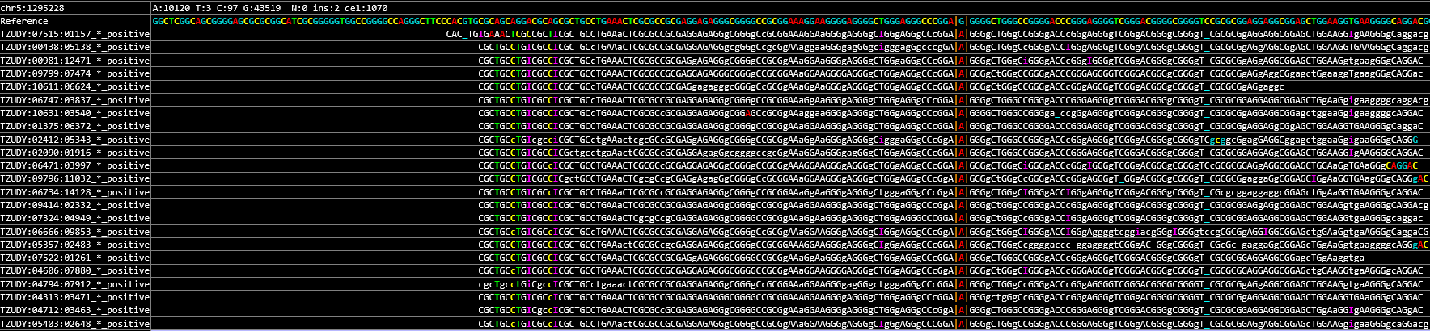
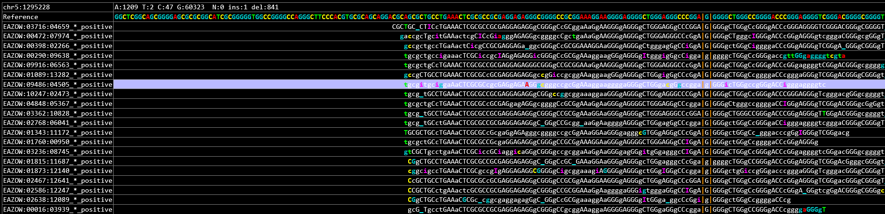
Supplementary Figure 1
The mutation IGV results of the patient:
A
The patient: TERT upstream promoter mutation-c.C228T (Chr5: 1295228)
TERT-c.C228T
Negative control sample
TERT-WT
Notes:
Supplementary Figure 1. The mutation IGV results of the patient. A-C. IGV results of TERT upstream promoter mutation (c.C228T (Chr5: 1295228)), CCDC6-RET fusion (CCDC6{NM_005436.4}:r.1_303+1_RET{NM_020975.4}:r.2137_5617) and TP53 mutation (c.842A>T (Chr17: 7577096)) of the patient's tumor sample and their corresponding IGV results of negative control sample.

Slide 2
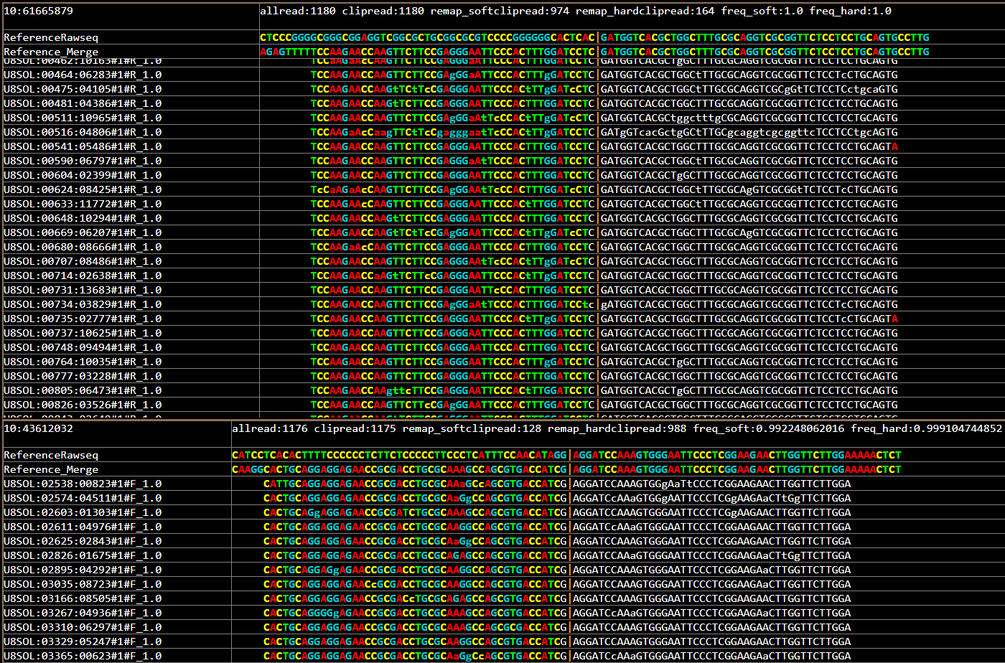
Supplementary Figure 1
The mutation IGV results of the patient:
B
The patient: CCDC6{NM_005436.4}:r.1_303+1_RET{NM_020975.4}:r.2137_5617
CCDC6
(NM_005436.4)
RET
(NM_020975.4)
CCDC6-RET mRNA
Ex1
Ex12-20
Tyrosine Kinase domain
PKinase
CCDC6（Chr10: 61,665,829-61,665,929）
RET（Chr10: 43,611,982-43,612,082）
Negative control sample
Notes:
Supplementary Figure 1. The mutation IGV results of the patient. A-C. IGV results of TERT upstream promoter mutation (c.C228T (Chr5: 1295228)), CCDC6-RET fusion (CCDC6{NM_005436.4}:r.1_303+1_RET{NM_020975.4}:r.2137_5617) and TP53 mutation (c.842A>T (Chr17: 7577096)) of the patient's tumor sample and their corresponding IGV results of negative control sample.

Slide 3
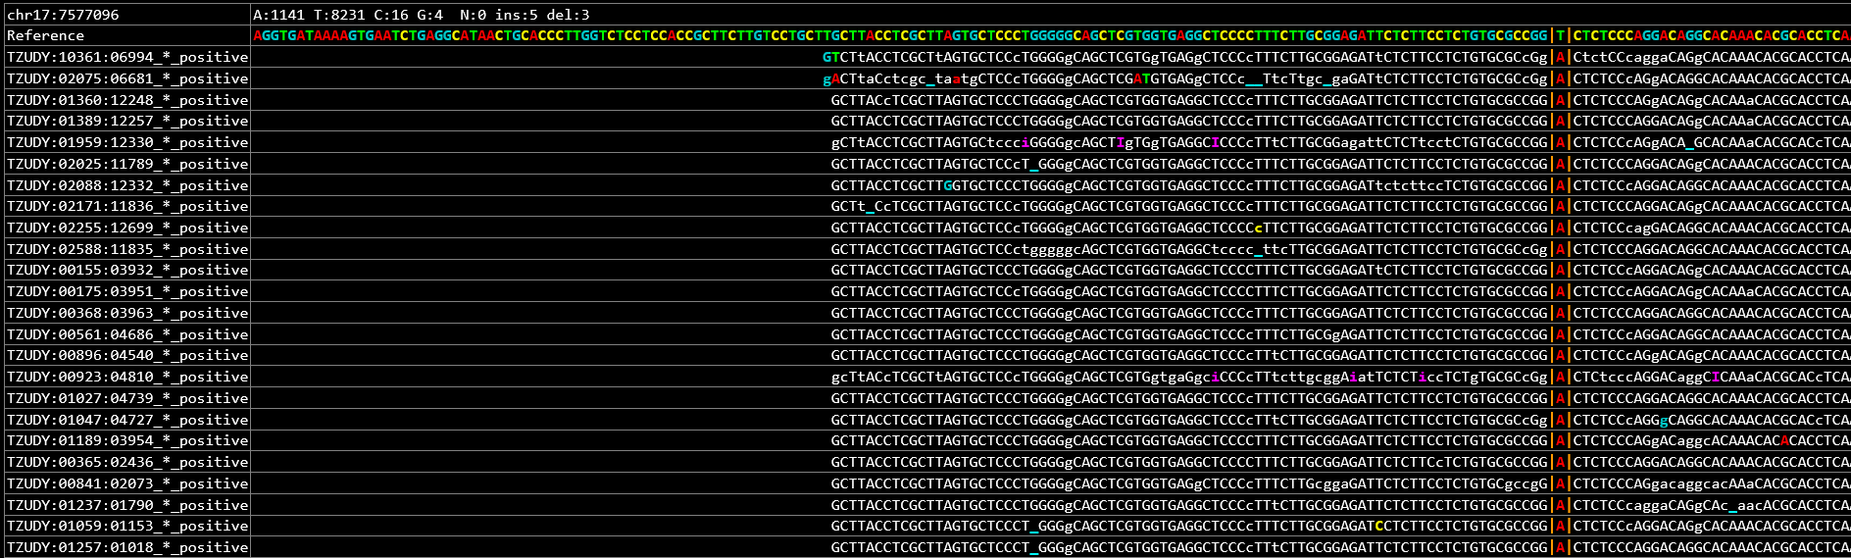
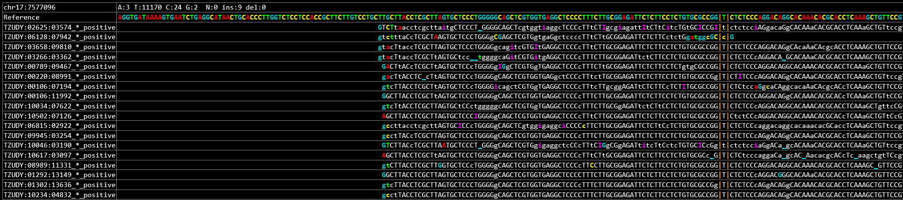
Supplementary Figure 1
The mutation IGV results of the patient:
C
The patient:TP53 mutation-c.842A>T (Chr17: 7577096)
TP53-c.842A>T
Negative control sample
TP53-WT
Notes:
Supplementary Figure 1. The mutation IGV results of the patient. A-C. IGV results of TERT upstream promoter mutation (c.C228T (Chr5: 1295228)), CCDC6-RET fusion (CCDC6{NM_005436.4}:r.1_303+1_RET{NM_020975.4}:r.2137_5617) and TP53 mutation (c.842A>T (Chr17: 7577096)) of the patient's tumor sample and their corresponding IGV results of negative control sample.

Slide 4
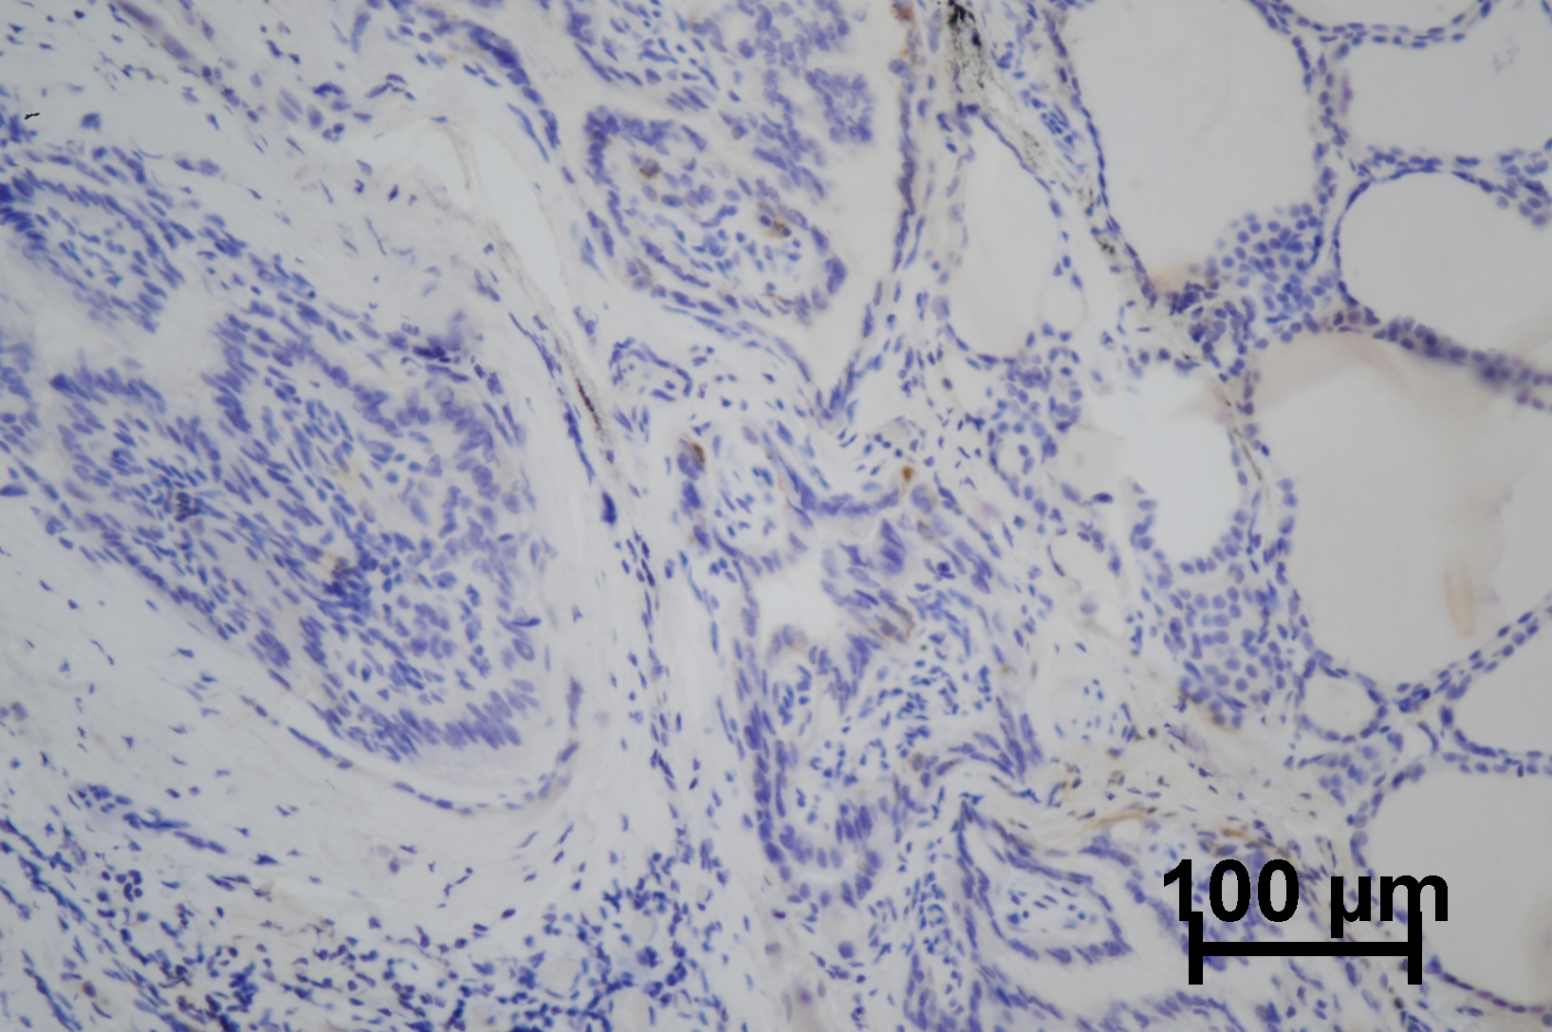
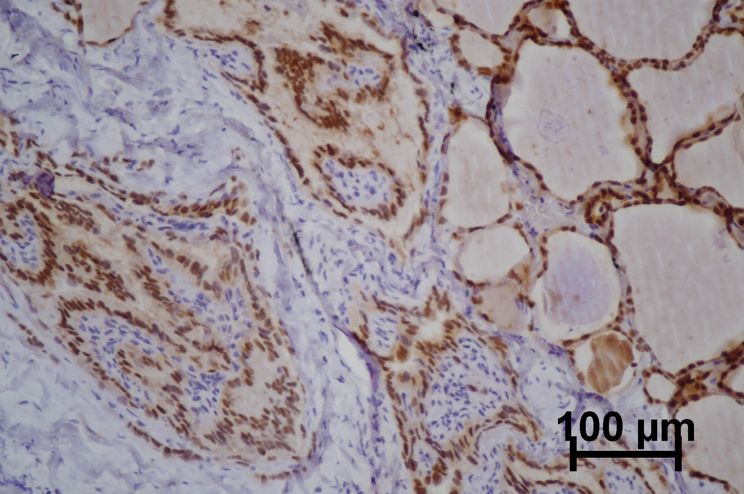
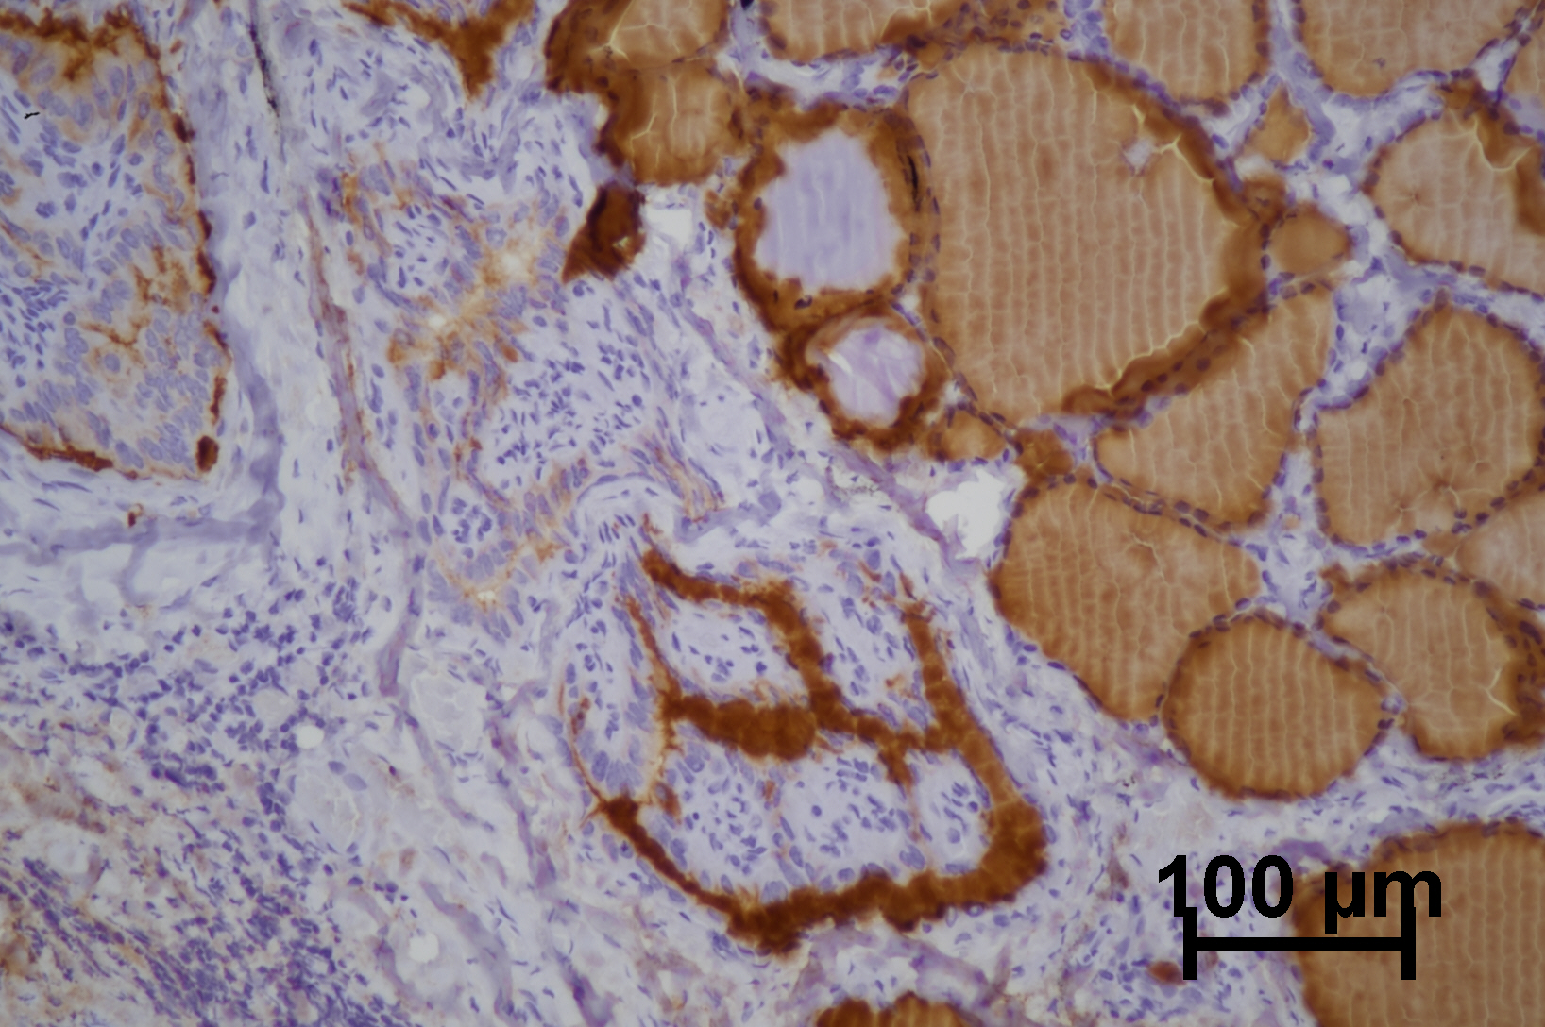
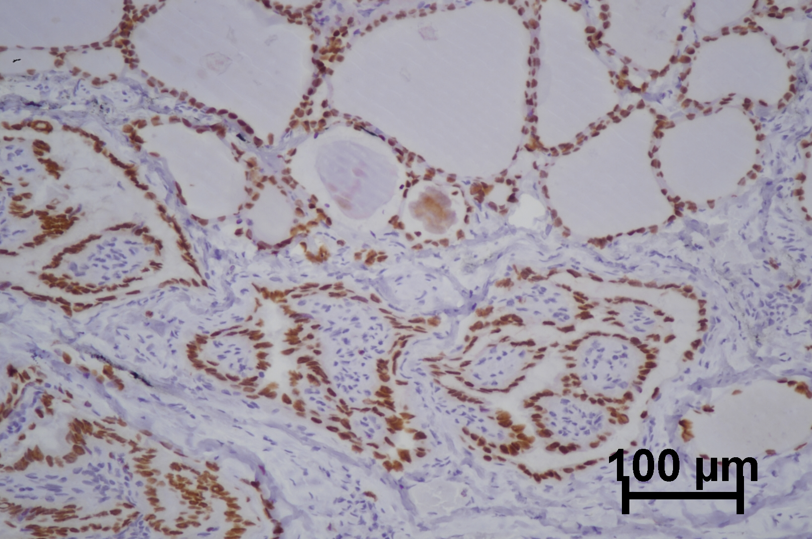
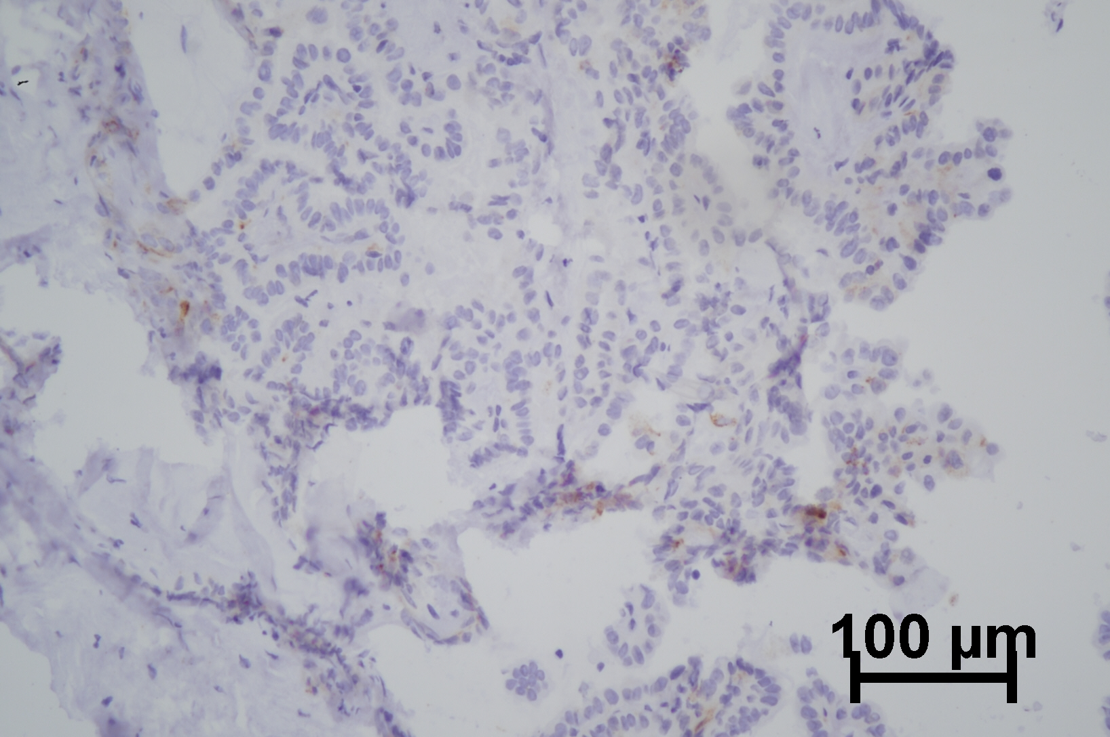
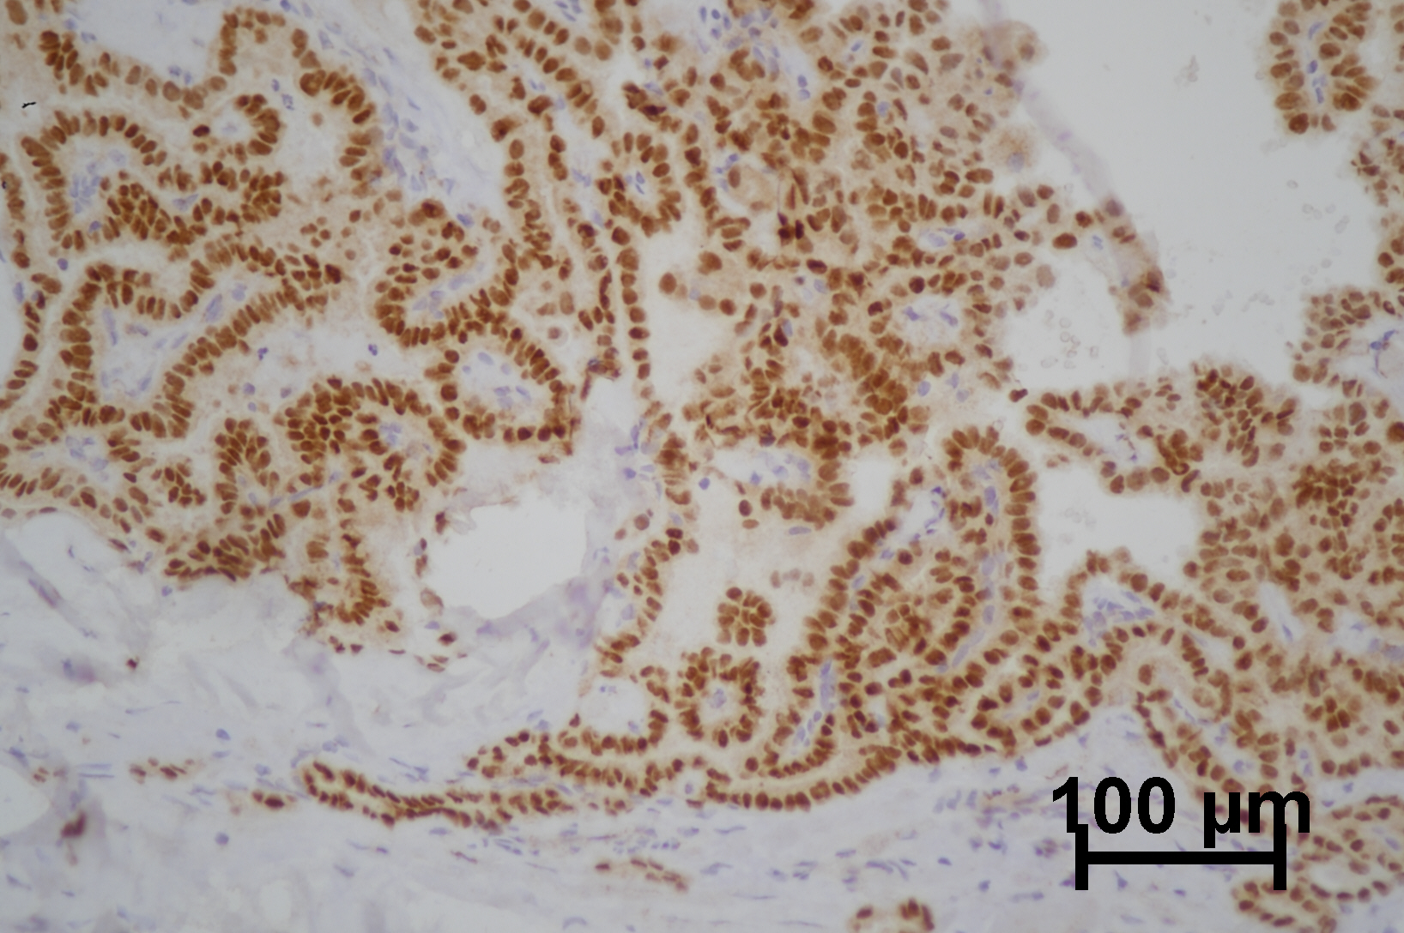
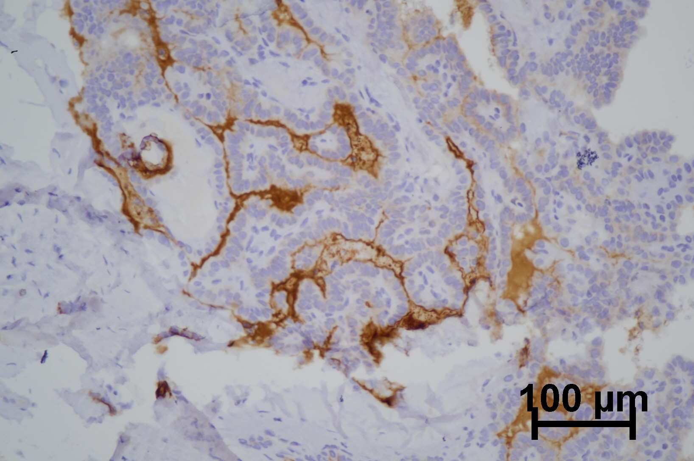
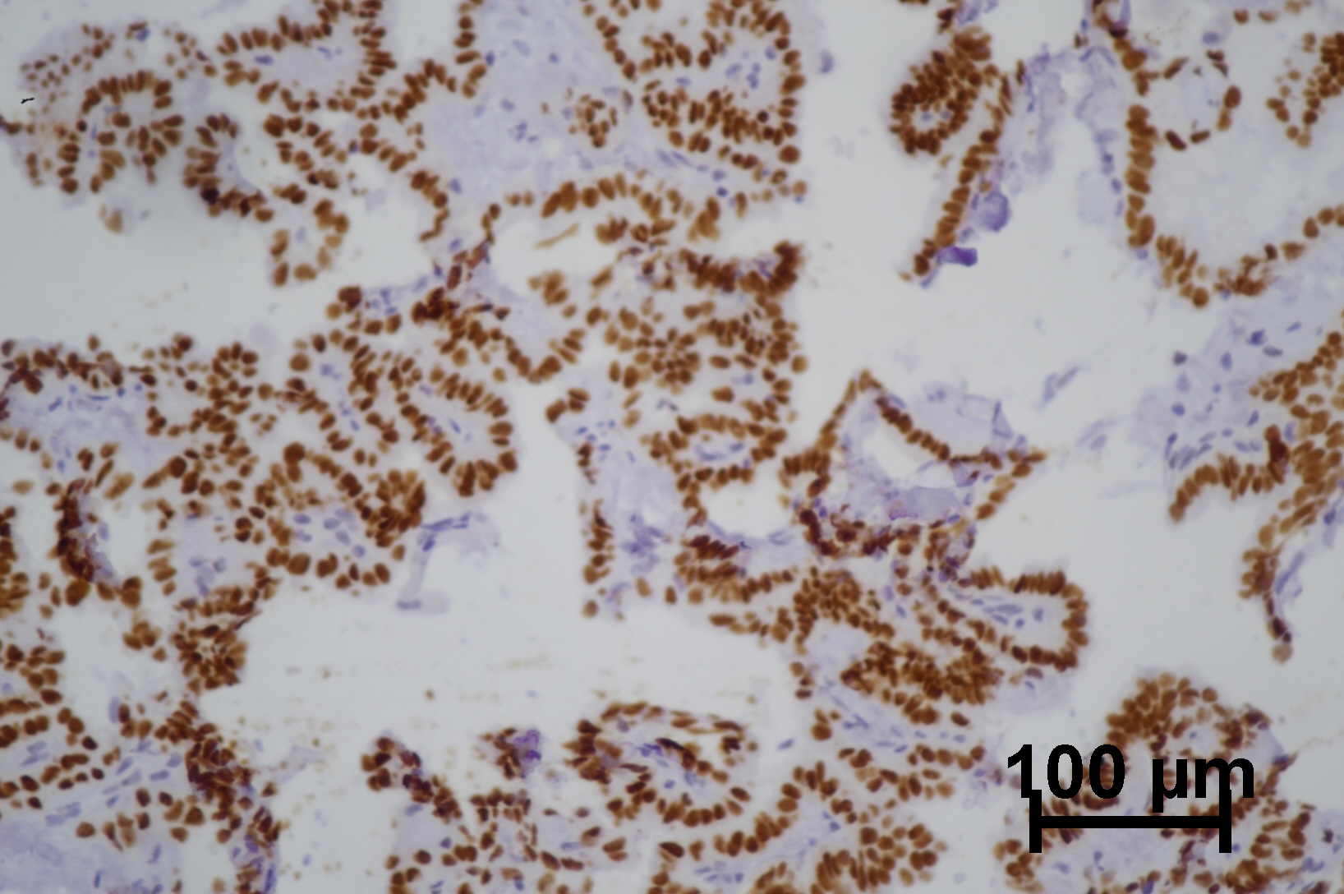
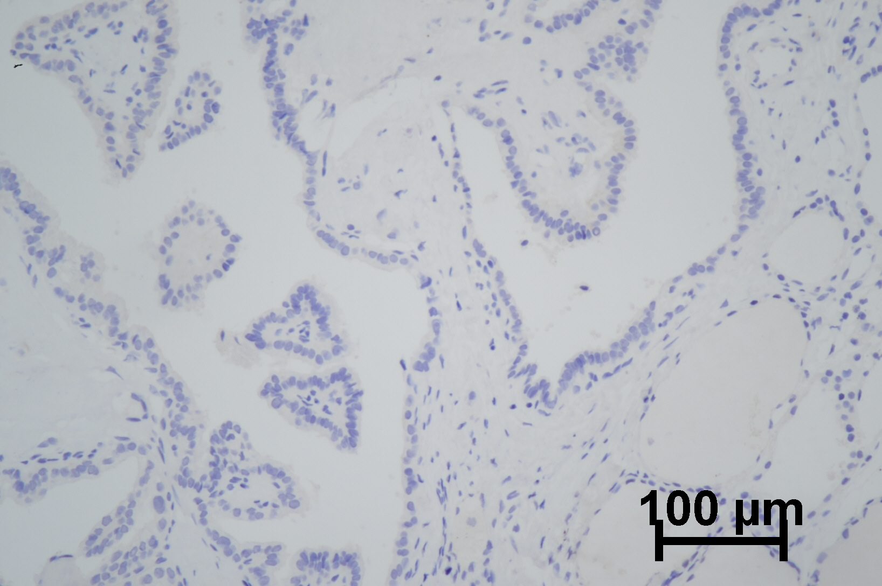
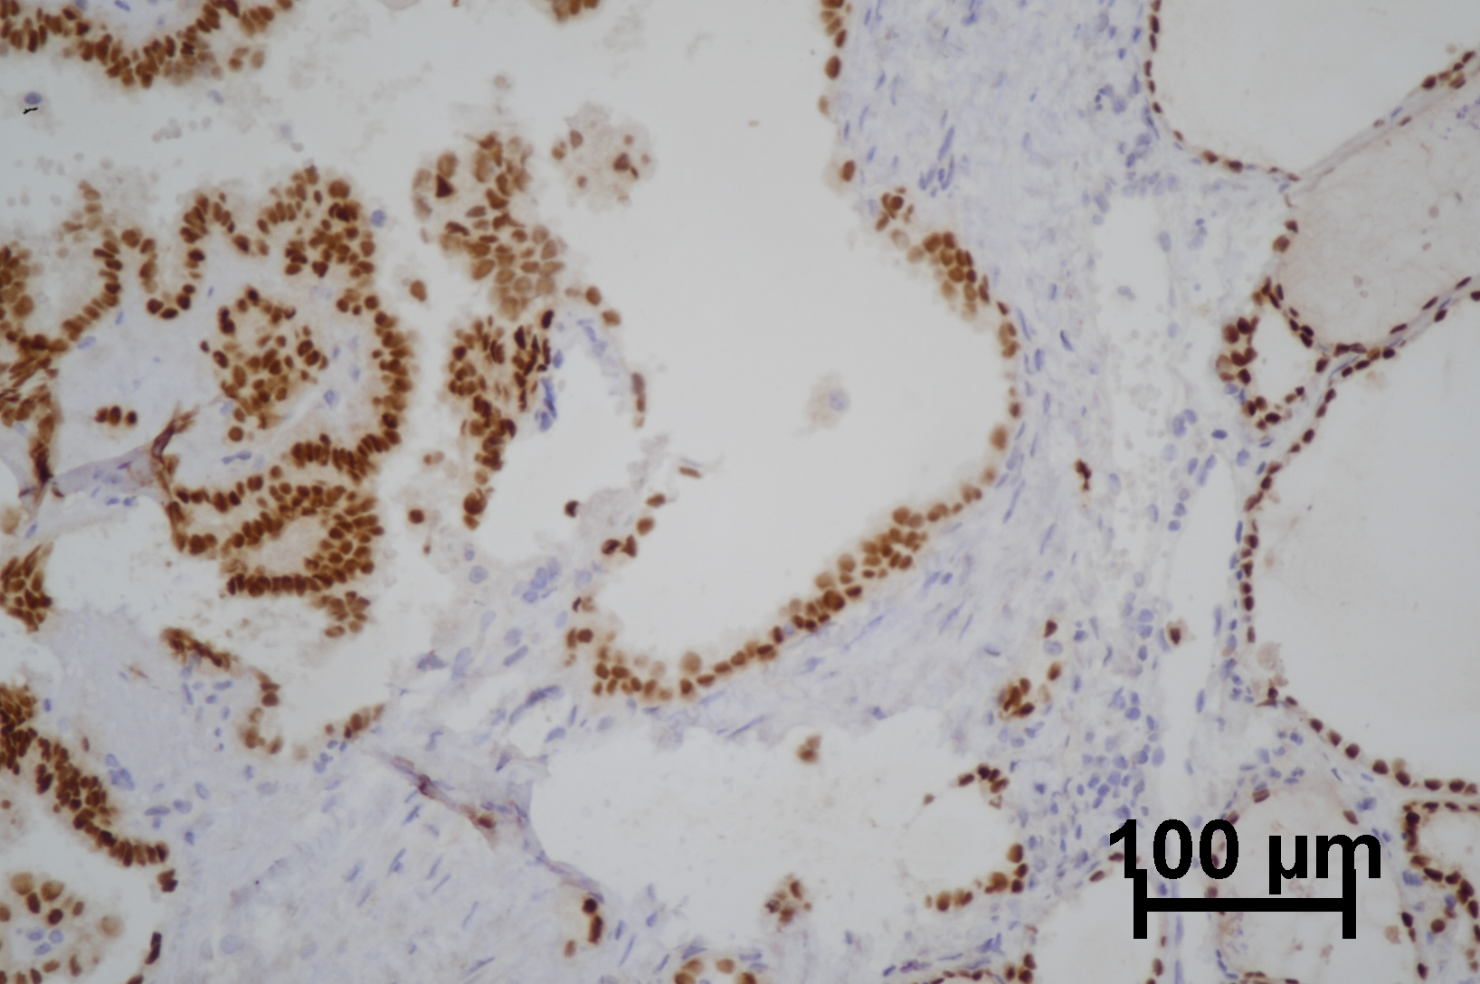
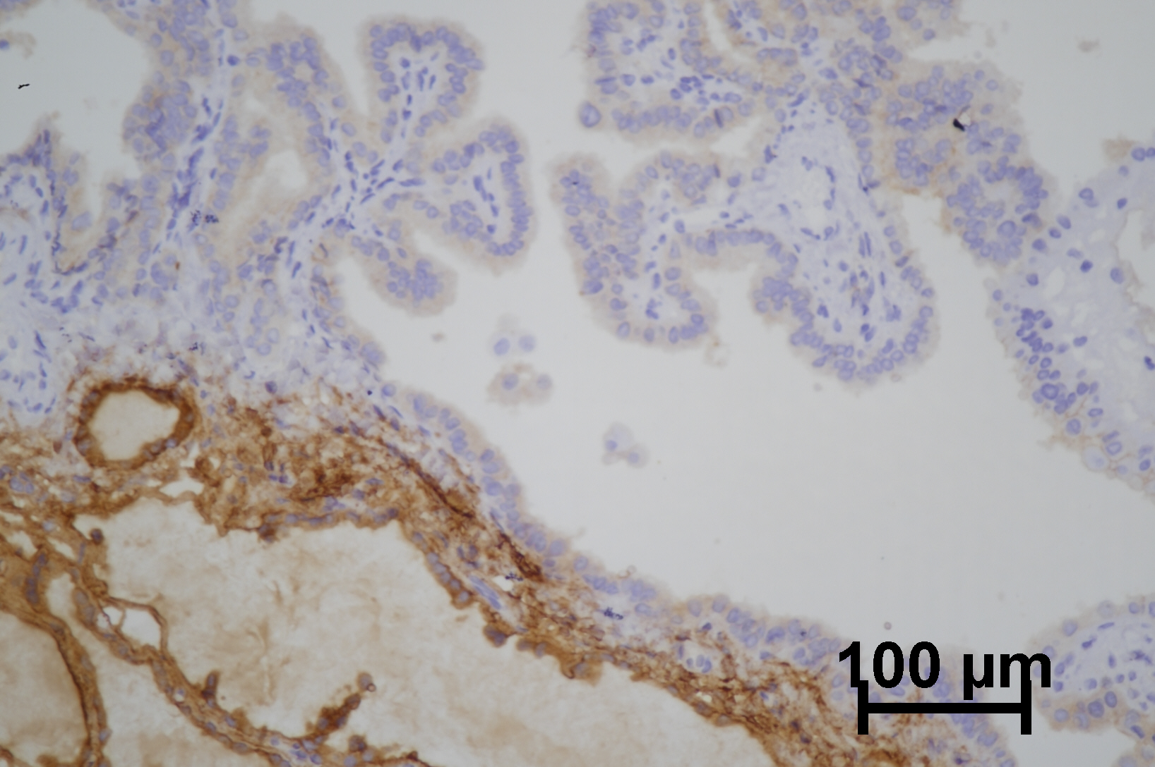
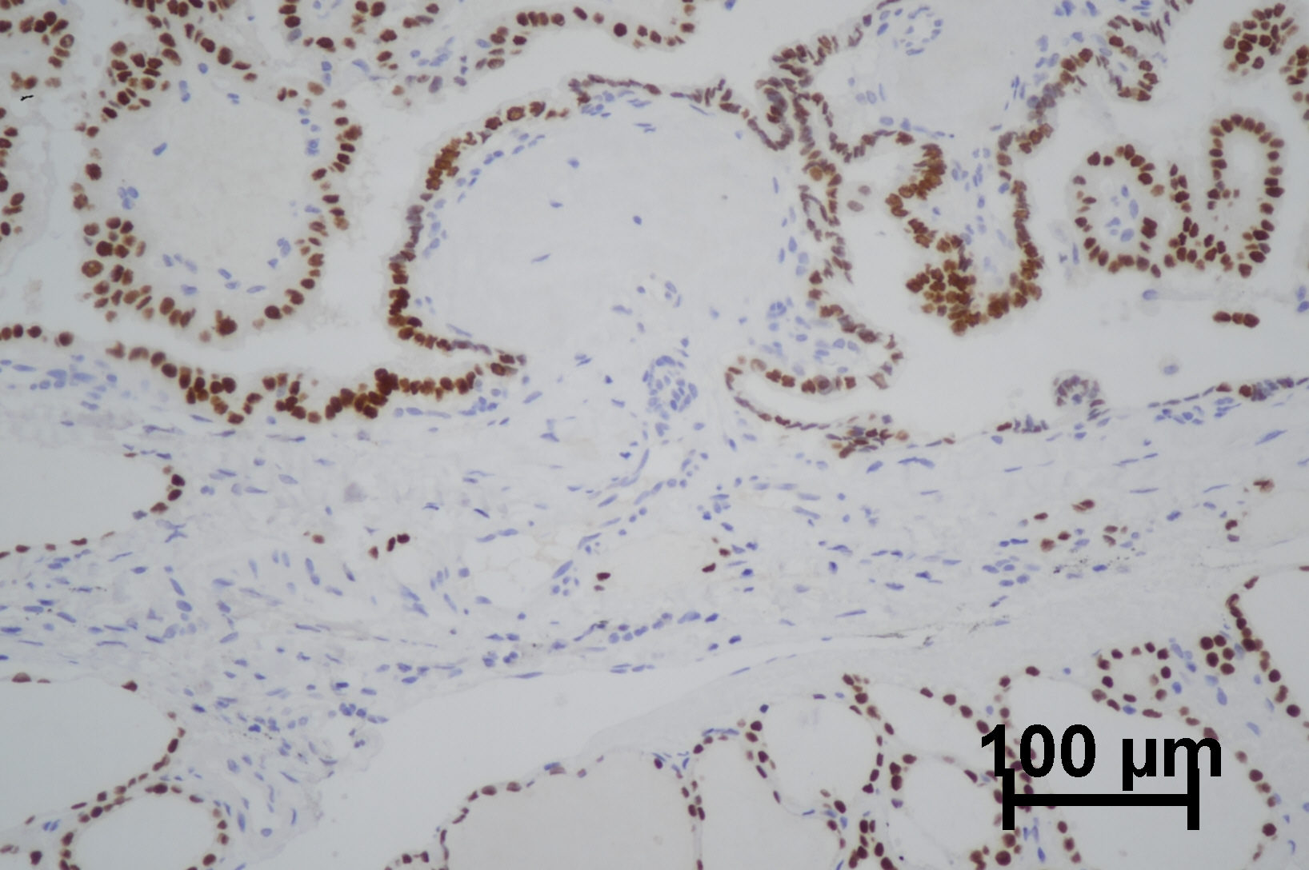
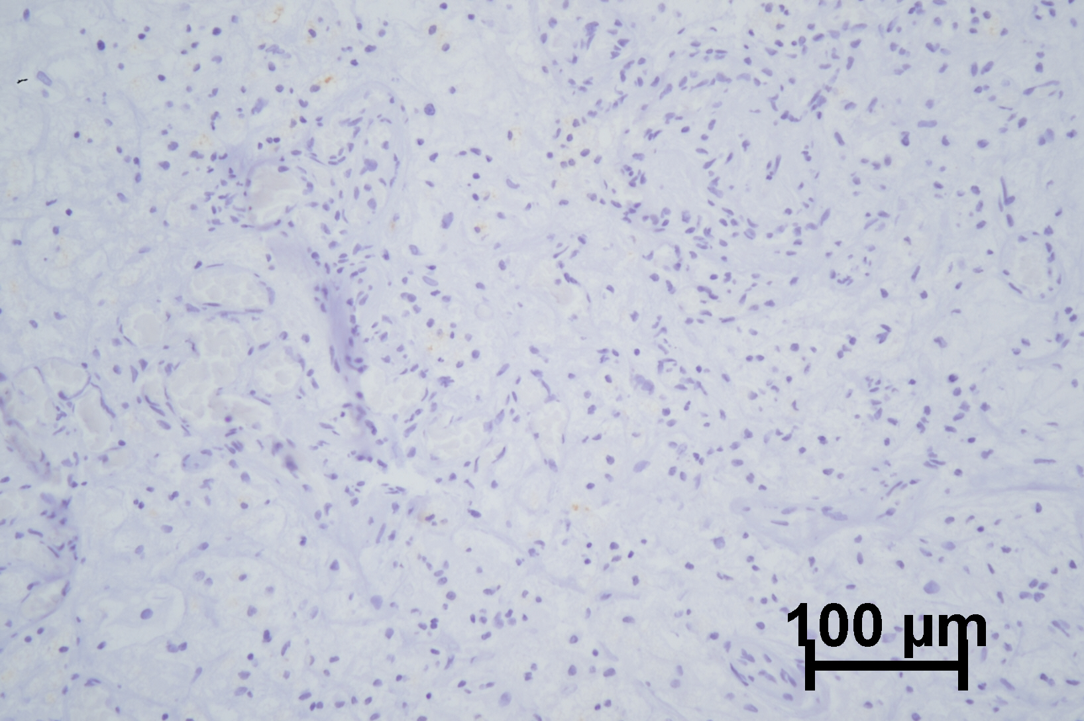
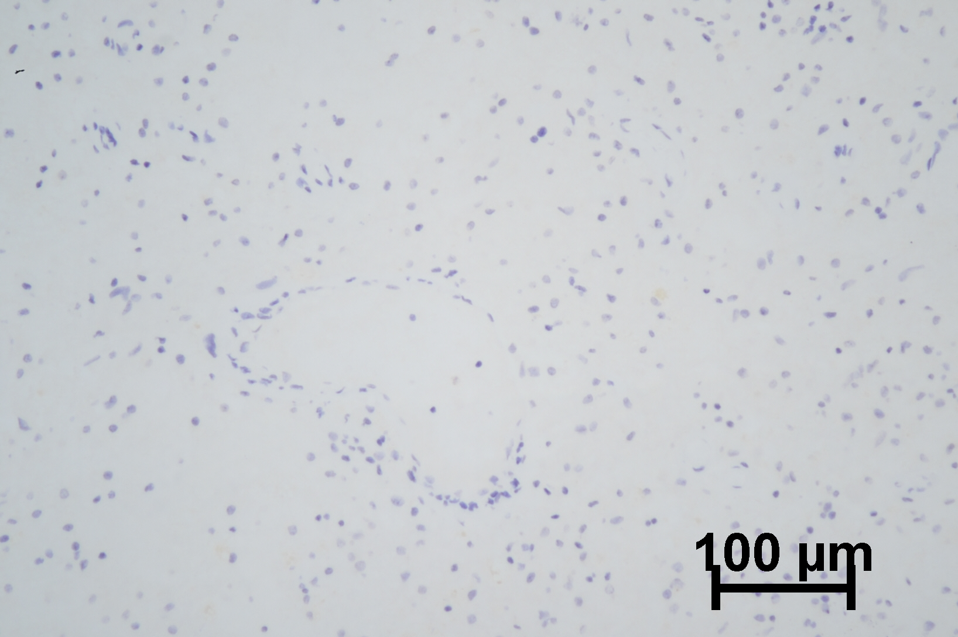
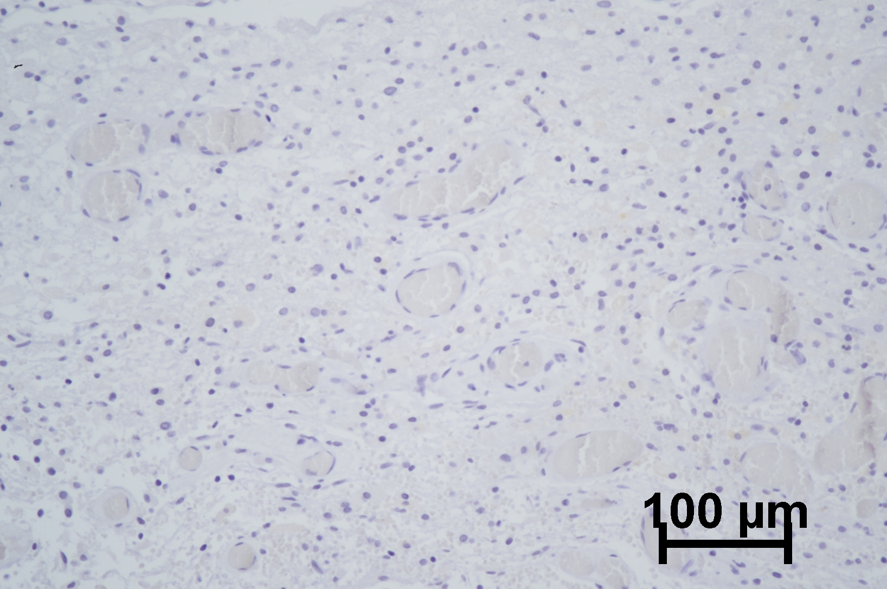
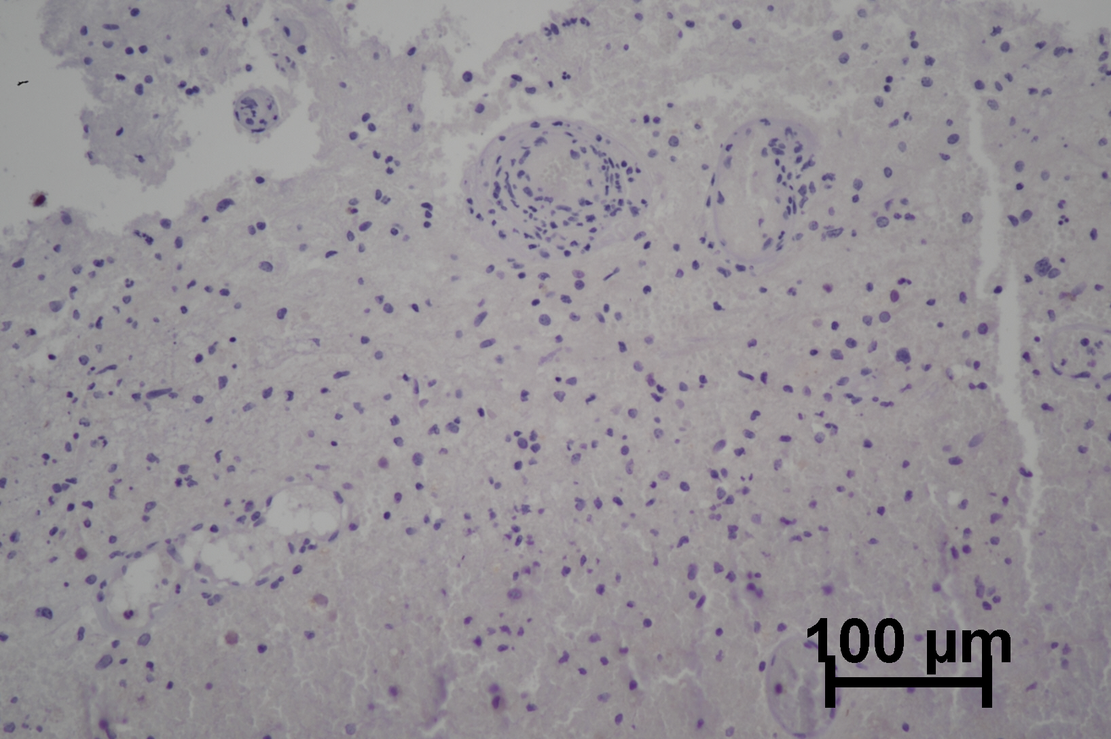
Supplementary Figure 2
NapsinA
(-)
PAX8
(+)
TG
(+)
TTF-1
(+)
Thyroid papillary carcinoma of
the eldest son
200X
(-)
(+)
(+)
(+)
Thyroid papillary carcinoma of
the second son
200X
Thyroid papillary carcinoma of
the youngest son
200X
(-)
(+)
(+)
(+)
(-)
(-)
(-)
(-)
Negative sample
200X
Notes:
Supplementary Figure 2. Immunochemistry results of each son's tumor tissue. From top to bottom, the immunochemistry results of the eldest son, second son and youngest son's tumor were shown. The three sons' tumor showed negative of Napsin A, showing as “(-)”in top right corner of the graphs. Positive of TTF-1, PAX8 and TG were identified in all of the three sons' tumors, presenting as “(+)”in top right corner of the graphs. Negative results from negative control samples were also shown. The immunohistochemical tests of the patient and her three sons were repeated simultaneously, so the same negative controls were used. Scale bar was in the lower right corner of each image. All images were magnified by 200 times.

Slide 5
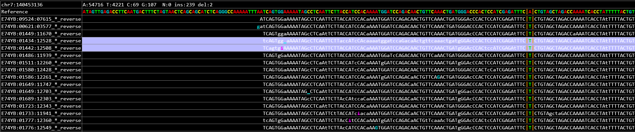
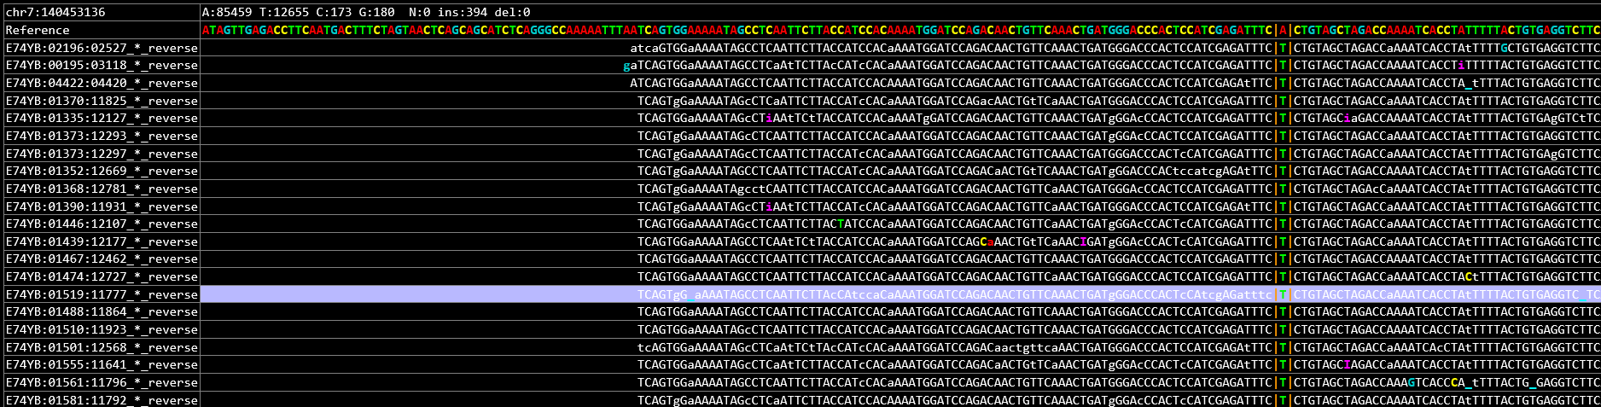
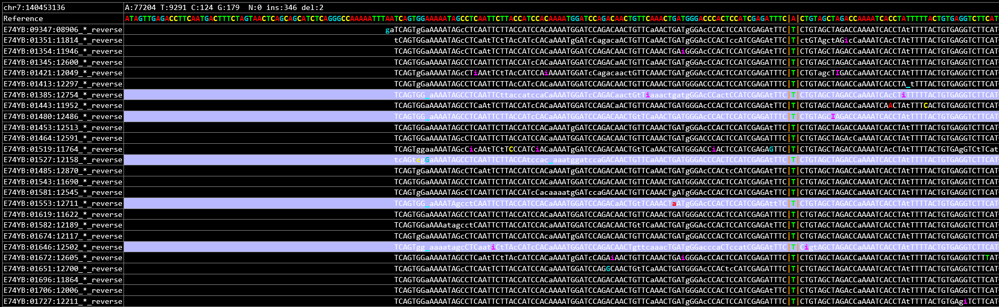
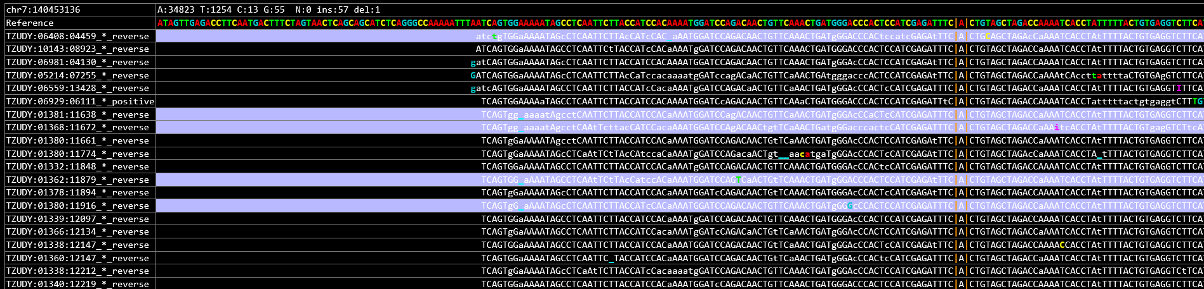
Supplementary Figure 3
The mutation IGV results of three sons of the patient
The youngest son: BRAF mutation-c.1799T>A (Chr7: 140453136)
BRAF-c.1799T>A
The second son: BRAF mutation-c.1799T>A (Chr7: 140453136)
BRAF-c.1799T>A
The eldest son: BRAF mutation-c.1799T>A (Chr7: 140453136)
BRAF-c.1799T>A
Negative control sample
BRAF-WT
Notes:
Supplementary Figure 3. IGV results of BRAF mutation (c.1799T>A (Chr7: 140453136)) of the tumor samples of the patient's three sons. Corresponding IGV results of negative control sample were also provided.

