Slide 1
Supplementary Material
Distinct Immunophenotypes of T cells in Bronchoalveolar lavage fluid from Leukemia Patients with ICI-related Pulmonary Complications
Sang Kim et al.
Supplementary Figure 1. Gating strategy to identify major lymphoid immune cell subsets
Supplementary Figure 2. Gating strategy to identify CD4⁺ T cell subsets
Supplementary Figure 3. Surface and/or transcription factor staining of CD4⁺ T cell
Supplementary Figure 4. Intracellular staining of CD4⁺ and CD8⁺ T cells in bronchoalveolar lavage fluid
Supplementary Figure 5. Intracellular staining of CD4⁺ and CD8⁺ T cells in peripheral blood
Supplementary Figure 6. Analysis of T-cell receptor (TCR) repertoire in peripheral blood and bronchoalveolar lavage.
Supplementary Table 1. Flow cytometry antibodies
Supplementary Table 2. Basic information about bronchoalveolar lavage (BAL) and peripheral blood (PB) samples

Slide 2
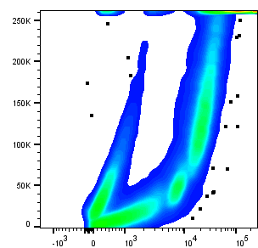
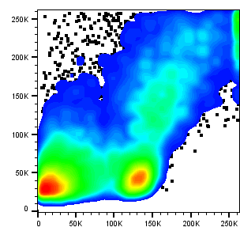
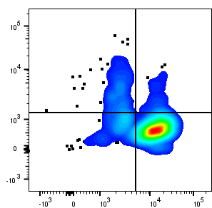
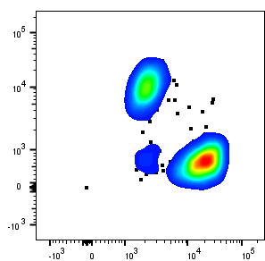
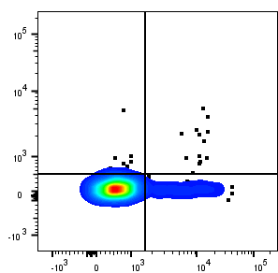
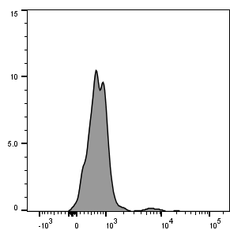
Supplementary Figure 1
Total cells
Live cells
Live lymphocytes
CD3⁺ CD56⁻
CD8⁺ T
NK
NK T
CD4⁺ T
Tcm
Tn
SSC-A
SSC-A
CD56
CD4
CD8⁺ T
CCR7
Tem
Temra
Dead
FSC-A
CD3
CD3⁻ CD56⁻
CD8
CD45RA
B
CD19
Supplementary Figure 1. Gating strategy to identify major lymphoid immune cell subsets
Live immune cells were detected by gating live-dead. The lymphocytes were further examined by forward scatter (FSC) and side scatter (SSC). Natural killer and natural killer T cells were identified based on CD3 and CD56 expression. Within CD3⁺ CD56⁻ cell population, we further gated to identify CD4⁺ T cells, and CD8⁺ T cells. CD8⁺ T cells were further examined by CD45RA and CCR7 staining. Within CD3⁻ CD56⁻ population, CD19 expressing B cells were gated. Representative plots of eleven bronchoalveolar lavage and peripheral blood samples. NK, natural killer cells; NK T, natural killer T cells; CD4⁺ T, CD4⁺ T cells; CD8⁺ T, CD8⁺ T cells; B, B cells; Tcm, central memory T cells; Tn, naïve T cells; Tem, effector memory T cells; Temra, terminally differentiated T cells.

Slide 3
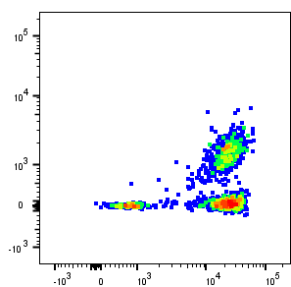
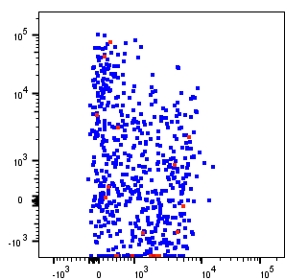
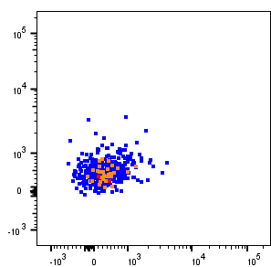
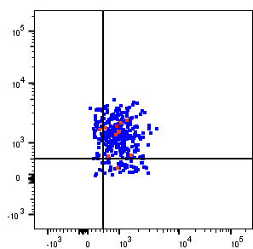
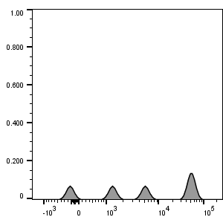
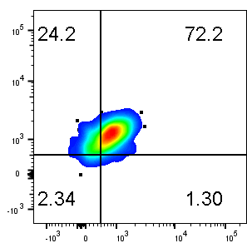
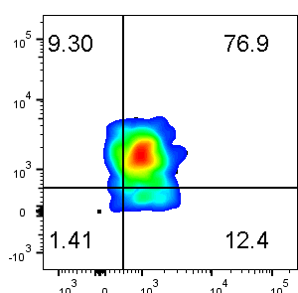
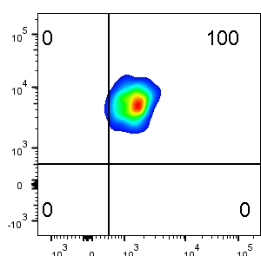
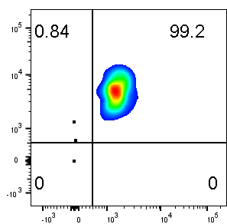
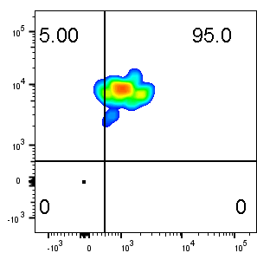
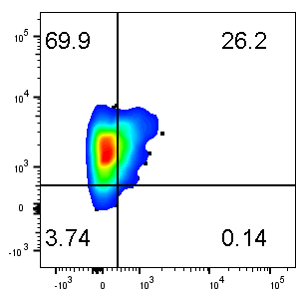
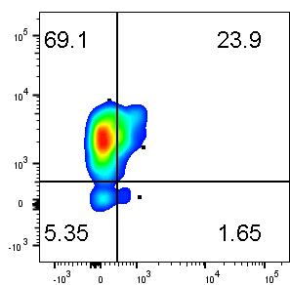
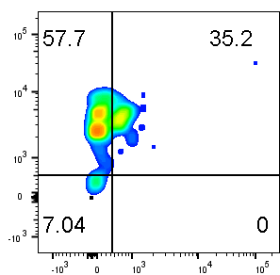
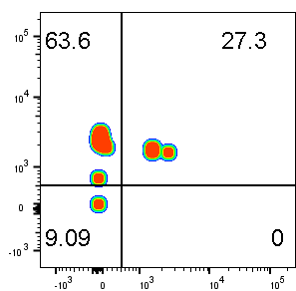
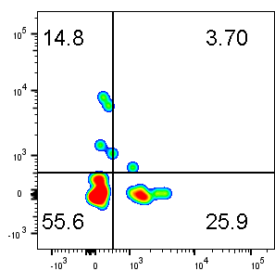
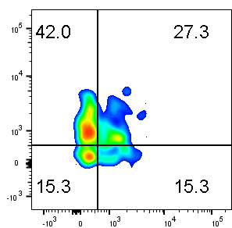
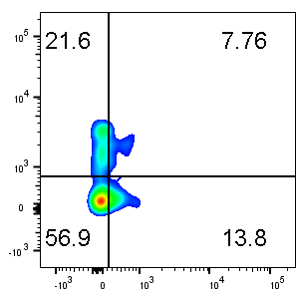
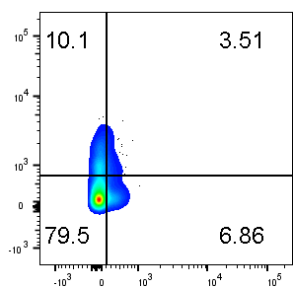
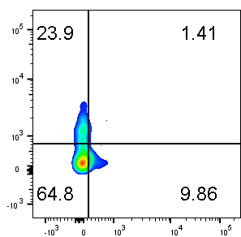
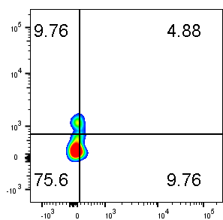
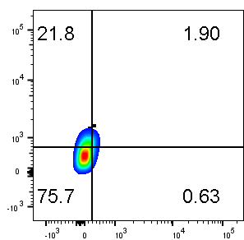
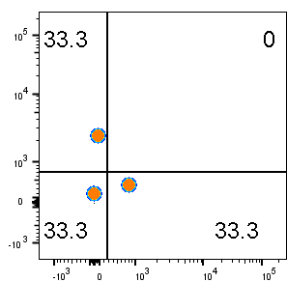
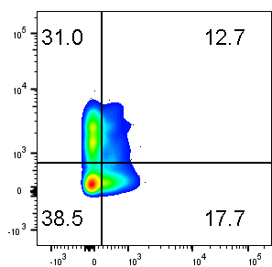
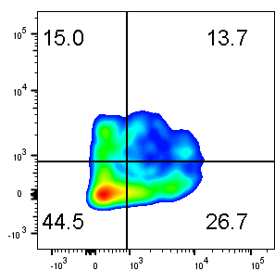
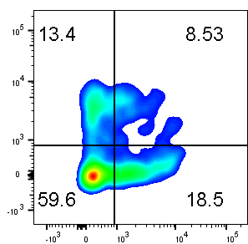
Supplementary Figure 2
A
Live lymphocytes
CD3⁺ CD4⁺
Non-Treg
Non-Tfh effector
CXCR3⁻ CCR6⁻
Treg
Non-Treg
Th1
Th17/Th1
Tfh
Th2
Naive
CD4
CD25
CXCR5
Non-Tfh effector
CXCR3
Th17
CD3
CD127
CD45RA
CCR6
CCR4
B
BAL non-Tfh effector
ICI_1
ICI_2
ICI_3
ICI_4
ICI_5
ICI_6
ICI_7
CXCR3
Cont_1
Cont_2
Cont_3
Cont_4
PB non-Tfh effector
CCR6
ICI_1
ICI_2
ICI_3
ICI_4
ICI_5
ICI_6
ICI_7
CXCR3
n/a
Cont_1
Cont_2
Cont_3
Cont_4
n/a
CCR6
Supplementary Figure 2. Gating strategy to identify CD4⁺ T cell subsets
(A) After gating regulatory T cells (CD25^{hi} CD127^{lo}), non-Tregs were further divided into CD45RA⁺ naïve T cells, CXCR5-expressing follicular helper T cells (Tfh), and CD45RA⁻ CXCR5⁻ cells (non-Tfh effector). Non-Tfh effectors were further divided into effector subsets based on CXCR3, CCR4, and CCR6 expression: Th1 (CXCR3⁺ CCR6⁻), Th2 (CXCR3⁻ CCR6⁻ CCR4⁺), Th17 (CXCR3⁻ CCR6⁺), and Th17/Th1 (CXCR3⁺ CCR6⁺) cells. Representative plots of eleven bronchoalveolar lavage and peripheral blood samples. (B) CCR6 and CXCR3 expression on non-Tfh effector cells from the ICI group and control. Plots of individual samples are shown. Treg, regulatory T cells; Tfh, follicular helper T cells; ICI, Immune checkpoint inhibitor; BAL, Bronchoalveolar lavage; PB, peripheral blood; n/a, not available. (C) Percentage and absolute numbers of CD4⁺ T cell subsets in PB.

Slide 4
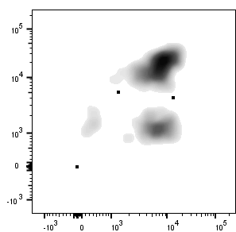
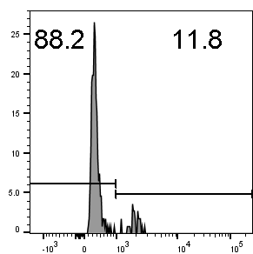
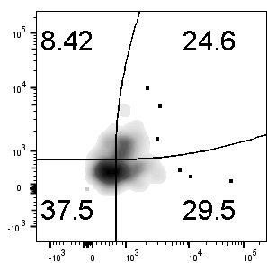
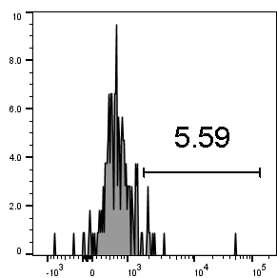
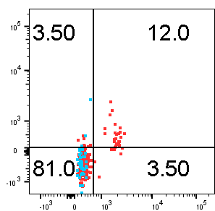
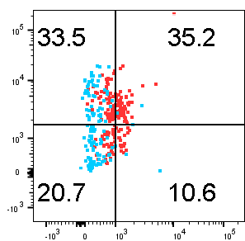
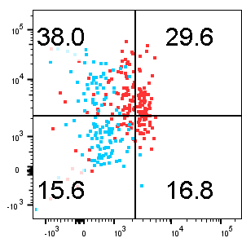
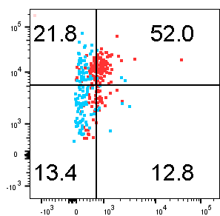
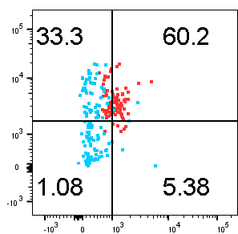
Supplementary Figure 3
A
PB
CD4⁺ T cell subset
PB
CD4⁺ T cell subset
Control
% CD4⁺ T
# of cells/mL
ICI-pneumonia
ICI-pneumonitis
Tfh
Tfh
Th1
Th2
Th1
Treg
Th17
Treg
Th2
Naïve
Th17/Th1
Naïve
Th17
Th17/Th1
B
Live lymphocytes
CD3⁺ CD4⁺
FoxP3⁻ CD4⁺ T
CD4
RORγt
CD3
FOXP3
T-bet
T-bet⁻ RORγt⁻
C
GATA3
CCR6⁺ RORγt⁺
CD3⁺ CD4⁺
CD3⁺ CD4⁺
CD25
CXCR3
CCR4
CCR6
CXCR3
FoxP3
T-bet
GATA3
RORγt
T-bet
CD3⁺ CD4⁺ T CD3⁺ CD4⁻ T
Supplementary Figure 3. Surface and/or transcription factor staining of CD4⁺ T cell
(A) Percentage and absolute numbers of CD4⁺ T cell subsets in peripheral blood (PB). (B) After gating live lymphocytes, bronchoalveolar lavage (BAL) CD4⁺ T cells were gated based on FoxP3 expression. FoxP3⁻ CD4⁺ T cells were further divided based on expression of key transcription factors of CD4⁺ T cells including T-bet, GATA3, and RORγt. Representative plots of eight BAL samples. (C) Expression of key surface molecules and transcription factors of CD4⁺ T subsets were accessed. Representative plots of eight BAL samples. Plots of CD3⁺ CD4⁻ cells were overlaid to show gates.

Slide 5
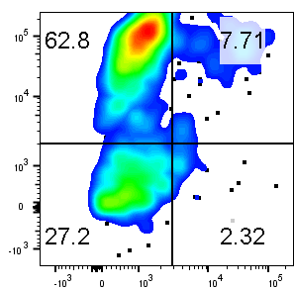
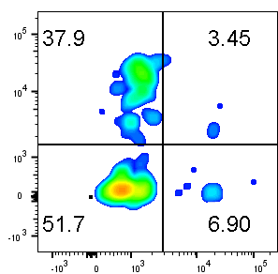
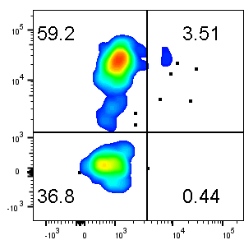
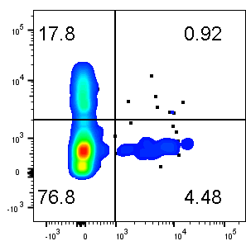
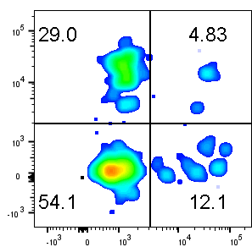
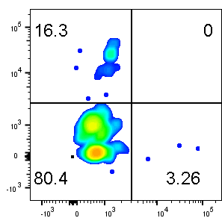
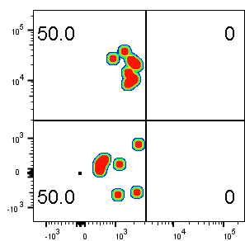
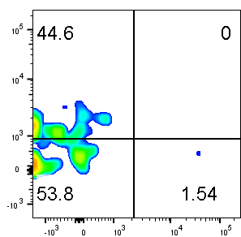
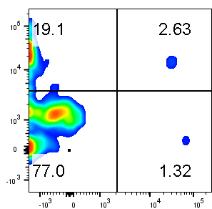
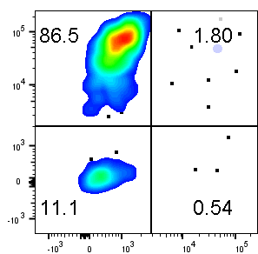
Supplementary Figure 4
BAL CD4⁺ T cells
ICI_1
ICI_2
ICI_3
ICI_4
ICI_5
ICI_6
ICI_7
IFNγ
n/a
n/a
Cont_1
Cont_2
Cont_3
Cont_4
BAL CD8⁺ T cells
IL-17
ICI_1
ICI_2
ICI_3
ICI_4
ICI_5
ICI_6
ICI_7
IFNγ
n/a
n/a
Cont_1
Cont_2
Cont_3
Cont_4
IL-17
Supplementary Figure 4. Intracellular staining of CD4⁺ and CD8⁺ T cells in bronchoalveolar lavage fluid
Bronchoalveolar lavage fluid cells were stimulated with PMA/Ionomycin for 4 hours, fixed, and permeabilized. Expression of interferon gamma and interleukin-17 on CD4⁺ T cells were determined by intracellular staining. Plots of individual patients from the ICI group and control are shown. BAL, Bronchoalveolar lavage; ICI, immune checkpoint inhibitors; PB, peripheral blood; IFNγ, Interferon gamma; IL-17, interleukin-17; n/a, not available

Slide 6
Supplementary Figure 5
A
PB CD4⁺ T cells
ICI_1
ICI_2
ICI_3
ICI_4
ICI_5
ICI_6
ICI_7
IFNγ
n/a
Cont_1
Cont_2
Cont_3
Cont_4
n/a
IL-17
PB CD8⁺ T cells
ICI_1
ICI_2
ICI_3
ICI_4
ICI_5
ICI_6
ICI_7
IFNγ
n/a
Cont_1
Cont_2
Cont_3
Cont_4
n/a
IL-17
B
PB
IFNγ⁺ and/or IL-17⁺ CD4⁺ T
PB
IFNγ⁺ and/or IL-17⁺ CD8⁺ T
% CD4⁺ T
# of cells/mL
% CD8⁺ T
# of cells/mL
IFNγ
IL-17
+
-
+
+
-
+
+
-
+
+
-
+
+
-
+
+
-
+
+
-
+
+
-
+
Control
ICI-pneumonia
ICI-pneumonitis
Supplementary Figure 5. Intracellular staining of CD4⁺ and CD8⁺ T cells in peripheral blood
(A) Plots of individual patients from the ICI group and control are shown. PB, peripheral blood; IFNγ, Interferon gamma; IL-17, interleukin-17; n/a, not available. (B) Proportions of IFNγ and/or IL-17 producing T cells and absolute numbers of the cells in 1 mL PB.

Slide 7
Supplementary Figure 6
10%
ICI_1
10%
ICI_2
10%
ICI_3
10%
ICI_4
PB
1%
1%
1%
0.1%
0.1%
0.1%
1%
0.01%
0.01%
0.01%
0.1%
0
0
0.01%
0.1%
1%
10%
0
0
0.01%
0.1%
1%
10%
0
0
0.01%
0.1%
1%
10%
0
0
0.1%
1%
10%
100%
ICI_5
1%
ICI_6
100%
ICI_7
10%
10%
1%
0.1%
1%
0.1%
0.1%
0.01%
0.01%
0
0
0.01%
0.1%
1%
10%
100%
0
0
0.1%
1%
0
0
0.01%
0.1%
1%
10%
100%
Cont_1
Cont_2
Cont_3
Cont_4
10%
10%
1%
1%
n/a
1%
0.1%
0.1%
0.1%
0.01%
0.01%
0
0
0.1%
1%
10%
0
0
0.01%
0.1%
1%
10%
0
0
0.01%
0.1%
1%
BAL
Supplementary Figure 6. Analysis of T-cell receptor (TCR) repertoire in bronchoalveolar lavage and peripheral blood
Prevalence of T cell clones in the bronchoalveolar lavage (BAL) fluid compared with peripheral blood (PB). ICI, Immune checkpoint inhibitor; n/a, not available.

Slide 8
Supplementary Table 1. Flow cytometry antibodies
Antibody | Clone | Source | Identifier
Anti-human CXCR3 | G025H7 | BioLegend | Cat# 353716
Live-Dead Fixable Aqua | Not applicable | BioLegend | Cat# 423101
Anti-human CD45RA | HI100 | BioLegend | Cat# 304140
Anti-human CD3 | SK7 | BioLegend | Cat# 344808
Anti-human CCR6 | G034E3 | BioLegend | Cat # 353412
Anti-human CD25 | BC96 | BioLegend | Cat# 302604
Anti-human CCR4 | L291H4 | BioLegend | Cat# 359409
Anti-human CXCR5 | J25D4 | BioLegend | Cat# 356929
Anti-human CD127 | A019D5 | BioLegend | Cat# 351344
Anti-human CD56 (NCAM) | HCD56 | BioLegend | Cat# 318304
Anti-human CD19 | HIB19 | BioLegend | Cat# 302208
Anti-human CCR7 | G043H7 | BioLegend | Cat# 353226
Anti-human CD4 | A161A1 | BioLegend | Cat# 357407
Anti-human CD4 | SK3 | BD Horizon | Cat# 563550
Anti-human CD8 | HIT8a | BioLegend | Cat# 300920
Anti-human PD-1 | EH12.2H7 | BioLegend | Cat# 329940
Anti-human IFNγ | 4S.B3 | BioLegend | Cat# 502505
Anti-human IL-17A | BL168 | BioLegend | Cat# 512333
Anti-human FoxP3 | 206D | BioLegend | Cat# 320106
Anti-human RoRγt | Q21-559 | BD PharmingenTM | Cat# 563081
Anti-human T-bet | 4B10 | BioLegend | Cat# 644828
Anti-human GATA3 | 16E10A23 | BioLegend | Cat# 653813

Slide 9
Supplementary Table 2. Basic information about bronchoalveolar lavage (BAL) and peripheral blood (PB) samples
BAL | ICI group (n=7) | ICI-Pneumonia (n=4) | ICI-Pneumonitis (n=3) | Control (n=4)
Volume, mL, median [range] | 10 [10-35] | 13 [10-35] | 11.5 [10-13] | 13 [10-25]
Recovery, %, median [range]* | 66 [31.5-88.3] | 67.2 [50.3-88.3] | 66 [31.5-69.3] | 54.7 [50.4-55.8]
Lymphocytes per 1 mL BAL, x10³/mL, median [range]* | 8.8 [2.1-116] | 15.8 [3.2-116] | 4.5 [2.1-8.8] | 1.4 [1.0-2.3]
PB | ICI group (n=7) | ICI-Pneumonia (n=4) | ICI-Pneumonitis (n=3) | Control (n=4)
Volume, mL, median [range] | 25 [10-30] | 25 [15-30] | 20 [10-30] | 20 [20-25]
Recovery, %, median [range]* | 70.5 [55.7-81.2] | 71.7 [55.7-81.2] | 70.5 [66.6-75.1] | 77.7 [68.6-85.1]
Lymphocytes per 1 mL PB, x10⁶/mL, median [range]* | 0.26 [0.04-2.09] | 0.21 [0.16-1.61] | 0.42 [0.04-2.09] | 0.38 [0.09-1.19]
ICI, immune checkpoint inhibitor
*, Calculated using flow cytometry analysis

