Slide 1
A
B
Grain yield（kg/ha)
Nitrogen content (mg/g)
C
D
Relative expression level
Relative expression level
Inorganic N application(kg N/ha)
Figure S1. The effects of N supply level on grain yield, and N concentration, the expression of Ta.5139.1.S1_at and Ta.9132.3.S1_s_at in flag leaves. The wheat variety KN9204 was grown in the field experiment with N application rates at 0, 90 and 180 kg N/ha. The flag leaves were collected at flowering for analysis of N concentrations and gene expression profiles. Grain yield were measured at maturity. (A) Grain yield; (B) N concentration in flag leaves; (C, D) The relative expression of Ta.5139.1.S1_at (C) and Ta.9132.3.S1_s_at (D) in flag leaves. Data are mean ± SE of 4 biological replications. Total RNA was extracted using Trizol reagent (Invitrogen) and purified using an RNeasy kit (Qiagen). RNA was quantified and quality assessed by running several dilutions of each sample using the Agilent RNA 6000 nano Kit and Agilent Bioanalyzer 2100. RNA samples were processed following the Affymetrix GeneChip expression analysis technical manual, the methods for cDNA synthesis, cRNA synthesis, cRNA fragmentation, microarray hybridization, washing and staining are described in the GeneChip expression analysis technical manual (http://www.affymetrix.com/). The arrays were scanned using a GeneChip 3000 scanner, wheat microarray design and expression profiling data are available in PLEXdb (http://www.plexdb.org).

Slide 2
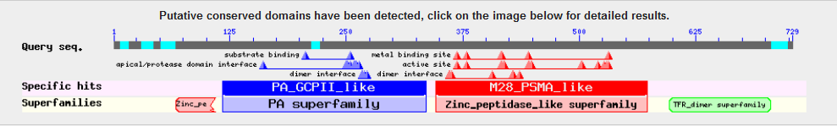
Figure S2. Alignments between the amino acid sequences of TaLAMP1 homologues alleles in wheat.

Slide 3
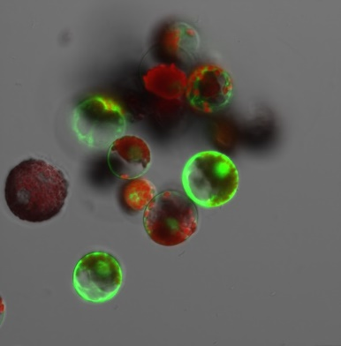
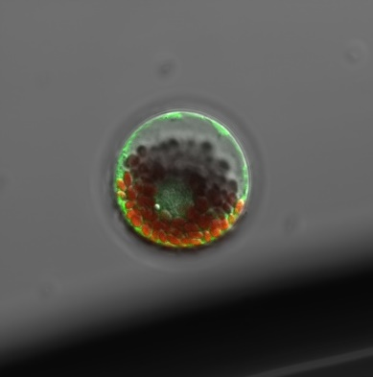
A
B
B
Figure S3. Subcellular location of TaLAMP1-3B. (A) and (B) The protoplasts of wheat transformed with UBI::TaLAMP1-3B::GFP and UBI::GFP plasmids (A), Control pUBI163GFP, (B), pUBITaLAMP13B-GFP, bar=10 μm.

Slide 4
ZR content (ng/g FW)
Figure S4. The zeatin riboside (ZR) content in the TaLAMP1 transgenic lines and wild type at seeding stage. The seedlings of KN199 and TaLAMP1 transgenic lines were grown for 7 days in the nutrient solution containing 2.0 mM NO₃⁻ (HN), then the whole seedlings were collected for ZR analysis. KN199 and NC are wild type and negative control transgenic line. OE1, OE2 are TaLAMP1-3B overexpression transgenic lines, R1, R2 are TaLAMP1 knock-down transgenic lines. Data are the mean ± SE (n = 5). Different letters after the data indicate significant difference at P < 0.05.

Slide 5
Table S1 The primers used in this study
Primer name | Sequence（5’-3’） | Experiment
G1 PF | AGGGAGCGCAAAGGGAC | Cloning TaLAMP1
G1 PR | CCAGAAATAAAGCCAAGGATG
G2 Pf | ATGCGAGCGGGCTTTG
G2 PR | TCTGGGTGCCTGCGTGT
G3 PF | CATAAGCCAAGGATGATTTG
G3 PR | ATGAGACGCAAGCAAAATATGCA
5'RACE SP1 | GTTCTTGCTCACCTTCCC
5'RACE SP2 | CGATCAATCGGAGCTTGGAG
3'RACE SP1 | GGAGTTGCGACAAA
3'RACE SP2 | GTCAAATACAGGGTTA
ABD SP1 | AACACCGCCCTACTCGC
B SP2 | AACGATGACGGAAATA
B SP3 | TGCTTTGCACCCACATAGTTCT
TaLAMP1 RT PF | TTTGTCCCAACGCACCAGTA | TaLAMP1 expression analysis
TaLAMP1 RT PR | CTTCCACGTCGCATTACCTCTT
TaLAMP1-3A RT PF | ATCACAAGATCCCTGAGAACCAG | TaLAMP1-3A expression analysis
TaLAMP1-3A RT PR | AACTGTTTTCCTGTCACTTTGTTGTTT
TaLAMP1-3B RT PF | ACGCCGGGAATGGTTATTACTT | TaLAMP1-3B expression analysis
TaLAMP1-3B RT PR | TGGTGTGCTGATGGCACTATG
TaLAMP1-3D RT PF | GGATAGTCAGGGTGCCTTATTTGA | TaLAMP1-3D expression analysis
TaLAMP1-3D RT PR | GCCGGTTTCTTAACGCAAAGT
TaNPF6.3-1D RT PF | GCAACGCCATTCTGCTTGT | TaNPF6.3-1D expression analysis
TaNPF6.3-1D RT PR | AGCTTCTGCGTCCTGTGTACTG
TaGS1-6A RT PF | CAACCATGCTAAACCACAACTGA | TaGS1-6A expression analysis
TaGS1-6A RT PR | TGGATGAAGCCGTGACTTGTAG
TaNR1-6D RT PF | ATGGAGAGCTTCCCAGGTATGA | TaNR1-6D expression analysis
TaNR1-6D RT PR | AAGGCTCGCCAGACAGACAT
TaGDH2-2B RT PF | GCTTGCACGTTGCATCACA | TaGDH2-2B expression analysis
TaGHD2-2B RT PR | AGCGCGAGAACGCAAGAC
TaNRT2.1-6B RT PF | GAGCTTGAGGGCTTCCATGTAG | TaNRT2.1-6B expression analysis
TaNRT2.1-6B RT PF | TGCCACCCACCAGGATAAG
TaActin RT PF | CTTGGCGACCATCCATGA | TaActinexpression analysis
TaActin RT PR | GTGCTGCTATCCCGACAACAC
(OE)ATG-Hind III | GGCGCTTCCTGGTGATGA | Construct TaLAMP1-3B overexpression vector
(OE)TGA-EcoR I | CATGCCATGCCGTCTCAT
(RNAi)1100F-BamH I | CAAATTATTCTTACATCACCAACGAAGA | Construct TaLAMP1 RNAi overexpression vector
(RNAi)1560R-EcoR I | CCCTTGAAATCTGAAGCAGAAAGA
(RNAi)1100F-Kpn I | TCTGCAAGCTAGGGCGATGT
(RNAi)1560R- Hind III | CTCGGTGGCGGTGAATCTT
TaLAMP1-F Nde I | TTGAAAATTTCCTTCTTCTGGGTAATC | Subcellular localization analysis
TaLAMP1-R BamH I | GTCTCCCTCAAACTAGCCAAGAGAT

