Slide 1
Table S1 . Primer sequences for quantitative real-time polymerase chain reaction (qPCR). Presented are the primer sequences of wild type (WT) and alternative transcripts (ALT) used for qPCR
ATM_ALT_F | TGGCCAGAACTTT CAAGAACA
ATM_ALT_R | GATTGTTCTGTATAAGAAAGGCAAAAT
ATM_WT_F | CCAGCTATTTGGTTTGAGAAGC
ATM-WT_R | GCCCTGTTCAAAAGCAACAC
FOXP1_F | CCTCACTGCACACCTCTCAATGC
FOXP1_ALT_R | CTGGTACCATTGGTGATGTAACAAG
FOXP1_WT_R | CATGGAAGCGGTAGTGTATAGAGGT
ANKHD1_F_e2_e3 | CTAGAAGCAGCAGGAATTGG
ANKHD1_F_e2_ae3 | GAAGCAGCAGCTTTTGCAGAT
ANKHD1_R_e3 | GTGTCCACTTGTCCTGCATT
hTTi1_WT_F3 | TGAGAAGAGCACCACCACAG
hTTi1_WT_R3 | CACATCTGGACGGGTGTCAT
hTTi1_ALT_F3 | CTCTTGAGAAGAGCACCACCA
hTTi1_ALT_R3 | GGAAAAAGAGCACACTTCTTCATT
hMAP3K7_WT_F | TGGAATATGCTGAAGGGGGC
hMAP3K7_WT_R | TTGCGTGGGCAGCAGTATAA
hMAP3K7_ALT_F | CGGCAGTTATCCCGTGTGAA
hMAP3K7_ALT_R | CAGCACTGCGAAAGAAAGGC
hSRSF3_F | TGGAACTGTCGAATGGTGAA
hSRSF3_ALT_R | GGGTGGTGAGAAGAGACATGA
hSRSF3_WT_R | TCTTGGAGATCTGCGACGAG
GAPDH_F | GCATCTTCTTTTGCGTCGCC
GAPDH_R | GACCAAATCCGTTGACTCCG

Slide 2
No. | RAI/Binet | IGHV | 17p, 11q or tris12 (%) | Category functional analysis* | Mutation (%)** | Amino acid change | Therapy
B0309 (1) | I/A | UM | del13q (95) | SF3B1 | SF3B1 (30) | G742D (30) | no
B1536 (2) | III/C | UM | normal | SF3B1 | SF3B1 (50) | G742D (50) | no
B1596 (3) | II/B | NA | 13q (32), tris12 (65) | SF3B1 | SF3B1 (38) | T2111G: I704S | no
B0679 (4) | NA | M | 13q (96) | SF3B1 | SF3B1 (20) | K700E | no
B1416 (5) | I/A | UM | tris12 (80) | SF3B1 | SF3B1 (100) | K700E | no
5115 (6) | II | UM | normal | SF3B1 | SF3B1 (51.5) | H662D | no
6215 (7) | II | UM | NA | SF3B1 | SF3B1 (34.5) | K700E | no
5787 (8) | III | border | 13q (90) | SF3B1 | SF3B1 (60.4) | K666E | no
8460 (9) | B | UM | normal | SF3B1 | SF3B1 (41.8) | K666E | no
P1046 (10) | NA | UM | normal | SF3B1 | SF3B1 (43) | G742D | no
A162 (11) | III | NA | normal | SF3B1 | SF3B1 (±35) | K700E | no
P0047 (12) | NA | M | normal | WT |  |  | no
P0708 (13) | NA | UM | 13q (24) | WT |  |  | no
P0982 (14) | NA | UM | 13q (19) | WT |  |  | no
A154 (15) | III | M | normal | WT |  |  | no
A227 (16) | II | M | normal | WT |  |  | Chl
A647 (17) | III | M | normal | WT |  |  | no
A156 (18) | II | M | normal | WT |  |  | no
A160 (19) | I | UM | normal | WT |  |  | no
A636 (20) | 0 | M | normal | WT |  |  | no
A854 (21) | 0 | ? | normal | WT |  |  | no
A532 (22) | 0 | M | normal | WT |  |  | no
A534 (23) | 0 | M | normal | WT |  |  | no
Table S2. Patient characteristics and type of SF3B1 mutations (VAF≥20%) from patients used for functional experiments. Rai-stage and/or Binet stage were determined at time of performance of functional analyses. FISH, mutational and functional analyses were performed at same time point in most patients, but at least within one year.*This column shows in which group patients were included for functional experiments. **% of mutant allele burden is mentioned. Abbreviations: UM=unmutated, M=mutated, NA=unknown, Chl=chlorambucil.

Slide 3
No. | RAI/Binet | IGHV | 17p, 11q or tris12 (%) | Category functional analysis* | Mutation (%)** | Amino acid change | Therapy
B0309 (1) | I/A | UM | del13q (95) | SF3B1 | SF3B1 (30) | G742D (30) | no
B1536 (2) | III/C | UM | normal | SF3B1 | SF3B1 (50) | G742D (50) | no
B1596 (3) | II/B | NA | 13q (32), tris12 (65) | SF3B1 | SF3B1 (38) | T2111G: I704S | no
B0679 (4) | NA | M | 13q (96) | SF3B1 | SF3B1 (20) | K700E | no
B1416 (5) | I/A | UM | tris12 (80) | SF3B1 | SF3B1 (100) | K700E | no
 | I/A |  |  |  | TP53 (1%) | c.673-1_688del | no
5115 (6) | II | UM | normal | SF3B1 | SF3B1 (51.5) | H662D | no
6215 (7) | II | UM | NA | SF3B1 | SF3B1 (34.5) | K700E | no
5787 (8) | III | border | 13q (90) | SF3B1 | SF3B1 (60.4) | K666E | no
8460 (9) | B | UM | normal | SF3B1 | SF3B1 (41.8) | K666E | no
P1046 (10) | NA | UM | normal | SF3B1 | SF3B1 (43) | G742D | no
A162 (11) | III | NA | normal | SF3B1 | SF3B1 (±35) | K700E | no
P0047 (12) | NA | M | normal | WT | SF3B1 (3) | K700E | no
P0708 (13) | NA | UM | 13q (24) | WT | SF3B1 (11.5) | K700E | no
P0982 (14) | NA | UM | 13q (19) | WT |  |  | no
A154 (15) | III | NA | normal | WT |  |  | no
A227 (16) | II | NA | normal | WT |  |  | Chl
A647 (17) | III | NA | normal | WT |  |  | no
A156 (18) | II | NA | normal | WT |  |  | no
A160 (19) | I | NA | normal | WT |  |  | no
A636 (20) | 0 | NA | normal | WT |  |  | no
A854 (21) | 0 | NA | normal | WT |  |  | no
A532 (22) | 0 | NA | normal | WT |  |  | no
A534 (23) | 0 | NA | normal | WT |  |  | no
Table S3. CLL patient characteristics and type of mutations from patients used for functional experiments. Rai and Binet stage were determined at time of performance of functional analyses. FISH, mutational and functional analyses were performed at same time point in most patients, but at least within one year. *This column shows in which group patients were included for functional experiments, **% of mutant allele burden is mentioned. Abbreviations: UM=unmutated, M=mutated, NA=unknown, fs=frame shift, Chl=chlorambucil, FCR=fludarabine, cyclophosphamide and rituximab, Al=alemtuzumab, R-CHOP=rituximab, cyclophosphamide, doxorubicin, vincristine and prednisone, R-CVP= rituximab, cyclophosphamide, vincristin and prednisone, R-DHAP= rituximab, dexamethason, cytarabine and cisplatin

Slide 4
No. | RAI/Binet | IGHV | 17p, 11q or tris12 (%) | Category; functional analyses* | Mutation (%)** | Amino acid change | Therapy
719 (24) | IV | UM | no | SF3B1 | ATM | Y729STOP | F, R-CVP
 |  |  |  |  |  | E2423K
 |  |  |  |  | SF3B1 | G740V
812 (25) | I | M | no | WT | NOTCH1 | P2514fs | Chl
1075 (26) | I | UM | 11q (98) | WT | ATM | skipp.ex50 | no
452 (27) | IV | M | 17p (53) | WT | TP53 | R273C | Chl
406 (28) | I | UM | 17p (67) | WT | TP53 | C135R | no
605 (29) | III | UM | 17p (87) | WT | TP53 | Q317STOP | Chl, CVP, FCR, Al, R-CHOP
1028 (30) | I | M | 17p (94) | WT | TP53 | H178P | Chl, FCR, RDHAP
854 (31) | 0 | NA | no | WT |  |  | no
717 (32) | I | UM | no | SF3B1 | SF3B1(±30.0) | G742D | no
743 (33) | IV | UM | 11q (80) | WT | ATM | R2973W | Chl, FCR, Al
13 (34) | I | UM | 11q (NA) | WT | ATM | C2624fs | no
 |  |  |  |  |  | L2953Q
 |  |  |  |  |  | L55STOP
270 (35) | IV | UM | 11q (18) | SF3B1 | SF3B1 (34.5) | H662D | no
 |  |  |  |  | NOTCH1 (12.7) | P2515fs
508 (36) | IV | UM | 11q (75) | WT | ATM | E343fs | Chl
534 (37) | 0 | M | no | WT |  |  | no
532 (38) | 0 | M | no | WT |  |  | no
190 (39) | IV | M | no | SF3B1 | SF3B1 (37.5) | K700E | no
212 (40) | I | M | no | SF3B1 | SF3B1 (46.0) | K666T | no
B679 (41) | 0 | M | no | SF3B1 | SF3B1 (20) | K700E | no
B831 (42) | IV | UM | no | SF3B1 | SF3B1 | K700E (40%) | FC
160 (43) | I | UM | no | WT |  |  | no
636 (44) | 0 | M | no | WT |  |  | no
647 (45) | III | M | no | WT |  |  | no
912 (46) | 0 | UM | no | WT |  |  | no
197 (47) | |V | UM | no | SF3B1 | SF3B1 (40.2) | K700E | no
914 (48) | IV | UM | no | SF3B1 | SF3B1 (±45.0) | K700E | Chl, FCR
 |  |  |  |  |  |  | R-CHOP
1235 (49) | I | NA | 11q (11) | SF3B1 | SF3B1 (<50) | I704F | Chl, R-CVP, FR
B479 (50) | 0 | UM | no | SF3B1 | SF3B1 (50.0) | E776D | FCR
Table S3 (continued). CLL patient characteristics and type of mutations from patients used for functional experiments. Rai and Binet stage were determined at time of performance of functional analyses. FISH, mutational and functional analyses were performed at same time point in most patients, but at least within one year. *This column shows in which group patients were included for functional experiments, **% of mutant allele burden is mentioned if available. Abbreviations: UM=unmutated, M=mutated, NA=unknown, fs=frame shift, Chl=chlorambucil, FCR=fludarabine, cyclophosphamide and rituximab, Al=alemtuzumab, R-CHOP=rituximab, cyclophosphamide, doxorubicin, vincristine and prednisone, R-CVP= rituximab, cyclophosphamide, vincristin and prednisone, R-DHAP= rituximab, dexamethason, cytarabine and cisplatin.

Slide 5
No. | Cohort | Category; functional analyses* | Mutation (%)** | Amino acid change | Nucleotide change
1 | HOVON 89 | WT
2 | HOVON 89 | WT | DNMT3A
3 | HOVON 89 | WT
4 | HOVON 89 | WT
5 | HOVON 89 | WT
6 | HOVON 89 | WT
7 | HOVON 89 | WT
8 | HOVON 89 | WT | TET2
9 | HOVON 89 | WT
10 | HOVON 89 | WT
11 | HOVON 89 | SF3B1 | SF3B1 (22) | K333E | c.997A>G
12 | HOVON 89 | SF3B1 | SF3B1 (34) | E622D | c.1866G>C
13 | HOVON 89 | SF3B1 | SF3B1 (29) | E622D | c.1866G>T
14 | HOVON 89 | SF3B1 | SF3B1 (28) | R625H | c.1873C>T
15 | HOVON 89 | SF3B1 | SF3B1 (30) | H662Q | c.1986C>G
16 | HOVON 89 | SF3B1 | SF3B1 (36) | H662Q | c.1986C>G
17 | HOVON 89 | SF3B1 | SF3B1 (35) | H662Q | c.1986C>G
18 | HOVON 89 | SF3B1 | SF3B1 (35) | K666R | c.1997A>G1
19 | HOVON 89 | SF3B1 | SF3B1 (26) | K666R | c.1997A>G
20 | HOVON 89 | SF3B1 | SF3B1 (31) | K666N | c.1998G>T
21 | HOVON 89 | SF3B1 | SF3B1 (25) | G742D | c.2225G>A
Table S4. Patient characteristics and type of mutations
from MDS patients used for functional experiments. *This column shows in which group patients were included for functional experiments. **% of mutant allele burden is mentioned if available

Slide 6
No. | Age (diagnosis) | TNM classification | Chromosomal aberrations | Category; Functional analysis* | Mutation | Amino acid change | MFS (m)
138 (1) | 34 | 1 | +1p,+6p | WT | EIF1AX |  | 179,7
155 (2) | 55 | 4 | +8 | WT | EIF1AX |  | 175,7
256 (3) | 40 | 2 | Normal | WT | EIF1AX |  | 135,3
159 (4) | 37 | 3 | +6p,-6q | SF3B1 | SF3B1 | p.Arg625Cys | 129,6
270 (5) | 65 | 3 | +6p,-6q, -8p | SF3B1 | SF3B1 | p.Arg625His | 23,3
274 (6) | 42 | 3 | +6p, | SF3B1 | SF3B1 | p.Arg625Cys | 105,1
147 (7) | 56 | 2 | -1p, +6p,-6q | SF3B1 | SF3B1 | p.Arg625Cys | 95,7
162 (8) | 54 | 2 | -3,-8p,+8q | WT | BAP1 |  | 25,2
166 (9) | 49 | 3 | -3,-8p,+8q | WT | BAP1 |  | 85,3
174 (10) | 58 | 3 | -3,+6p,+8 | WT | BAP1 |  | 45,4
180 (11) | 79 | 3 | -3,-8p,+8q | WT | BAP1 |  | 26,9
187 (12) | 65 | 3 | -3,-6q,-8p,+8q | WT | BAP1 |  | 22,5
Table S5. Patient characteristics and type of mutations from uveal melanoma (UM) patients used for functional experiments. Age and TNM classification were determined at diagnosis. FISH, mutational and functional analyses were performed directly after enucleation. *This column shows in which group patients were included for functional experiments. MFS= metastasis free survival after enucleation in months (m).

Slide 7
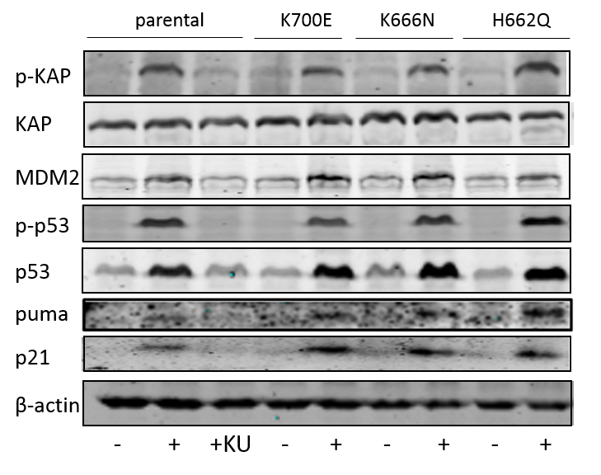
Figure S1. Analysis of alternatively spliced transcripts and DDR target RNAs and proteins in isogenic NALM-6 cells -/+ SF3B1 mutation
A
B
C
- untreated
+ IR 5Gy 16 hours

Slide 8
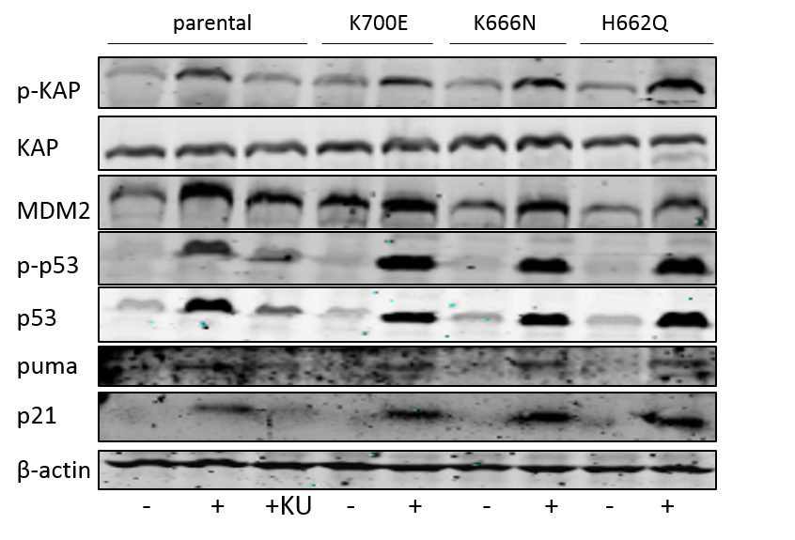
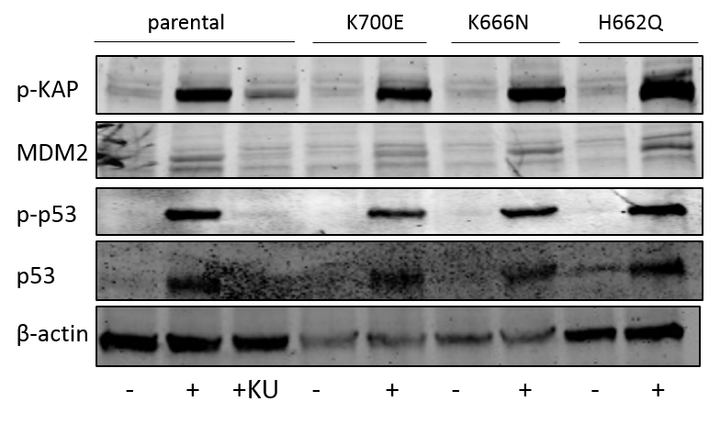
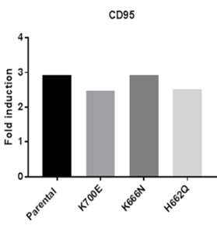
Figure S2. Analysis of DDR response in treatment naïve SF3B1 mutated CLL cells in isogenic NALM-6 cells -/+ SF3B1 mutation.
A
B
- untreated
+ IR 1Gy 16 hours
C
D

Slide 9
Figure S3. Serine 139 phosphorylation of H2AX in response to IR in NALM-6 cells -/+ SF3B1 mutation
Figure S4. Effect SF3B1 mutation status on resistance to fludarabine (left) or doxorubine (right) in NALM-6 cells

Slide 10
Figure S5. Effect of cyclin-dependent kinase inhibition on ATM/p53 protein response in NALM-6 cells -/+ SF3B1 mutation.
A
NALM-6 isogenic cell lines -/+ SF3B1mut
IR-
IR 1Gy 16hr
par
K700E
K666N
par
K700E
K666N
- + - + - + - + - + - +
p-KAP
KAP
p-p53
p53
DMSO
+ CDKi 0.5uM (palbociclib)
B

