Slide 1
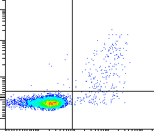
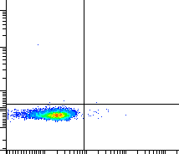
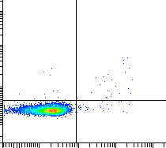
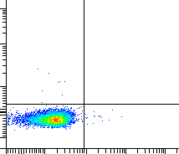
A
CALRLong36
Unstimulated
0.2%
2.7%
0.1%
0.0%
TNF-α
1.2%
TNF-α
0.3%
IFN-γ
IFN-γ
B
0.2%
0.3%
0.1%
0.0%
TNF-α
0.4%
TNF-α
0.2%
IFN-γ
IFN-γ

