Slide 1
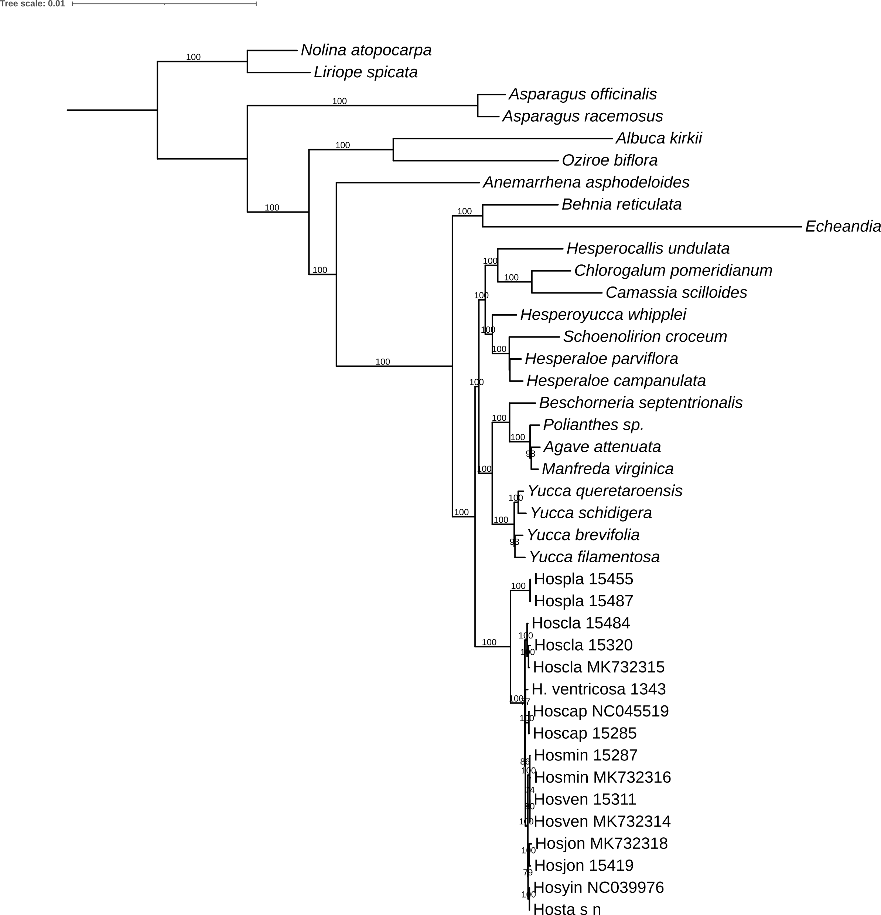
Nolinoideae
Asparagoideae
Scilloideae
Agavoideae
Supplementary Figure 1. Maximum likelihood tree with branch lengths based on 79 protein-coding sequence matrix (68,766 bp) with model TVM+F+R2. The numbers on the node represent bootstrap support values from 10,000 bootstrap replicates.

