Slide 1
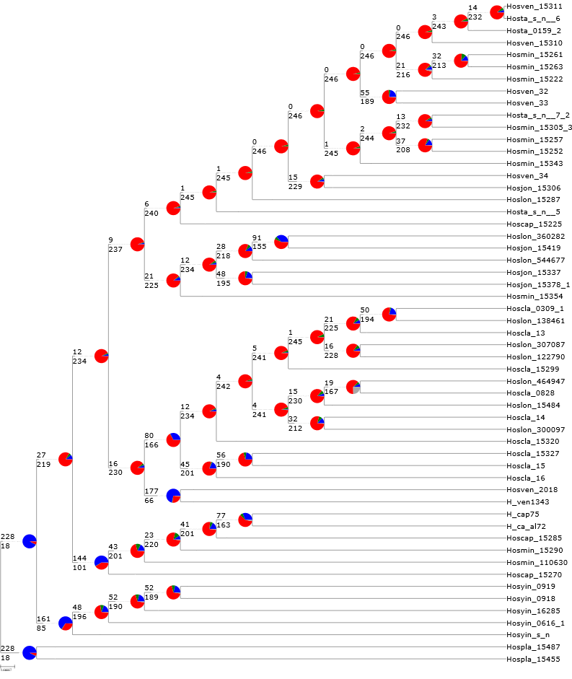

H. minor/H. venusta
H. jonesii
H. clausa
H. ventricosa
H. capitata
H. yingeri
H. plantaginea
Supplementary Figure 3. ASTRAL species tree based on 246 gene trees. For each branch, the number of genes concordant (top) or in conflict (bottom) is shown at each node. Pie charts present the proportion of genes support for that clade (blue), in conflict (red), alternative (green), and uninformative (grey).

