Slide 1
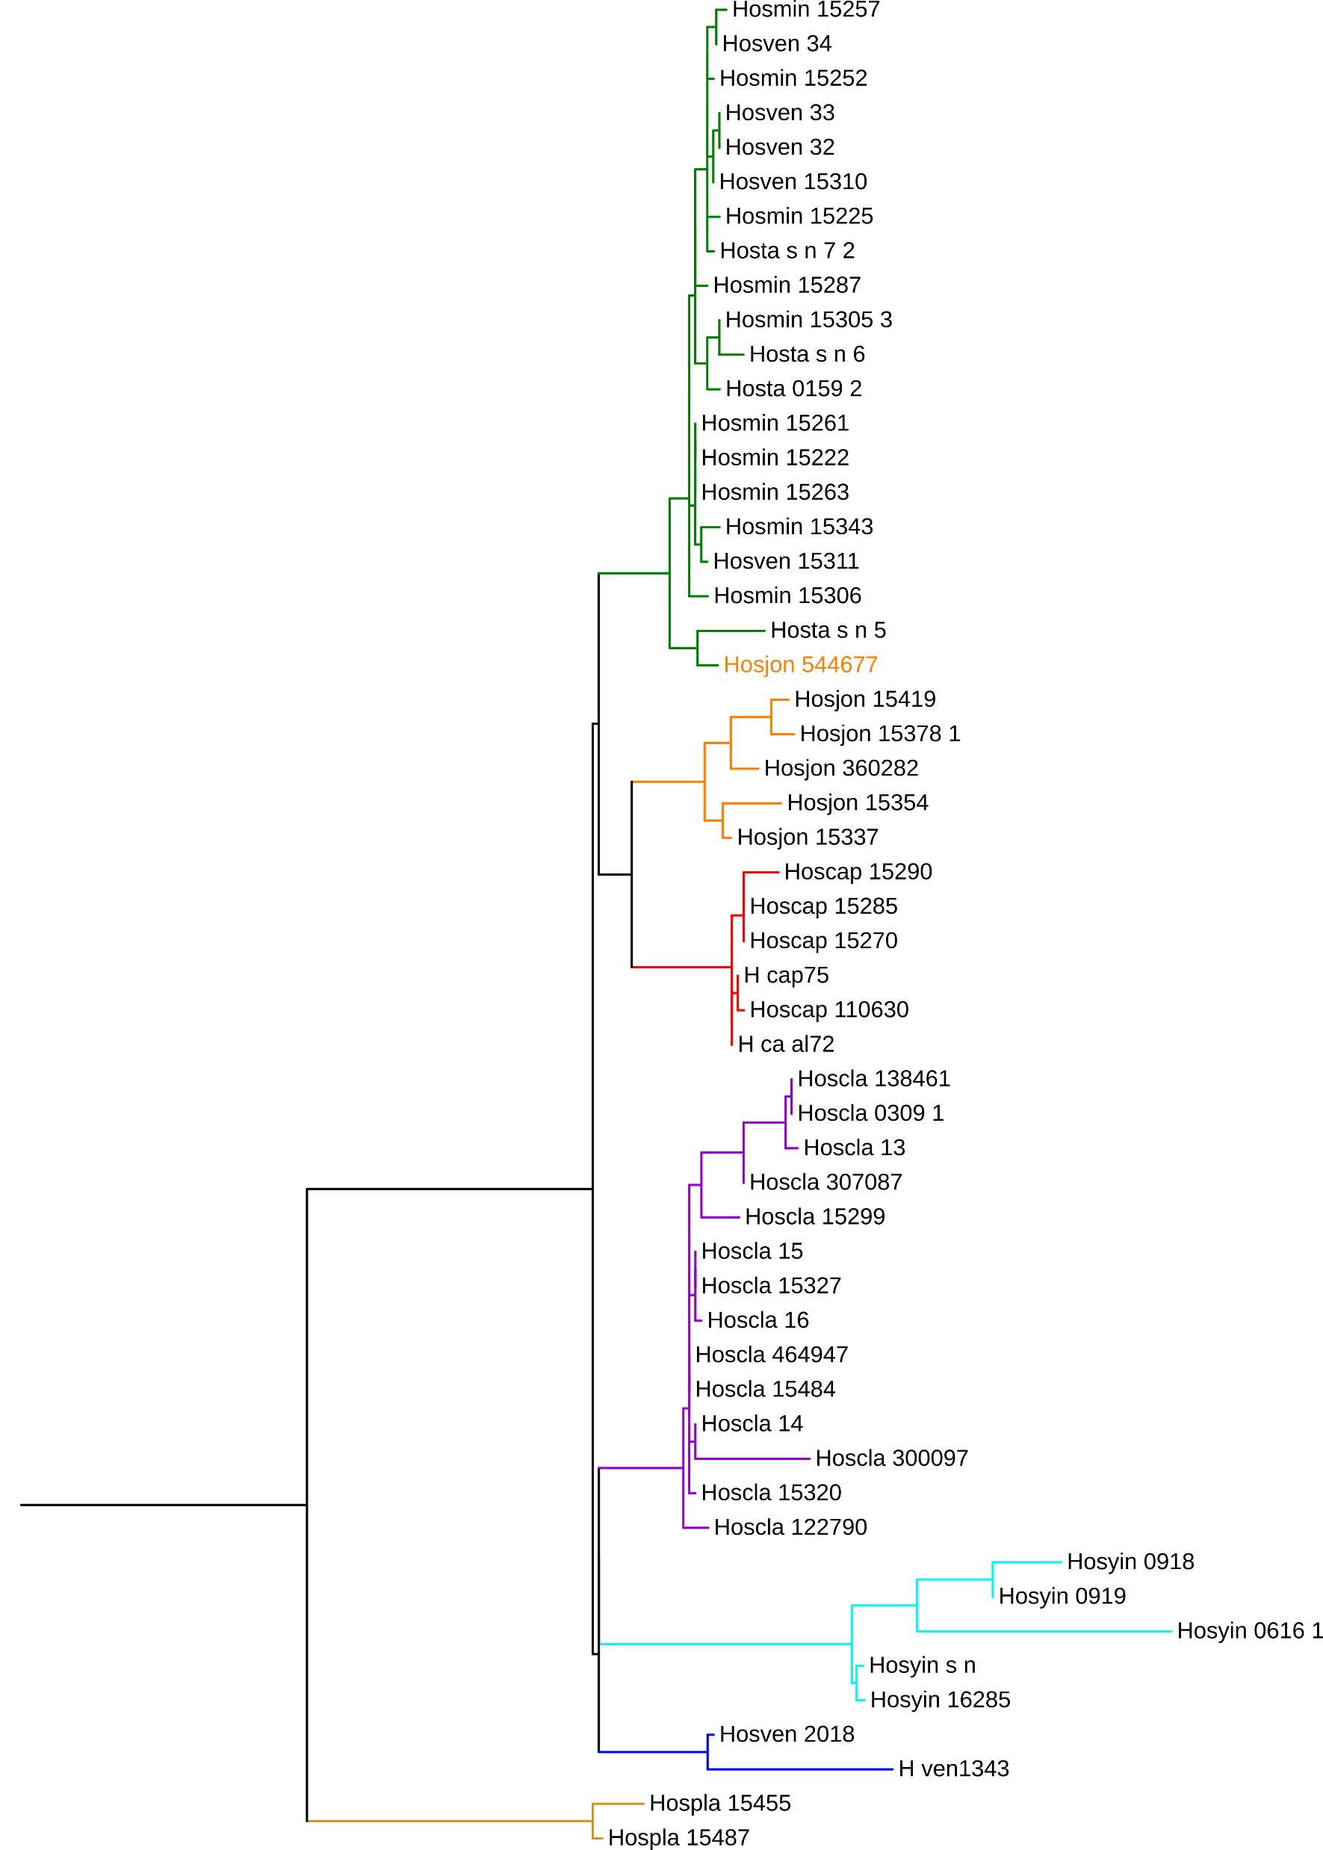
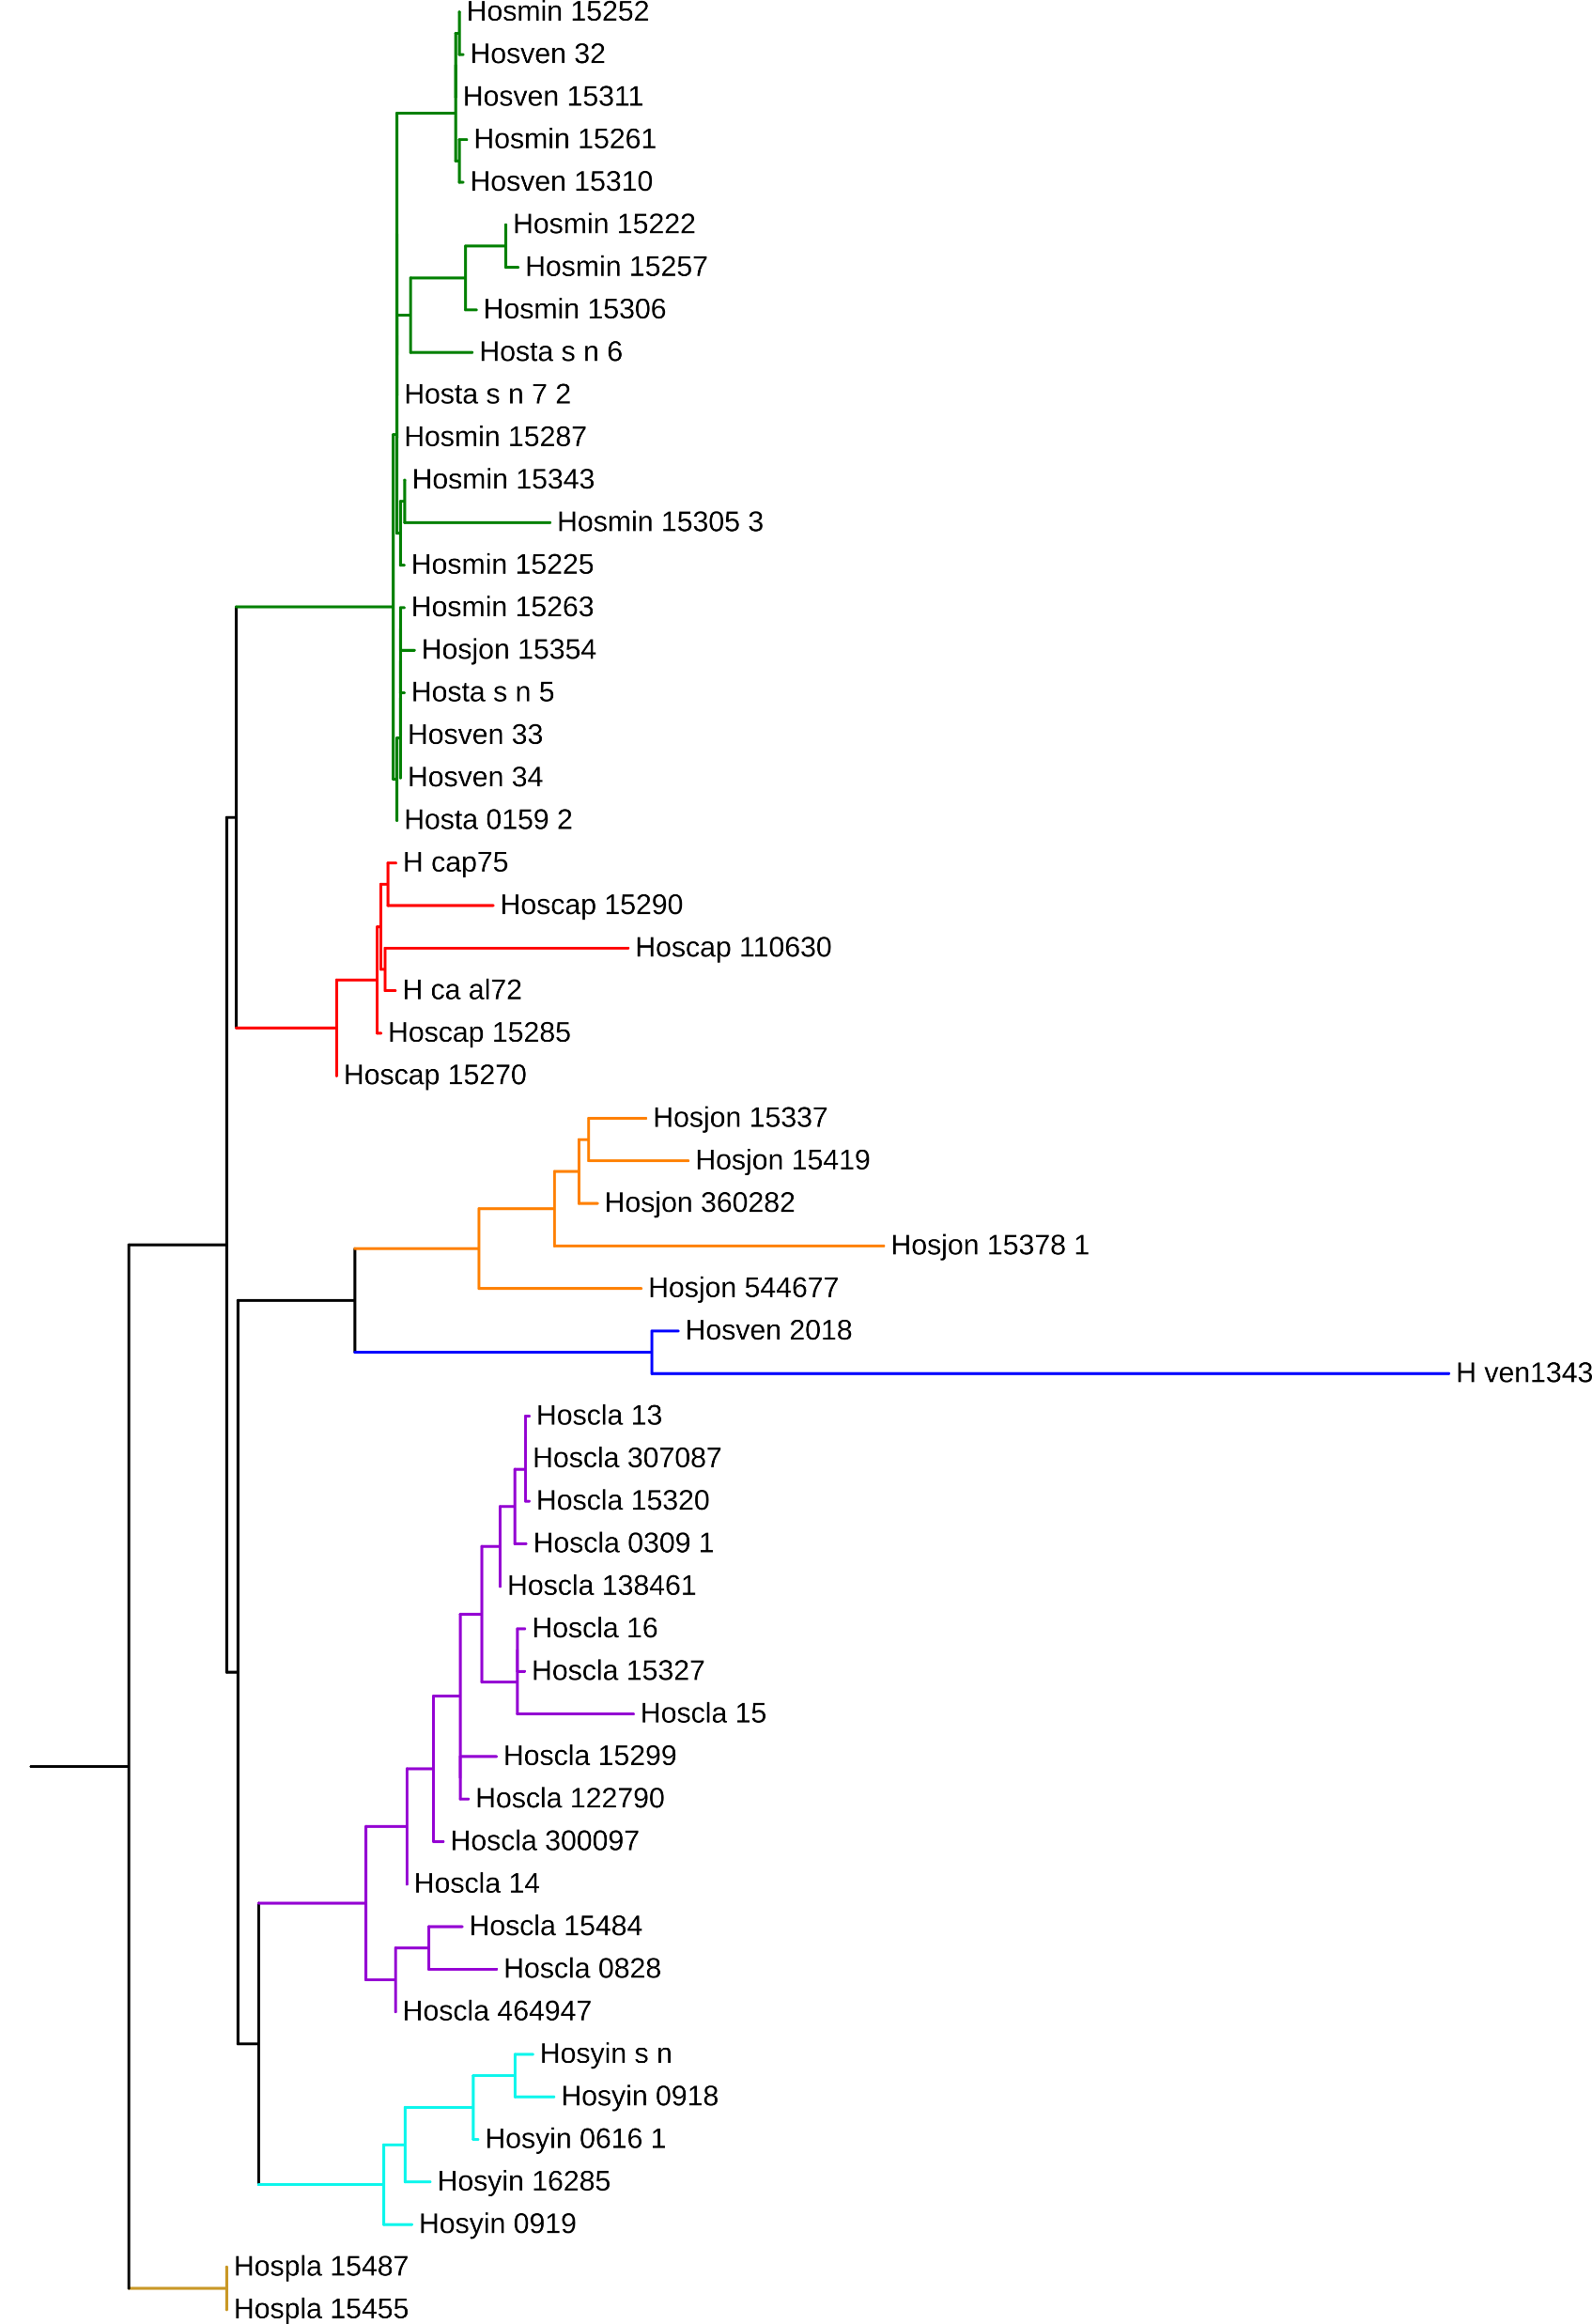
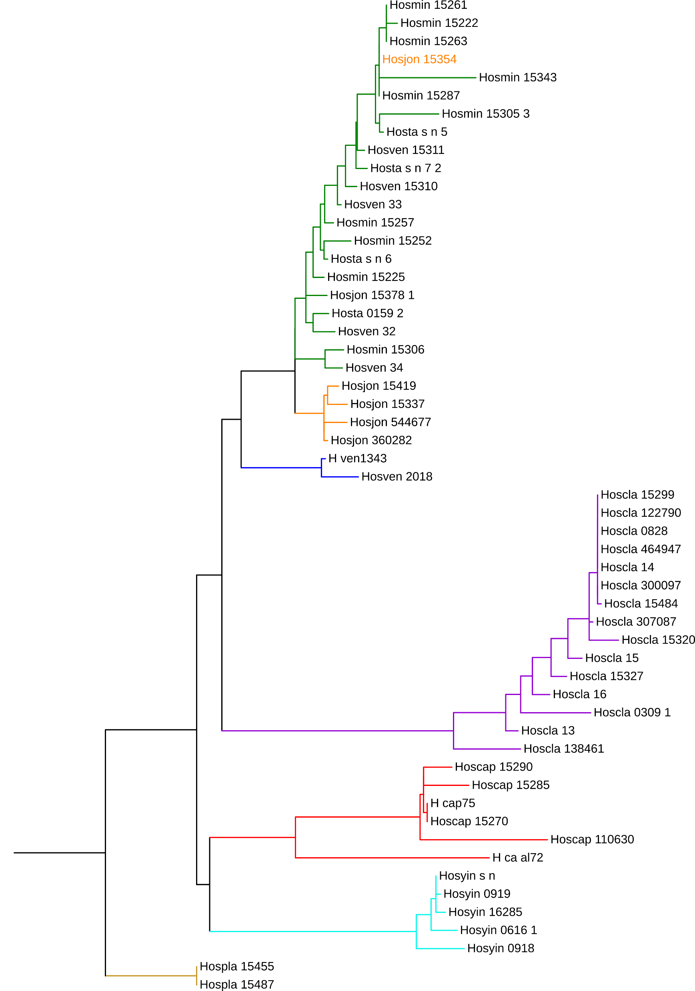
#36
#141
#175
Supplementary Figure 4. Alternative topologies of a maximum likelihood tree obtained from partitioned data of nuclear genes. An accession of H. jonesii in orange text in #36 and #175 trees formed a clade with H. minor and H. venusta, supporting a possible introgression inferred from the plastome sequences.

