Slide 1
Supplementary figures
Research article:
Assessing dynamic changes of taste-related primary metabolisms during ripening of durian pulp using metabolome and transcriptome analyses

Slide 2
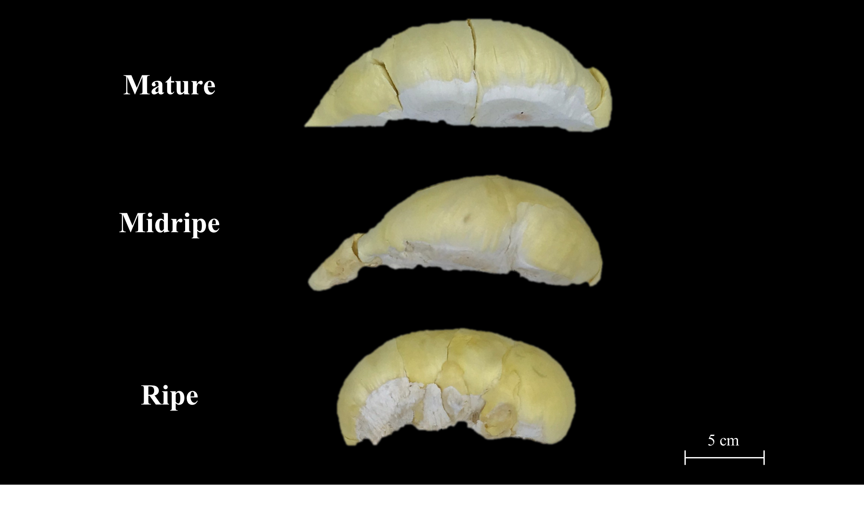
Supplementary Figure 1 Photos of durian cv. Monthong pulp at three stages: Mature, Midripe, and Ripe stages.

Slide 3
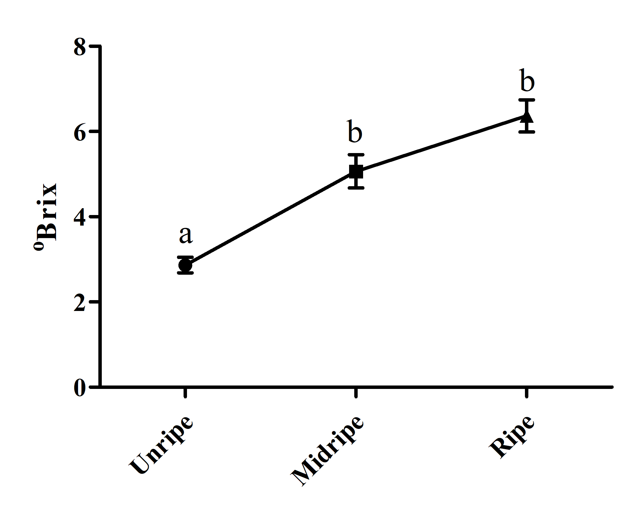
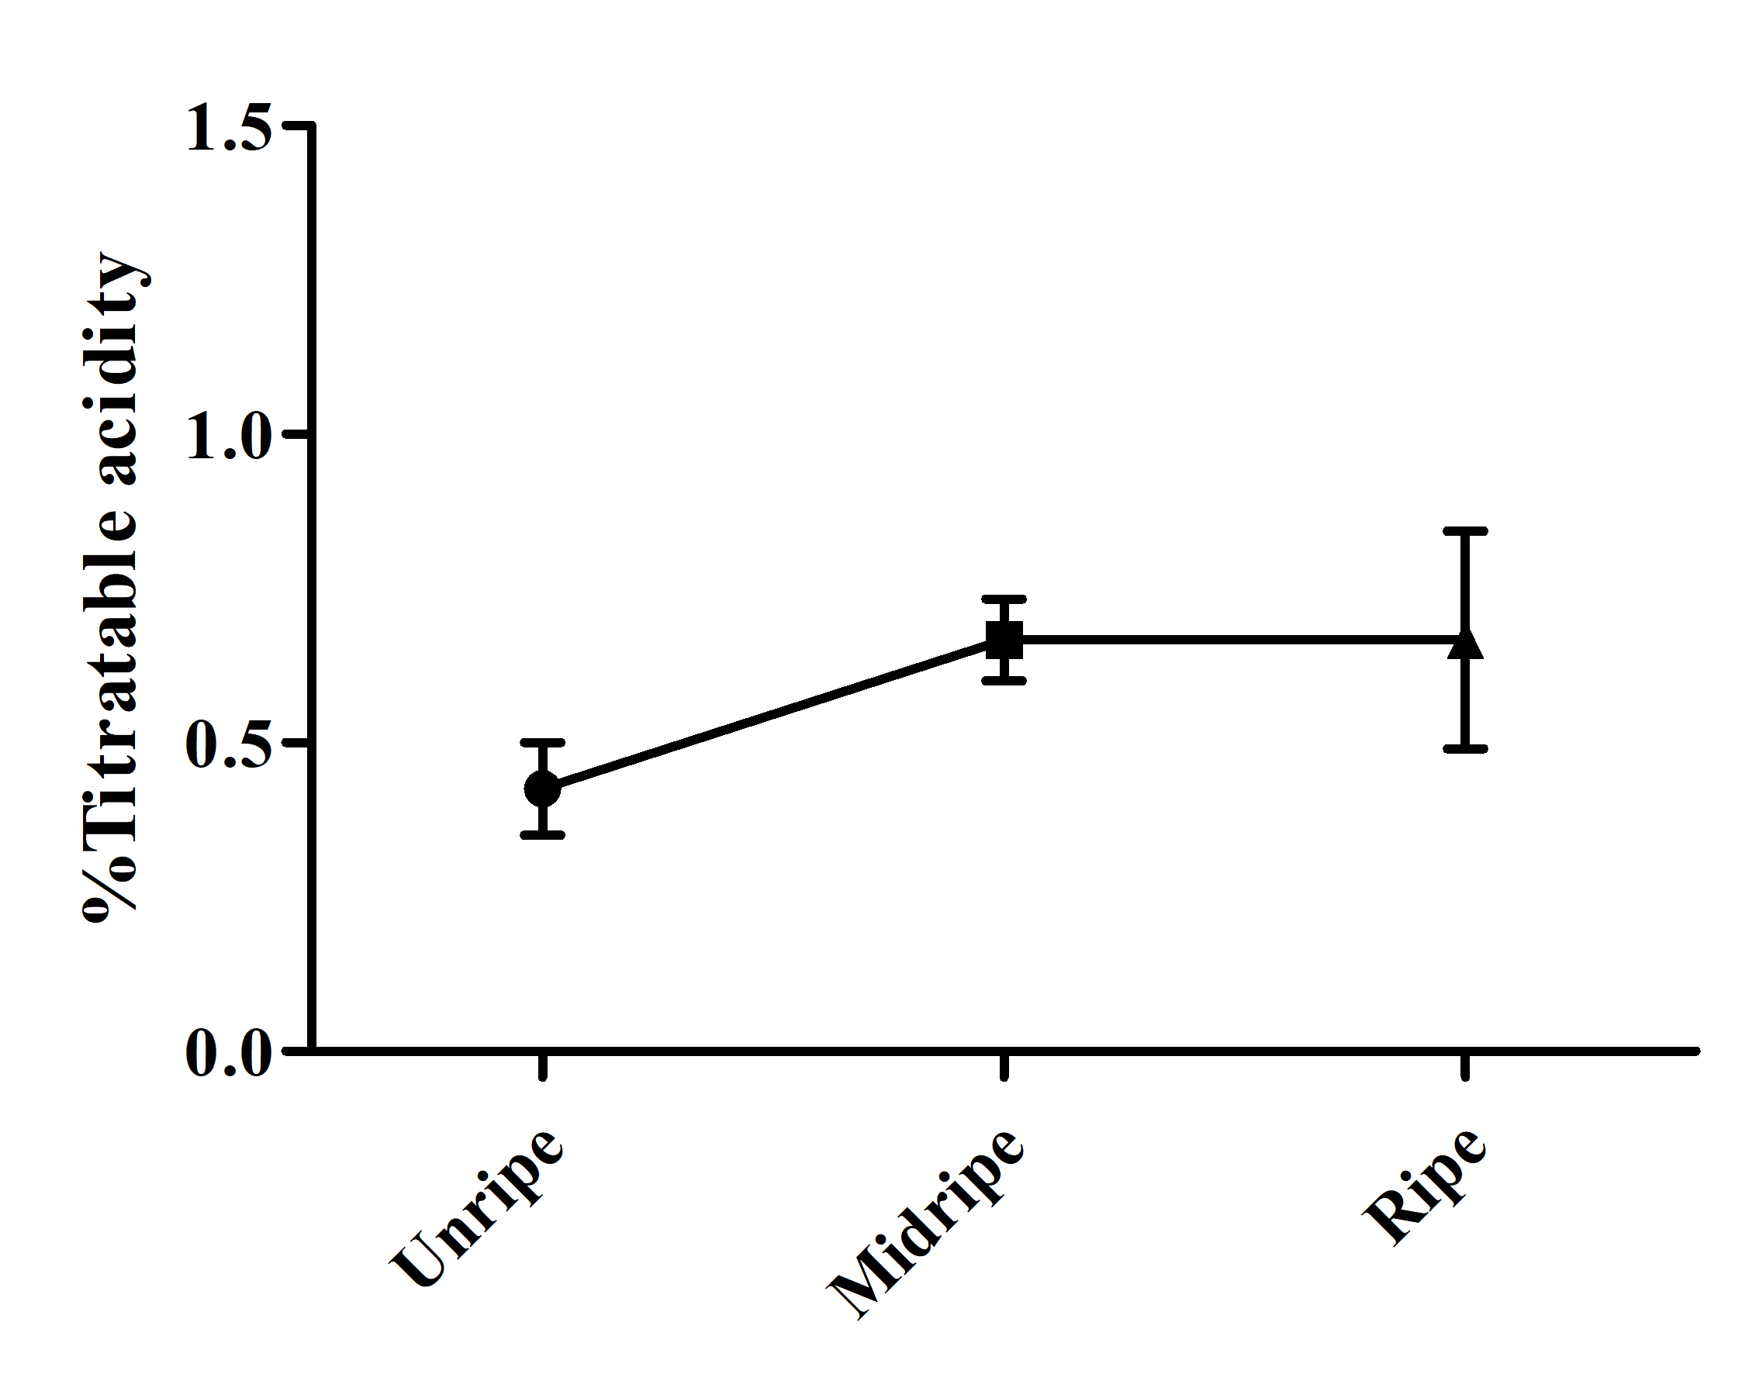
(A)
(B)
Supplementary Figure 2 (A) Total soluble solids (TSS) and (B) % Titratable acid of durian pulp at unripe, midripe, and ripe stages.

Slide 4
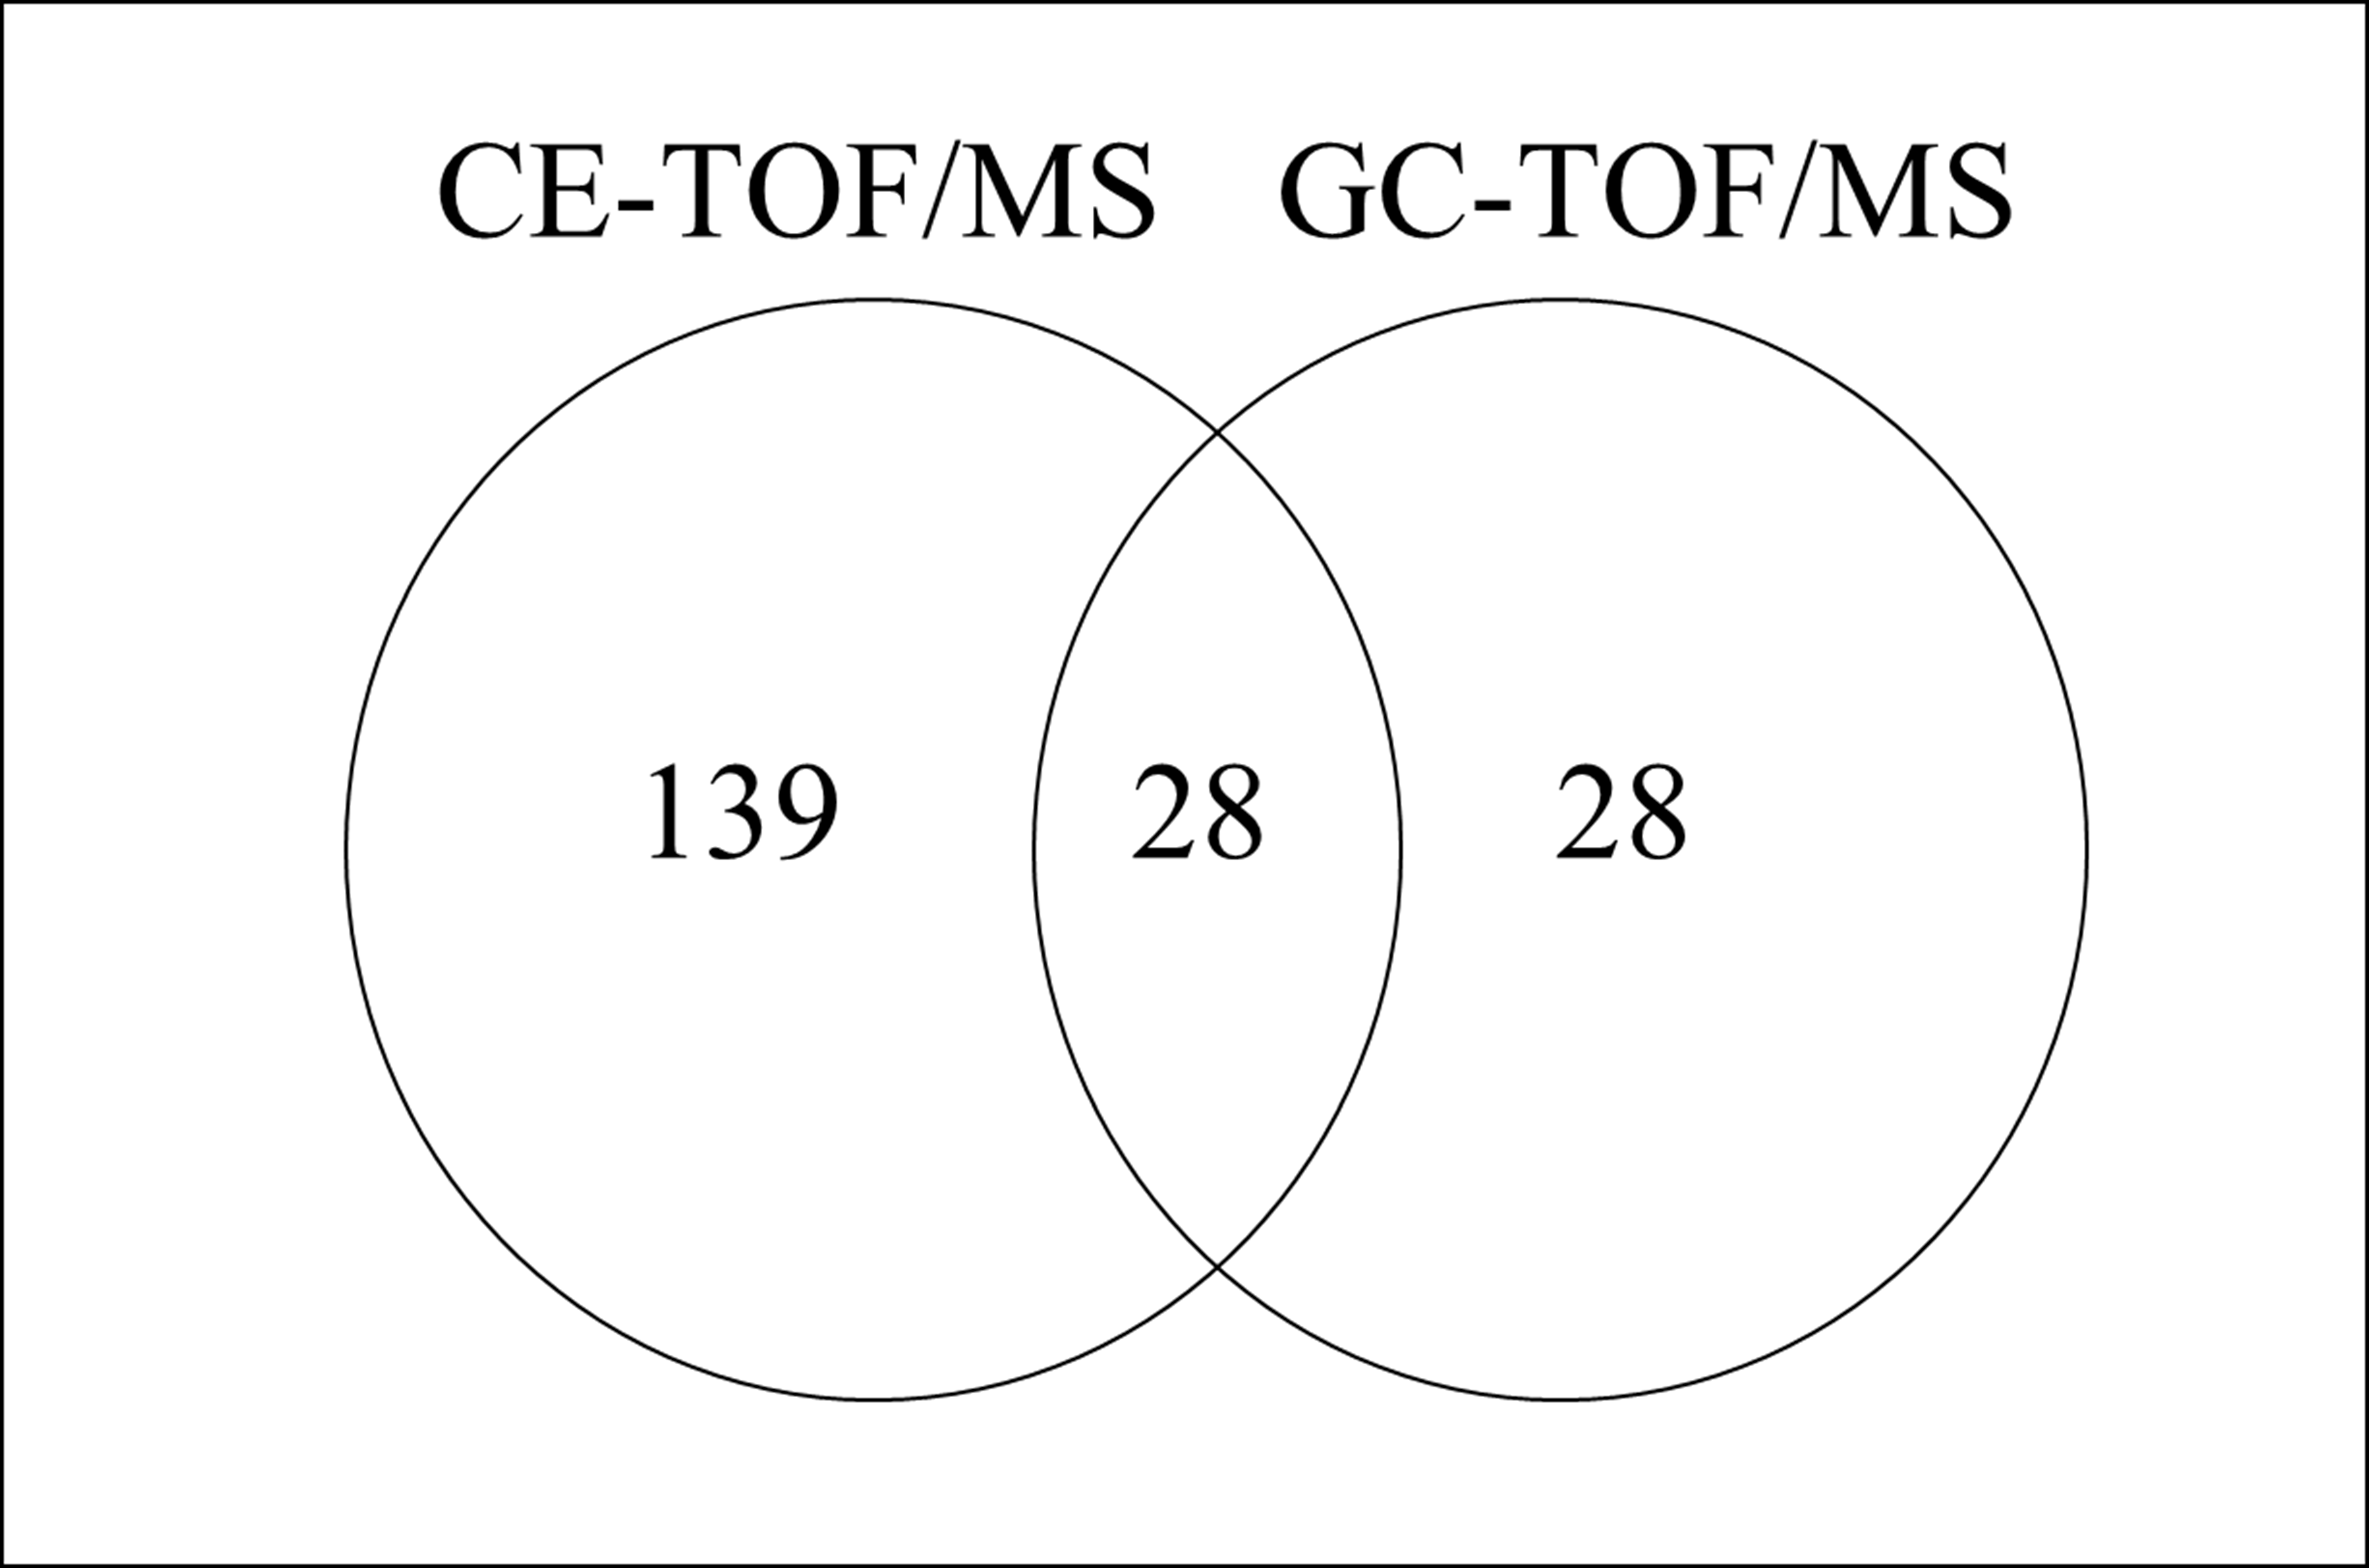
Supplementary Figure 3 Venn diagram showing number of metabolites detected by CE-TOF/MS and GC-TOF/MS.

Slide 5
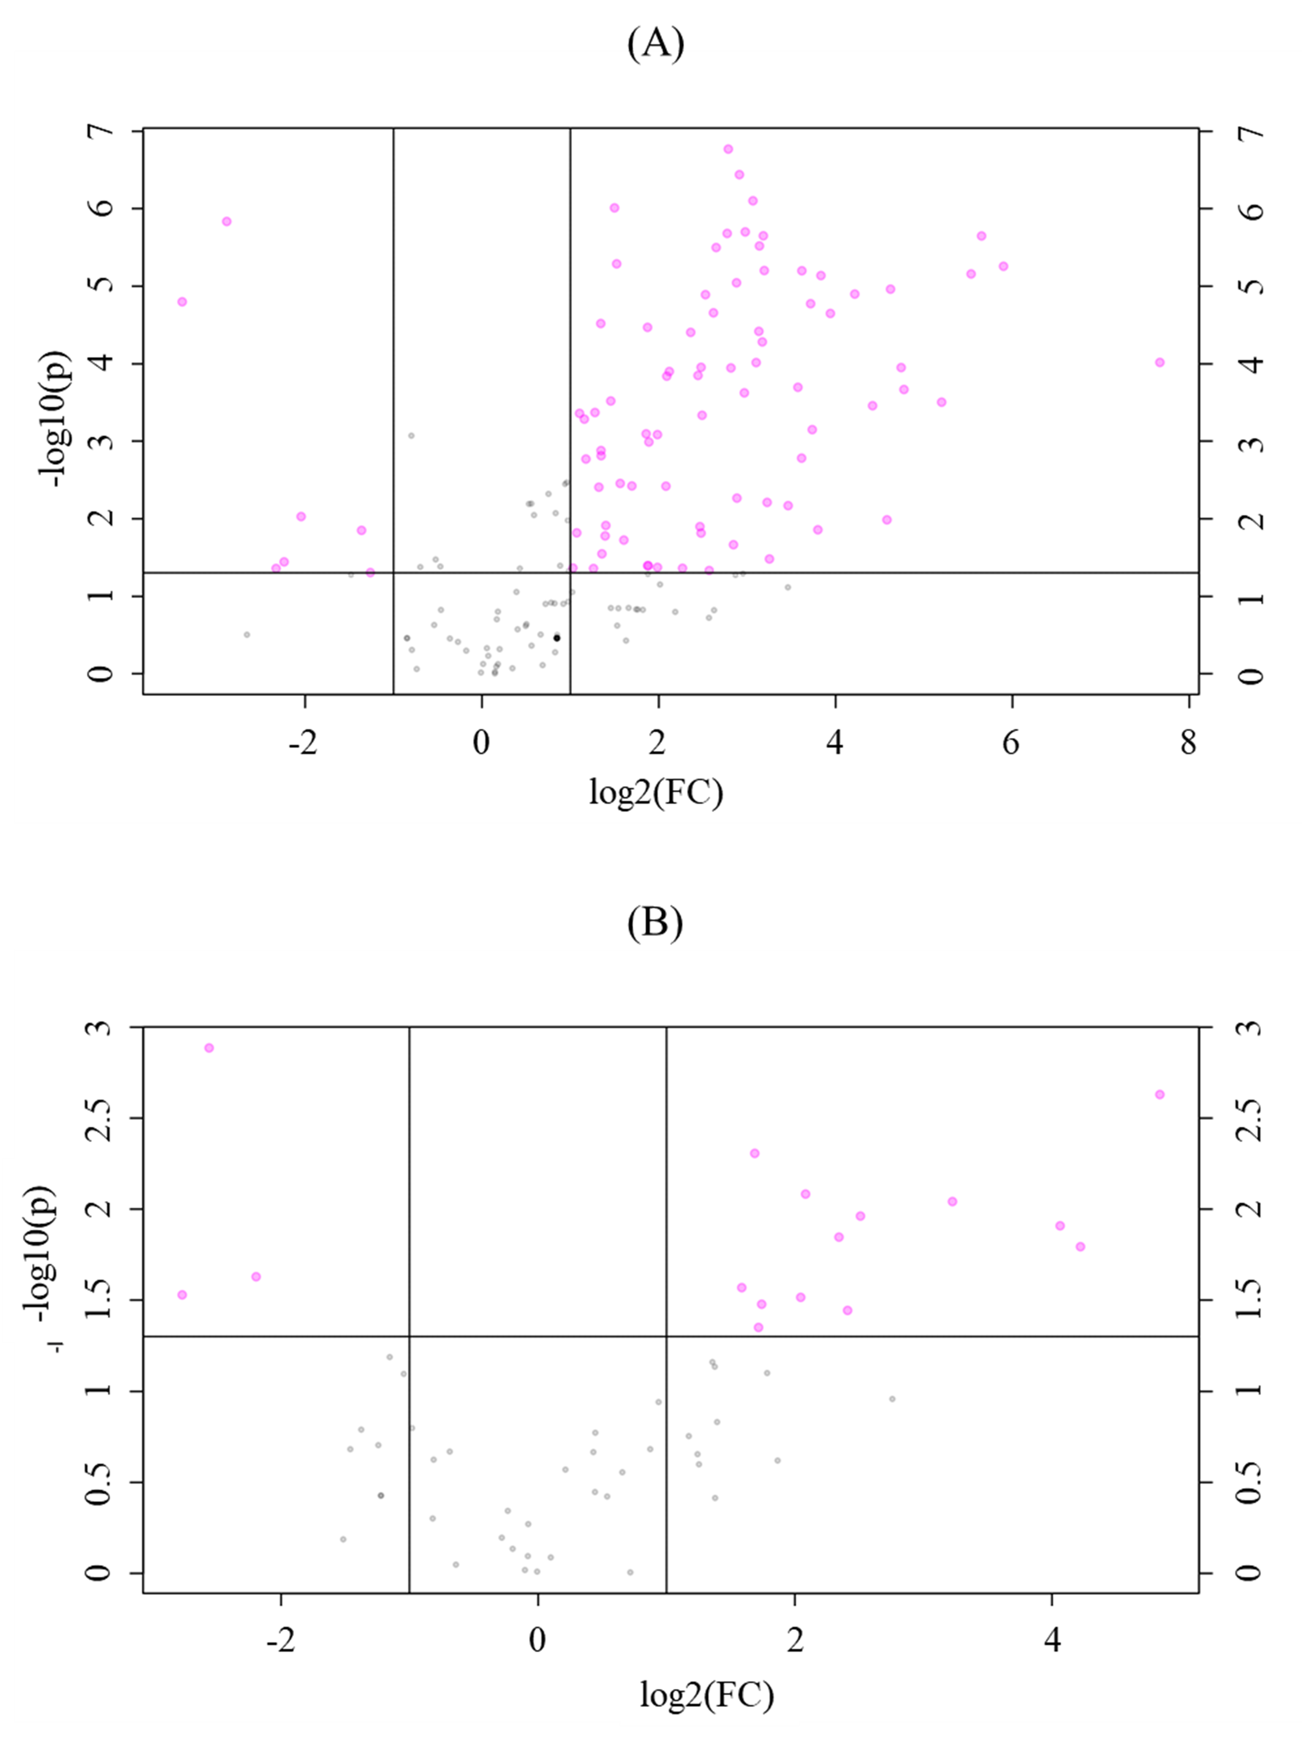
Supplementary Figure 4 Volcano plot presenting the significant metabolites in (A) CE-TOF/MS metabolome data and (B) GC-TOF/MS metabolome data.

Slide 6
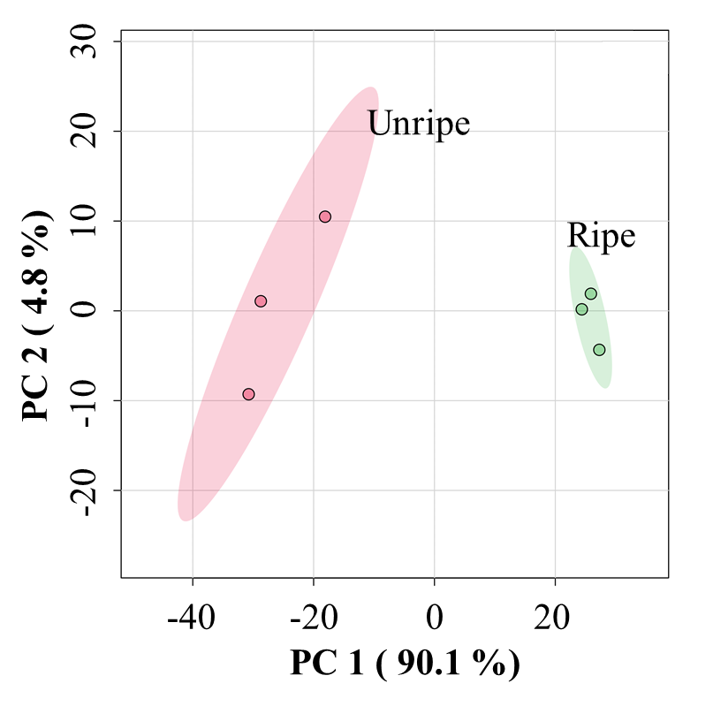
Supplementary Figure 5 PCA score plot of transcriptome data from the pulp of durian cv. Monthong at unripe and ripe stages, which are labelled in red and green, respectively

Slide 7
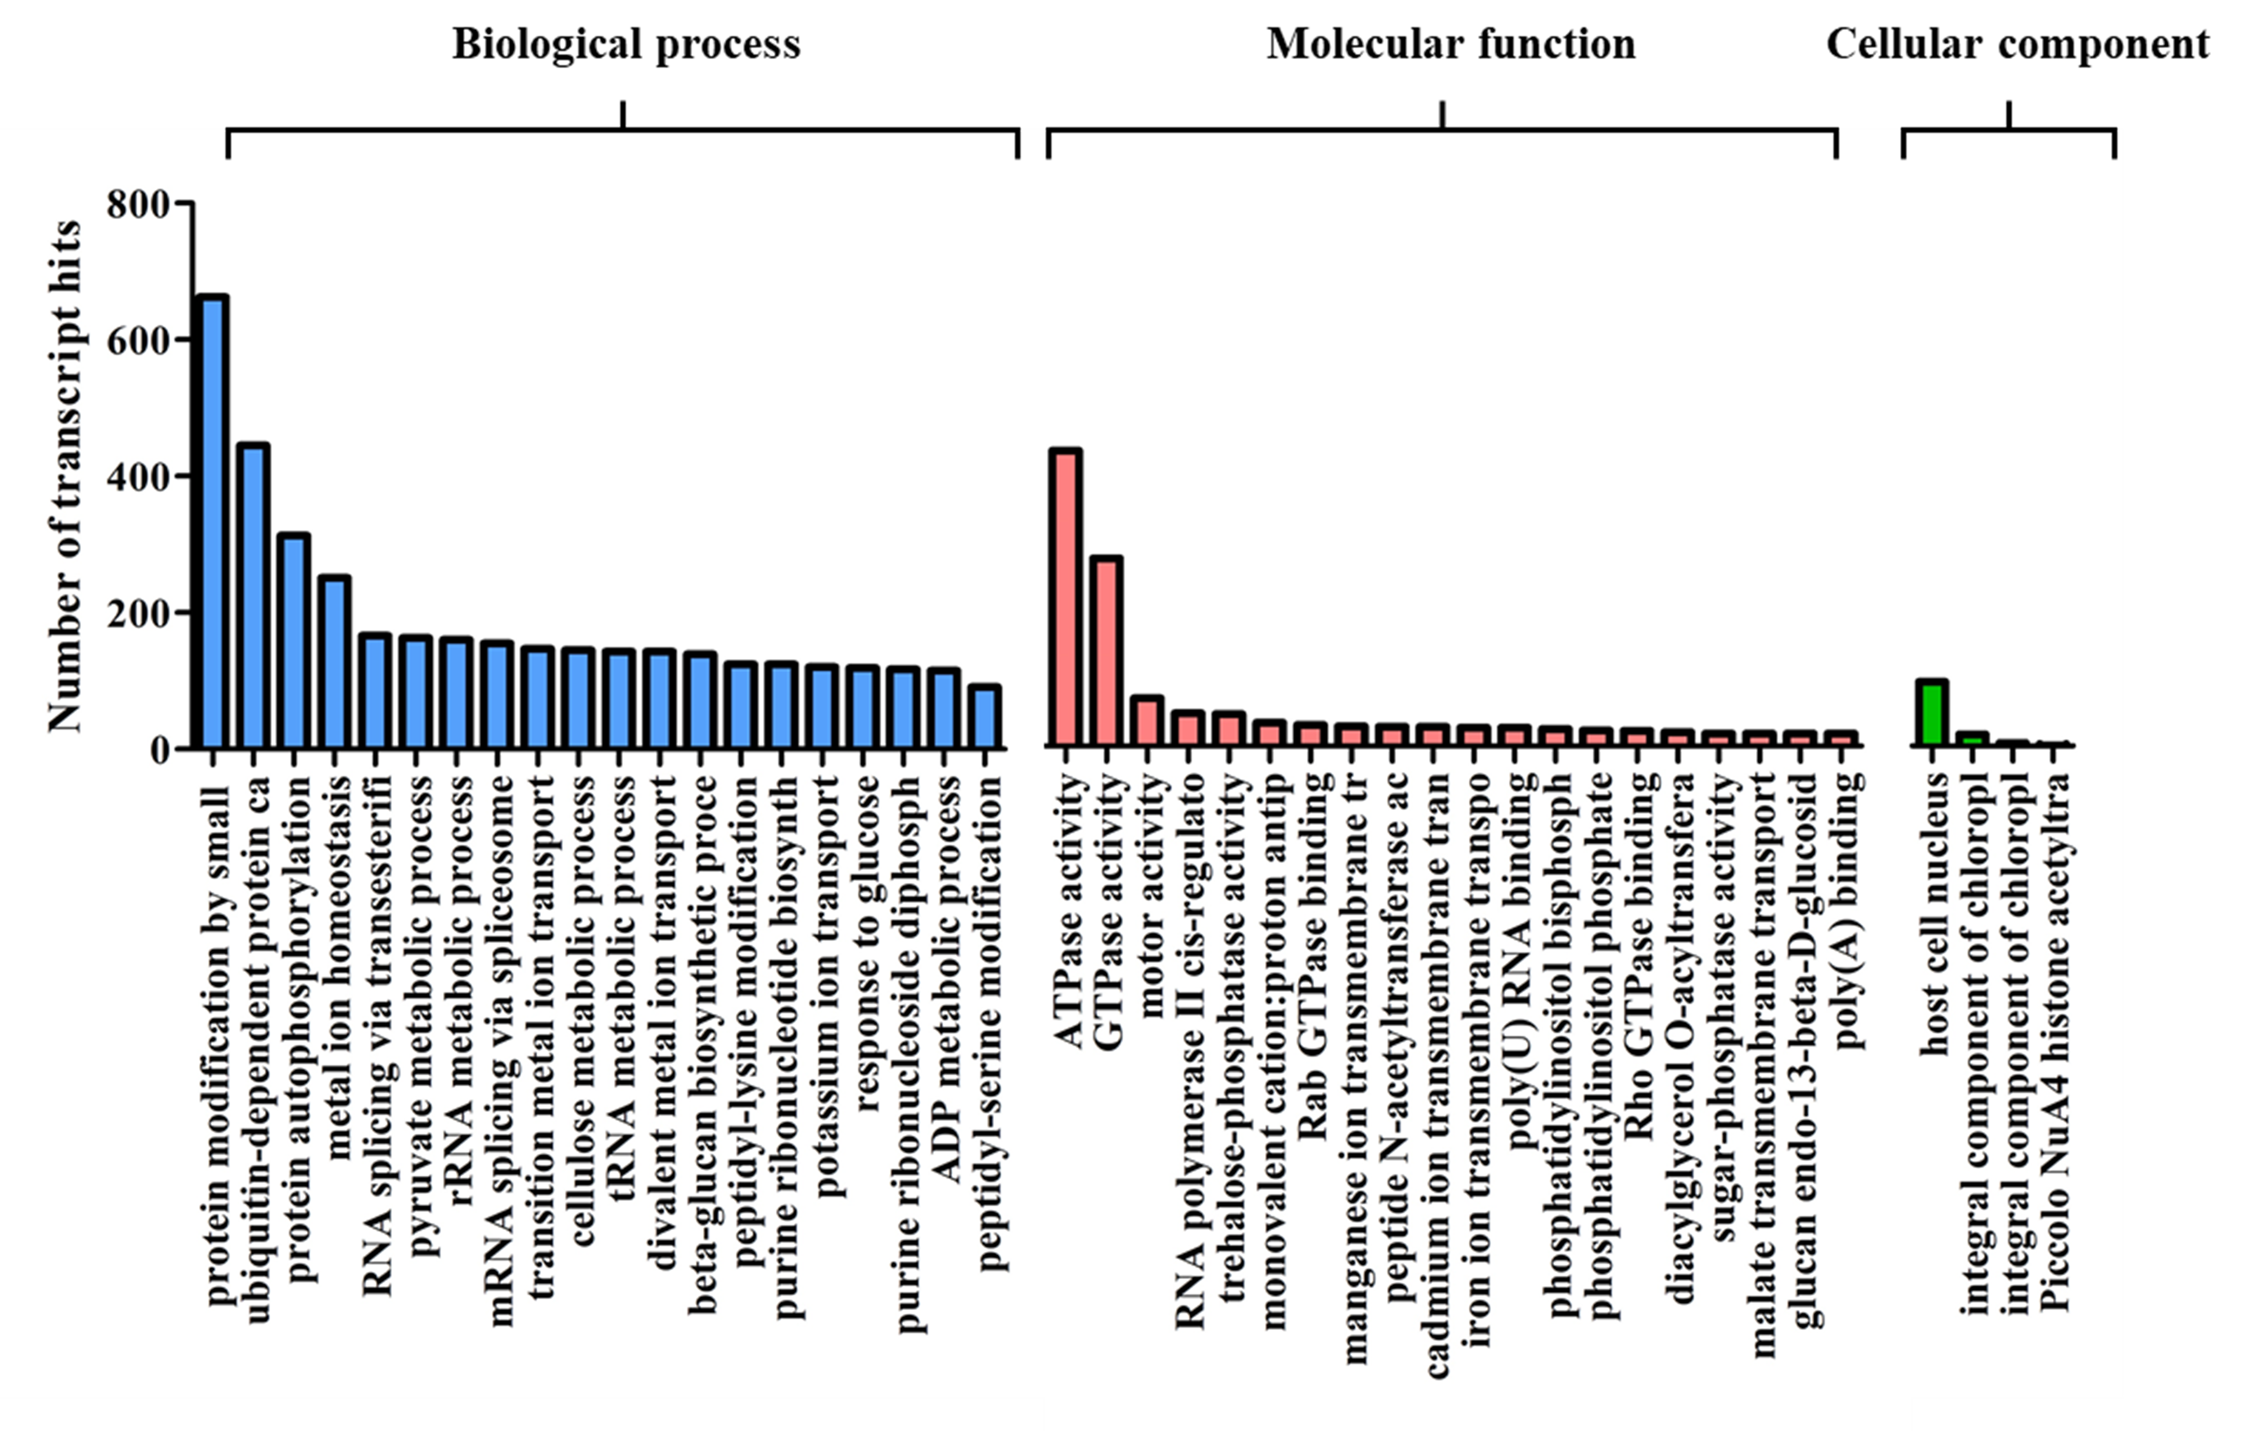
Supplementary Figure 6 Gene ontology classification of DEGs.

Slide 8
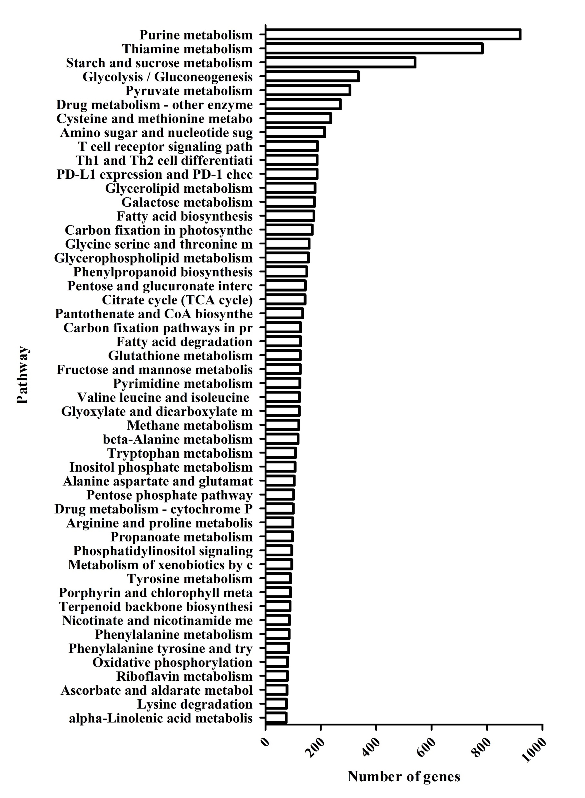
Supplementary Figure 7 The top 50 KEGG pathway of DEGs.

