Slide 1
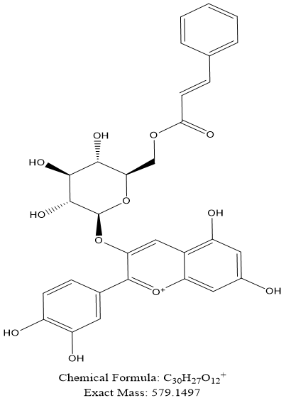
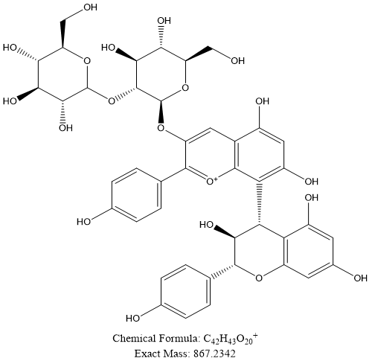
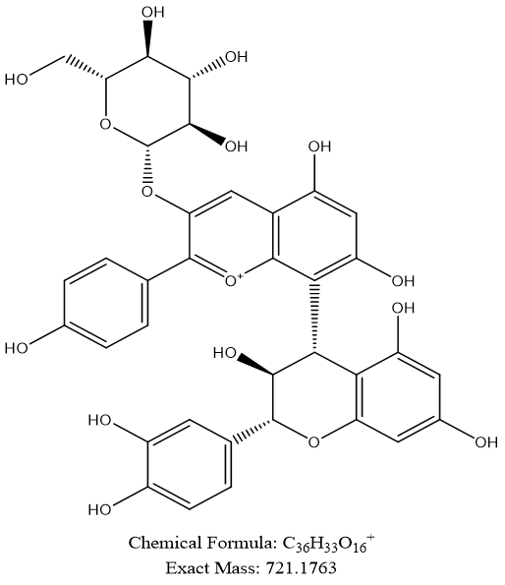
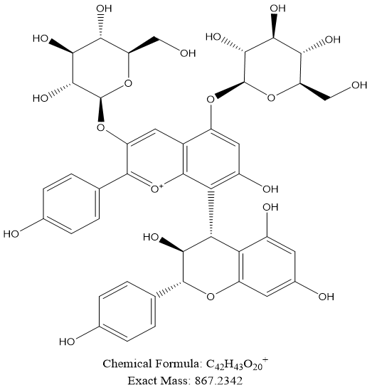
Sup Fig1
5
7 8 9 10 11 12 13
3
4
6
14
16
25
1 2
15
Peak | Scan model | MS | MS^2 | Formula | Identification
1 | [M]+ | 579 | 287 | C₃₀H₂₇O₁₂ | Cyanidin-3-(6''-cinnamoyl)glucoside
2 | [M]+ | 867 | 543, 705 | C₄₂H₄₃O₂₀ | (Epi)afzelechin(4α->8)pelargonidin 3,5-O-diglucoside
3 | [M]+ | 721 | 559 | C₃₆H₃₃O₁₆ | (Epi)catechin(4α->8)pelargonidin 3-O-glucoside
4 | [M]+ | 867 | 543, 705 | C₄₂H₄₃O₂₀ | (Epi)afzelechin(4α->8)pelargonidin 3-O-sophoroside
5 | [M]+ | 705 | 313, 407, 543 | C₃₆H₃₃O₁₅ | (Epi)afzelechin(4α->8)pelargonidin 3-O- glucoside
6 | [M]+ | 433 | 271 | C₂₁H₂₀O₁₀ | Pelargonidin 3-O-glucoside
Peak | Scan model | MS | MS/MS | Formula | Identification
7 | [M-H] | 433 | 301 | C₁₉H₁₄O₁₂ | Ellagic acid pentoside ¹
8 | [M+HCOOH-H] | 615 | 165, 195, 359, 407 | C₂₇H₃₈O₁₃ | Rourinoside ¹
9 | [M-H] | 301 | 284 | C₁₄H₆O₈ | Ellagic acid
10 | [M-H] | 609 | 301 | C₂₇H₃₀O₁₆ | Rutin (Quercetin 3-O-rutinoside)
11 | [M-H] | 463 | 300, 301 | C₂₁H₂₀O₁₂ | Isoquercitrin (Quercetin 3-O-glucoside)
12 | [M-H] | 593 | 255, 284 | C₂₇H₃₀O₁₅ | Kaempferol-3-o-rutinoside isomer ²
13 | [M-H] | 447 | 227, 255, 284 | C₂₁H₂₀O₁₁ | Kaempferol 3-O-hexoside isomer ²
14 | [M-H] | 593 | 255, 285 | C₂₇H₃₀O₁₅ | Nikotoflorin (kaempferol-3-O-rutinoside)
15 | [M-H] | 447 | 227, 255, 284 | C₂₁H₂₀O₁₁ | Astragalin (kaempferol-3-O-glucoside)
16 | [M-H] | 593 | 255, 285 | C₃₀H₂₆O₁₃ | Tiliroside (kaempferol-3-p-coumaroylglucoside)
Peak1
287
Peak 9
301
Peak2
705
543
407
Peak10
195
359
Peak3
559
Peak11
Peak4
705
705
543
Peak12
301
543
Peak 13
300
Peak5
Peak 16
284
Peak6
271
284
Peak 17

