Slide 1
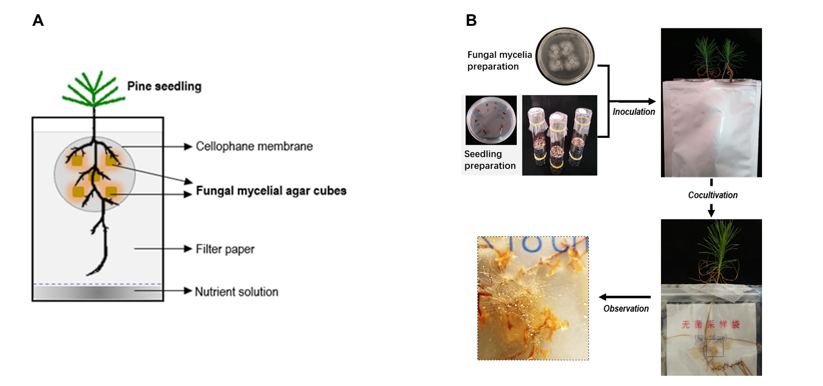
Figure S1: In vitro pouch system for EcM synthesis (A) and major steps involved (B).

