Slide 1
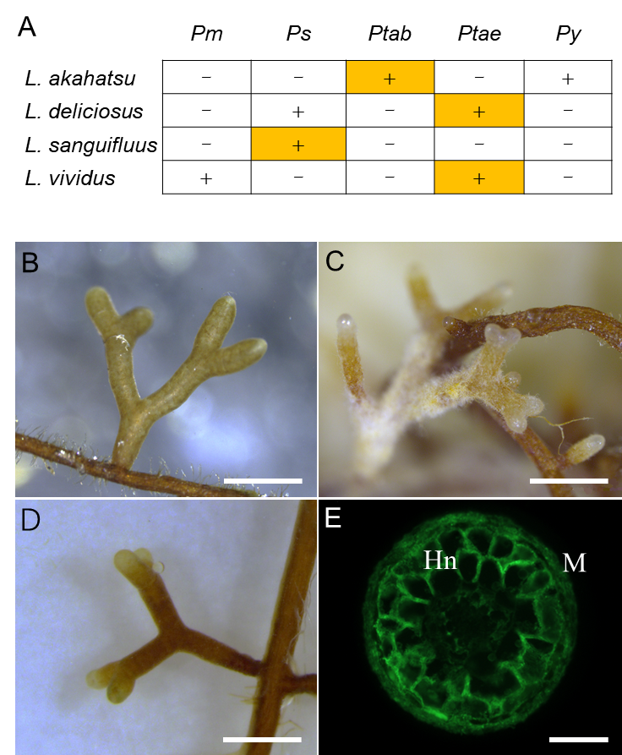
Figure S2. Mycorrhization assay of Lactarius.
Each of the four Lactarius species was paired with five different Pinus species to assay their ectomycorrhizal compatibility (A); Compatible Lactarius-Pinus combinations leading to symbiosis development are indicated as “+” while incompatible combinations as “–”. The four interactions highlighted in orange were used for RNA sequencing. In addition to the L. deliciosus-P. taeda ectomycorrhizal roots shown in Fig.1, ectomycorrhizal roots of three other compatible combinations were checked by stereomicroscopy, including L. akahatsu with P. tabuliformis (B), L. sanguifluus with P. sylvestris (C), and L. vividus with P. taeda (D). Agarose-embedded L. vividus-P. taeda sections (50 µm), stained with WGA-FITC were further checked for the presence of mantle and Hartig net (E). Abbreviations: M, Mantle; Hn, Hartig net; Pm, Pinus massoniana; Ps, P. sylvestris; Ptab, P. tabuliformis; Ptae, P. taeda; Py, P. yunnanensis. Scale bar in b-d: 1 mm and in e: 100 µm.

