Slide 1
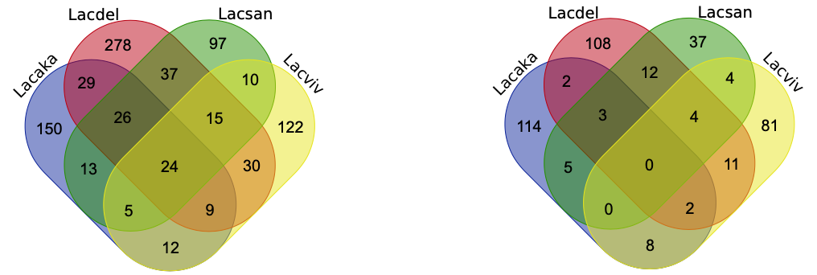
Figure S4. Orthogroups (OGs) containing commonly and specifically regulated genes among four Lactarius species. Abbreviations: Lacaka, L. akahatsu; Lacdel, L. deliciosus; Lacsan, L. sanguifluus; Lacviv, L.vividus.
Induced
Repressed

