Slide 1
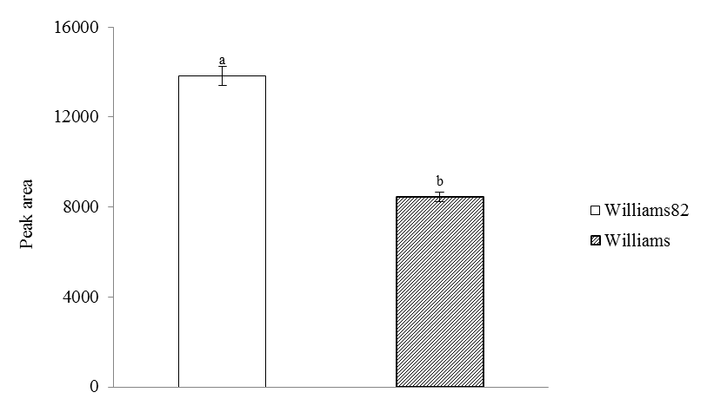
Supplementary Figure 1. Relative peak area of 4-Ethylphenol in susceptible and resistant soybeans measured by GC-MS.

Slide 2
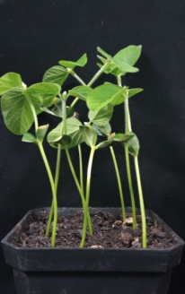
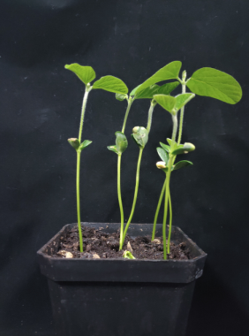
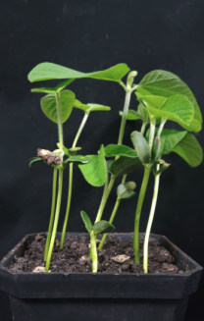
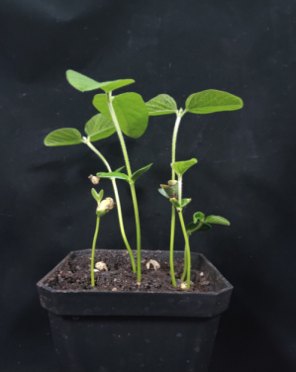
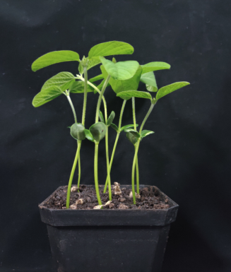
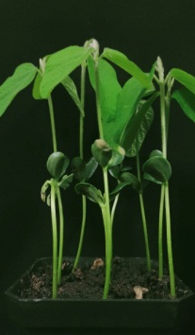
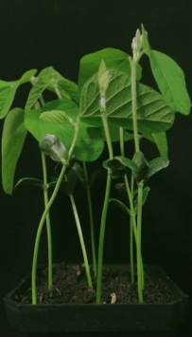
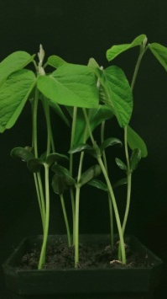
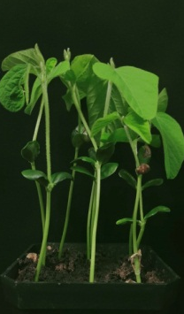
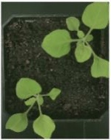
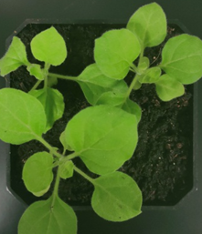
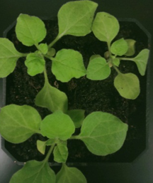
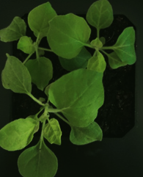
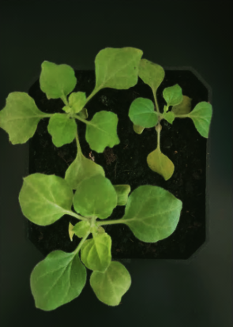
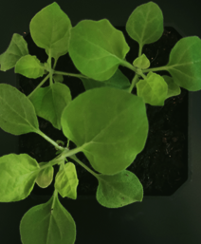
A
7 days
14 days
Supplementary Figure 2. 4-Ethylphenol is safety to host plants
(A) Effects of 4-Ethylphenol on soybean plant growth. (1)Negative control (without 4-Ethylphenol), (2-6) 5,10, 15, 20, 25 mg a.i./plant 4-Ethylphenol mixed soil treatment. (B) Effects of 4-Ethylphenol on tobacco plant growth. (1) Negative control (without 4-Ethylphenol), (2-5) 5, 10, 15, 20 mg a.i./plant 4-Ethylphenol mixed soil treatment.
1 2 3 4 5 6
B
7 days
14 days
1 2 3 4 5

Slide 3
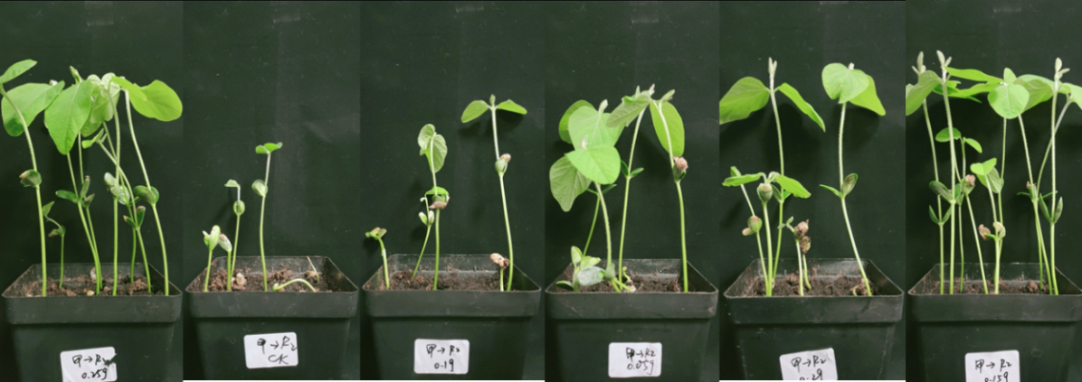
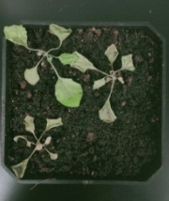
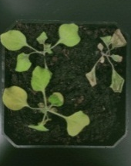
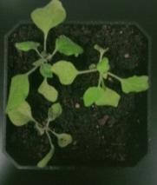
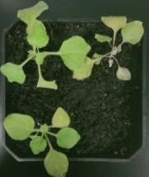
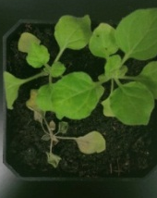
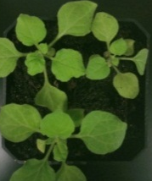
A
1 2 3 4 5 6
B
1 2 3 4 5 6 7
Supplementary Figure 3 (A) Control effect of 4-Ethylphenol on soybean root rot resistance. (1) Negative control, without Phytophthora sojae and 4-Ethylphenol. (2-6) 0, 5, 10, 15, 20 mg a.i./plant 4-Ethylphenol and equal amount of Phytophthora sojae mixed soil treatment. (B) Control effect of 4-Ethylphenol on soybean root rot in pot. Data are the mean ± S.E. from three replicates per treatment. (B) Control effect of 4-Ethylphenol on tobacco black shank. (1) Negative control, without Phytophthora nicotianae and 4-Ethylphenol. (2-7) 0, 5, 10, 15, 20, 25 mg a.i./plant 4-Ethylphenol and equal amount of Phytophthora nicotianae mixed soil treatment.

Slide 4
4-Ethylphenol Concentration(mmol/L) | P.sojae | P.nicotianae
0 | ++++ | ++++
0.2 | +++ | +++
0.4 | ++ | ++
0.6 | ++ | +
0.8 | - | +
1 | - | -
Supplementary Table 1 Effects of 4-Ethylphenol on the germination of zoospores of Phytophthora sojae and Phytophthora nicotianae. The suspensions of zoospores were taken and smear on V8 medium containing 4-Ethylphenol of different concentrations to observe the germination of zoospores. The experiment was repeated three times with similar results.

