Slide 1
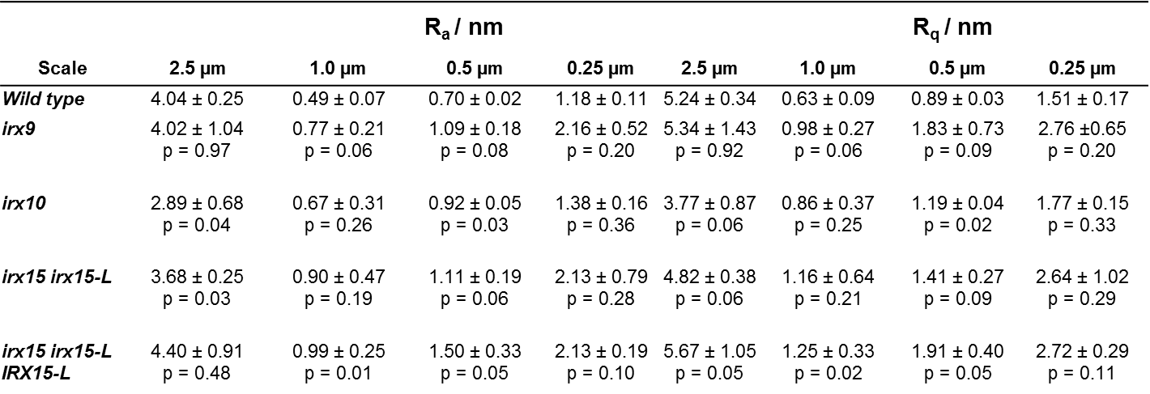
Supplementary Table 1. Roughness analysis inner SCWs using AFM.
Roughness parameters for average roughness (R_{a}) and root-mean-square roughness (R_{q}) measured on AFM height images at multiple image scales. Roughness is utilized in this case to measure cell wall uniformity. Roughness calculations were preformed on three individual images for each scale (n = 3), with standard deviations shown in table. P values indicate statistical significance compared to wild type from t-test.

