Slide 1
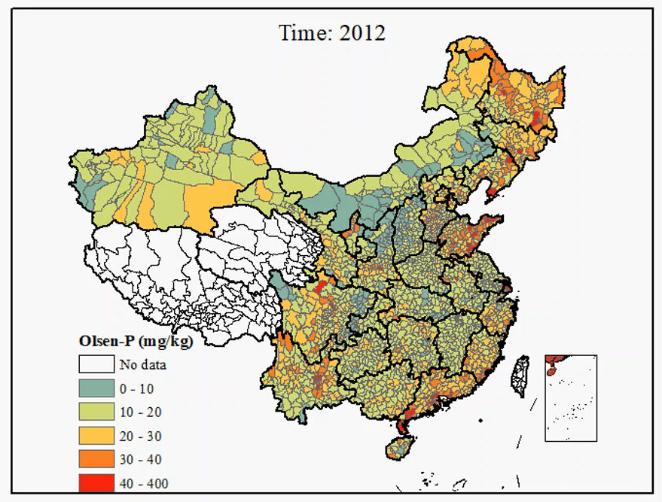
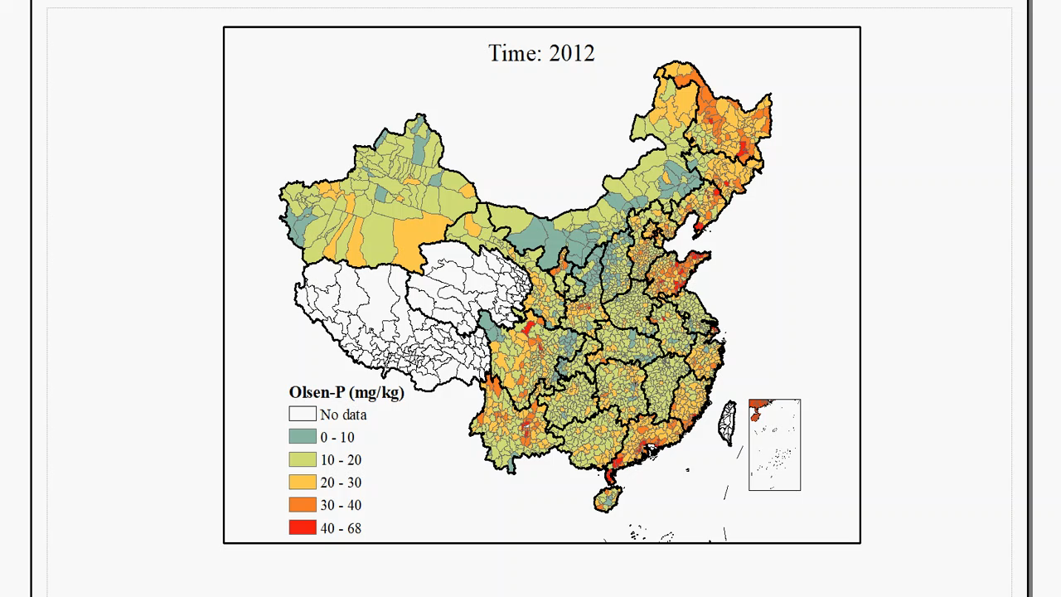
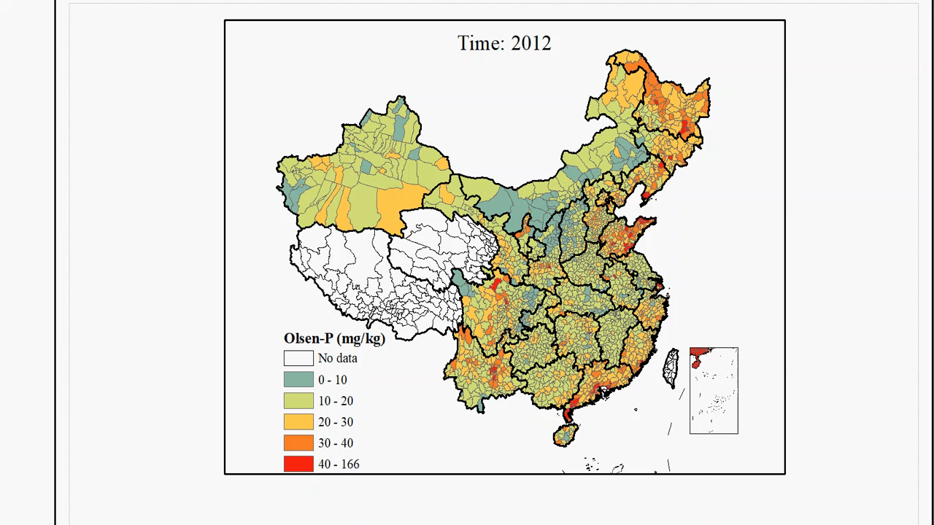
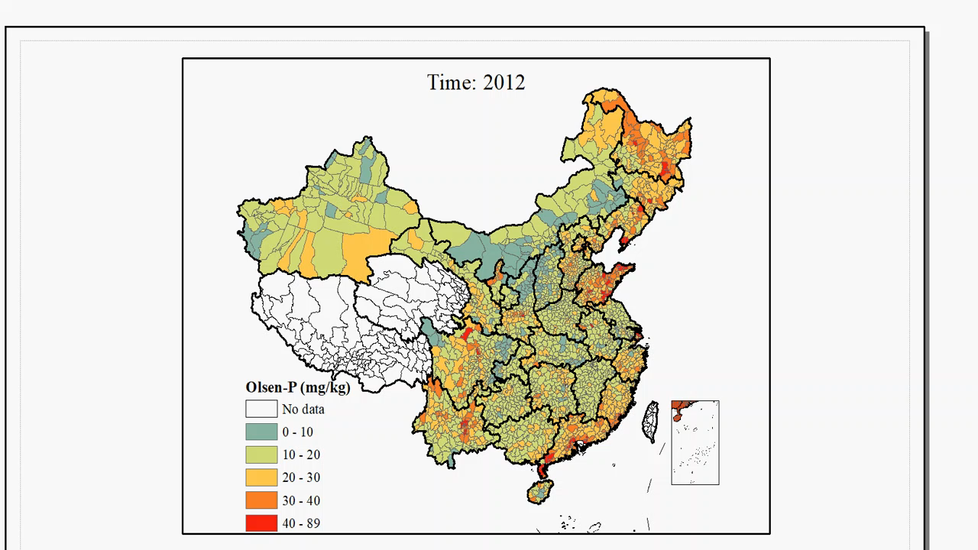
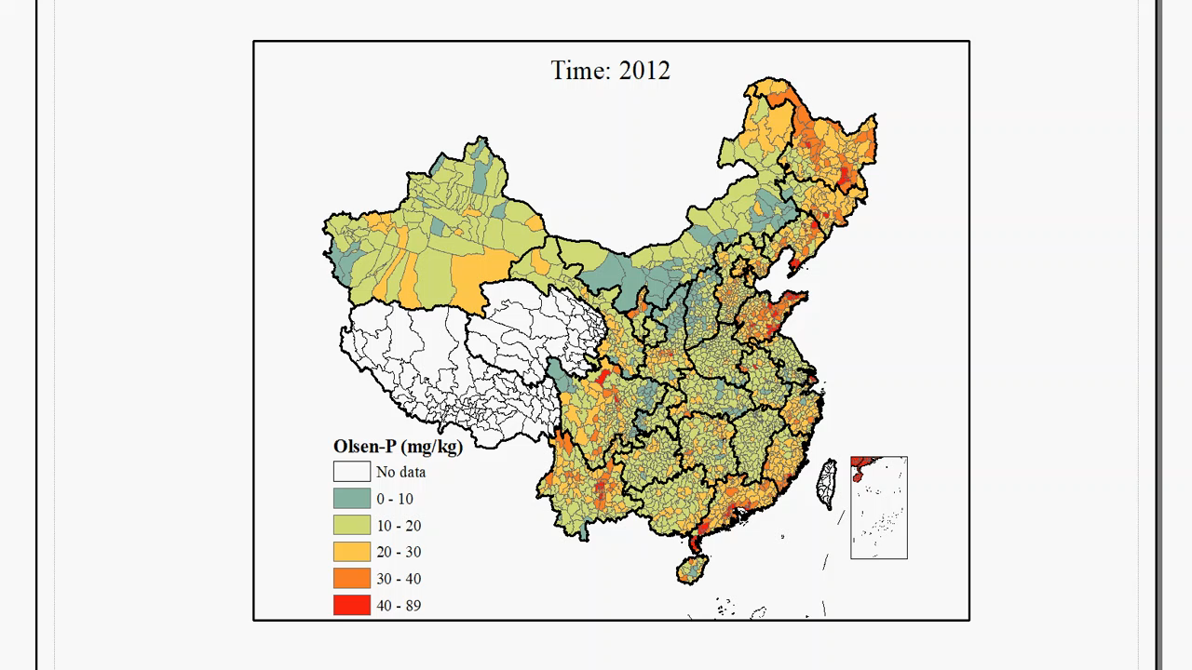
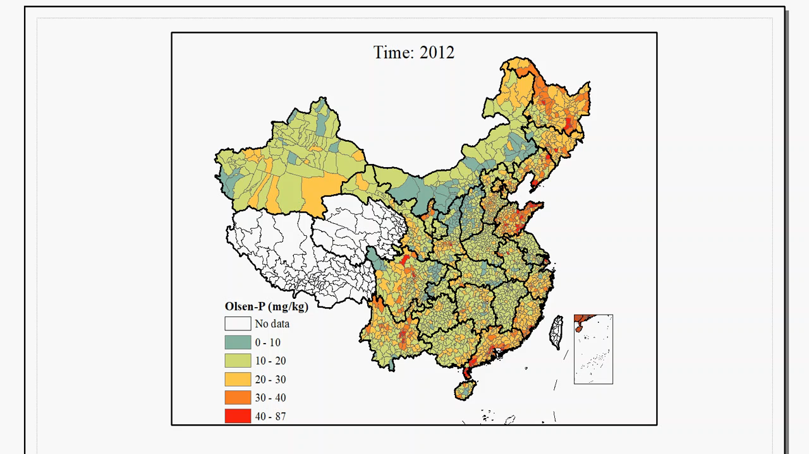
Scenario 1
(A)
Scenario 2
(B)
Scenario 3
(C)
Scenario 4
(D)
Scenario 5
(E)
Scenario 6
(F)
Movie S2. The changes in soil Olsen-P per county under the six scenarios during the time period 2012-2080

