Slide 1
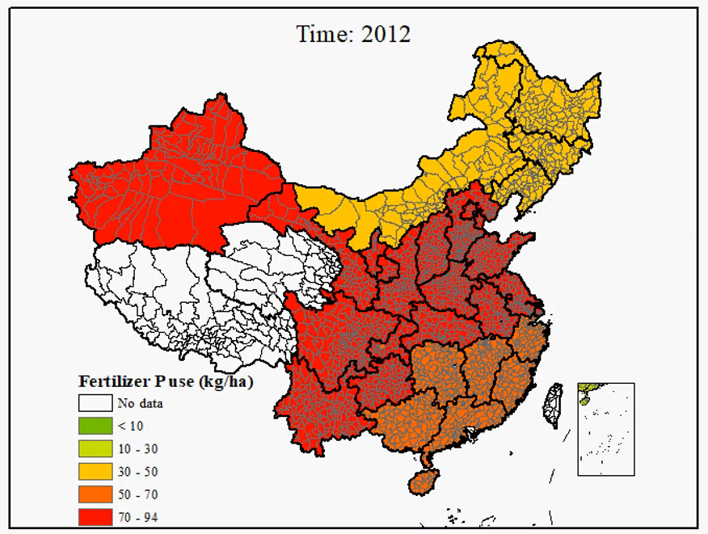
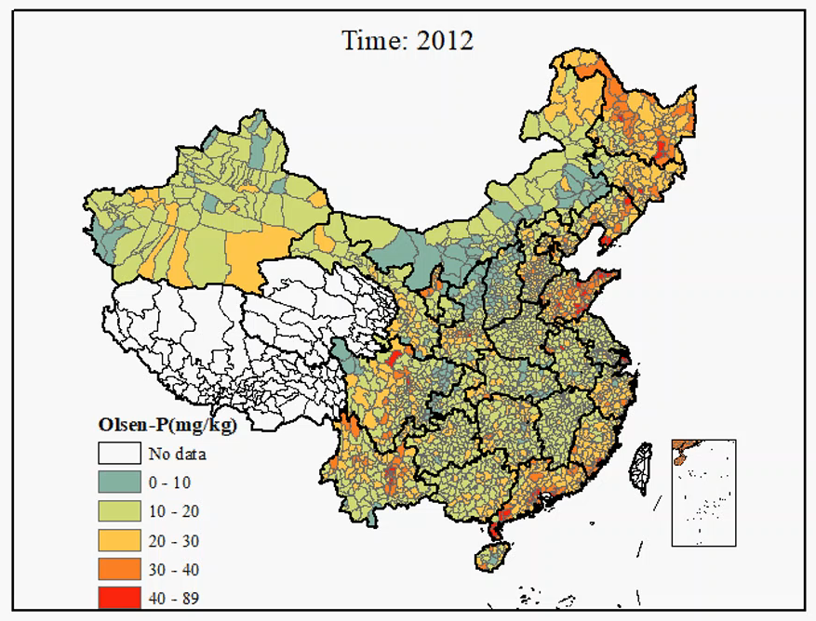
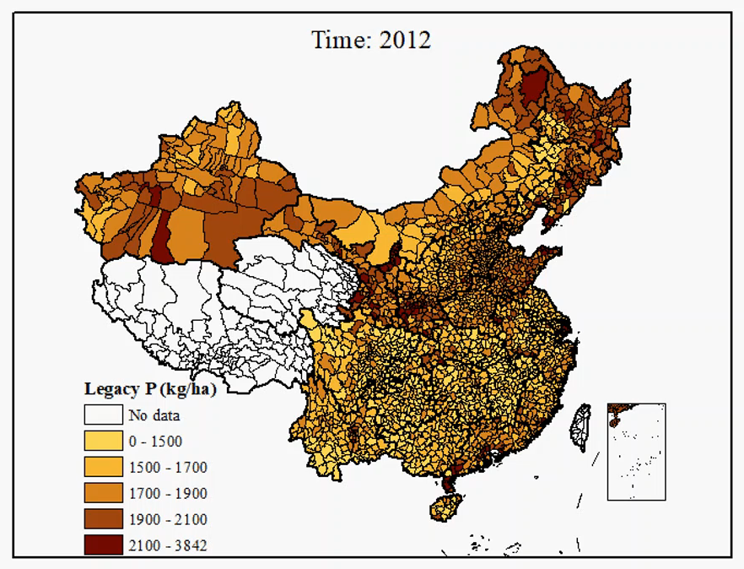
(A)
(B)
(C)
Movie S4. P fertilizer demand per county (A), the changes in soil Olsen-P (B) and legacy P (C) per county under the optimal scenario during the time period 2012-2080

