Slide 1
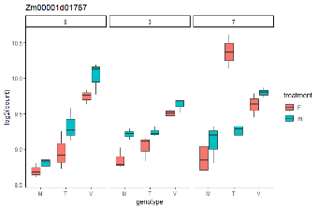
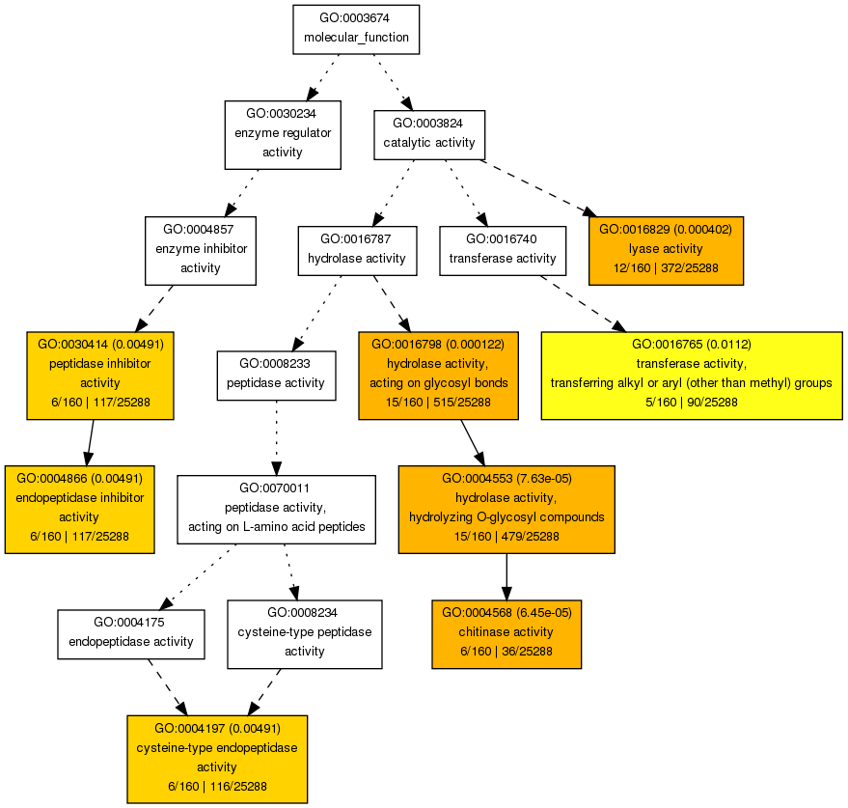
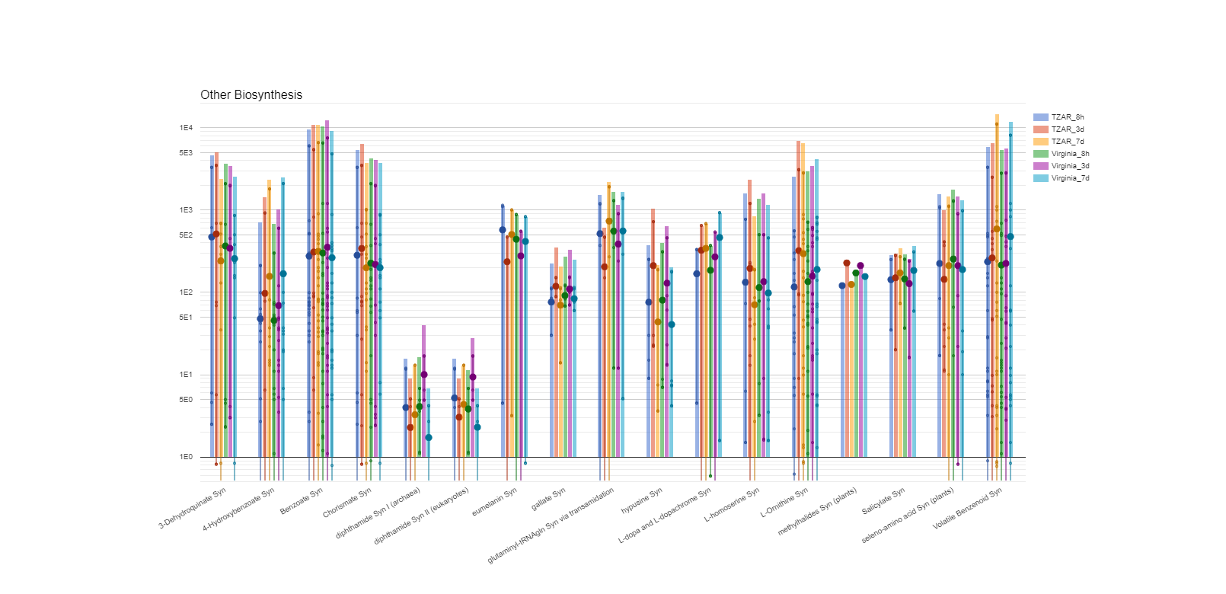
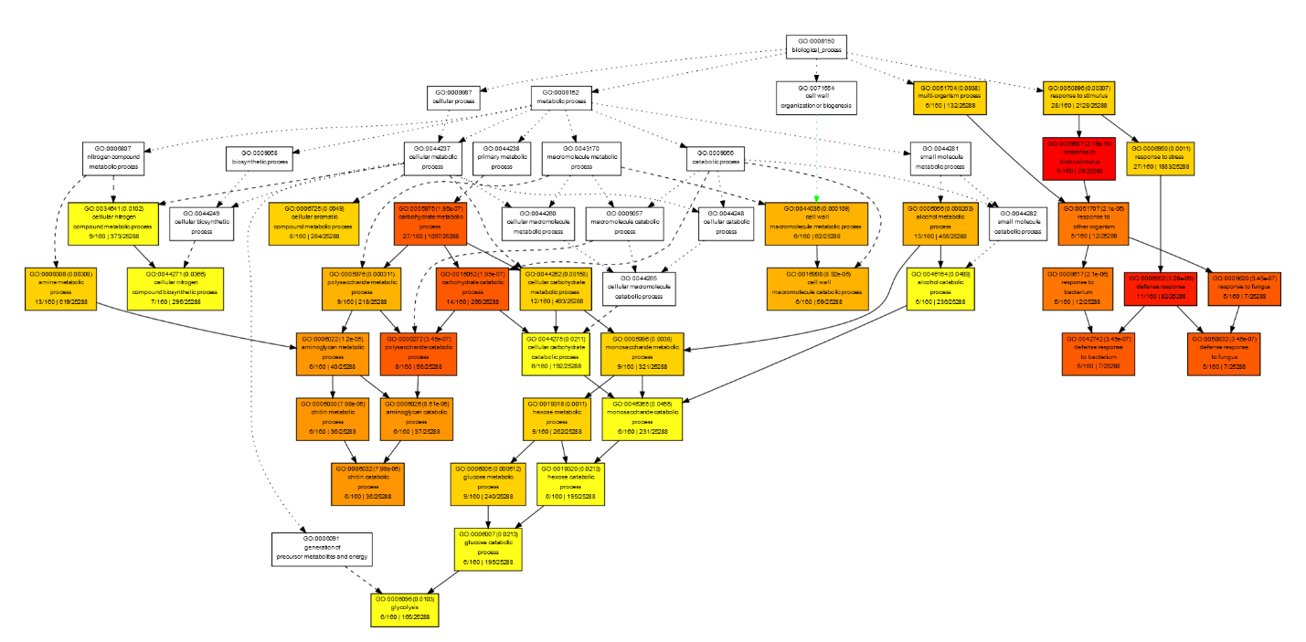
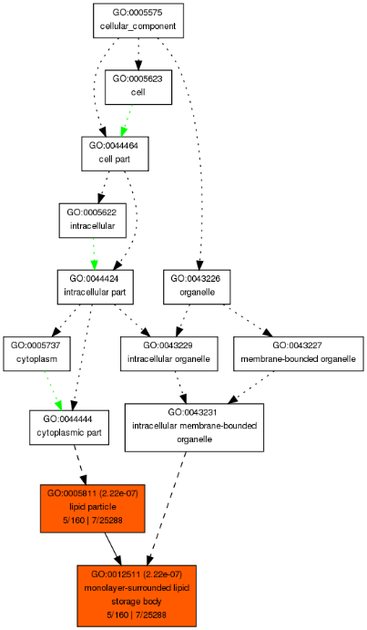
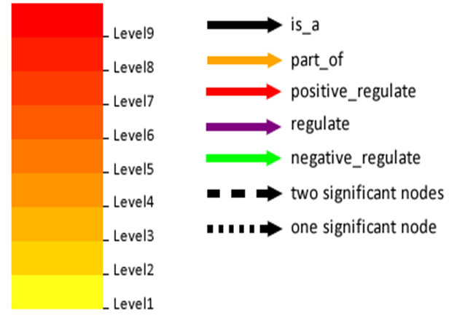
A)
B)
C)
D)
Supplemental figure 1. General visualization of gene expression patterns using A) metabolic pathways and gene ontology enrichment analysis of B) molecular function, C) biological process and d) cellular compartment using the candidate genes with 2 standard deviations from the RDA axis 1 and 2. Gene ontology annotations were performed using AgriGO online tools. In boxes: colors represent statistical significance: darker and redder colors indicate greater statistical significance. The numbers in parentheses are the enrichment multiple-test adjusted p-values; first ratio is the number of GO terms of proteins that were searched from RDA candidate genes and background (Maize genome locus from maizeseuqnce.org); the second ratio is the total number proteins queued and background (Maize gene model).

Slide 2
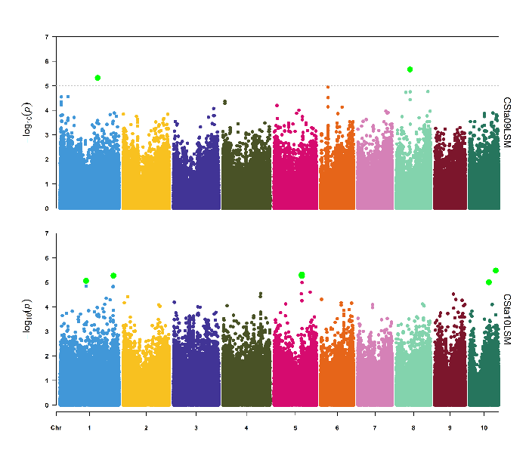
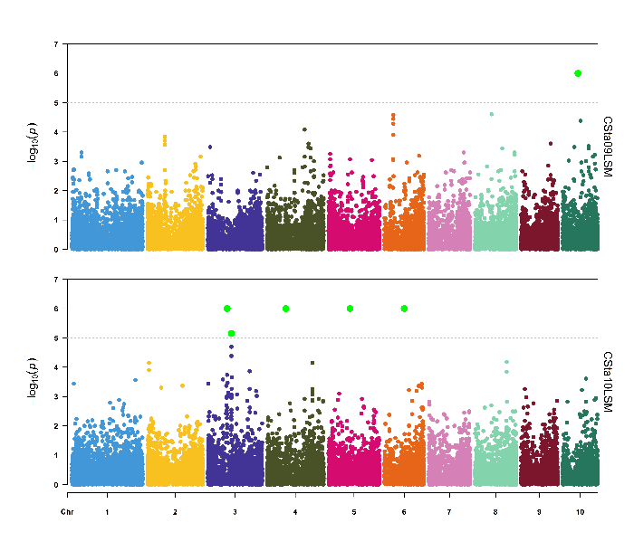
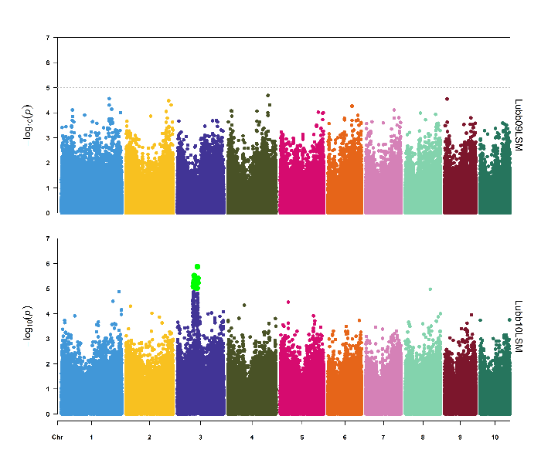
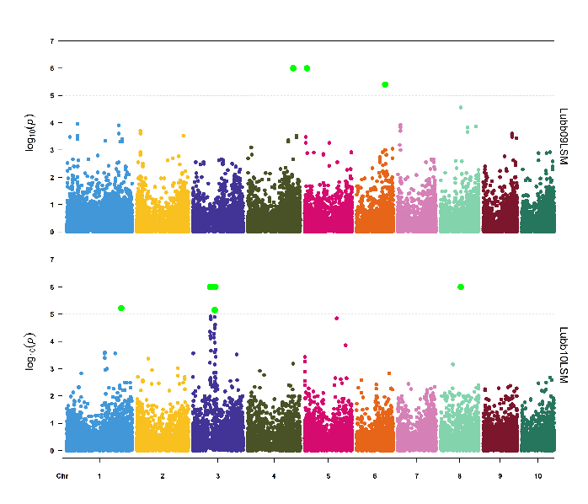
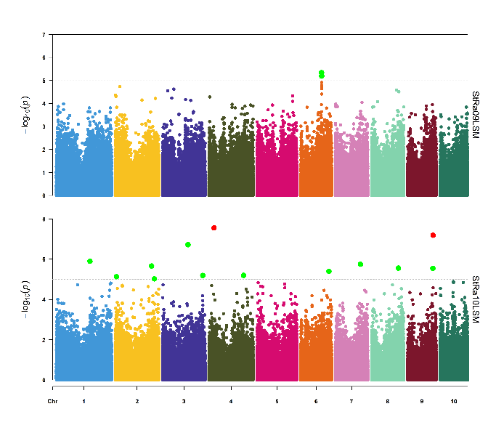
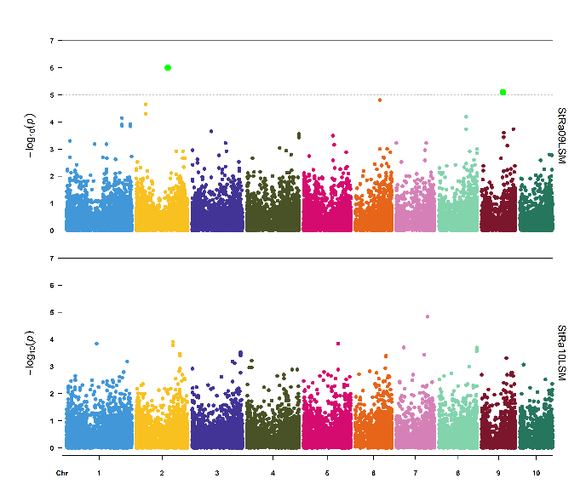
A)
7
College Station, TX
D)
7
College Station, TX
6
6
5
5
4
2009
4
2009
Log10(p)
Log10(p)
3
3
2
2
1
1
0
0
7
7
6
6
5
5
4
2010
4
2010
Log10(p)
Log10(p)
3
3
2
2
1
1
0
0
CHR
1
2
3
4
5
6
7
8
9
10
CHR
1
2
3
4
5
6
7
8
9
10
B)
7
Lubbock, TX
E)
Lubbock, TX
6
7
5
6
4
5
Log10(p)
4
3
Log10(p)
2
2009
3
2009
1
2
0
1
7
0
6
7
5
6
4
5
Log10(p)
4
3
Log10(p)
2
2010
3
2010
1
2
0
1
0
CHR
1
2
3
4
5
6
7
8
9
10
CHR
1
2
3
4
5
6
7
8
9
10
C)
7
Starkville, MS
D)
7
Starkville, MS
6
6
5
5
4
4
Log10(p)
2009
Log10(p)
2009
3
3
2
2
1
1
0
0
8
7
6
6
5
4
4
Log10(p)
2010
Log10(p)
2010
3
2
2
0
1
0
CHR
1
2
3
4
5
6
7
8
9
10
CHR
1
2
3
4
5
6
7
8
9
10
Supplemental figure 2. Genome wide association and post GWAS results using aflatoxin data from (Warburton et al., 2015). Manhattan plots of GWAS results for A) College Station, TX, B) Lubbock, TX, C) Starkville, MS and Manhattan plots of MAGMA analyses performed the SNP (404,860) to Gene genomic data (25,768 genes) for D) College Station, TX, E) Lubbock, TX and F) Starkville, MS. In GWAS Manhattan plots, each dot is a single nucleotide polymorphism, while in MAGMA Manhattan plots each dot is a gene. The horizontal dotted lines are the thresholds for significant log 10 p value/Number of markers). SNPs and genes within a chromosome are colored as follows: chromosome 1 blue, 2 yellow, 3 purple, 4 dark green, 5 fuscia, 6 orange, 7 pink, 8 light green, 9 brown, and 10 blue green.

Slide 3
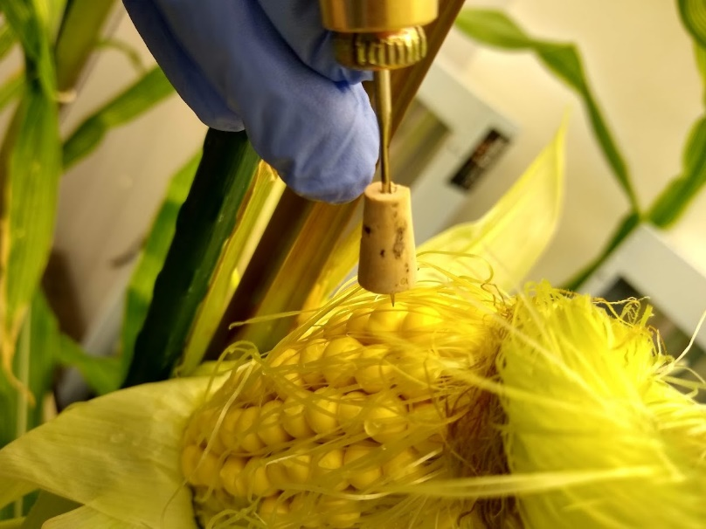
A)
B)
C)
AFB₁
AFB₂
Concentration (ng/g)
Va35-U
Va35-T
TZAR-U
TZAR-T
Supplemental figure 3. In planta experiments, A) fungal inoculation method B) TZAR102 cob after 3 days of fungal inoculation. C) Aflatoxin levels in susceptible (Va35) and resistant (TZAR) lines (ng AF/g maize, PPB). Aflatoxins B1 (AFB₁) and B2 (AFB₂), untreated (U), treated (T).

Slide 4
Supplemental table 1. Total number of genes that were significantly up or down regulated when comparing maize lines, time of post infection or treatment. Data analysis was performed using DESeq2 (v1.28.1). Differentially expressed genes were defined as having an adjusted p-value < 0.05 and an absolute log2 fold change > 1. The comparisons show the main effects controlling for other covariates with the design formula genotype + treatment + time.
Comparison | Upregulated | Downregulated
MI82 vs Va35 | 3903 | 3128
TZAR102 vs Va35 | 4064 | 3687
MI82 vs TZAR102 | 4028 | 3446
3d vs 8h | 7363 | 3343
7d vs 3d | 4760 | 1063
Treated vs Untreated | 1515 | 650

Slide 5
Supplemental table 3. Defense response to fungus significant category: Hevein-like preproprotein - Fungal growth inhibitors that are ~ PR proteins.
Genomic region | GO terms
GRMZM2G117989 : Zm00001d048947 Genome location: Chromosome 4:10,513,764-10,514,291 | GO:0048871 multicellular organismal homeostasis GO:0050832 defense response to fungus GO:0050825 ice binding GO:0042742 defense response to bacterium GO:0042309 homoiothermy GO:0050826 response to freezing
GRMZM2G117942 : Zm00001d048950 Genome location: Chromosome 4:10,553,796-10,554,681 | GO:0050832 defense response to fungus GO:0042742 defense response to bacterium
GRMZM2G117971 : Zm00001d048949 Genome location: Chromosome 4:10,536,338-10,537,204 | GO:0050832 defense response to fungus GO:0042742 defense response to bacterium
GRMZM2G454556 : Zm00001d048948 Genome location: Chromosome 4:10,532,759-10,533,688 | GO:0048871 multicellular organismal homeostasis GO:0050832 defense response to fungus GO:0050825 ice binding GO:0042742 defense response to bacterium GO:0042309 homoiothermy GO:0050826 response to freezing
GRMZM2G419675 : Zm00001d048948 Genome location: Chromosome 4:10,532,759-10,533,688 | GO:0048871 multicellular organismal homeostasis GO:0050832 defense response to fungus GO:0050825 ice binding GO:0042742 defense response to bacterium GO:0042309 homoiothermy GO:0050826 response to freezing

